Slide 1
Reset means
REPACKING
Acts 18:24-19:6

Slide 2
Now a Jew named Apollos, a native of Alexandria, came to Ephesus . He was an eloquent man, competent in the Scriptures. ²⁵ He had been instructed in the way of the Lord. And being fervent in spirit, he spoke and taught accurately the things concerning Jesus, though he knew only the baptism of John. ²⁶ He began to speak boldly in the synagogue, but when Priscilla and Aquila heard him, they took him aside and explained to him the way of God more accurately. [Acts 18:24-26, ESV]

Slide 3
²⁷ And when he wished to cross to Achaia, the brothers encouraged him and wrote to the disciples to welcome him. When he arrived, he greatly helped those who through grace had believed, ²⁸ for he powerfully refuted the Jews in public, showing by the Scriptures that the Christ was Jesus.
[Acts 18: 27-28, ESV]

Slide 4
And it happened that while Apollos was at Corinth, Paul passed through the inland country and came to Ephesus. There he found some disciples. ² And he said to them, “Did you receive the Holy Spirit when you believed?” And they said, “No, we have not even heard that there is a Holy Spirit.” ³ And he said, “Into what then were you baptized?” They said, “Into John’s baptism.”
[Acts 19:1-3, ESV]

Slide 5
4 And Paul said, “John baptized with the baptism of repentance, telling the people to believe in the one who was to come after him, that is, Jesus.” 5 On hearing this, they were baptized in the name of the Lord Jesus. 6 And when Paul had laid his hands on them, the Holy Spirit came on them, and they began speaking in tongues and prophesying.
[Acts 19:4-6, ESV]

Slide 6
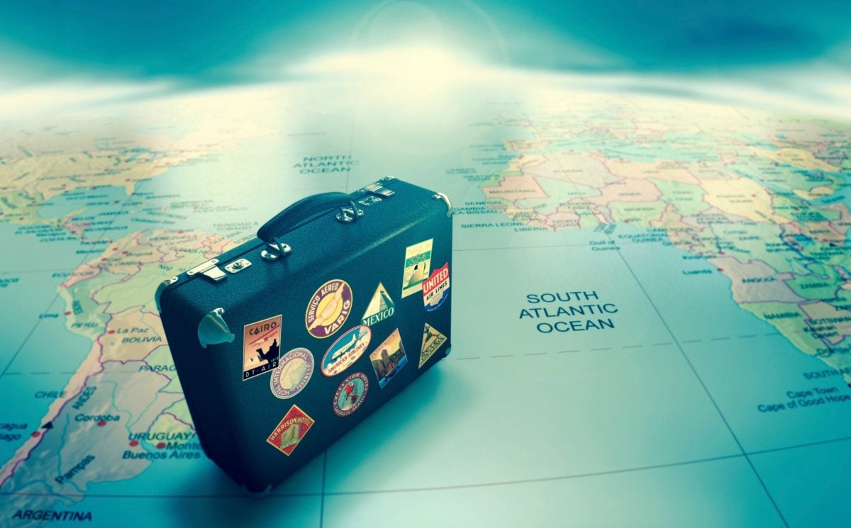

Slide 8
Who you
are
Who God created you to be
Notes:
Your Marriage, Family, This Community, Country

Slide 9
To follow Jesus you have to pack differently.
You need His power
To fulfill His plans.
Notes:
You have to repack
From your power to his
From your story to his story
From your idols to his presence

Slide 10
Acts 1:4-5,8
“Do not leave Jerusalem, but wait for the gift my Father promised, which you have heard me speak about. ⁵ For John baptized with water, but in a few days you will be baptized with the Holy Spirit . . you will receive power when the Holy Spirit comes on you; and you will be my witnesses in Jerusalem, and in all Judea and Samaria, and to the ends of the earth.”

Slide 11
Jesus was all about giving power
Jesus returned to Galilee in the power of the Spirit, and news about him spread [Lk 4:14 ]
Jesus gave them power and authority to drive out all demons and to cure diseases [Lk 9:1]
I am going to send you what my Father has promised; but stay in the city until you have been clothed with power from on high.” [Lk 24:49]

Slide 12
TO GET TO YOUR DIVINE DESTINATION
Step 1: Empty what you already packed
Repent of sin | Baptism of John in water
Step 2: Refill with what you really need
Reset in the Spirit | Baptism of Jesus in the Holy Spirit

Slide 13
John answered, “I baptize you with water. But one more powerful than I will come, …He will baptize you with the Holy Spirit and with fire. [Luke 3:16]
John 1:33, Mark 1:8, Matt. 3:11, Acts 1:5

Slide 14
These Disciples Were Missing “MORE”
Apollos taught accurately the things concerning Jesus, though he knew only the baptism of John. … they … explained to him the way of God MORE accurately [Acts 18:25-26]
“John’s baptism was a baptism of repentance. He told the people to believe in the one coming… Jesus.” [Acts 19:4]
I am going to send you what my Father has promised; but stay in the city until you have been clothed with power from on high.” [Lk 24:49]

Slide 15
Being “stuck” isn’t about the circumstances around you.
Its about the Spirit
within you!

Slide 16
Stuck feeling hopeless or unloved:
“Hope does not put us to shame, because God’s love has been poured into our hearts through the Holy Spirit who has been given to us.”
[Romans 5:5]

Slide 17
Stuck feeling far from God:
“Because you are sons, God [Father] sent the Spirit of his Son into our hearts, the Spirit who calls out, “Abba, Father.”
[Galatians 4:6]

Slide 18
Stuck feeling cursed & cut off:
“And if the Spirit of him who raised Jesus from the dead is living in you, he who raised Christ from the dead will also give life to your mortal bodies through his Spirit, who lives in you.”
[Rom 8:11]

Slide 19
Stuck feeling like you can’t go on:
“Through the eternal Spirit Jesus offered himself [on the Cross] as a perfect sacrifice to God.
[Heb. 9:14 , GNB]

Slide 20
Stuck feeling like can’t
get relationships right:
“But the fruit of the Spirit is love, joy, peace, patience, kindness, goodness, faithfulness, gentleness, self-control; against such things there is no law”
[Galatians 5:22]

Slide 21
Which prayer will you pray?
God, take away what is too strong for me.
God, make me stronger to overcome.
God, fill me with Your Spirit
and be strong through me.

Slide 22
PRAYING FOR “MORE” AS A CHURCH
“It was Jesus who [through the Holy Spirit] gave some to be apostles, some to be prophets, some to be evangelists, and some to be pastors and teachers, ¹² to prepare God’s people for works of service, so that the body of Christ may be built up ¹³ until we all reach unity in the faith and in the knowledge of the Son of God and become mature, attaining to the whole measure of the fullness of Christ.”
[Ephesians 4:11]

Slide 23
Which prayer will you pray?
God, take away what is too strong for me.
God, make me stronger to overcome.
God, fill me with Your Spirit
and be strong through me.

