Slide 1
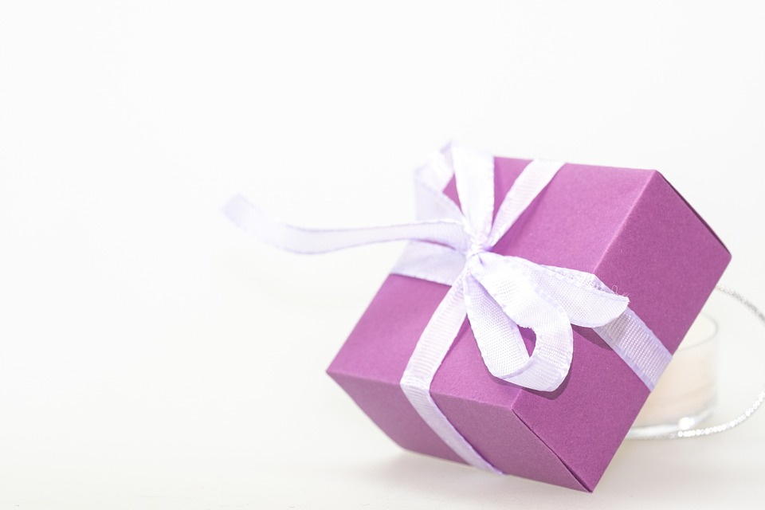
Happy Mother’s Day
:

Slide 2
Luke 1: 26-34,56

Slide 3
26 In the sixth month of Elizabeth’s pregnancy, God sent the angel Gabriel to Nazareth, a town in Galilee, 27 to a virgin pledged to be married to a man named Joseph, a descendant of David. The virgin’s name was Mary. 28 The angel went to her and said, “Greetings, you who are highly favored! The Lord is with you.”
Luke 1:26-28 NIV

Slide 4
29 Mary was greatly troubled at his words and wondered what kind of greeting this might be. 30 But the angel said to her, “Do not be afraid, Mary; you have found favor with God. 31 You will conceive and give birth to a son, and you are to call him Jesus. Luke 1:29-31 NIV

Slide 5
32 He will be great and will be called the Son of the Most High. The Lord God will give him the throne of his father David, 33 and he will reign over Jacob’s descendants forever; his kingdom will never end.”
34 “How will this be,” Mary asked the angel, “since I am a virgin?” Luke 1:32-34 NIV

Slide 6
Mary stayed with Elizabeth for about three months and then returned home.
Luke 1:56 NIV

Slide 7
A heart with the right Question mark
“Zechariah said to the angel, “How can I be sure this will happen? I’m an old man now, and my wife is also well along in years.” Luke 1:18 NLT

Slide 8
Mary asked the angel, “But how can this happen? I am a virgin.”
Luke 1:34 NLT

Slide 9
“I am the Lord’s servant,” Mary answered. “May your word to me be fulfilled.” Then the angel left her.
Luke 1:38 NIV

Slide 10
When the wine was gone, Jesus’ mother said to him, “They have no more wine.”
“Woman,[a] why do you involve me?” Jesus replied. “My hour has not yet come.”
His mother said to the servants, “Do whatever he tells you.”
John 2: 3-5 NIV

Slide 11
Mary stayed with Elizabeth for about three months and then returned home.
Luke 1:56 NIV

Slide 12
?
Instructional Question Mark
Jesus replied: “‘Love the Lord your God with all your heart and with all your soul and with all your mind.’[a] 38 This is the first and greatest commandment. 39 And the second is like it: ‘Love your neighbor as yourself.’
Mathew 22:37-39 NIV

