Slide 1
Humble Unity
Or Prideful Division?
Acts 15:1-19
Acts 14:1-22
Notes:
The key to revival – shown throughout the book of acts
And how the church started

Slide 2
“When the Day of Pentecost had fully come, they were all with one accord in one place . . . Then there appeared to them divided tongues, as of fire, and one sat upon each of them. ⁴ And they were all filled with the Holy Spirit and began to speak with other tongues, as the Spirit gave them utterance.”
– Acts 2:1-4
Notes:
They were unified.
they were in one accord, they were together physically
But they also received divided tongues
and spoke in tongues in many different languages
You see . . .

Slide 3
The church began in great unity but not uniformity.
Their humble unity within such great diversity was the setting for an outpouring of the Holy Spirit.
Notes:
From the beginning
God has always told us that humble unity
is where God pours out His blessing
[next slide]

Slide 4
How good and pleasant it is when brothers live together in unity! . . .For there the LORD bestows his blessing, even life forevermore.
– Ps 133:1-3
Holy Father, protect them by the power of your name—the name You gave Me—so that they may be one as we are one.
- John 17:11
Notes:
Humble Unity & Beauttiful Diversity
Brings Glory To Jesus
But as the book of Acts shows
Our differences and sin can threaten it

Slide 5
Differences & Difficulties Among Believers In Acts
Sin & Control Ananais & Sapphira [5:1-10]
Culture & Ethnicity Hebrew/Hellenistic [6:1]
Fear & Speculation Disciples afraid of Paul [9:26]
Tradition / Experience Jewish Christians & Peter [11:1]
Immaturity / Age Mark abandons Paul [13:13]
Personalities & Giftings Barnabas & Paul [15:37f]
Threat to the Gospel Salvation by grace [15:1f]
Notes:
Here in Acts 15 – we get to pivotal moment
Will the early church overcome all their differences
To protect the truth about the Gospel
As we read – we will see they do.

Slide 6
Read Acts 15:1-19 Looking For These
Sin & Control Ananais & Sapphira [5:1-10]
Culture & Ethnicity Hebrew/Hellenistic [6:1]
Fear & Speculation Disciples afraid of Paul [9:26]
Tradition / Experience Jewish Christians & Peter [11:1]
Immaturity / Age Mark abandons Paul [13:13]
Personalities & Giftings Barnabas & Paul [15:37f]
Threat to the Gospel Salvation by grace [15:1f]
Notes:
* All these differences threaten to divide the early church
And stop the revival and mission of God
* But somehow they maintain their unity. How?
* That is the same question we must answer
As God begins! revival in us!

Slide 7
As Jesus’ disciples, we will never stop having differences. We will never stop needing to grow and repent of sin.
All these things only divide us if we allow one thing to remain in our lives:

Slide 8
As Jesus’ disciples, we will never stop having differences. We will never stop needing to grow and repent of sin.
All these things only divide us if we allow one thing to remain in our lives:
PRIDE

Slide 9
WRITE IT DOWN!
Humility unites.
Pride divides.
Notes:
* Pride says life is all about me.
If its not like me, for me, my way its not right or important.
* Pride says I am the standard of all things (diversity my way)
And my happiness is the goal of all things
* Pride can show itself as victor or victim (self pity)

Slide 10
For this is what the high and lofty One says— he who lives forever, whose name is holy: “I live in a high and holy place, but also with him who is contrite and lowly in spirit, to revive the spirit of the lowly and to revive the heart of the contrite.
– Isaiah 57:15
Notes:
* The entire bible says
Pride is the ultimate weakness
Humility is the ultimate strength
* God rejects pride & God revives humility
* Look at these quotes from church fathers:

Slide 11
The essential vice, the utmost evil, is pride . . . it was through pride that devil became the devil. Pride leads to every other sin: it is the complete anti-God stage of mind.
– CS Lewis
Notes:
Anti-God / Pro-self

Slide 12
Pride must die in you or nothing of Heaven can live in you.
– Andrew Murray
Notes:
Luke 9:23 - come after me
Deny, take up cross, follow Jesus
Who rejected pride to go to the cross
Spiritual pride is dangerous and blinding!!!

Slide 13
Spiritual pride disposes one to speak of other persons’ sins and [their faults] . . . Those with spiritual pride focus on how others are the great hypocrites as they do so with bitterness or even with an air of contempt. Conversely, pure Christian humility leads one to be silent about others sin . . . Spiritual pride is very apt to suspect others; whereas the humble saint is so suspicious of nothing in the world as he is of his own heart.
- Jonathan Edwards
Notes:
Goes on to say
Proud people spend their time judging others
Humble people are too busy repenting of their own sin
We live in a culture/ social media – judge everyone else
Pride is a self-made prision / Humility freedom

Slide 14
God opposes the proud but gives grace to the humble.’ Submit yourselves, then, to God. Resist the devil [and his pride], and he will flee from you. . . Humble yourselves before the Lord, and he will lift you up.
– James 4:6-10
Notes:
So what do we do with this.
When we have pride we are blind too it.
Praise God, the first thing Jesus did to prepare them
Was this . . .

Slide 15
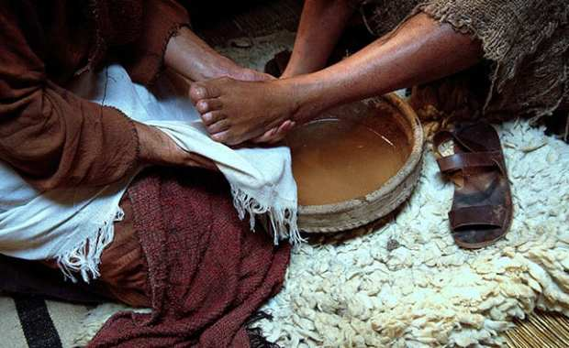
Notes:
John 13:12-17
Washed Peter’s feet (deny 3x) Judas (betray), Thomas (Doubt), All (Abandobe Him)
When we wash feet – our hands get clean
The pride of our differences get washed away

Slide 16
Video Here
Notes:
*Lots of differences
All become beautiful unity
* Humble to wash feet
Proud people can’t do it
* WHY? [next slide]

Slide 17
All of us get our feet dirty walking
through this world. Jesus calls us to wash the pain, pride & fear away for each other.

Slide 18
All of us get our feet dirty walking
through this world. Jesus calls us to wash the pain, pride & fear away for each other.
USE YOUR INDEX CARD TO BLESS
SOMEONE ELSE HERE TODAY
“Thank you for . . . ”
“Just wanted to say I appreciate . . . in you.”
“I can see the love of Jesus in you . . . ”
“I pray God’s blessing on you . . . ”

