Slide 1
1
3
2
ONE THING WE NEED
TWO CONVICTIONS WE HAVE
THREE DECISIONS WE MAKE
Notes:
Talk about what we all need.
Whether you are a Christian or not you know you need it.
Why we make New year’s resolutions

Slide 2
Most make resolutions about things
they know they need to get back to.
39% Of Americans make resolutions
7 out top 10 resolutions are about healthy living
23% 64% 91%
They are hoping to revive
what their life should be about.
Notes:
We lose what life is supposed to be about
We know but we are not able
People in the Bible knew this

Slide 3
Lord Jesus, Send Revival
Habakkuk 3:2
O Lord, I have heard the report of you,
and your work, O Lord, do I fear.
In the midst of the [these] years revive it;
Isaiah 64:1-2
Oh that you would rend the heavens and come down, that the mountains might quake at your presence … to make your name known
Hosea 6:1-3
Come, let us return to the Lord...
After two days he will revive us;
on the third day he will raise us up,
that we may live before him…
let us press on to know the Lord;
Notes:
Habakkuk: we have lost our way & are suffering
Hosea: sees the mess we have made of life: raise us up
Isaiah: we can’t reach you. You need to come down
We need change but can’t do it: Opposite of world

Slide 4
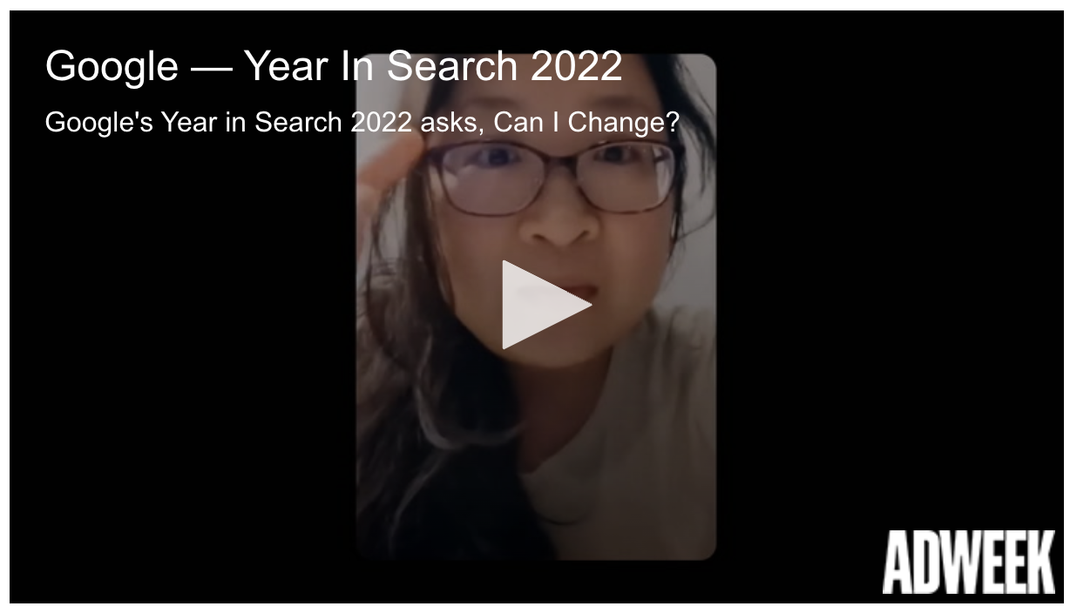
Most searched on google
Notes:
Person after person
this year I will find a way to chang I’m going to do it.
No you won’t (91%)
You need one thing . . .

Slide 5
ONE NEED: REVIVAL
WHEN GOD RESTORES & ACCELERATES
HIS PRESENCE, PURPOSE & POWER
IN HIS PEOPLE FOR HIS GLORY
AND OUR GOOD!
Notes:
This new year: one resolution! Not interested/open – resolved!
We can’t revive ourselves - only God can.
We can’t create revival but we can only repent of what hinders it.
We can’t reach God but we can return to obedience to His Word
Revival is not a planned service or emotionalism . . .

Slide 6
“Revival [should be] a season in the life of any church. It is when God causes the normal ministry of the Gospel to surge forward with extraordinary power…The Bible is full of revival theology… The biblical vision of our reviving God is breathtaking. So, if we accept the authority of Scripture, we will have to enlarge our concept of what God can do for us… revival is a valid biblical expectation that should fill God’s people.”
– Dr. Ray Ortland, Jr.
Notes:
Revival isn’t about emotions
It’s about devotion to His Word
Returning to the only one who brings life
Clearing the clutter of this world in our hearts & lives
Its getting back to what life and church should be…

Slide 7
“The world’s competition for the hearts of people is nothing new to the church. However, the answer is not to make church a convenience. The answer can only be to make church a conviction. We need to wage war against lazy, passionless, and disengaged faith. Apathy is a silent killer. . . We need to raise believers that deeply hunger for the presence of God, who believe in resurrection (revival) and who are resolved to serve Christ with everything they have…”
- Pastor Jason Mandis
Notes:
So that’s why we start this year 21 days!
Because if we want revive what life is all about
If we want to revive love is all about . . .

Slide 8
People who enter into God’s reviving work have two convictions
ONLY GOD CREATES
ONLY GOD LOVES
Notes:
We can’t create: only discover, harness, use
And so only God can recreate life in us!!!
We don’t love. Can’t love ourselves. Only vessel for God
Only God is perfect & unfailing love.
Chicken Fiesta – ONLY PLACE TO GET YELLOW SAUCE

Slide 9
Psalm 85:4-7
Restore us again, O God of our salvation, and put away your indignation toward us! Will you be angry with us forever? Will you prolong your anger to all generations? Will you not revive us again, that your people may rejoice in you? Show us your steadfast love, O Lord, and grant us your salvation.
Notes:
Psalmist has these two convictions – God only you!
So we turn to God’s Word. Humble ourselves. Ask God to restore us
Say send revival – we will fast and remove the world
We admit we have sinned and ruined what you created
[READ OUTLOUD] – What the Gospels say…

Slide 10
JESUS IS THE ONLY WAY TO LIFE
John 6:62
It is the Spirit who gives life; the flesh is no help at all. The words that I have spoken to you are spirit and life.
John 6:68
Simon Peter answered him, “Lord, to whom shall we go? You have the words of eternal life,
John 11:25
Jesus said to her, “I am the resurrection and the life. Whoever believes in me, though he die, yet shall he live"
Notes:
Who are you hoping will bring you life?
What are you turning to – worshiping for it?
How are you trying to feel loved and love yourself?
Where are you looking?
ALL OF US KNOW THESE TWO SOMEWHAT . . .

Slide 11
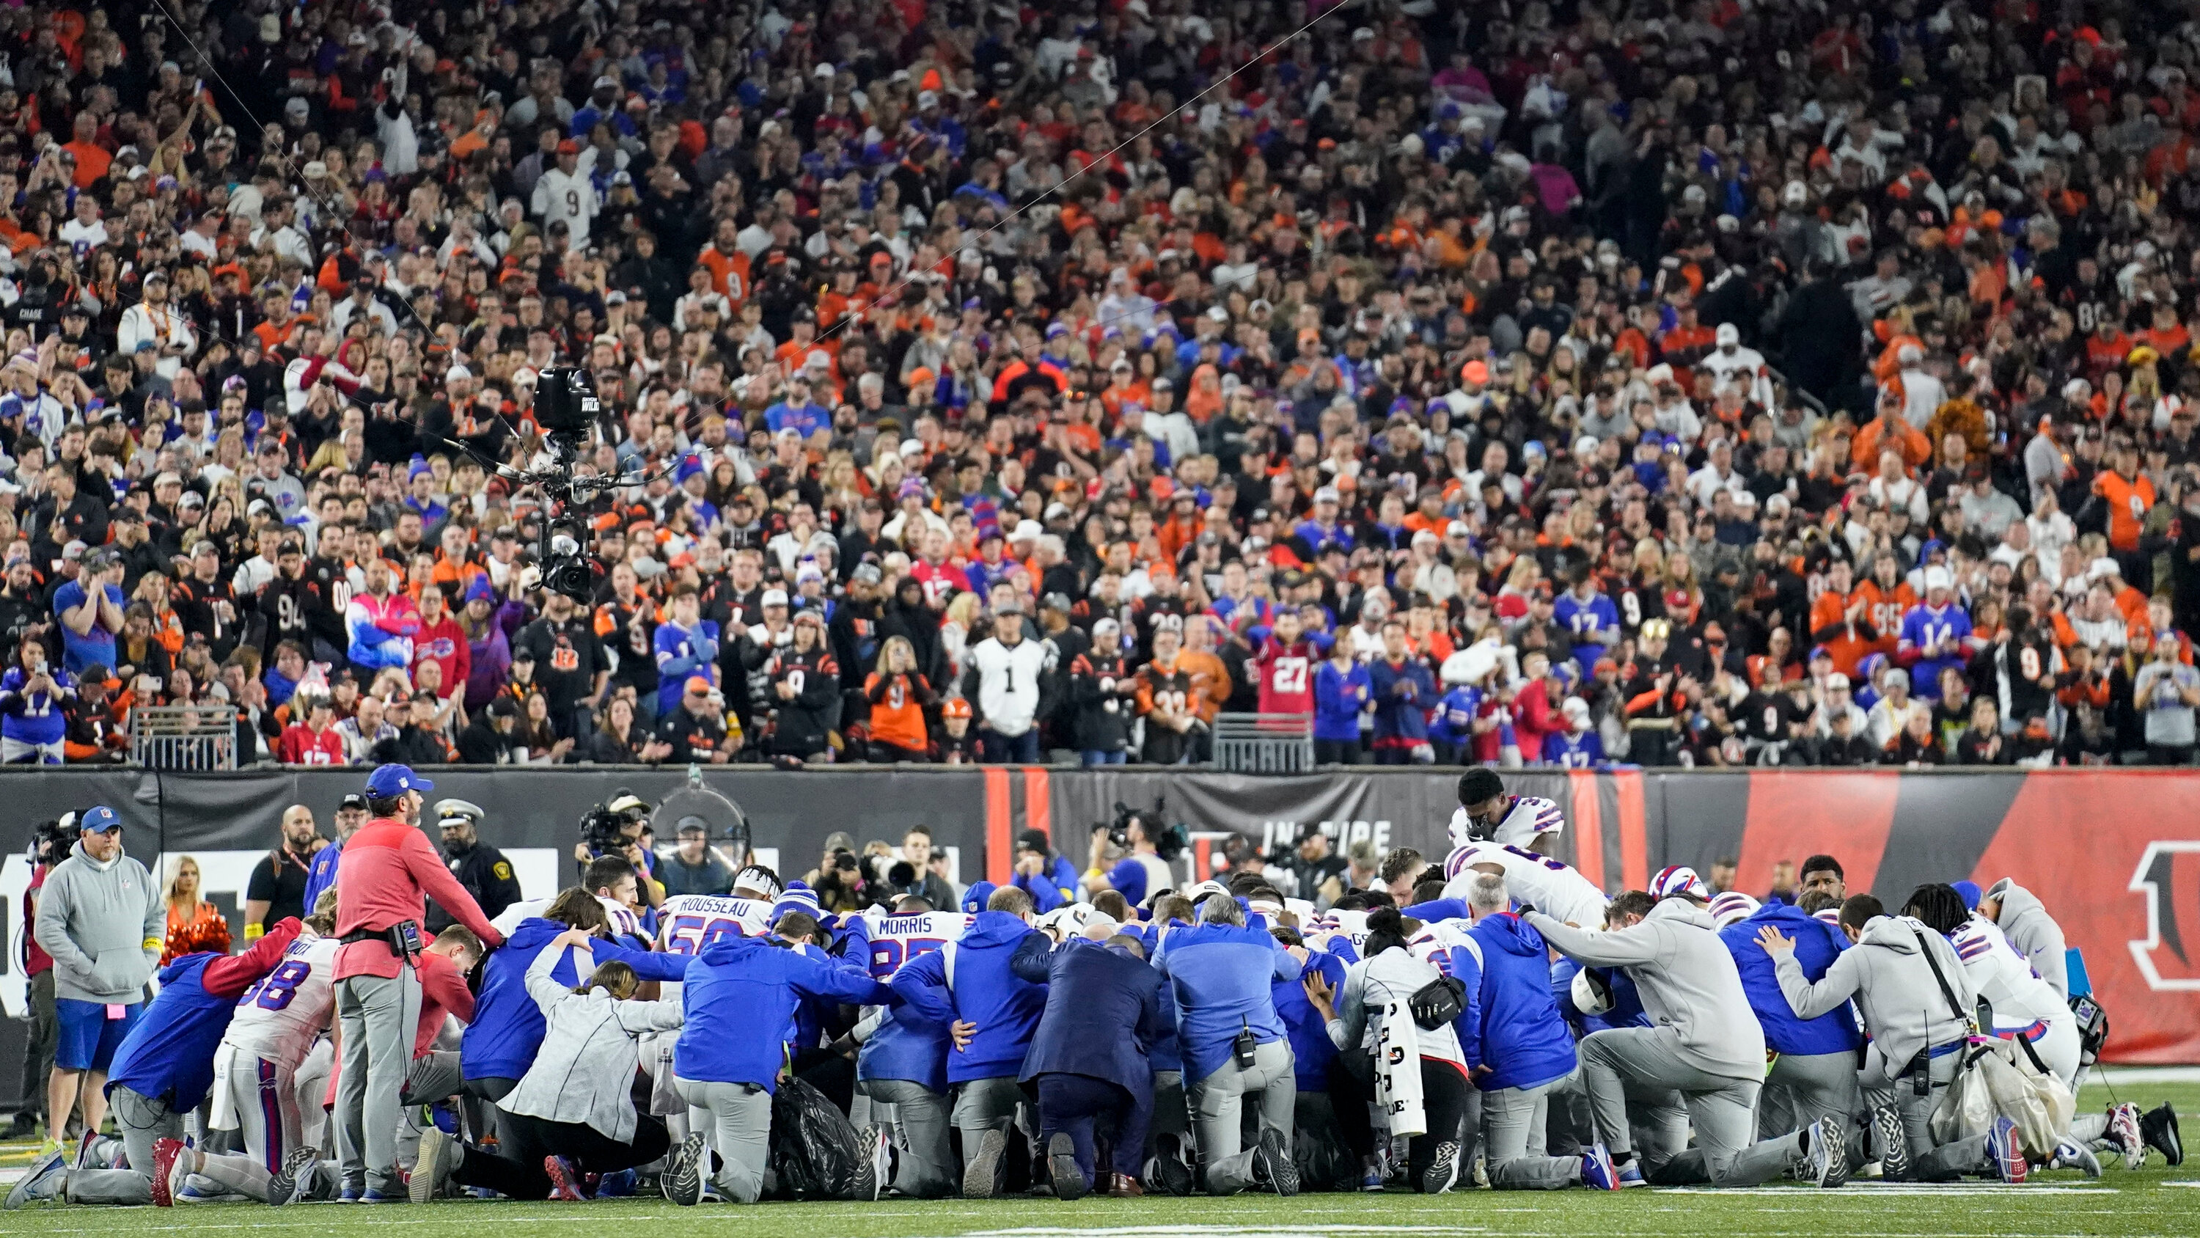
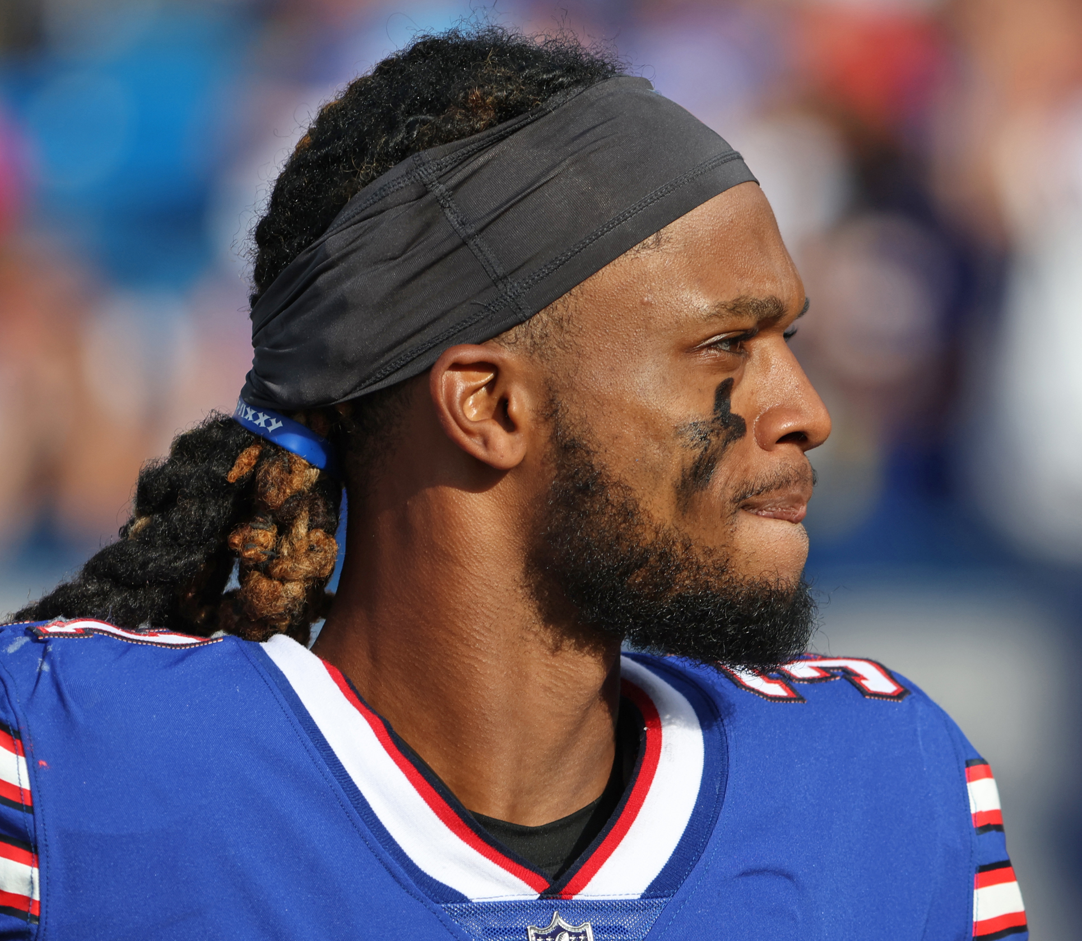
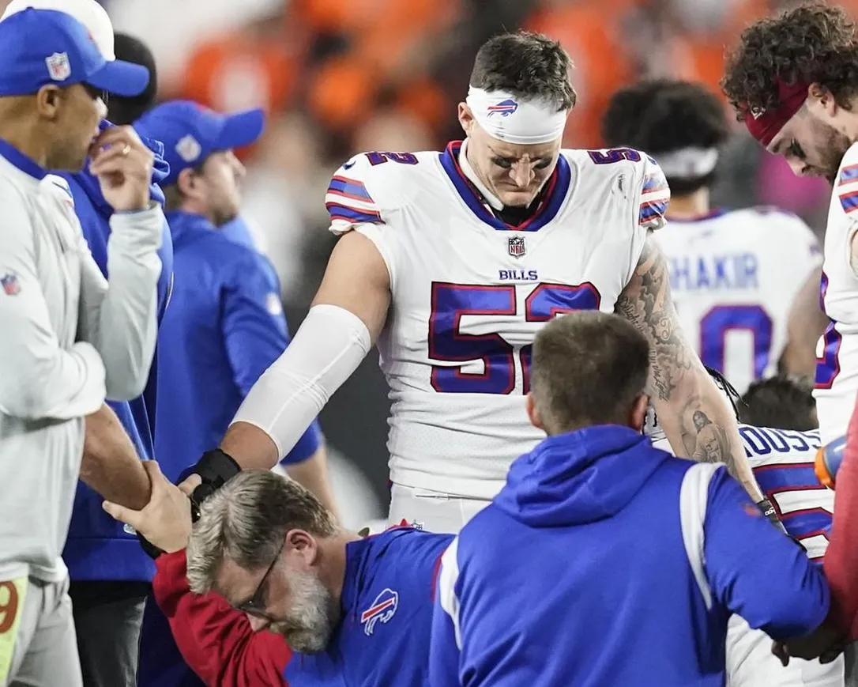
“Please pray for our brother,” the Bills' quarterback, Josh Allen, wrote on Twitter, where players and coaches across the league shared similar messages.
Notes:
The near death of Damar Hamlin last Sunday
Everyone knew they had one need – Hamlin needed to be revived
Everyone there a conviction: God can do this
Those without 3 decisions – for their to be life
What Damar needed – we have to decide to do as well

Slide 12
1
3
2
ONE NEED: REVIVAL
TWO CONVICTIONS: ONLY GOD CREATES & LOVES
THREE DECISIONS WE MUST MAKE
Notes:
If this is our resolution and our conviction
Then we turn to Jesus and His word
How to get there (resolved!)
John 15 – Jesus talks about how to have life

Slide 13
JOHN 15:1-4
“I am the true vine, and my Father is the vinedresser. 2 Every branch in me that does not bear fruit he takes away, and every branch that does bear fruit he prunes, that it may bear more fruit. Already you are clean because of the word that I have spoken to you. 4 Abide in me, and I in you. As the branch cannot bear fruit by itself, unless it abides in the vine, neither can you, unless you abide in me.
Notes:
I am the true vine – source of life
[give out dead branches]
Notice three decisions (highlighted words)
First abide

Slide 14
JOHN 15:5-6
I am the vine; you are the branches. Whoever abides in me and I in him, he it is that bears much fruit, for apart from me you can do nothing. 6 If anyone does not abide in me he is thrown away like a branch and withers; and the branches are gathered, thrown into the fire, and burned.
Notes:
Second –idea of fruit

Slide 15
JOHN 15:7-10
7 If you abide in me, and my words abide in you, ask whatever you wish, and it will be done for you. 8 By this my Father is glorified, that you bear much fruit and so prove to be my disciples. 9 As the Father has loved me, so have I loved you. Abide in my love. 10 If you keep my commandments, you will abide in my love, just as I have kept my Father’s commandments and abide in his love.

Slide 16
JOHN 15:11-14
11 These things I have spoken to you, that my joy may be in you, and that your joy may be full. 12 “This is my commandment, that you love one another as I have loved you. 13 Greater love has no one than this, that someone lay down his life for his friends. 14 You are my friends if you do what I command you.
Notes:
There is the third – love another
Jesus’ teaching show if we want to be revived
Three areas –which mean three choices
How we repent and return to God’s word so he can send life

Slide 17
THREE CHOICES
LIVE IN HIS PRESENCE: “ABIDE”
“You can’t live in His presence & be far from His Word”
During this 21 days:
Choose His Word!
[1]
Notes:
VERSE 7 – IF YOU ABIDE IN ME & MY WORDS IN YOU
21 days make more time: not to read but hear him speak to you
In the beginning was the word!
“Father in Heaven I choose Your word”
OUR HOUSE – HANGRY – SO HUNGRY EFFECTS EMOTIONS

Slide 18
THREE CHOICES
LIVE IN HIS PRESENCE: “ABIDE”
“You can’t live in His presence & be far from His Word”
LOVE ONE ANOTHER: JESUS’ COMMAND
“You can’t stay close to Jesus & far from His Body”
During this 21 days:
Choose to gather with His people!
[1]
[2]
Notes:
V10 f you keep my commandments, you will abide in my love,
V13 This is my commandment, that you love one another
First disciples were devoted to being together (Act 2, Heb 10:25)
not neglecting to meet together, as is the habit of some, but encouraging one another
3 DECEIVED: DRIVING, HUMOR, LISTENING (4TH FOLLOWING – NEED OTHERS)

Slide 19
THREE CHOICES
LIVE IN HIS PRESENCE: “ABIDE”
You can’t live in His presence & be far from His Word
LOVE ONE ANOTHER: JESUS’ COMMAND
You can’t stay close to His Presence & far from His Body
LEAD OTHERS TO JESUS: “FRUIT”
You can’t know the power of His Presence & live for yourself
[1]
[2]
[3]
Notes:
Debate – veg or fruit / cucumbers (f), olives (f), tomato(f),
Fruit – the seed bearing structure of a flowering plant
Veg – any other edible part of a plant {STOP BEING A VEG]
Seed is what – life – who is that? Jesus
During these 21 days – choose to share His life
Giving / serving/ encouragement / listening

Slide 20
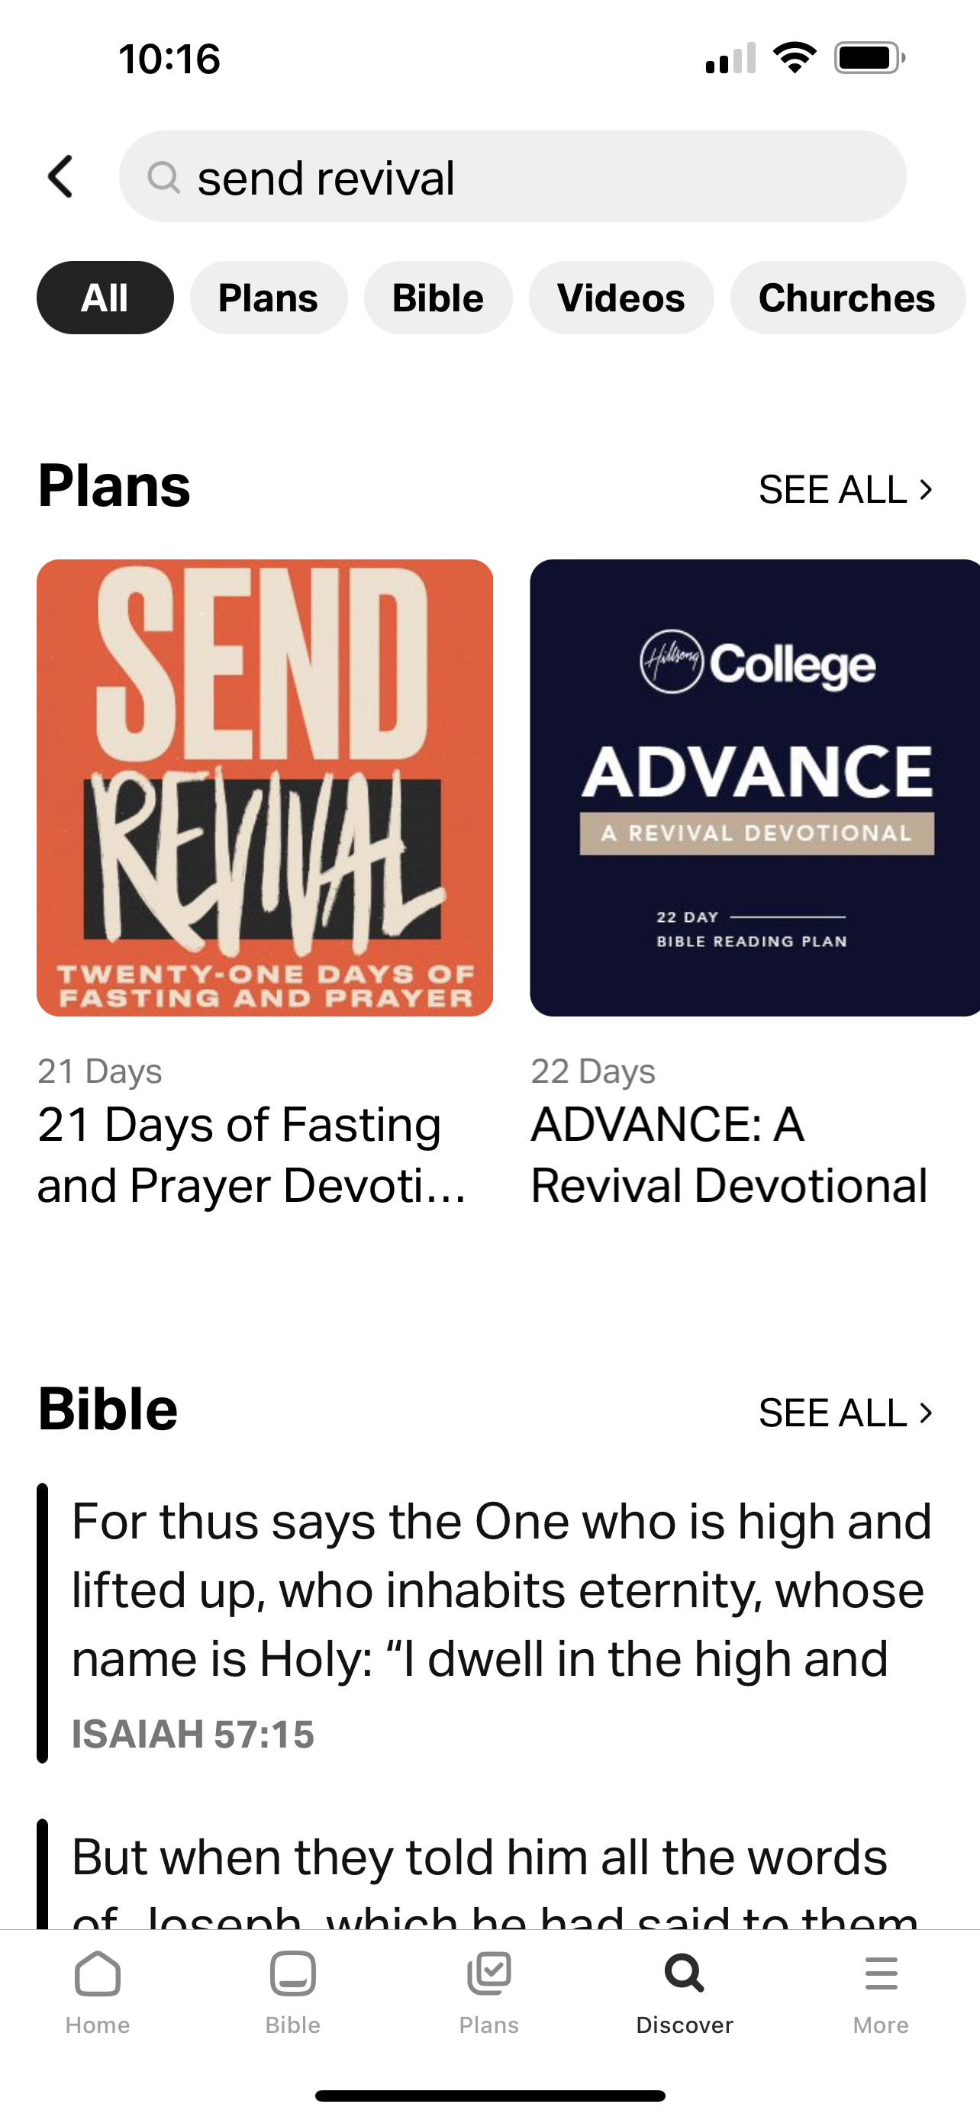
CORNERSTONE.AG/SENDREVIVAL
Sunday, Jan 8 – Sunday, Jan 29
Bible App: “Send Revival”
Fast the world to choose LIVE.LOVE.LEAD.
Notes:
Begin today – invite others to do it with you
Three questions:
What part of life given up will be revived
Will you turn to God instead of you/world
Will join me in praying right now for revival?

Slide 21
WILL YOU
PRAY NOW?
Psalm 85:4 [Repentance]
Restore us again, O God of our salvation, and put away your indignation toward us!
Habakkuk 3:2 [Mercy]
O Lord, I have heard the report of you, and your work… In the midst of [these] years revive it;
Hosea 6:3 [Obedience]
Let us press on to the know the Lord … He will come to us as showers
Isaiah 64:1 [God’s Glory]
Oh that you you would rend the heavens and come down
ONE NEED
SEND REVIVAL
TWO CONVICTIONS
ONLY GOD
CREATES & LOVES
THREE CHOICES
LIVE IN HIS PRESENCE
LOVE ONE ANOTHER LEAD OTHERS TO JESUS
Notes:
Short prayers (else can’t do many)
Praying these verses
Or the 1 2 3
Let’s sing and then call out to God together

