Slide 1
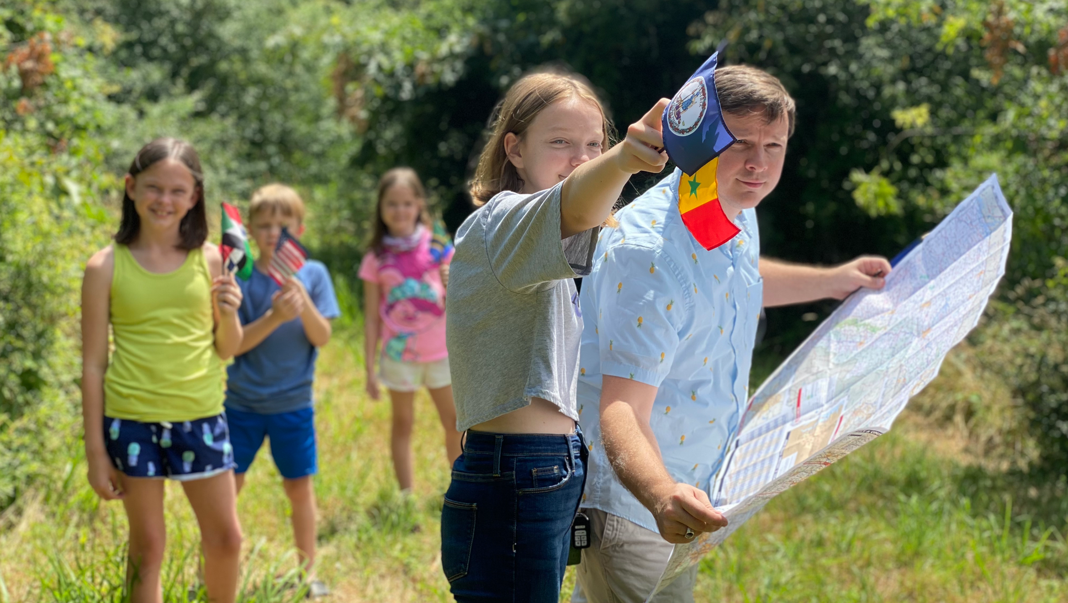
on the border of a new pentecost

Slide 2
“It was in that moment, with dollar bills and a thousand pennies scattered on my lap, that I saw things clearly. I could see him.”
— Will Hutchinson

Slide 3
“In recent years, our world has seen a pandemic of depression, anxiety, and despair in kids and teenagers. In fact, the age group that has seen the highest increase in suicide rates is in kids age 10 to 14 years old.”
— Will Hutcherson and Chinwé Williams

Slide 4
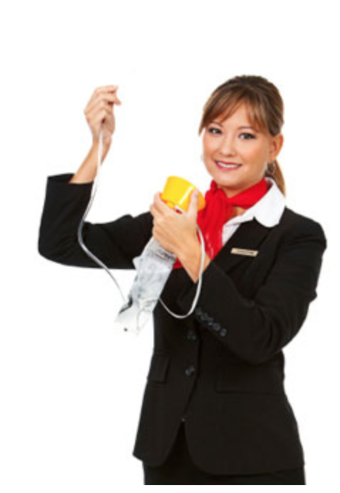
“In the event of a decompression, an oxygen mask will automatically appear in front of you. To start the flow of oxygen, pull the mask towards you. Place it firmly over your nose and mouth, secure the elastic band behind your head, and breathe
normally. Although the bag
does not inflate, oxygen is flowing to
the mask. If you are traveling with a
child or someone who requires assistance,
secure your mask on first, and then
assist the other person.”

Slide 5
Sawubona
“‘I see you.’ I see all of you; your dignity and your humanity. I see your vulnerability and your pride, your dreams and your fears. I see your agency, your power and potential. I see you and I value you.”
— April Rinne

Slide 6
Sawubona
“‘I see you.’ I see all of you; your dignity and your humanity. I see your vulnerability and your pride, your dreams and your fears. I see your agency, your power and potential. I see you and I value you.”
— April Rinne

Slide 7
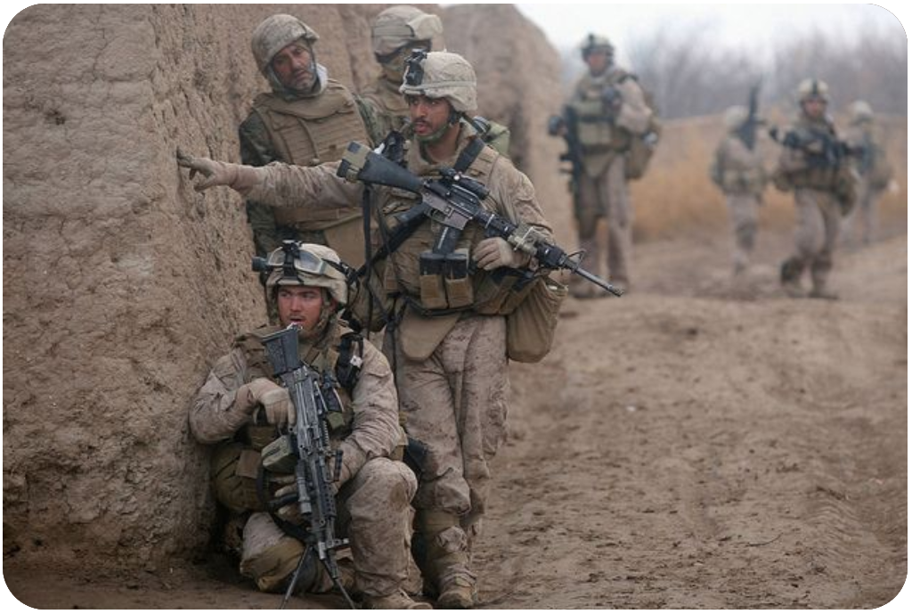

Slide 8
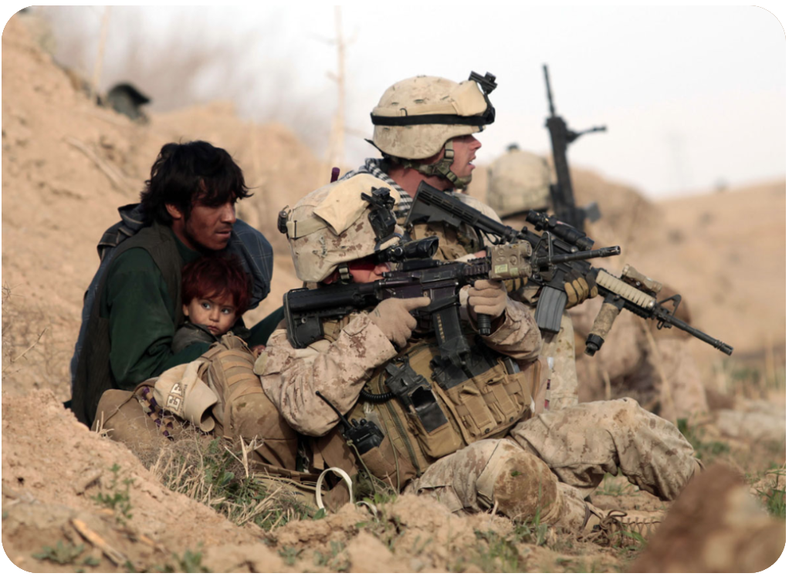

Slide 9
At Caesarea there was a man named Cornelius, a centurion in what was known as the Italian Regiment. He and all his family were devout and God-fearing; he gave generously to those in need and prayed to God regularly. One day at about three in the afternoon he had a vision. He distinctly saw an angel of God, who came to him and said, “Cornelius!”
Cornelius stared at him in fear. “What is it, Lord?” he asked.
Acts 10.1-4a (NIV)

Slide 10
The angel answered, “Your prayers and gifts to the poor have come up as a memorial offering before God. Now send men to Joppa to bring back a man named Simon who is called Peter. He is staying with Simon the tanner, whose house is by the sea.”
When the angel who spoke to him had gone, Cornelius called two of his servants and a devout soldier who was one of his attendants. He told them everything that had happened and sent them to Joppa.
Acts 10.4b-8 (NIV)

Slide 11
Cornelius was seen by God
Dios vio a Cornelio

Slide 12
“In many aspects, therefore, Caesarea represented not only the presence of an invader, colonizer, and exploiter of Israel but also the existence of a detestable and unclean race, the Romans, who should be driven out at all cost. Pagan nations represented by Roman authorities were not merely political rivals and occupiers of the Israelites. They were also worshipers of strange deities, entities that had to be shunned religiously.”
— Youngmo Cho & Hyung Dae Park

Slide 13
Cornelius was called to respond by God
Dios llamó a Cornelio para responder

Slide 14
“Divine initiative
calls for human response.”
— Stanley Horton
“La iniciativa divina
exige una respuesta humana.”

Slide 15
Sawubona
“I see you.”
Shikoba
“I exist for you.”

Slide 16
Sawubona
“I see you.” “Te veo.” j
Shikoba
“I exist for you.” “Yo existo para ti.”

Slide 17
“Then the man and his wife heard the sound of the Lord God as he was walking in the garden in the cool of the day, and they hid from the Lord God among the trees of the garden. But the Lord God called to the man, “Where are you?” He answered, “I heard you in the garden, and I was afraid because I was naked; so I hid.”
Genesis 3.8-10 (NIV)

Slide 18
Cornelius was on the border
of a new Pentecost
Cornelio estaba en la frontera
de un nuevo Pentecostés

