Slide 1
Kids Message Mensaje para niños
Kids PreK to 4th Grade Come Up To The Front
(parent of a small child can come up)
Notes:
Kids church last week: God created you.
Something connected to it – its this . . .

Slide 2
Since God created me,
He can also heal me
when I am sick.
Desde que Dios me creó, Él también puede curarme cuando estoy enfermo.
Notes:
The best person to fix something
Is the person who made it.
Here’s an example.

Slide 3
Notes:
What’s this?
Looks nice – but gets messed up
Everything is out of order
Hard to put back to the way its supposed to be
I feel like this . . .

Slide 4
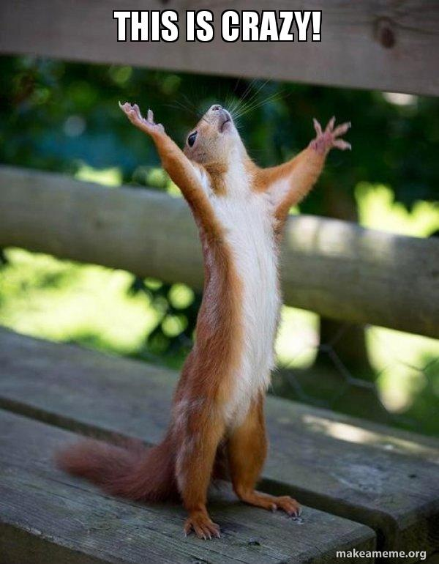
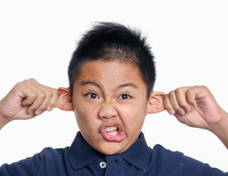
¡Esto es Loco!
Notes:
The one person who knows exactly how to fix it.
To get it back to what it should be is this person . . .

Slide 5
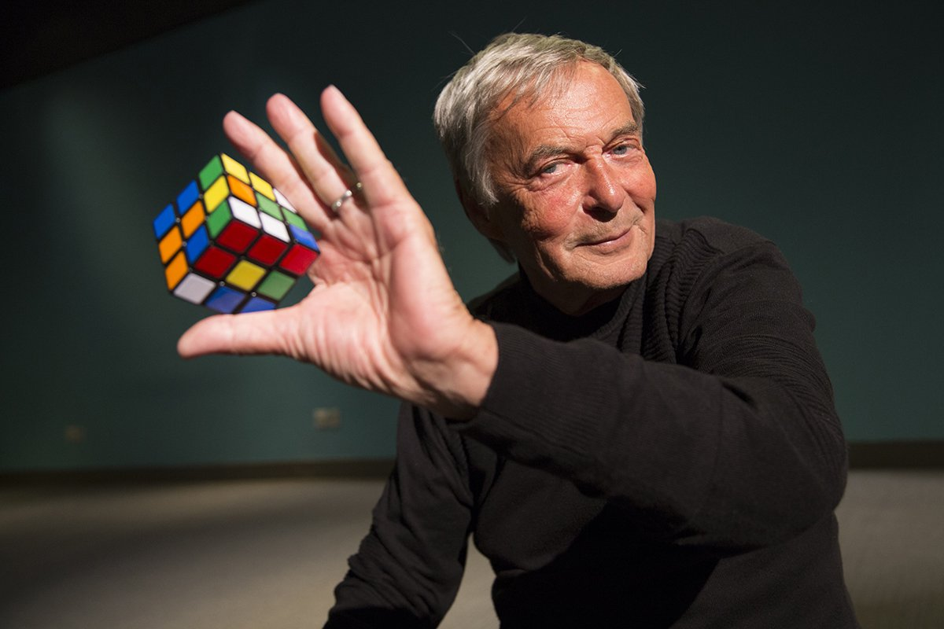
Erno Rubik
Notes:
He’s the one who made it
All the way back in 1974 / not from hear –Hungary
He knows how to not just solve one side
But how all the sides can all be back together
(God is the same for me and you)

Slide 6
Psalm 139:13-14 ^{(NCV)}
“O God, You made my whole being;
you formed me in my mother’s body.
I praise you because you made me
in an amazing and wonderful way.
What you have done is wonderful.
I know this very well.”
Notes:
You are amazing.
You have lots of different sides
Your body, your heart, your spirit, your family . . .
God can heal all of them
(this Scripture - started this morning)

Slide 7
Psalm 103:2-3 ^{(NCV)}
“All of me will praise the Lord
and I will not forget all His goodness to me.
God forgives all my sins
and heals all my diseases.
He saves my life
and loads me with love and mercy.”
Notes:
Spiritual side (forgives my sins)
Physical side (heals all my diseases)
Emotional life (saves my life)
Relationships (loads me w love) /family purpose
I can’t do all this – but God can / tried to learn - interesting

Slide 8
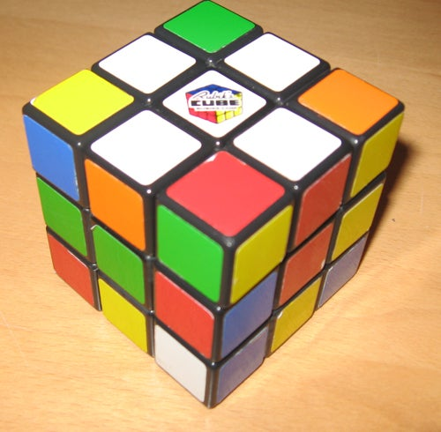
Notes:
Think of sides and layers.
How you start – is form a cross on the top (White cross” method)
When you want everything back – that’s where you start
Bible says at the Cross Jesus died to forgive sins and heal sickness
So as you get ready to go – pray for you and healing

Slide 9
Psalm 103:2-3 ^{(NCV)}
“All of me will praise the Lord
and I will not forget all His goodness to me.
God forgives all my sins
and heals all my diseases.
He saves my life
and loads me with love and mercy.”
Notes:
Since created all of me
He can heal all of me
He gave His son to fix all of me.
(pray the verse)

Slide 10
Nuevos comienzos
Notes:
Get out handout (online too)
Today – will study and seek
God’s presence and healing this morning
Why – next part of Book of Acts.
God planned it for today

Slide 11
Acts 9:32-35 ^{(NIV)}
As Peter traveled about the country, he went to visit the saints in Lydda. ³³ There he found a man named Aeneas, a paralytic who had been bedridden for eight years. ³⁴ “Aeneas,” Peter said to him, “Jesus Christ heals you. Get up and take care of your mat.” Immediately Aeneas got up. ³⁵ All those who lived in Lydda and Sharon saw him and turned to the Lord.
Notes:
As we come to this passage
I have one statement and one big question
(Statement only spot to write down)

Slide 12
What you believe about… the Bible is eternally more important than you realize!
¡Lo que usted cree acerca de la Biblia es eternamente más importante de lo que cree!

Slide 13
What defines reality for you?
¿Qué define la realidad para ti?
The Bible. El Multitud.
Nuestra Cultura. Your Experience.
Your Emotions. Your Circumstances. Your Fears. Tu dolor

Slide 14
If you choose more than one thing to define reality for you, your life, personality & emotions will splinter in every increasing ways.
Si eliges más de una cosa para definir la realidad, tu vida, personalidad y emociones se desmoronarán cada vez más.

Slide 15
Since God created me,
He can also heal me
according to His Word.
Desde que Dios me creó, Él también puede
curarme cuando estoy enfermo.

Slide 16
God’s Ways Include Supernatural Healing
(Handout)
(Handout)
Psalm 103:3
Exodus 15:26
Psalm 107:19
Jeremiah 30:17
Los caminos de Dios incluyen sanidad sobrenatural
Notes:
¹⁷But I will restore you to health
and heal your wounds,’

Slide 17
God’s Ways Include Supernatural Healing
(Handout)
Psalm 103:3
Exodus 15:26
Psalm 107:19
Jeremiah 30:17
[Mk 1:40] Jesus is willing
[Mt 4:23] Jesus heals
[1 Pt 2:24] Jesus paid for it
[Mk 16:18] Tells us to share it
Notes:
¹⁷But I will restore you to health
and heal your wounds,’

Slide 18
What defines reality for you?
¿Qué define la realidad para ti?
The Bible. El Multitud.
Nuestra Cultura. Your Experience.
Your Emotions. Your Circumstances. Your Fears. Tu dolor
Acts 9:33
& Aeneas
Notes:
Eight years! He has a story!
He has had crushing loss
Eight years of trying and praying
He has a family. Had a job.
What defines his reality: (above)

Slide 19
Acts 9:33-34 ^{(NIV)}
³³ There he found a man named Aeneas, a paralytic who had been bedridden for eight years. ³⁴ “Aeneas,” Peter said to him, “Jesus Christ heals you. Get up and take care of your mat.”
Notes:
Since created all of me
He can heal all of me
He gave His son to fix all of me.

Slide 20
“Jesus Christ heals you” “Jesucristo te sana”
(Handout)
Heb. 13:8
Jude 24
Isa. 55:9
Eph. 1:11
Rom. 8:31

Slide 21
“Jesus Christ heals you” “Jesucristo te sana”
(Handout)
Heb. 13:8
Jude 24
Isa. 55:9
Eph. 1:11
Rom. 8:31
[Mt 14:13] Compassion
[Mt 9:5] To teach us
[Mt. 12:28] Attention & Change
[Acts 9:35] A Sign To Believe
Notes:
It was good for me to be afflicted
so that I might learn your decrees. Psalm 119:71
Acts 9 – result of healing and preaching

Slide 22
What defines reality for you?
¿Qué define la realidad para ti?
The Bible. El Multitud.
Nuestra Cultura. Your Experience.
Your Emotions. Your Circumstances. Your Fears. Tu dolor
Only
His Word
Solo Su Palabra

Slide 23
Luke 22:41-42 ^{(NIV)}
Keep looking at Jesus, His Word & His Cross
Sigue mirando a Jesús, Su Palabra y Su Cruz
“Jesus withdrew about a stone’s throw beyond them, knelt down and prayed, ‘Father, if you are willing, take this cup from me; yet not my will, but yours be done.’”
Notes:
My grandfather – 3 surgeries – then healing.
Because of compassion in his time. His way.
To teach. To Witness. To lead to salvation.

Slide 24
Keep looking at Jesus, His Word & His Cross
Is anyone among you sick? Let them call the elders of the church to pray over them and anoint them with oil in the name of the Lord. And the prayer offered in faith will make them well; the Lord will raise them up. If they have sinned, they will be forgiven. Therefore confess your sins to each other and pray for each other so that you may be healed. The prayer of a righteous person is powerful and effective. [James 5:14-16]
Notes:
Since created all of me
He can heal all of me
He gave His son to fix all of me.

