Slide 2
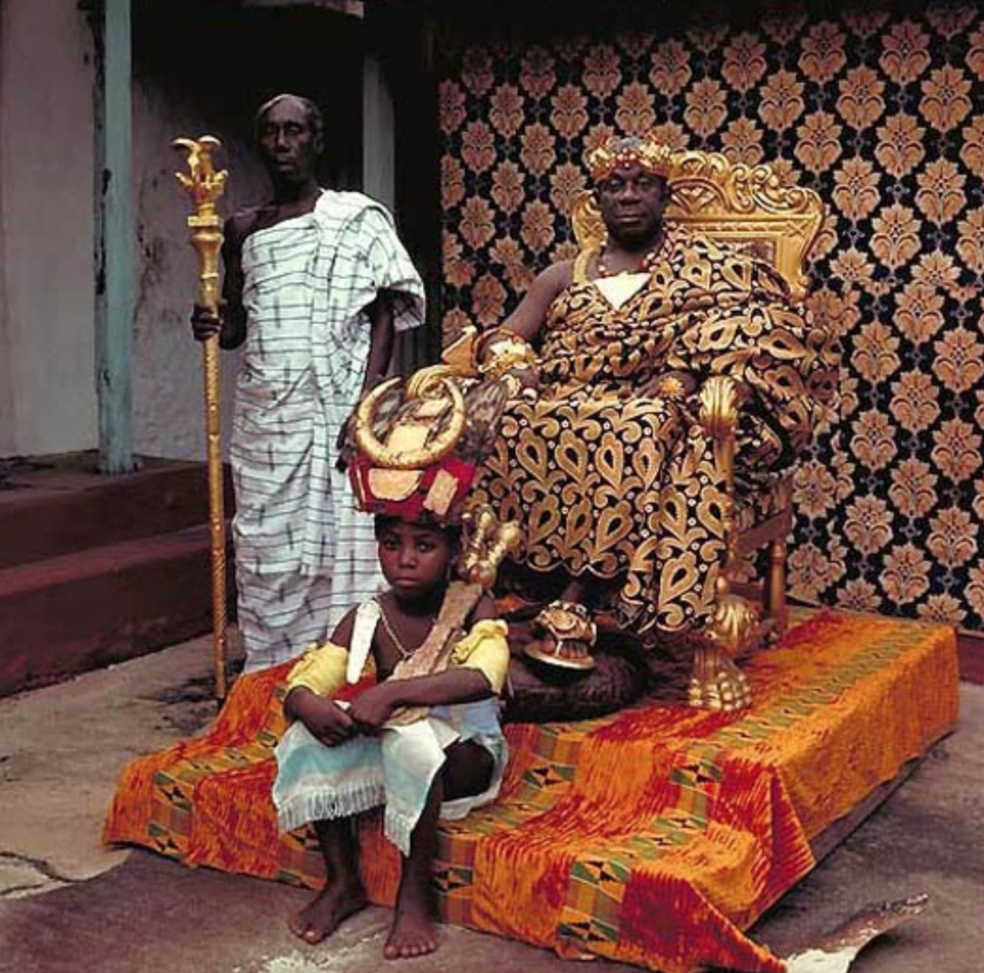
Photography by Daniel Laine

Slide 3
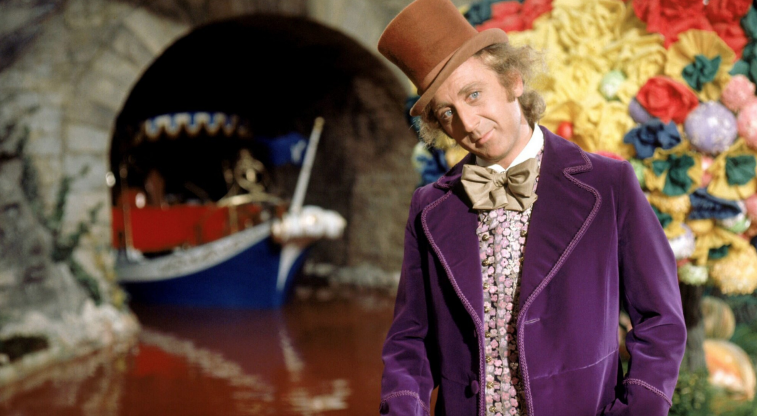

Slide 4
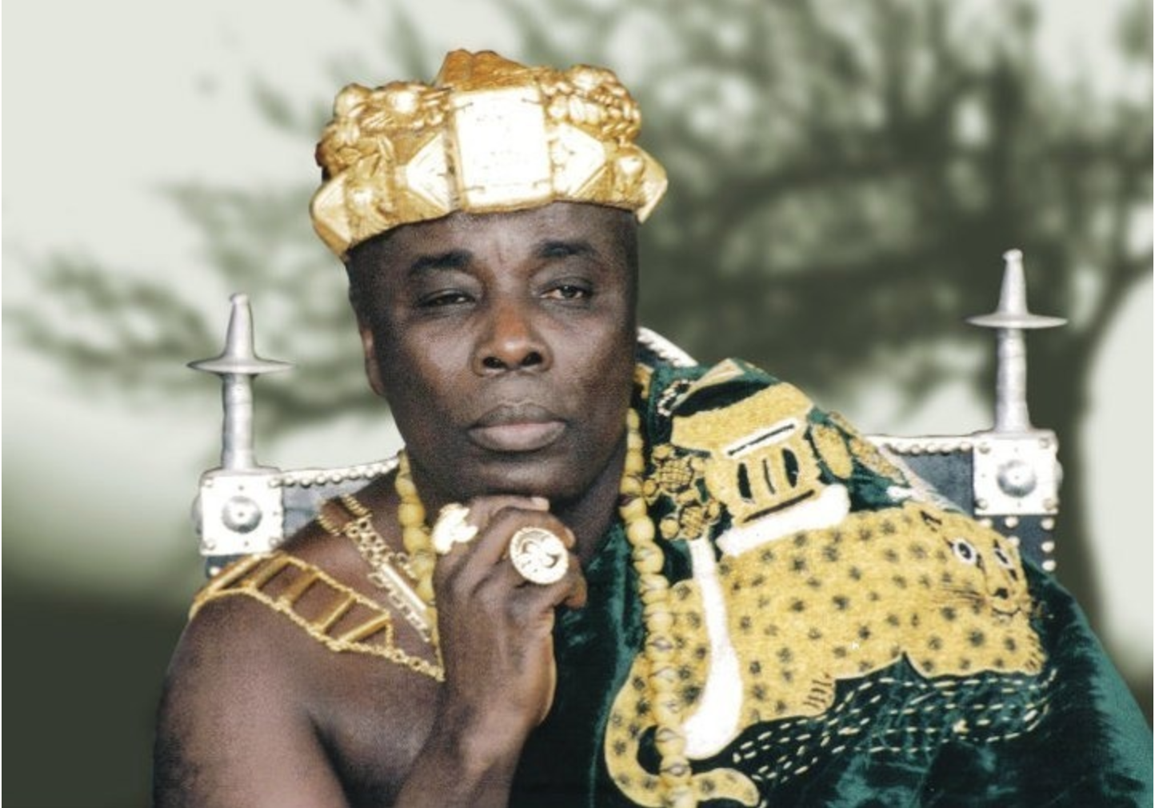

Slide 5
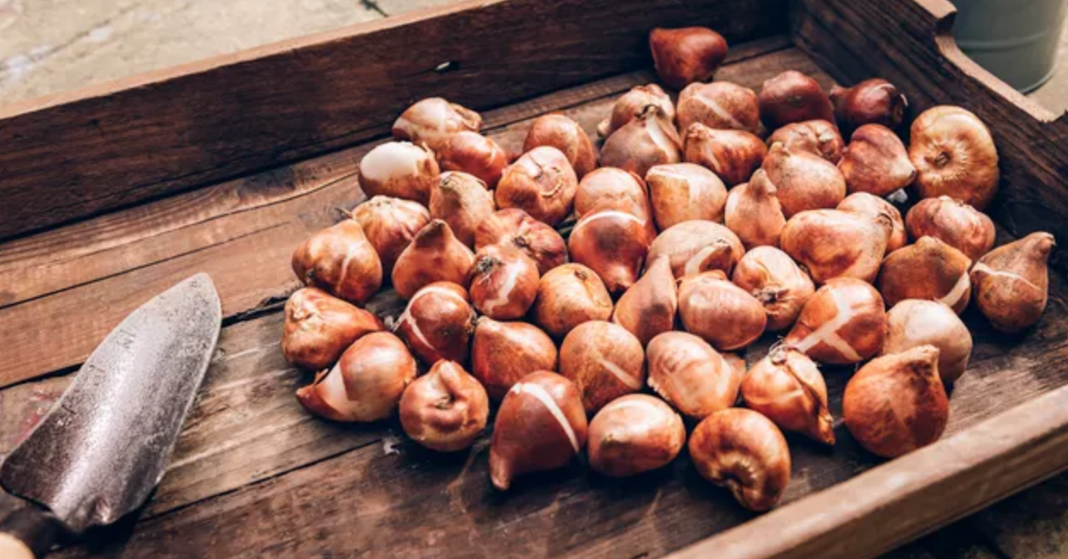
Photography by
Anna Denisova

Slide 6
“Frauds find platforms. It doesn’t matter what kind of platform. They desire being noticed because being seen for them measures their success. Deeper yet, publicity means identity… Consequently, cynicism’s cold tentacles grip us when we hear of the next celebrity who has become a believer.
“Such cynicism was already at work in the early churches, and the two most important gospel centers, Damascus and Jerusalem, did not want to believe the stories about Saul’s conversion. His past was too clear and, as the adage goes, past behavior is the best predictor of future behavior.”
— Scot McKnight

Slide 7
“When the choice is to suffer or dominate, suffer.
When the choice is to suffer or exploit, suffer.
When the choice is to suffer or attack, suffer.
This is the way of the cross.”
— Malcolm Foley

Slide 8
“Saul spent several days with the disciples in Damascus. At once he began to preach in the synagogues that Jesus is the Son of God. All those who heard him were astonished and asked, “Isn’t he the man who raised havoc in Jerusalem among those who call on this name? And hasn’t he come here to take them as prisoners to the chief priests?” Yet Saul grew more and more powerful and baffled the Jews living in Damascus by proving that Jesus is the Messiah.”
Acts 9.19b-22 (NIV)

Slide 9
People couldn’t reconcile the message of this man who wreaked havoc among the Christians and came to round them up and take them prisoner.
At one point his life made sense, but now Saul is a living, human question mark.

Slide 10
“The question is many-layered, but it starts simply with
What happened? What happened to Saul, the Saul we thought we knew and understood?”
The question then moves to its second layer: what is he saying, and what does that mean for us?
Then we meet a third layer; what should we do with him?
“This dense question is unbelievably serious because it exposes the direct implication of someone who interrupts the given social order of a world—they now stand in the position of a betrayer.”
— Willie James Jennings

Slide 11
“After many days had gone by, there was a conspiracy among the Jews to kill him, but Saul learned of their plan. Day and night they kept close watch on the city gates in order to kill him. But his followers took him by night and lowered him in a basket through an opening in the wall.”
Acts 9.23-25 (NIV)

Slide 12
If we will be so bold as to pray for a generation of men and women like Saul we cannot be surprised when their existence disrupts the social order of this fallen world, nor can we leave them out in the cold on their own because we have shielded ourselves with self-preservation and cynicism because we’ve been burned in the past.

Slide 13
Saul “escapes in the solitude of a basket, a person dangling in the air between life and death, between his peoples hope and his peoples hatred. In this regard, there is a loneliness slowly appearing now that will accompany Saul. He is moving toward a liminal space where he will always need help, always need friends, and always look for community. He is moving toward church.”
— Willie James Jennings

Slide 14
“When he came to Jerusalem, he tried to join the disciples, but they were all afraid of him, not believing that he really was a disciple. But Barnabas took him and brought him to the apostles. He told them how Saul on his journey had seen the Lord and that the Lord had spoken to him, and how in Damascus he had preached fearlessly in the name of Jesus. So Saul stayed with them and moved about freely in Jerusalem, speaking boldly in the name of the Lord. He talked and debated with the Hellenistic Jews, but they tried to kill him. When the believers learned of this, they took him down to Caesarea and sent him off to Tarsus.
Acts 9.26-30 (NIV)

Slide 15
“Then the church throughout Judea, Galilee and Samaria enjoyed a time of peace and was strengthened. Living in the fear of the Lord and encouraged by the Holy Spirit, it increased in numbers.”
Acts 9.31 (NIV)

Slide 16
“For God, who said, “Let light shine out of darkness,” made his light shine in our hearts to give us the light of the knowledge of God’s glory displayed in the face of Christ. But we have this treasure in jars of clay to show that this all-surpassing power is from God and not from us.”
2 Corinthians 4.6-7 (NIV)

Slide 17
“For I received from the Lord what I also passed on to you: The Lord Jesus, on the night he was betrayed, took bread, and when he had given thanks, he broke it and said, ‘This is my body, which is for you; do this in remembrance of me.’ In the same way, after supper he took the cup, saying, ‘This cup is the new covenant in my blood; do this, whenever you drink it, in remembrance of me.’ For whenever you eat this bread and drink this cup, you proclaim the Lord’s death until he comes.”
1 Corinthians 11.23-26 (NIV)

Slide 18
