Slide 1
Notes:
As we step back
Our final look at Acts 7
Shows us God’s bigger plan
Couldn’t be more perfect time to hear this message.
Here it is.

Slide 2
AN UNCHANGING GOD WANTS YOU TO CHANGE
Notes:
This is Stephen’s message in Acts 7
Message for us today.
Most of us don’t like it. (80%)
Many see bad change in society.
HERE IS THE TRUTH

Slide 3
The only way to accomplish an unchanging purpose is to change
Notes:
Don’t believe me – ask my lawn
(or is this your lawn)

Slide 4
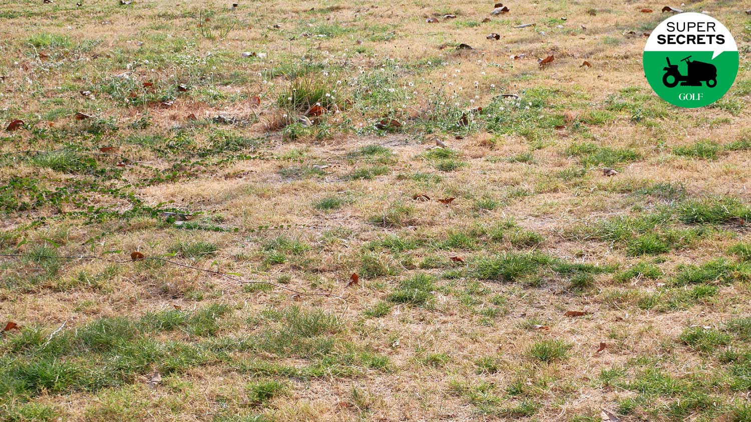
Notes:
Poke holes / fill in holes
Feed / Poison some of it
Water a lot / don’t at all
Let it grow high / cut it really low
My purpose hasn’t changed - reasons

Slide 5
Change is needed for an unchanging purpose of growth and life because of: Seasons Enemies Brokenness
Notes:
1. Season – better not treat every season the same
2. Enemies – voles, bugs, dogs, heat, cold
3. Brokeness – VA Clay!, 17 big gulp gups and linoleum
Unchanging purpose: life & growth needs change
HERE IS GOD’S

Slide 6
God’s Unchanging Purpose For God did not send his Son into the world to condemn the world, but to save the world through him. (Jn 3:17) The Lord is patient with you, not wanting anyone to perish, but everyone to come to repentance. (2 Ptr 3:9) The thief comes only to steal and kill and destroy; I have come that they may have life, and have it to the full. (Jn 10:10)
Notes:
God’s work changes with season, enemies & weaknesses
JC - season: Healing/Beaten
JC – Enemies: Sanhedrin, romans, hometown, jerusalem
READ AND SEE how Stephen calls them to change
And we need to change when the world rejects us.

Slide 7
Now Stephen, a man full of God’s grace and power, did great wonders and miraculous signs among the people. Opposition arose . . .They seized Stephen and brought him before the Sanhedrin. . . ¹⁴ we have heard him say that this Jesus of Nazareth will destroy this place and change the customs Moses handed down to us. ¹⁵ All who were sitting in the Sanhedrin looked intently at Stephen, and they saw that his face was like the face of an angel... Acts 6:8-9,12-15
Notes:
Stephen explains we jump to end of his sermon and reaction

Slide 8
^{7:48} the Most High does not live in houses made by men. As it is written in the prophets: ⁴⁹ “Heaven is my throne, and the earth is my footstool. What kind of house will you build for me? says the Lord... ⁵¹ “You stiff-necked people, with uncircumcised hearts and ears! You are just like your fathers: You always resist the Holy Spirit! Acts 7:48-49,51

Slide 9
⁵² Was there ever a prophet your fathers did not persecute? They even killed those who predicted the coming of the Righteous One. And now you have betrayed and murdered him— ⁵³ you who have received the law that was put into effect through angels but have not obeyed it.” Acts 7:52-53

Slide 10
⁵⁴ When they heard this, they were furious and gnashed their teeth at him. ⁵⁵ But Stephen, full of the Holy Spirit, looked up to heaven and saw the glory of God, and Jesus standing at the right hand of God. ⁵⁶ “Look,” he said, “I see heaven open and the Son of Man standing at the right hand of God.” ⁵⁷ At this they covered their ears and, yelling at the top of their voices, they all rushed at him, ⁵⁸ dragged him out of the city and began to stone him. Acts 7:54-58

Slide 11
Meanwhile, the witnesses laid their clothes at the feet of a young man named Saul. ⁵⁹ While they were stoning him, Stephen prayed, “Lord Jesus, receive my spirit.” ⁶⁰ Then he fell on his knees and cried out, “Lord, do not hold this sin against them.” When he had said this, he fell asleep. ^{8:1} And Saul was there, giving approval to his death. Acts 7:58-8:1
Notes:
Stephen’s message – God used moses, temple, law, customs
NOW itst time to change. Purpose always Jesus.
This is the call to become a Christian (repent)
But also for those who already supposed to know him (Sanhedrin)

Slide 12
Being willing to change isn’t only needed to come to Jesus. It is needed to continue to follow and grow in Jesus. You can only do this as Stephen did. With faith and full of the Holy Spirit
Notes:
The end of chapter – the world’s response
They do need to change
QUESTION TODAY – are we like Stephen
How do we need to ask God to change us?

Slide 13
THE WORLD THE SPIRIT Refuses to listen (v51) Listens and explains (c7)
Notes:
(v51) They covered their ears.
Stiff necked – always resisting the Holy Spirit
Acts. 7. -responds to their questions
Being strong in faith isn’t being closed to listening!
Not to change Word but understand how to apply it.

Slide 14
THE WORLD THE SPIRIT Refuses to listen (v51) Listens and explains (c7) Focus: themselves (v14) Focus: God’s Word (c7)
Notes:
(v14) you will change what we want
What is comfortable. What works for us.
Acts 7 – keeps giving them the word
Stephen used to feel like them. Feelings not ultimate
world worships self instead of Jesus BY WORD

Slide 15
THE WORLD THE SPIRIT Refuses to listen (v51) Listens and explains (c7) Focus: themselves (v14) Focus: God’s Word (c7) Blind to Jesus (v52) Sees Jesus clearly (v56)
Notes:
You can’t focus on self and Jesus
(v52) you killed Jesus
(v56) Look, I see the Son of Man”
They look at history. Jesus.
Want to make it about tradition, culture – Jesus!

Slide 16
THE WORLD THE SPIRIT Refuses to listen (v51) Listens and explains (c7) Focus: themselves (v14) Focus: God’s Word (c7) Blind to Jesus (v52) Sees Jesus clearly (v56) Filled with hate (v54) Filled with grace (6:8,15)
Notes:
Ironic people who say love is most important hate the most
(v58) they gnash their teeth – hate don’t know what to say
(c6) filled with grace looks like an angel
Bible – people who love self gnash teeth at Jesus
NOT just in this life – in hell (place of constant hate/not sadness)

Slide 17
THE WORLD THE SPIRIT Refuses to listen (v51) Listens and explains (c7) Focus: themselves (v14) Focus: God’s Word (c7) Blind to Jesus (v52) Sees Jesus clearly (v56) Filled with hate (v54) Filled with grace (6:8,15) Taking life (v58) Giving life (v59)
Notes:
Jesus came to give life – satan kills steals destroys
(v58) They stone him
(v59) he offers his life
World that when it doesn’t get – threatens death
That’s not the unchanging purpose of God

Slide 18
THE WORLD THE SPIRIT Refuses to listen (v51) Listens and explains (c7) Focus: themselves (v14) Focus: God’s Word (c7) Blind to Jesus (v52) Sees Jesus clearly (v56) Filled with hate (v54) Filled with grace (6:8,15) Taking life (v58) Giving life (v59) Condemning (v59) Forgiving (v60)
Notes:
Their stoning is their condemnation
Stephen forgives as they hate him
“Lord, do not hold this sin against them.”
Yes – he rebukes / but goal is for them to win

Slide 19
THE WORLD THE SPIRIT Refuses to listen (v51) Listens and explains (c7) Focus: themselves (v14) Focus: God’s Word (c7) Blind to Jesus (v52) Sees Jesus clearly (v56) Filled with hate (v54) Filled with grace (6:8,15) Taking life (v58) Giving life (v59) Condemning (v59) Forgiving (v60) Growing in power Growing in purpose
Notes:
Sanhedrin – change that brings power
World wants change (more freedom)
Free to do what made to do (purpose)
change that doesn’t grow in God’s purposes- BAD
Marriage. Work. Lifestyle. Society. Christianity.

Slide 20
Meanwhile, the witnesses laid their clothes at the feet of a young man named Saul. ⁵⁹ While they were stoning him, Stephen prayed, “Lord Jesus, receive my spirit.” ⁶⁰ Then he fell on his knees and cried out, “Lord, do not hold this sin against them.” When he had said this, he fell asleep. ^{8:1} And Saul was there, giving approval to his death. Acts 7:58-8:1
Notes:
Prayer – God let them really change!
I will lose. If they win with you.
There is a Saul watching you
Arguments aren’t going to change him
Suffering and sacrificing by the Spirit is

