Slide 1
“When God comes closer” What we have to do right now! Acts 4:1-22
Notes:
God is coming
World if falling apart
He is coming with so much good
Something we have to do right now!
(declutter: clean ourt. Make way.

Slide 2
Lent is a time to declutter our souls. If spring cleaning is any indication, we have a really big problem!
- 79% need to declutter but only 60% try each spring.
- 25% of 2 car garages don’t have room for a car.
- There are 5x more storage facilities than Starbucks.
- The average 10 year old has 238 toys & plays with 12.
- We spend more on shoes, jewelry & watches than education.
- We have more tvs than people in homes (on at least 8 hrs/ day)
- We spend 3,680 hours looking for 198,743 lost things in a lifetime.
- We spend $1.2 trillion annually on stuff we don’t need.
Notes:
Clutter steals your:
Focus. Time. Peace. Health.
Most of all - your relationship
with God and turn it into religion.
So God comes to us – to set us free.

Slide 3
The closer God comes, the more “spring cleaning” we have to do.
Matthew 21:12-13 | Jesus At The Temple
Jesus entered the temple area and drove out all who were buying and selling there. . . “It is written,” he said to them, “ ‘My house will be called a house of prayer,’ but you are making it a ‘den of robbers.’”
Notes:
Jesus tries to come
His home. No room for him
He is rejected – Sanhedrien
Resurrects

Slide 4
The closer God comes, the more “spring cleaning” we have to do.
Acts 1:8 | Near The Temple
But you will receive power when the Holy Spirit has come upon you, and you will be my witnesses in Jerusalem . . .
Notes:
You will be witnesses of me.
I will come again through you.

Slide 5
The closer God comes, the more “spring cleaning” we have to do.
Acts 2:32-33 | Southern Steps To The Temple
God has raised this Jesus to life, and we are all witnesses of the fact. Exalted to the right hand of God, he has received from the Father the promised Holy Spirit and has poured out what you now see and hear.
Notes:
Jesus pours out His Spirit
Peter calls them to repent.
Clean out your heart.

Slide 6
The closer God comes, the more “spring cleaning” we have to do.
Acts 3:15-16 | Inside The Temple Grounds
You killed the author of life, but God raised him from the dead. We are witnesses of this. . . It is Jesus’ name and the faith that comes through him that has given this complete healing to this man, as you can all see.
Notes:
Jesus shows up again.
Closer. A miracle no one can deny.
Repent – clean out your heart.

Slide 7
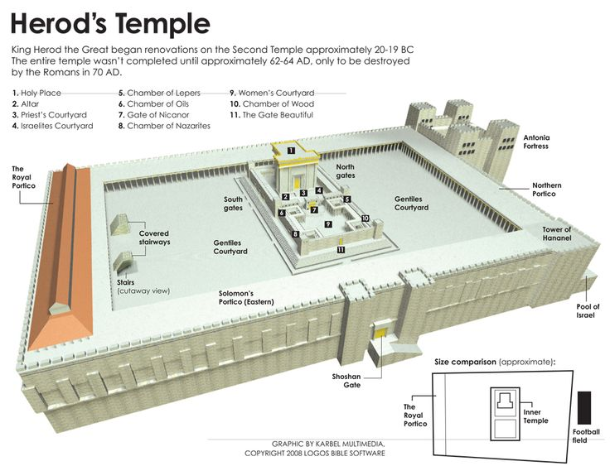
Acts 2 Acts 3 Acts 4
(The Southern Steps) (The Beautiful Gate) (The Hall Of Hewn Stones)
Acts 1
The Mount Of Olives
Notes:
Supposed to be God cluttered
This is the progression.
back at the Sanhedrin
Same declaration of Jesus.
Temple: where God is . . .

Slide 8
The closer God comes . . . the greater the healing
After further threats they let them go. They could not decide how to punish them, because all the people were praising God for what had happened. For the man who was miraculously healed was over forty years old. (4:21-22)
Notes:
God did in one moment To get our attention abt life.
Not even when Jesus was there
Why – greatest glory and good
God is coming. Don’t give up.

Slide 9
The closer God comes . . . the greater the confrontation
The next day the rulers, elders and teachers of the law met in Jerusalem. Annas the high priest was there, and so were Caiaphas, John, Alexander and the other men of the high priest’s family. They had Peter and John brought before them and began to question them: “By what power or what name did you do this?” (4:5-7)
Notes:
Idols - What we love more
This is the clutter.
Saducees – ran the temple
By Rome / No resurrection
They used religion – Jesus said

Slide 10
“‘These people honor me with their lips, but their hearts are far from me. They worship me in vain; their teachings are but rules taught by men.’ (Matthew 15:8) (Isaiah 29:13-16)
Notes:
Other things are more important
They center their beliefs about me
based on what they want.
Money, reputation, power.

Slide 11
We can’t have more of God and keep our idols
Jonah 2:8 | “Those who cling to worthless idols turn away from God’s love for them.
Isaiah 45:20 | “Ignorant are those who trust in idols, who pray to gods that cannot save.”
Leviticus 19:4. | ”Do not turn to idols or make other gods for yourselves. I am the LORD your God.”
Notes:
Entire story of Bible
Surrender your idols

Slide 12
We can’t have more of God and keep our idols
Psalm 16:4 | “Those who run after other gods will suffer more and more.”
Ps 135:18 | “Those who make idols will be like them, lifeless and blind.”
Ex. 20:3 | “You shall have no other gods before me.”

Slide 13
“The most important commandment . . Love the Lord your God with all your heart and with all your soul and with all your mind and with all your strength.’ The second is this: ‘Love your neighbor as yourself.’ (Mark 12:29-30)

Slide 14
There are two types of idols: 1. From the world to give you power and control like god. 2. Things from God that you end up putting before God.
Notes:
Family, Friends, Loving others
V6 – High Priest Family
We don’t get to choose
(sports, home school, parenting)
Jesus don’t mess with our family.

Slide 15
Yet I hold this against you: You have forsaken your first love. Remember the height from which you have fallen! [Find Me in your clutter again]. Repent and do the things you did at first. (Revelations 2:4-5)
Notes:
God is moving closer
Will we clean out our hearts?
Give up our idols
Why need great courage

Slide 16
The closer God comes . . . the greater the courage
When they saw the courage of Peter and John and realized that they were unschooled, ordinary men, they were astonished and they took note that these men had been with Jesus. . . Peter and John replied, “Judge for yourselves whether it is right in God’s sight to obey you rather than God. For we cannot help speaking about what we have seen and heard.” (4:13, 19-20)
Notes:
What world calls courage:
When you decide you are a witness
Not a winner in this world
All those verses - witness

Slide 17
Two Biblical Facts About Courage: 1. Its what people see you do, not what you say or think. 2. When you decide to be a witness of God instead of winner in this world.

Slide 18
J
E
S
U
S
I
S
L
I
F
E
¹⁵ You killed the author of life, but God raised him from the dead. We are witnesses of this.
“Martus / Martyr”
a judicial term of testifying to the truth of what one has seen and knows under the penalty of death
Notes:
Ukraine: stand for what is right
Will we do that for Jesus?
No matter what it cost
Has your clutter keep you from seeing.
(Easter) (Church)
Last time you had something to share.

Slide 19
The closer God comes . . . the greater the peace
know this, you and all the people of Israel: It is by the name of Jesus Christ of Nazareth, whom you crucified but whom God raised from the dead, that this man stands before you healed. He is “‘the stone you builders rejected, which has become the cornerstone.’ Salvation is found in no one else, for there is no other name under heaven given to men by which we must be saved.” (4:10-12)
Notes:
Greatest surrender – greatest peace.
Not confused or worried
I know the answer. Life.
World & idols can’t give.
Bed / sleep. House / family.

Slide 20
Don’t confuse comfort and peace. The world can give you comfort. It can never give you peace.
Time to do some house cleaning!
Notes:
Peter chooses peace.
Saducees – comfort and control
Choice is yours
Coming closer – what do you want?

Slide 21
Jesus loves this world. This world is falling apart. Its idols are failing. If you want the peace of God, reject the comfort of this world.
Have some courage & do some spring cleaning.
Notes:
Peter chooses peace.
Saducees – comfort and control
Choice is yours
Coming closer – what do you want?
Dump: leave it here – confess and no more

