Slide 1
Hechos 3.1-10

Slide 2
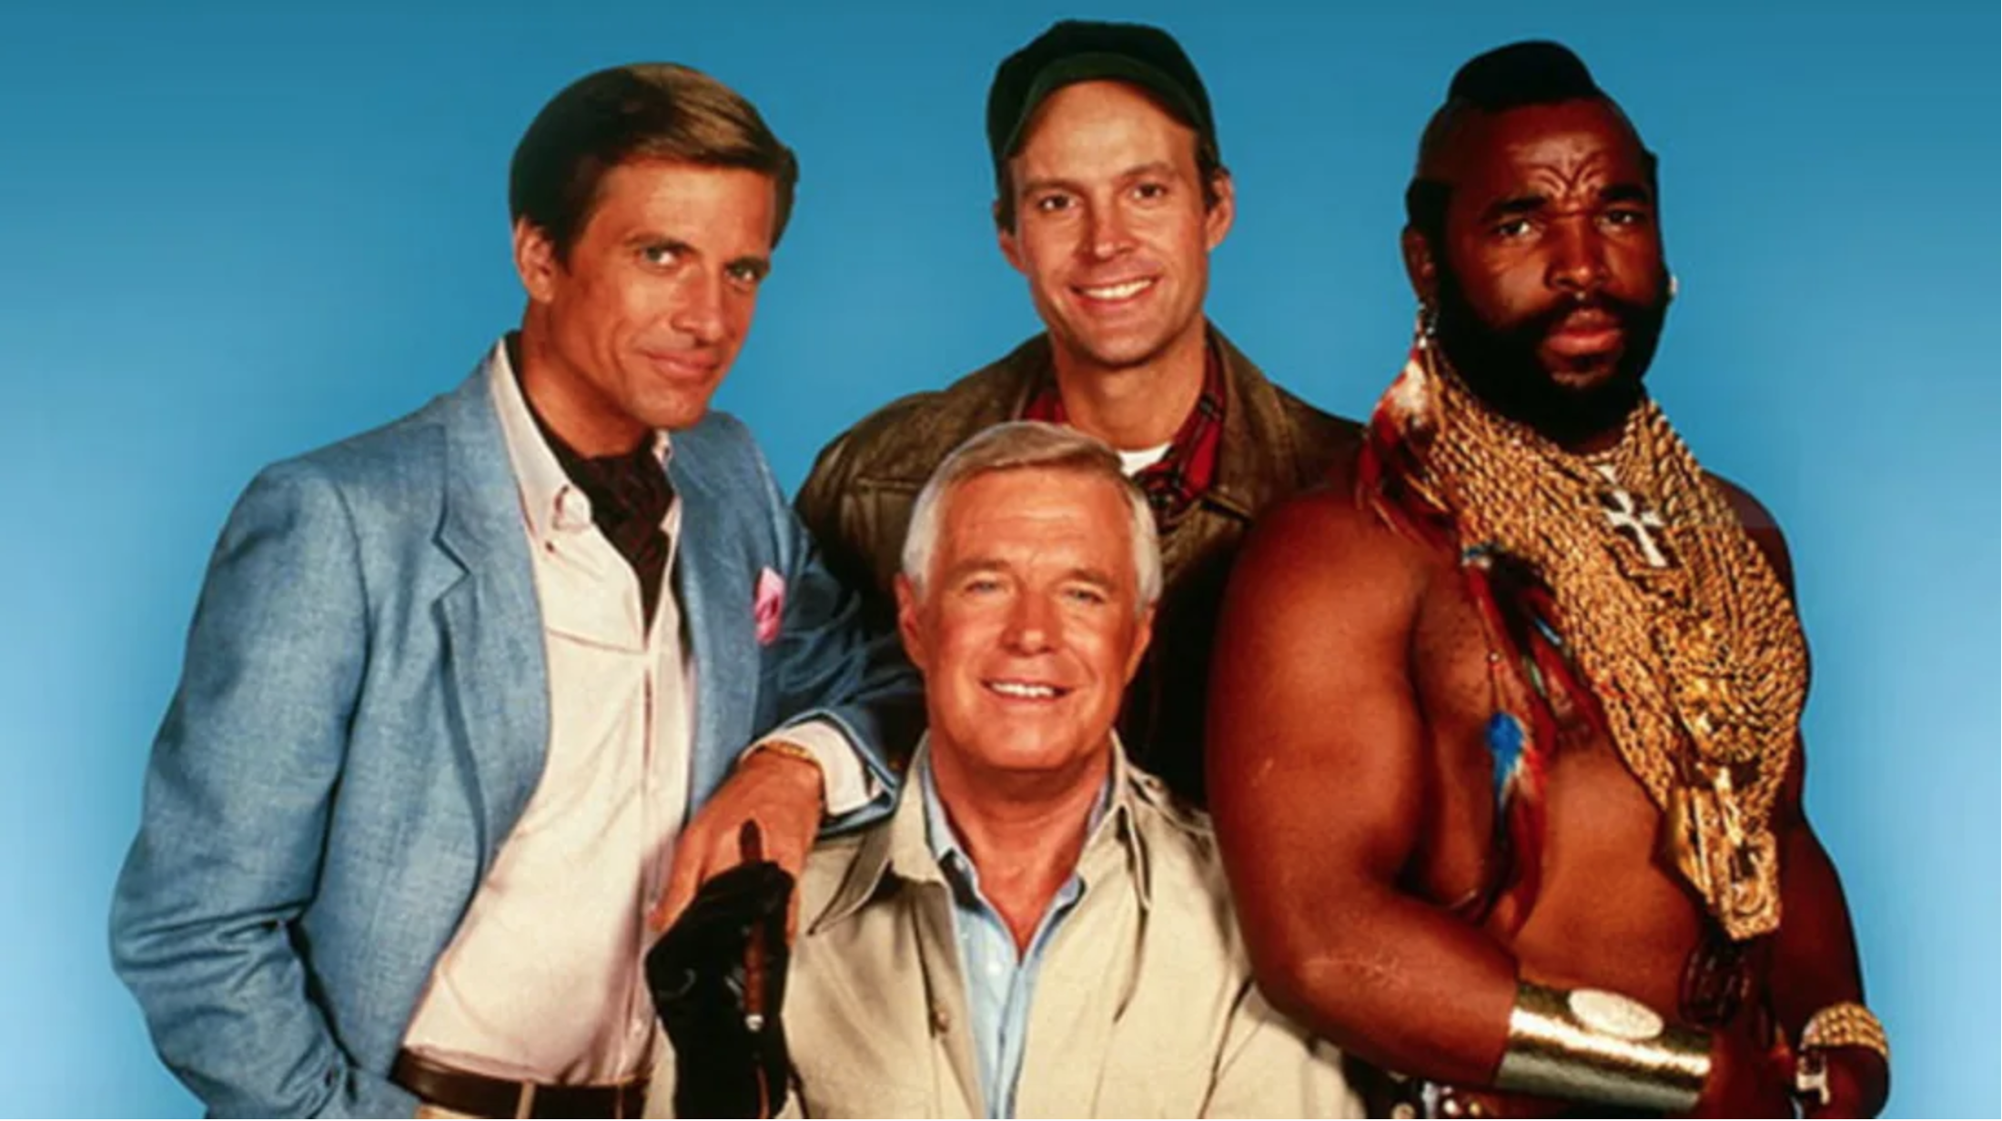
“I love it when a plan comes together.”

Slide 3
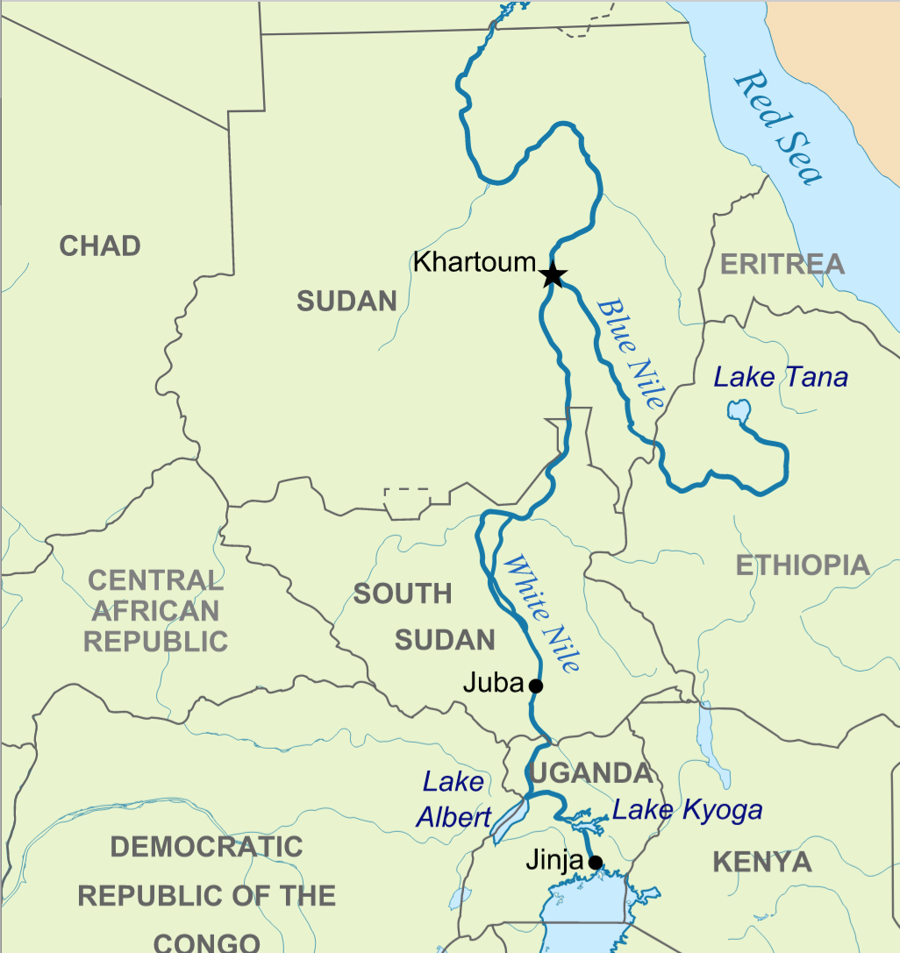

Slide 4
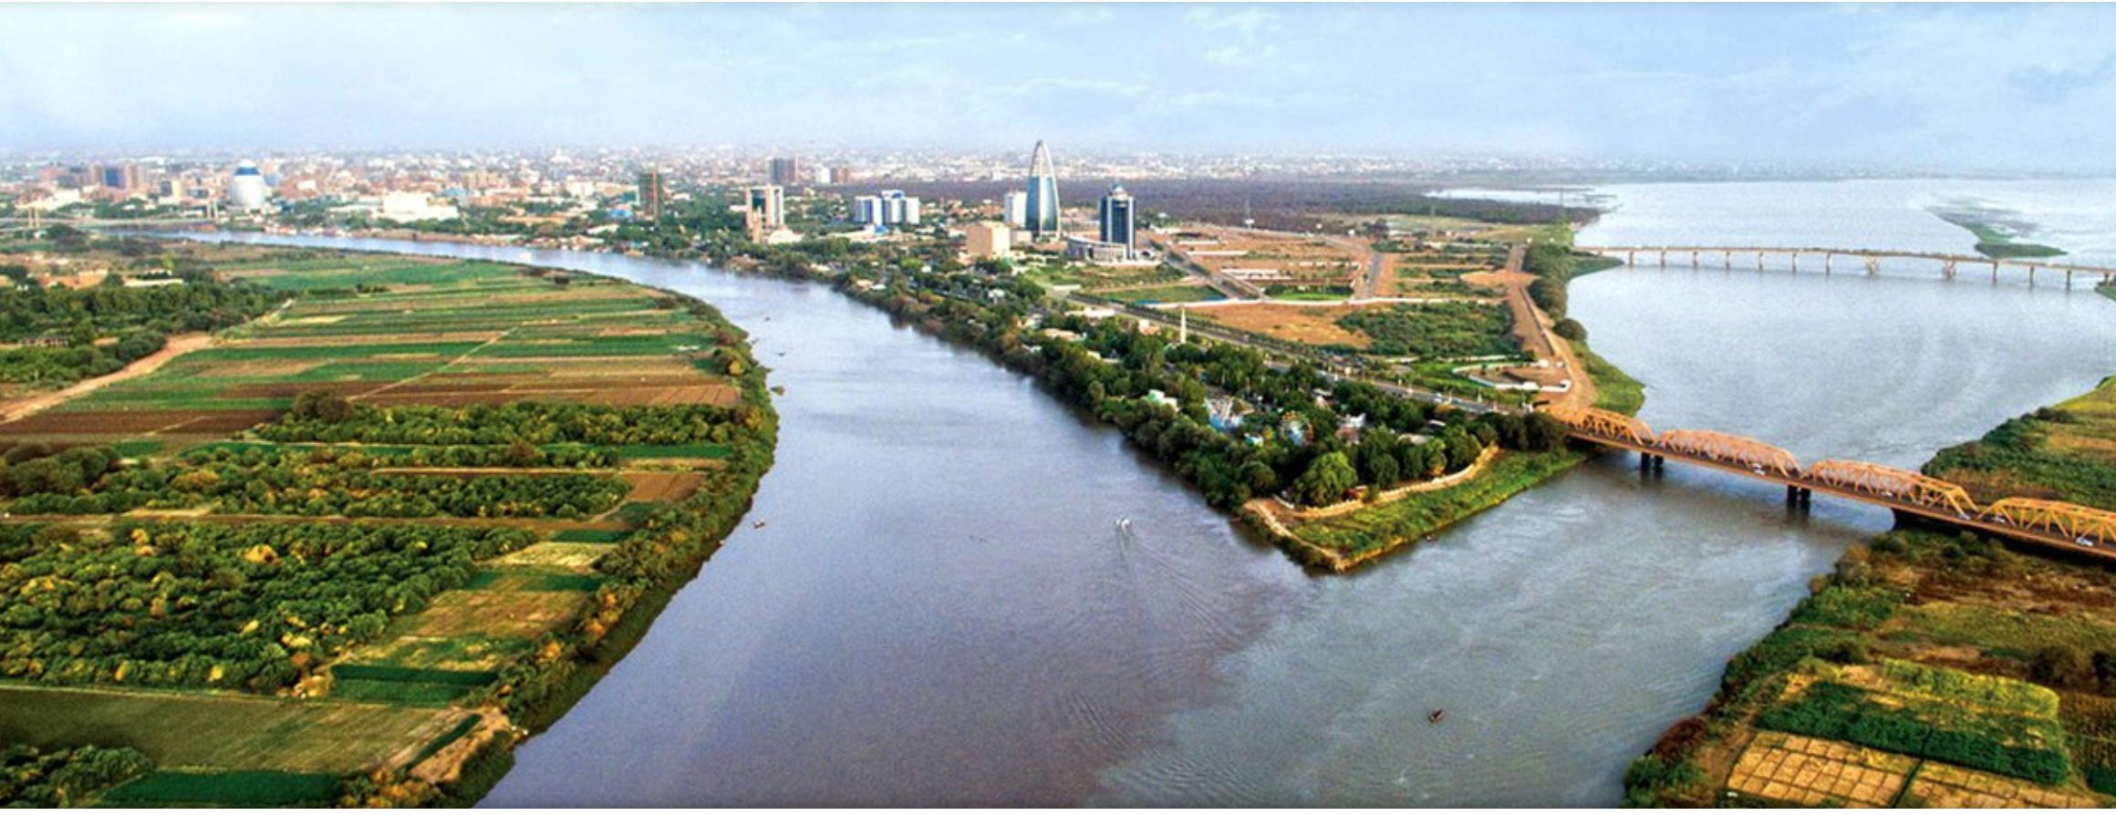
Confluencia
Acción de confluir
(unirse en un lugar varias carreteras,
ríos o corrientes de agua);
Lugar donde confluyen dos cosas.

Slide 5
Confluence
the junction of two rivers, especially rivers of approximately equal width;
an act or process of merging.

Slide 6
One day Peter and John were going up to the temple at the time of prayer—at three in the afternoon.
Now a man who was lame from birth was being carried to the temple gate called Beautiful, where he was put every day to beg from those going into the temple courts.
Acts 3.1-2 (NIV)

Slide 7
When he saw Peter and John about to enter, he asked them for money. Peter looked straight at him, as did John. Then Peter said, “Look at us!” So the man gave them his attention, expecting to get something from them.
Acts 3.3-5 (NIV)

Slide 8
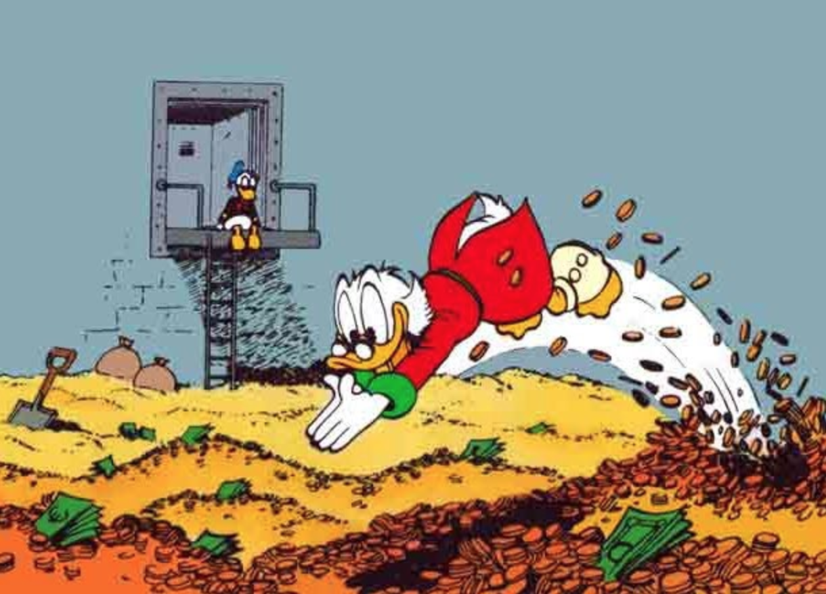

Slide 9
Then Peter said, “Silver or gold I do not have, but what I do have I give you. In the name of Jesus Christ of Nazareth, walk.”
Taking him by the right hand, he helped him up, and instantly the man’s feet and ankles became strong. He jumped to his feet and began to walk. Then he went with them into the temple courts, walking and jumping, and praising God.
Acts 3.6-8 (NIV)

Slide 10
Deep down, beneath the grime of the street caked on his shrivel knees, past the lifeless ankles that held him captive to those steps, was a hunger to cross the threshold into the presence of God.

Slide 11
When all the people saw him walking and praising God, they recognized him as the same man who used to sit begging at the temple gate called Beautiful, and they were filled with wonder and amazement at what had happened to him.
Acts 3.9-10 (NIV)

Slide 12
What principles would the Spirit
bring to our attention today?
¿Qué principios haría el Espíritu
traer a nuestra atención hoy?

Slide 13
Solitude
Soledad

Slide 14
Community
Comunidad

Slide 15
Ministry
Ministerio

Slide 16
“There is a moment in our life when we stand before the desert and want to do it ourselves. But there is the voice that comes, ‘Let go. Surrender. I will make you fruitful. Yes, trust me. Give yourself to me.’”
— Henri Nouwen

Slide 17
Communion
“As sleep and rest are needed each day for the body, so silence and solitude are needed each day for the soul. These disciplines have a way of airing out the mind and ironing out the wrinkles of the soul. Plan to come to the quiet everyday to met God in His Word and through prayer.”
— Donald Whitney

