Slide 1
“ON THE WINNING TEAM” Understanding What Church Truly Is Acts 2:40-47

Slide 2
Our Father, who is in heaven, hallowed be Your name; Your kingdom come; Your will be done; on earth as it is in heaven. Give us this day our daily bread. And forgive us our trespasses, as we forgive those who trespass against us. And lead us not into temptation; but deliver us from evil. For thine is the kingdom, the power and the glory, for ever and ever. Amen.
Notes:
We pray your kingdom to come
Your will be done.
Acts 2:42-47 is it
Until Jesus returns

Slide 3
With many other words Peter warned them; and he pleaded with them, “Save yourselves from this corrupt generation.” ⁴¹ Those who accepted his message were baptized, and about three thousand were added to their number that day. (Acts 2:40-41)
Notes:
Asking people to make a choice

Slide 4
They devoted themselves to the apostles’ teaching and to the fellowship, to the breaking of bread and to prayer. ⁴³ Everyone was filled with awe, and many wonders and miraculous signs were done by the apostles. ⁴⁴ All the believers were together and had everything in common. (Acts 2:42-44)

Slide 5
Selling their possessions and goods, they gave to anyone as he had need. ⁴⁶ Every day they continued to meet together in the temple courts. They broke bread in their homes and ate together with glad and sincere hearts, ⁴⁷ praising God and enjoying the favor of all the people. And the Lord added to their number daily those who were being saved. (Acts 2:45-47)

Slide 6
You can’t win if you are playing for the wrong team.
Notes:
Not uniform, stadium or knowing players
Playing ball
Don’t want wrong team choosing me
Jesus said two teams / church world

Slide 7
THE CHURCH THE WORLD
Saved Lost Lk 19:10 Those In Light Those in darkness Eph. 5:8
Free from Sin Bound by sin Rm. 6:22-23 Hope-full Hopeless Eph 2:12 Father: God Kidnapper: Satan Jn 8:42-44 With Jesus Against Jesus Lk 11:23
Die to Self Live for Self Lk 9:23-25
Spirit of God Spirit of the World 1 John 4:1-6
Persecuted Celebrated Mt. 5:10-12
Victorious Defeated Mt. 16:18
Notes:
Bible is crystal clear
JC: don’t accept/love me unless you agree
Not on this list – good/bad
Jesus – said who victorious

Slide 8
And I tell you that you are Peter, and on this rock I will build my church, and the gates of Hades will not overcome it. (Matthew 16:18)
Notes:
All of hell can’t defeat it.
Who we are all against
He lost – wants you too

Slide 9
God’s purpose in all this was to use the church to display his wisdom in its rich variety to all the unseen rulers and authorities in the heavenly places. ¹¹ This was his eternal plan, which he carried out through Christ Jesus our Lord. (Ephesians 3:10-11)
Notes:
No gov’t, university
Science lab, movement
That has more wisdom than church
We learn / We grow up

Slide 10
And he is the head of the body, the church; he is the beginning and the firstborn from among the dead, so that in everything he might have the supremacy. (Colossians 1:18)
Notes:
Church is how Jesus has supremacy

Slide 11
Now to him who is able to do immeasurably more than all we ask or imagine, according to his power that is at work within us, ²¹ to him be glory in the church and in Christ Jesus throughout all generations, for ever and ever! Amen. (Colossians 1:18)
Notes:
Church – jesus does more than imagined
Not services – church
So what is it

Slide 12
Until Jesus returns, it is His Church that is the light of the world, and, the end result of the Gospel
Notes:
It all ends in the church
That is what he is coming back for
Wants everyone to be on the team
What is that?

Slide 13
THE PATTERN OF THE TRUE CHURCH 1. Depending on God’s Word (v42)“They devoted themselves to the apostles’ teaching
Notes:
This is where we go.
Holy Spirit makes this alive to us.
“Sent the word and healed them”
“Thy Kingdom Come” – our reality

Slide 14
THE PATTERN OF THE TRUE CHURCH 1. Depending on God’s Word 2. Devoted To Being Together (v42,46) “They devoted themselves to the apostles’ teaching and to the fellowship, to the breaking of bread and to prayer. . . Every day they continued to meet together in the temple courts. They broke bread in their homes”
Notes:
Church: die to self (LP – OUR)
We get deceived by self
Basketball: you traveled!
Whether online/in - DEVOTED

Slide 15
THE PATTERN OF THE TRUE CHURCH 1. Depending on God’s Word 2. Devoted To Being Together 3. Living A Spirit-Filled Life (v43) “Everyone was filled with awe, and many wonders and miraculous signs were done by the apostles.”
Notes:
How we get daily bread
Same spirit raised Christ
We get filled and then pour
Only Spirit can show people JC

Slide 16
THE PATTERN OF THE TRUE CHURCH 1. Depending on God’s Word 2. Devoted To Being Together 3. Living A Spirit-Filled Life 4. Treasuring God’s Diversity (v44) “All the believers were together and had everything in common.”
Notes:
From so many languages and countries.
Like family: grow in diversity
We all know God more
Forgive us

Slide 17
THE PATTERN OF THE TRUE CHURCH 1. Depending on God’s Word 2. Devoted To Being Together 3. Living A Spirit-Filled Life 4. Treasuring God’s Diversity 5. Graciously Giving & Serving (v45-46)“Selling their possessions and goods, they gave to anyone as he had need . . . They broke bread in their homes and ate together with glad and sincere hearts”
Notes:
Lead us not in temptation
Keep and be served
Lack of trust to keep
Don’t live for this world

Slide 18
THE PATTERN OF THE TRUE CHURCH 1. Depending On God’s Word 2. Devoted To Being Together 3. Living A Spirit-Filled Life 4. Treasuring God’s Diversity 5. Graciously Giving & Serving 6. Winning The Lost (v47)“And the Lord added to their number daily those who were being saved.”
Notes:
So they can win
He is the kingdom power and glory

Slide 19
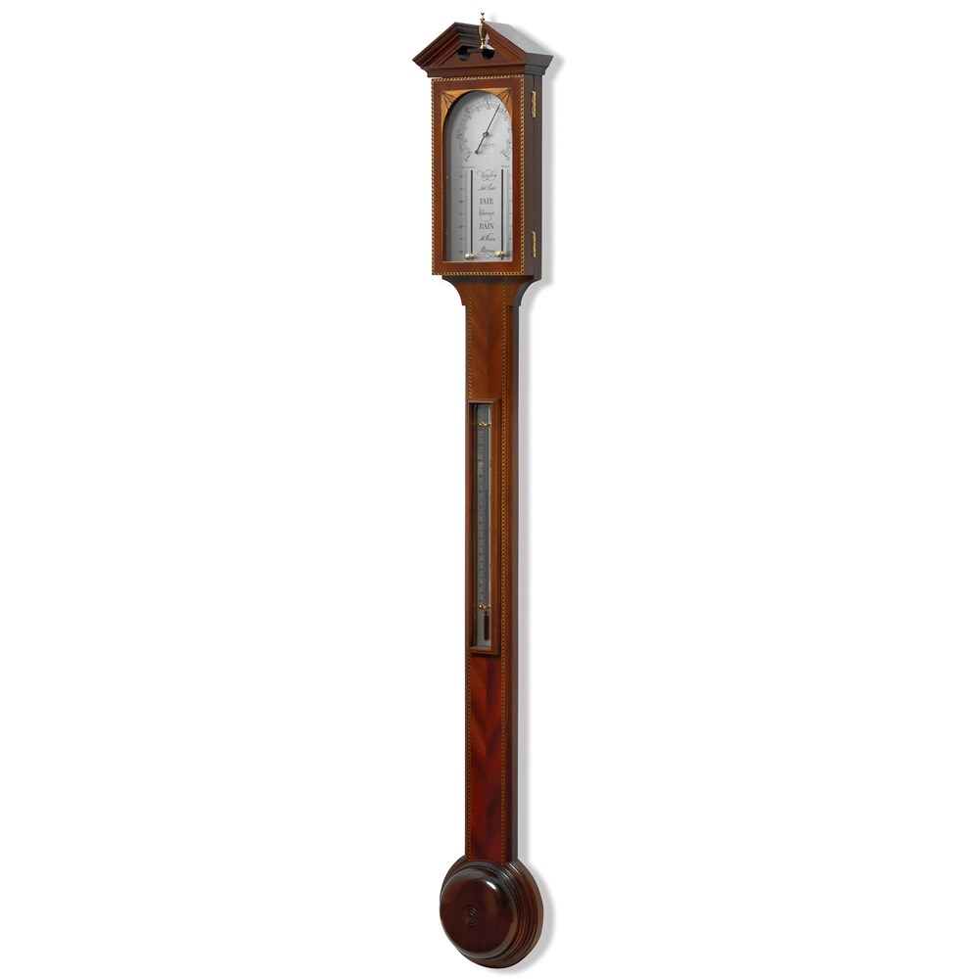
Notes:
Drop B – time it – speed to calculate
Measure height of B and its shadow
B on long string – let down and measure
Go to janitor – here is B – how tall

Slide 20
You can’t determine the greatness of a church by the world’s measurements or your feelings.
Notes:
This is the measurement (next slide) that it leads you to - - -

Slide 21
THE MEASURE OF THE TRUE CHURCH 1. Depending On God’s Word 2. Devoted To Being Together 3. Living A Spirit-Filled Life 4. Treasuring God’s Diversity 5. Graciously Giving & Serving 6. Winning The Lost
Notes:
the measurement & mission
Which is the weakest
must change now!
Here is why

Slide 22
2022 IS THE YEAR OF The Outpouring Of God’s Spirit or The Inner-Crisis From The World
Notes:
Almost used invasion

Slide 23
THE MEASURE OF THE TRUE CHURCH 1. Depending On God’s Word 2. Devoted To Being Together 3. Living A Spirit-Filled Life 4. Treasuring God’s Diversity 5. Graciously Giving & Serving 6. Winning The Lost
Notes:
Umbrella story
Didn’t learn – too late
David – don’t give no cost
Prayer card – altar - song

Slide 24
Our Father, who is in heaven, hallowed be Your name; Your kingdom come; Your will be done; on earth as it is in heaven. Give us this day our daily bread. And forgive us our trespasses, as we forgive those who trespass against us. And lead us not into temptation; but deliver us from evil. For thine is the kingdom, the power and the glory, for ever and ever. Amen.

