Slide 1
Wonderful Counselor
How to find hope and healing in Jesus this Christmas
Isaiah 9:2-6
Notes:
The irony of this season is that
The holidays emphasize the darkness in & around us But the real Christmas is the answer
[stand & read]

Slide 2
The people walking in darkness have seen a great light; on those living in the land of the shadow of death a light has dawned. . .For to us a child is born, to us a son is given, and the government will be on his shoulders. And he will be called Wonderful Counselor, Mighty God, Everlasting Father, Prince of Peace. Isaiah 9:2,6
Notes:
700 years ago
Prophesying abt Christmas
For people in darkness
[what happened first Christmas]

Slide 3
And there were shepherds living out in the fields nearby, keeping watch over their flocks at night. An angel of the Lord appeared to them, and the glory [and the light] of the Lord shone around them, and they were terrified. But the angel said to them, “Do not be afraid. I bring you good news of great joy that will be for all the people. Luke 2:8-10
Notes:
People in darkness

Slide 4
Today in the town of David a Savior has been born to you; he is Christ the Lord. This will be a sign to you: You will find a baby wrapped in cloths and lying in a manger.” Suddenly a great company of the heavenly host appeared with the angel, praising God and saying, “Glory to God in the highest, and on earth peace to men [all people] on whom his favor rests.” Luke 2:11-14
Notes:
for people trapped in darkness
God brought light on Christmas
Both Isaiah & Angel: PEACE
Hasn’t changed … still searching…google

Slide 5
Google – Year In Search 2021

Slide 6
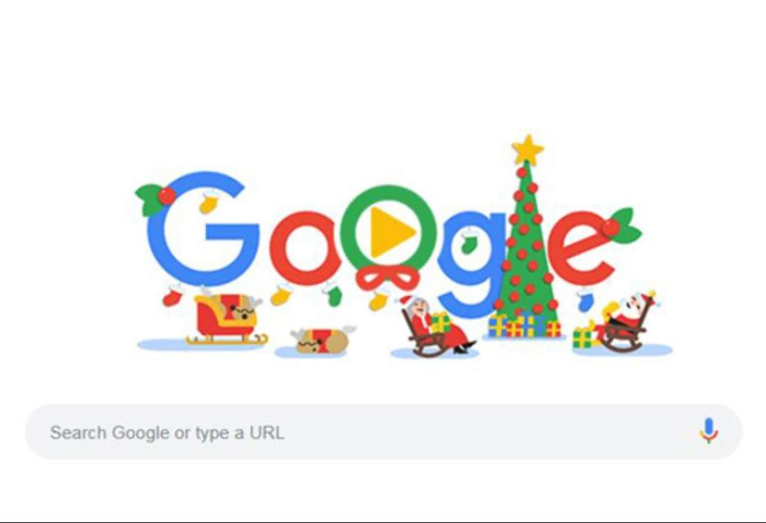
Some of the Top Google
Searches of 2021:
How to
. . . heal
. . . stay strong
. . . be resilient
. . . make a comeback
. . . move forward
. . . be hopeful
Notes:
Everything about those searches says
Help me out of darkness
I’m searching!!!
{next slide]

Slide 7
The very first Christmas was God bringing us the answer for darkness that we are all searching for.
Notes:
How brought – nothing world expected
We search for information - God gave relationship
What God wants us know today (sign)

Slide 8
God’s Answer To Our Darkness You don’t need the right information as much as you need the right relationship.
Notes:
Broken both legs in fire
Information to get out
Really need is someone
World is on fire / we are broken
In our pride we think

Slide 9
Our Answer To Our Darkness Leave me alone until I can search for and figure out the information that I need. Then, I will find & get to the light myself. Then, I will be ready for relationship.
Notes:
Wwho is the finder of lost keys in ur house?
Lose the keys – where was the last place you put it
If I knew that!!!!
Help me look

Slide 10
You can search all you want for right information, but it’s the right relationship that will lift you up and get you out of darkness.
Notes:
Listen the one of the writers of the Bible
Describe Christmas

Slide 11
In the beginning . . . God created everything through Jesus, His Son, and nothing was created except through Him. . . His life brings light to everyone . . . and the darkness can never extinguish it. . . The one who is the only true light, who gives light to everyone, was coming into the world . . . But the world in its darkness did not recognize Him. John 1:1,3-5,9-10
Notes:
You can’t see the right info in the dark

Slide 12
When Jesus spoke again to the people, he said, “I am the light of the world. Whoever follows me will never walk in darkness, but will have the light of My life.” John 8:12
Notes:
I am a light . . .follow me
This will be a sign
Here is right relationship

Slide 13
Invites you but doesn’t control you Offers small beginnings not big ‘fixes’ Leads to commitment over comfort
Christmas shows us the type [“sign”]
of relationship God offers:
Notes:
Will / Jacob-Lauren
Ella / David-Jenna
Judah / Stanely-Tiara
Liam / Samuel-Dunia

Slide 14
“Are you tired? Worn out? Burned out on religion? Come to me. Get away with me and you’ll recover your life. I’ll show you how to take a real rest. Walk with me and work with me—watch how I do it. Learn the unforced rhythms of grace. Matthew 11:28-30 (The Message)
An Invitation
Notes:
Not offering you religion – that controls
Offering relationship
Follow – walk – led you to light

Slide 15
Jesus said: “The kingdom of heaven is like a mustard seed, which a man took and planted in his field. Though it is the smallest of all your seeds, yet when it grows, it is the largest of garden plants and becomes a tree…” Matthew 13:31 (ESV)
A Small Beginning
Notes:
The more desperate – the more big
Get rich quick – 10 days and lose weight
God offers you a beginning

Slide 16
Jesus said: Then he said to them all: “If anyone would come after me, he must deny himself and take up his cross daily and follow me. For whoever wants to save his life will lose it, Luke 9:23-24 (ESV)
A Call For Commitment
Notes:
Baby – have to commit
Center life around
He was the first to commit {slide)

Slide 17
Very rarely will anyone die for a righteous man, though for a good man someone might possibly dare to die. But God demonstrates his own love for us in this: While we were still sinners [still in the dark], Christ died for us. John 8:12
Notes:
You are here today because he loves &chose you.

Slide 18
But you are a chosen people, a royal priesthood, a holy nation, a people belonging to God, that you may declare the praises of him who called you out of darkness into his wonderful light 1 Peter 2:9
Notes:
If you never known him…
If you know but a trapped in an area of darkness
Pray this prayer
Tell him He is worthy of your trust

Slide 19
Jesus, You are the relationship I need. You created me and know me. No one loves me more than You. You overcame all the darkness of this world, to bring light to me. Today, I accept your invitation, begin Your life in me. I commit to following You.

