Slide 1
Wonderful Counselor
How to find hope and healing in Jesus this Christmas
Isaiah 9:2-6
Notes:
The irony of this season is that the very darkness and depression the holidays cause for many is answered in the very holy day of what Christmas really is.

Slide 2
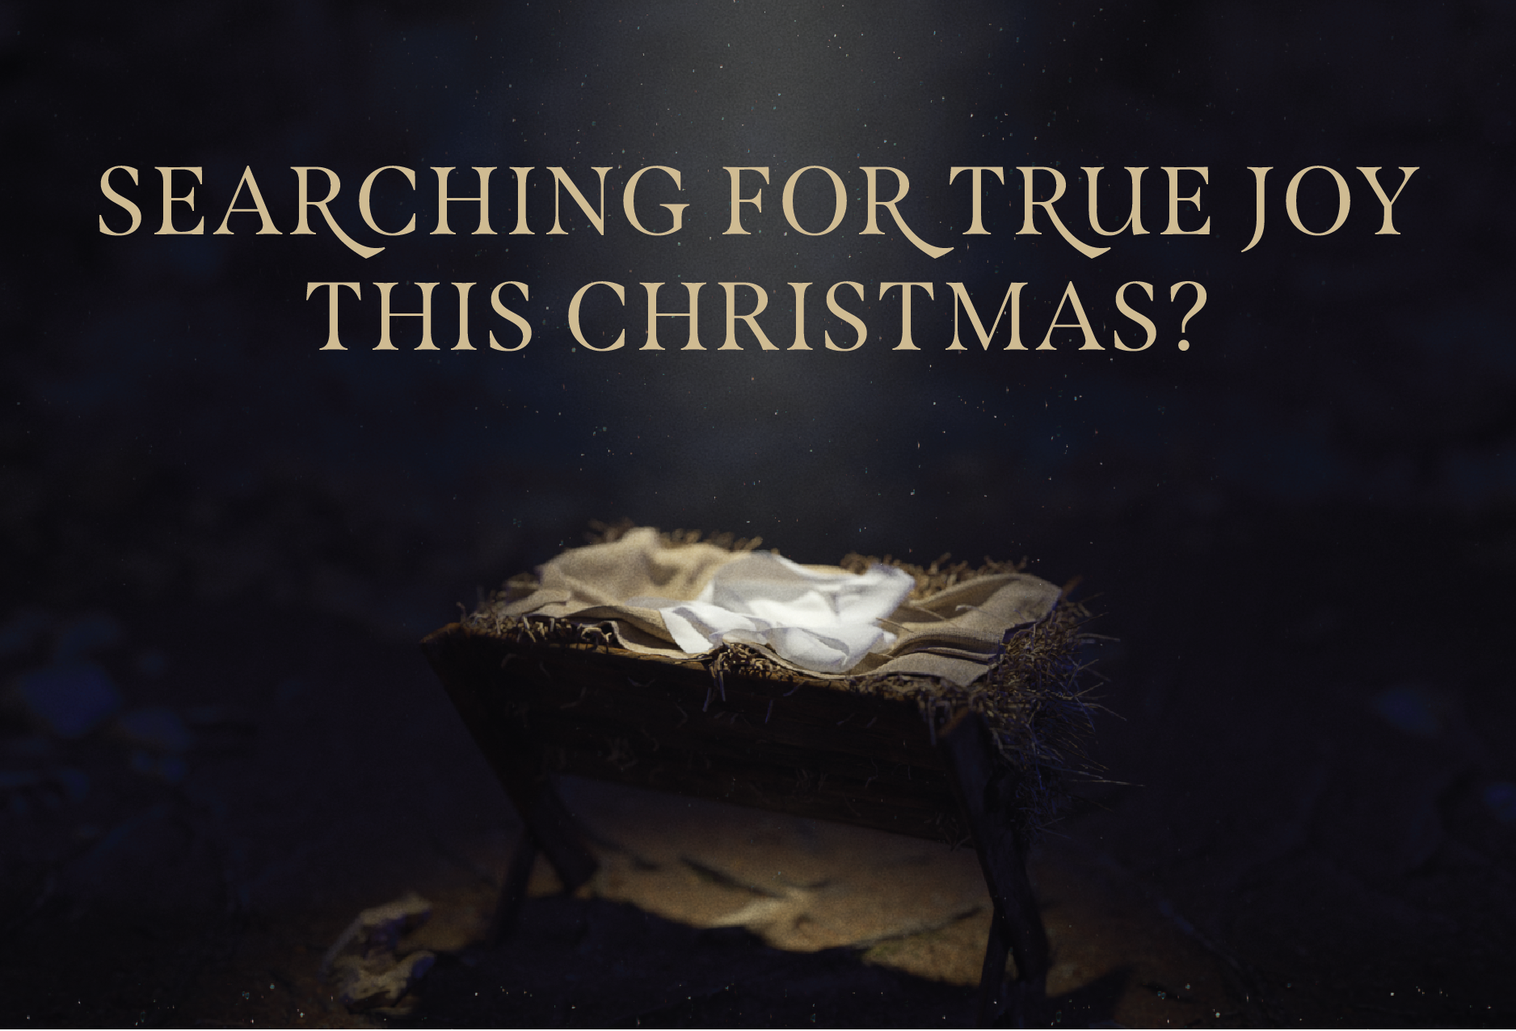
“For many, Christmas can be a time of greater struggles with mental health and sadness. Instead of joy, we can feel like we are in a dark place as the holidays have a way of emphasizing what or who we don’t have in our lives.”

Slide 3
The people walking in darkness have seen a great light; on those living in the land of the shadow of death a light has dawned. . .For to us a child is born, to us a son is given, and the government will be on his shoulders. And he will be called Wonderful Counselor, Mighty God, Everlasting Father, Prince of Peace. Isaiah 9:2-6

Slide 4
The world has made Christmas something that it never was. And in doing so, it deepens our darkness.

Slide 5
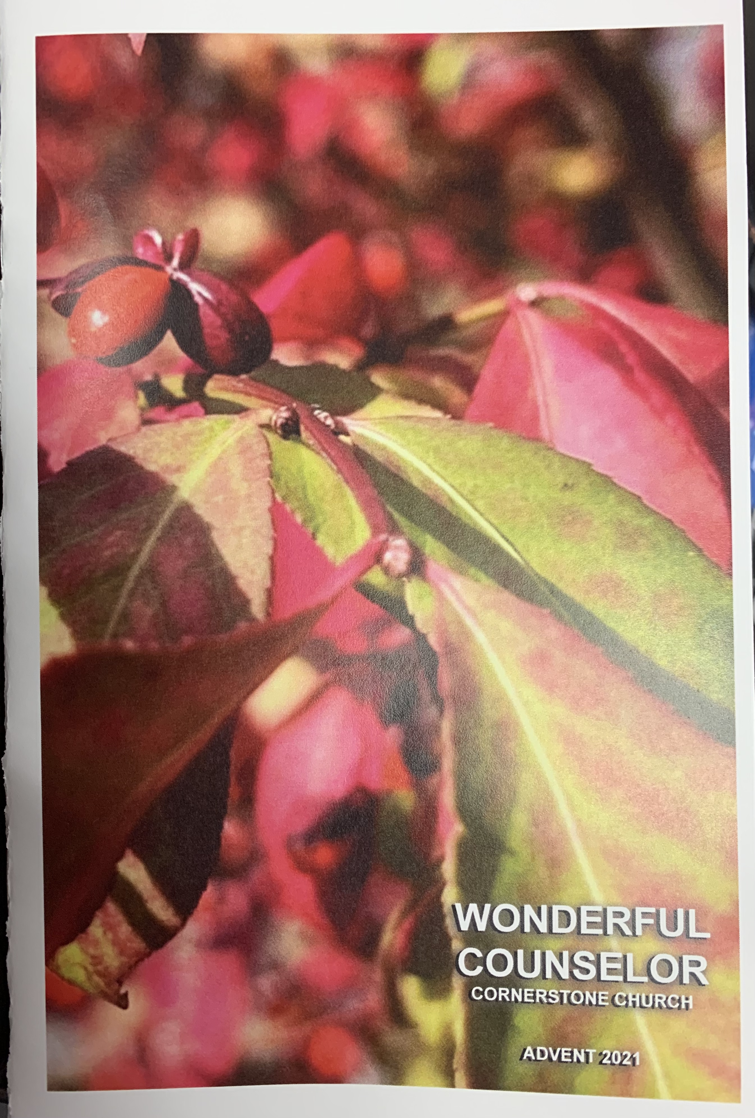
“Wonderful” / “Pala” Something outside the realm of explanation and outside our world; miraculous; supernatural. “Such knowledge is too wonderful for me; it is high, I cannot attain it.” Psalm 139:6
Notes:
Counselor was refering to the king who would lead everyone by wisdom
But instead we choose the world’s offer to get us out of darkness
And we live in greater darkness

Slide 6
“When men tell you to consult mediums and [the ways of the world] . . . should not a people inquire of their God instead? . . . If those things do not speak according to God’s word, they have no light of dawn. Distressed and hungry, they will wander . . . they will look toward the earth and see only distress and darkness and fearful gloom . . .” Isaiah 9:2-6

Slide 7
You don’t need the “magic” of Christmas. You need the manger of Christmas!

Slide 8
The Manger of Christmas 1. It’s messy (and not pretty) “and she gave birth to her firstborn, a son. She wrapped him in cloths and placed him in a manger, because there was no room for them in the inn.” - Luke 2:11-12

Slide 9
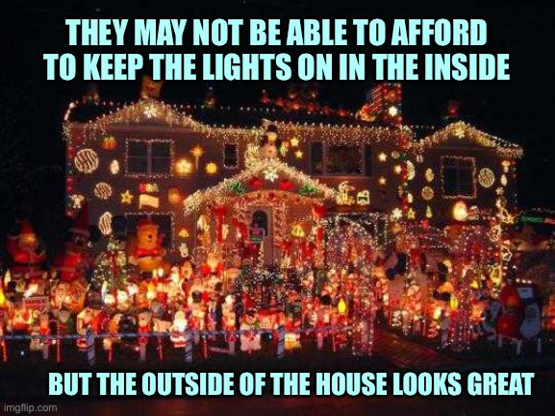

Slide 10
“Mere optimism is blind to the dark side of life and thus collapses in the face of evil that will not go away (from within or without). That’s not the life of Paul [and Jesus’ followers]. They live in faith and not optimism. Faith is realistic about evil and the greatness of God at the same time. To the Christian, Jesus’ resurrection by the Spirit dwarfs everything else. It is the ‘elephant in the room’, the overwhelming truth all other truths bow to.” - Dr. Paul E Miller, Resurrection Realism

Slide 11
We can’t heal and hide our mess at the same time.

Slide 12
The Manger of Christmas 2. It’s harder and heavier than you think “Today in the town of David a Savior has been born to you; he is Christ the Lord. This will be a sign to you: You will find a baby wrapped in cloths and lying in a manger.” - Luke 2:11-12

Slide 13
“For God so loved the world that he gave his one and only Son, that whoever believes in him shall not perish but have eternal life. For God did not send his Son into the world to condemn the world, but to save the world through him." John 3:16-17

Slide 14
“Whoever believes in him is not condemned but . . . This is the verdict: Light has come into the world, but men loved darkness instead of light because their deeds were evil [godless].” John 3:18-19

Slide 15
We can’t heal without facing a hard & heavy reality

Slide 16
The Manger of Christmas 3. It’s small & unimpressive to the world “So the shepherds hurried off and found Mary and Joseph, and the baby, who was lying in the manger.” - Luke 2:16

Slide 17
We can’t heal if we keep chasing big moments instead of small beginnings

Slide 18
The Manger of Christmas 4. It invites you to come and bow down “So the shepherds hurried off and found Mary and Joseph, and the baby, who was lying in the manger.” - Luke 2:16

Slide 19
There is no healing without humility & intentionality

