Slide 1
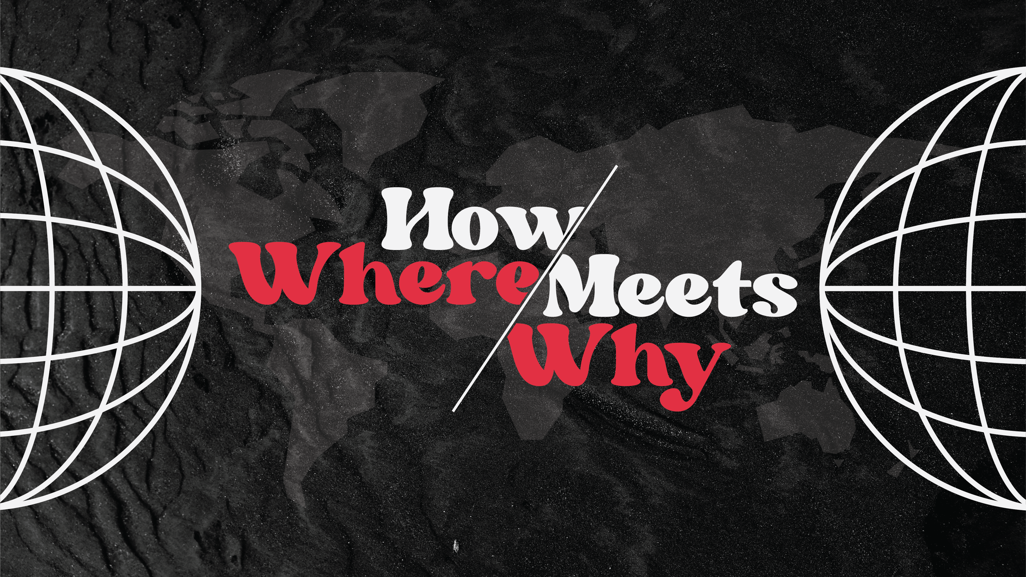

Slide 2
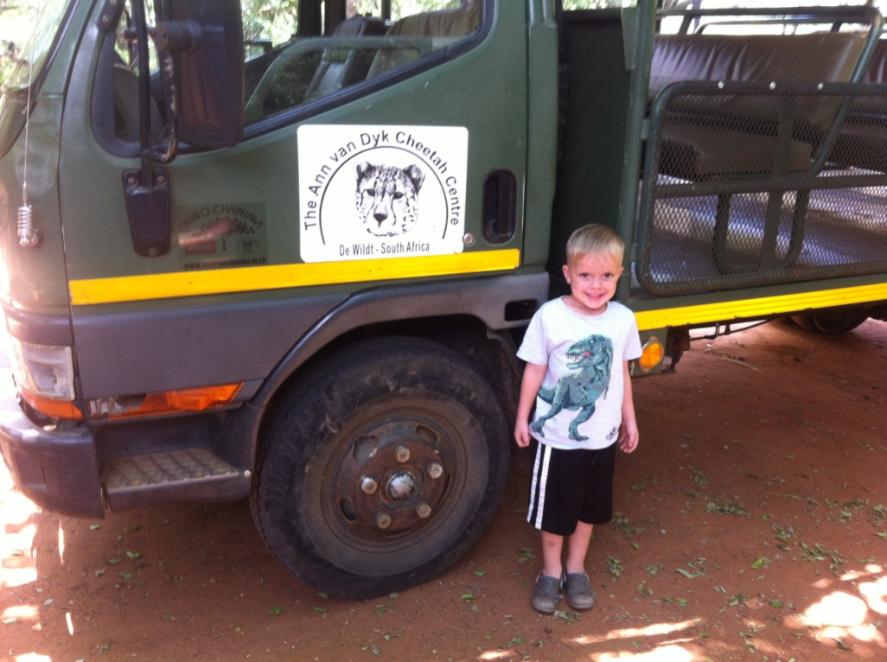

Slide 3
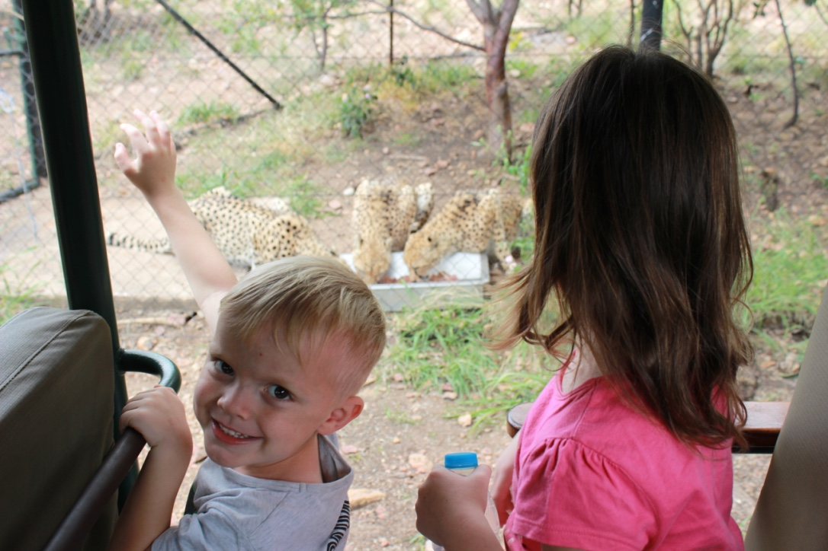

Slide 5
In missions, we can become obsessed with where.
Where is important.
Where people are matters.
But over time, our fixation on where can blind us to purpose.

Slide 6
Our where needs a greater why.
Nuestro donde necesita un mayor porqué.

Slide 7
“Not only bad decisions are made on false assumptions. Some times when things go right, we think we know why, but do we really? That the result went the way you wanted does not mean you can repeat it over and over.”
— Simon Sinek

Slide 8
“I have a friend who invests some of his own money. Whenever he does well, it’s because of his brains and when he loses money, he always blames the market. I have no issue with either line of logic, but either his success and failure hinge upon his own prescience and blindness or they hinge upon good or bad luck. But it can’t be both.”
— Simon Sinek

Slide 9
Where is important
and easier to find,
but why is more important
and more illusive.

Slide 10
“More data...doesn’t always help, especially if a flawed assumption set the whole process in motion in the first place.”
— Simon Sinek

Slide 11
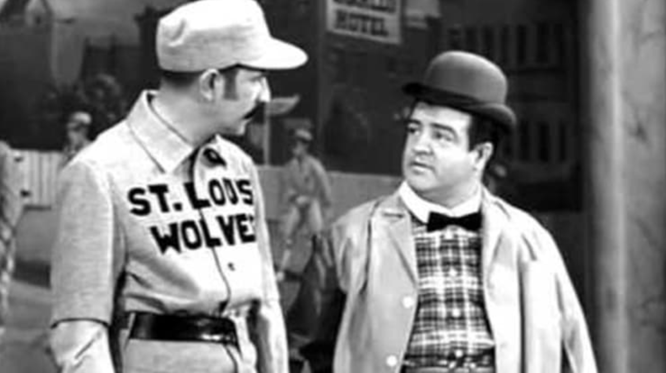

Slide 12
Isn’t this is exactly where
we get confused in our faith?

Slide 13
Abram

Slide 14
So often, we are waiting for God to tell us where,
and He is saying,
“Go. Step out in Faith.
Step out in Trust.
Once you do that
I will show you where.”

Slide 15
Many biblical scholars see the Calling of Abram as the thesis statement of the Bible.

Slide 16
The Calling of Abram
is the thesis statement
of the Bible,
but also the antithesis
to the world’s plan.

Slide 17
El llamado de Abram
es la declaración de tesis
de la Biblia,
pero también la antítesis
al plan del mundo.

Slide 18
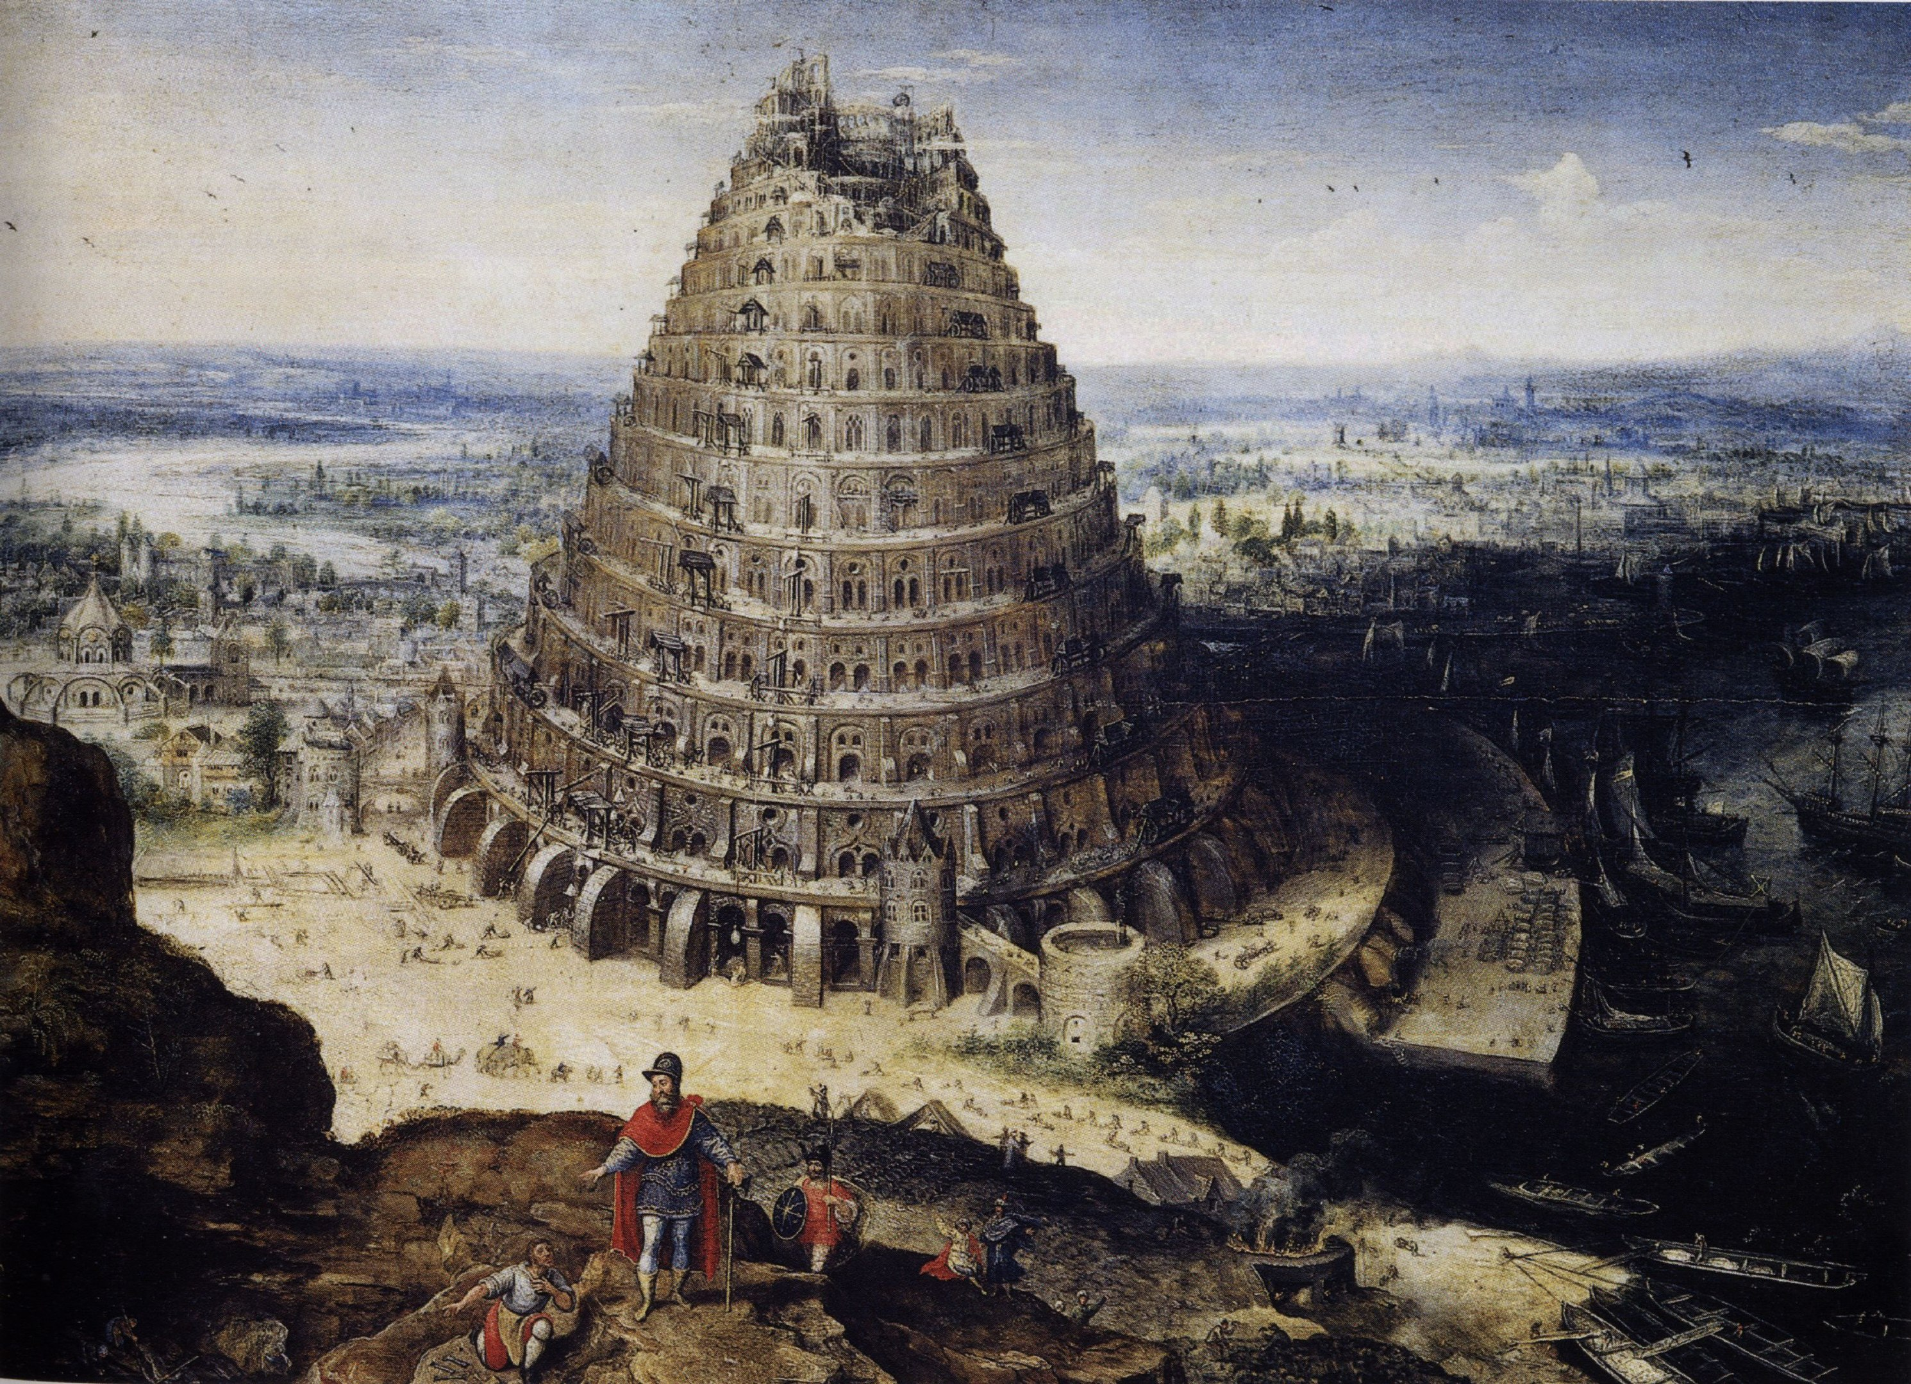

Slide 19
And yet, in spite of God’s command to spread out, to follow God’s why, they said:
“Come, let us build ourselves a city, with a tower that reaches to the heavens, so that we may make a name for ourselves; otherwise we will be scattered over the face of the whole earth.” (Genesis 11.4)

Slide 20
They prioritized their where
over God’s why.

Slide 21
This is why God calls Abram,
not to condemn the nations
but to bless the nations,
not to rebuke the lost
but to establish a priesthood
to love and care for the lost.

Slide 22
Jacob

Slide 23
“God Almighty bless you and make you fruitful and multiply you, that you may become a company of peoples. May he give the blessing of Abraham to you and to your offspring with you, that you may take possession of the land of your sojournings that God gave to Abraham!” Thus Isaac sent Jacob and he went.”
Genesis 28.3-5a

Slide 24
It’s not just the where of the promised land,
but why God promised that land to Abraham in the first place!

Slide 25
Jacob left Beersheba and went toward Haran. And he came to a certain place and stayed there that night, because the sun had set. Taking one of the stones of the place, he put it under his head and lay down in that place to sleep. And he dreamed, and behold, there was a ladder set up on the earth, and the top of it reached to heaven. And behold, the angels of God were ascending and descending on it!
Genesis 28.10-12

Slide 26
And behold, the Lord stood above it and said, “I am the Lord, the God of Abraham your father and the God of Isaac. The land on which you lie I will give to you and to your offspring. Your offspring shall be like the dust of the earth, and you shall spread abroad to the west and to the east and to the north and to the south, and in you and your offspring shall all the families of the earth be blessed. Behold, I am with you and will keep you wherever you go, and will bring you back to this land. For I will not leave you until I have done what I have promised you.”
Genesis 28.13-15

Slide 27
Then Jacob awoke from his sleep and said, “Surely the Lord is in this place, and I did not know it.” And he was afraid and said, “How awesome is this place! This is none other than the house of God, and this is the gate of heaven.”
Genesis 28.16-17

Slide 28
Beloved, where you are matters!Where matters! (Genesis 28.13)
It’s not an accident you are here!
Even if it’s just on the way to where you are supposed to be!

Slide 29
Amado, ¡dónde estás importa!(Génesis 28.13)
¡No es un accidente
que estés aquí!
¡Incluso si está de camino
a donde se supone
que debes estar!

Slide 30
Abram’s calling was the antithesis of the people’s babbling, their self-made plan.
But the ladder before Jacob
was God’s is the AntiBabel.

Slide 31
At this point,
you may be asking yourself,
“How does any of this connect to missions?”
This message has
everything to do with
missions!

Slide 32
At the foot of the heavenly ladder we find our missionary purpose in where we are.
God is speaking to us,
but not only to us.
God is ready to speak through us,
commissioning us to all peoples,
all tribes and all languages.

Slide 33
We are blessing bearers
wherever we go!

Slide 34
“God had a purpose
for Jacob’s life:
That “All peoples on earth will be blessed through you and your offspring.” (Genesis 28.14b)
God has a purpose for your life.

Slide 35
Who has God placed
in your path to love
with the good news of Jesus?

Slide 36
Let your home be the place
where meets God’s why
for your children.

Slide 37
Don’t let false assumptions
about someone’s relationship with God leave the important things left unsaid.
Let your life be the place their where meets God’s why.

Slide 38
Write that person’s name
in your Bible.
Ask God how where you are
with them meets God’s why
for their life?

Slide 39
Communion

Slide 40
The Lord Jesus, on the night he was betrayed, took bread, and when he had given thanks, he broke it and said, “This is my body, which is for you; do this in remembrance of me.”
1 Corinthians 11.23-24

Slide 41
In the same way, after supper he took the cup, saying, “This cup is the new covenant in my blood; do this, whenever you drink it, in remembrance of me.” For whenever you eat this bread and drink this cup, you proclaim the Lord’s death until he comes.
1 Corinthians 11.25-26

