Slide 1
Run Down or Renewed.
Your Words Matter.
James 1-3

Slide 2
Consider it pure joy, my brothers, whenever you face trials of many kinds . . . Perseverance must finish its work so that you may be mature and complete [renewed], not lacking anything [refreshed].
James 1:2,4
Notes:
Persevere through trials
But . . .

Slide 3
Our words create just as much
hardship and weariness in our lives as our circumstances
Notes:
Yes that was bad – and then you said –
What has impacted your life more:
Something someone said that meant really helped you
Or something someone said that really hurt you
This week what is the best thing you said.
What was the worse thing you said.
If you could do only one thing – which would you do:
Get to take back something you’ve said or say something you wish you would have said?
Why because words matter. They have so much power.
After Jesus, no one stresses that more than James.
There is not a chapter or topic in a chapter that he doesn’t refer to what we say and the words we use.
In chapter 3 he focuses on it – but he mentions it in every chapter.
James – who wants to refresh us – if you want to make your life better – make your words better
I want to give you James Top 5 warnings about words

Slide 4
James’ Top 5 Warnings About Words
5. More words. More anger.
Notes:
The more you talk the more angry & destructive
you will get.
James 1:19-20

Slide 5
My dear brothers and sisters, take note of this: Everyone should be quick to listen, slow to speak and slow to become angry, for people’s anger does not bring about the righteous life that God desires.
James 1:19-20
Notes:
What is James saying – if you want to be slow to get angry – be slow to speak
Been there – you’re upset at that text / email / call
Let me show them – fix it – fix them
The more words – the more angry
Especially this -
I have to talk – is the enemy messing with you
My rule – when want to don’t
TELL YOU WHAT YOU AND I SHOULD DO AT THE END
Got to get it out – battle buddy –someone you can vent to – not even right but

Slide 6
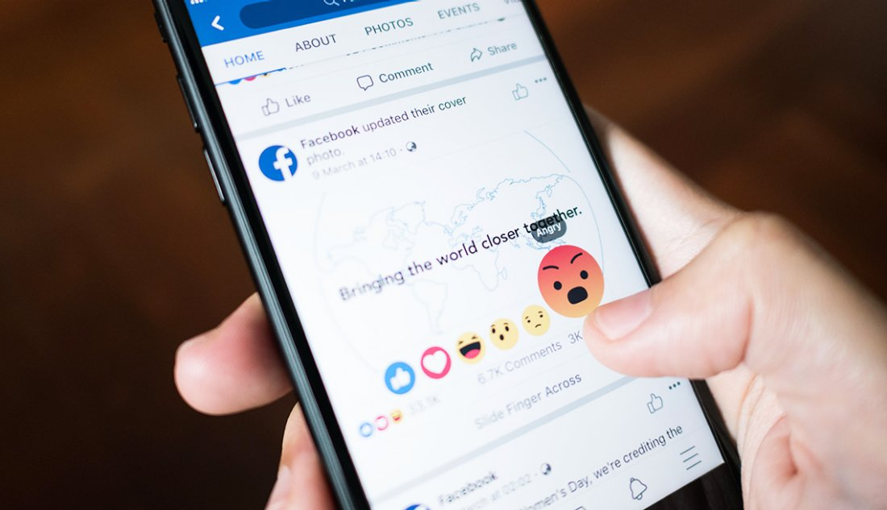

Slide 7
In the multitude of words sin is not lacking, but the person who restrains their lips is wise.
Proverbs 10:19

Slide 8
Watch your tongue and keep your mouth shut, and you will stay out of trouble.
Proverbs 21:23 nlt

Slide 9
James’ Top 5 Warnings About Words
5. More words. More anger.
4. Words can destroy your witness.

Slide 10
If anyone considers himself religious and yet does not keep a tight rein on his tongue, he deceives himself and his religion is worthless.
James 1:26
Notes:
Not saying what you did wasn’t sincere
Just that after all that –then what you said – ruined all the work
Every been there
Satan loves to steal, kill and destroy
Why satan knows this

Slide 11
Death and life are in the power of the tongue.
Proverbs 18:21
Notes:
What I say at a wedding

Slide 12
James’ Top 5 Warnings About Words
5. More words. More anger.
4. Words can destroy your witness.
3. God judges your words.

Slide 13
Speak and act as those who are going to be judged by the law that gives freedom, because judgment without mercy will be shown to anyone who has not been merciful. Mercy triumphs over judgment!
James 2:12-13
Notes:
Listen to what Jesus said

Slide 14
But I tell you that men will have to give account on the day of judgment for every careless word they have spoken. For by your words you will be acquitted, and by your words you will be condemned.”
Matthew 12:36-37
Notes:
There is an important reason
How would you feel if someone played back everything you said this week in front of everyone?
Heaven will – in a certain way

Slide 15
James’ Top 5 Warnings About Words
5. More words. More anger.
4. Words can destroy your witness.
3. God judges your words.
2. Small words can cause big damage.

Slide 16
the tongue is a small part of the body, but it makes great boasts. Consider what a great forest is set on fire by a small spark. The tongue also is a fire, a world of evil among the parts of the body. It corrupts the whole person, sets the whole course of his life on fire, and is itself set on fire by hell
James 3:5-6
Notes:
You are only one sentence away from having the worst or best relationship you’ve ever had.
Just one.
James says – if he were a betting man – here is what he would bet

Slide 17
James’ Top 5 Warnings About Words
5. More words. More anger.
4. Words can destroy your witness.
3. God judges your words.
2. Small words can cause big damage.
1. Your tongue is an evil you can’t fix.

Slide 18
All kinds of animals, birds, reptiles and creatures of the sea are being tamed and have been tamed by man, but no man can tame the tongue. It is a restless evil, full of deadly poison.
James 3:7-8
Notes:
Him in John 7 – to Jesus – he tells jesus to show himself – mocking him because he doesn’t believe
He has a lifetime of being with Jesus and saying all the wrong things – while he was super religious
He knows this
Why – because he knows what you say is connected to your heart – and you and I can’t fix that either

Slide 19
For out of the overflow of the heart the mouth speaks. The good man brings good things out of the good stored up in him, and the evil man brings evil things out of the evil stored up in him. But I tell you that men will have to give account on the day of judgment for every careless word they have spoken.
Matthew 12:34-36

Slide 20
James’ Top 5 Warnings About Words
5. More words. More anger.
4. Words can destroy your witness.
3. God judges your words.
2. Small words can cause big damage.
1. Your tongue is an evil you can’t fix.
Notes:
Here is the picture James gives us – your tongue destroys and you can’t change it
What you wish you could take back you can’t
What you know you should say you won’t
You and I both – need a savior
What’s our answer
We need to use our words – to save us from our words

Slide 21
if you confess with your mouth that Jesus is Lord and believe in your heart that God raised him from the dead, you will be saved. For with the heart one believes and is justified, and with the mouth one confesses and is saved. For the Scripture says, “Everyone who believes in him will not be put to shame.
Romans 10:9-11

Slide 22
Jesus, I ask You to forgive me for the sin and selfishness in my heart and in my words and how it has hurt You and so many. Today I confess You as my Lord with my mouth. Be in charge of what I say. Today, I believe that You died and rose again and so can my heart. I ask that my old heart die with you at The Cross and that You give me a new one by Your Spirit.

Slide 23
“From Run Down To Renewed”
Pause
Ponder
Pray

Slide 24
Pause: Why am I talking right now?
Ponder: What’s in my heart? Is it right?
Pray:
Notes:
He did it – acts 15

Slide 25
Pause: Why am I talking right now?
Ponder: What’s in my heart? Is it right?
Pray:
God, please help my words come
from Your heart, not mine.
Notes:
He did it – acts 15

Slide 26
Let the words of my mouth and the meditation of my heart Be acceptable in Your sight, O LORD, my strength and my Redeemer.
Psalm 19:14 nkjv

