Slide 1
Put Your Faith into Practice
James 1:19-25

Slide 2
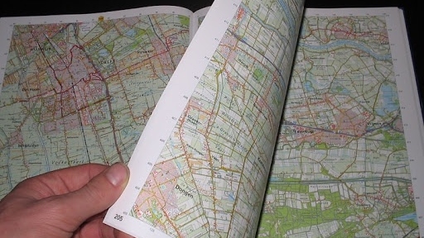

Slide 3
“My dear brothers and sisters, take note of this: Everyone should be quick to listen, slow to speak and slow to become angry, because human anger does not produce the righteousness that God desires. Therefore, get rid of all moral filth and the evil that is so prevalent and humbly accept the word planted in you, which can save you.”
James 1:19-21

Slide 4
“Everyone should be quick to listen (to God’s perspective), slow to speak (your own point of view) and slow to become angry (value God’s perspective over your own), because human anger does not produce the righteousness that God desires (getting angry will not achieve his plan for your life).” James 1:19-20

Slide 5
“Therefore, get rid of all moral filth and the evil that is so prevalent and humbly accept the word planted in you, which can save you (confess and repent and receive the Word that God has spoken).”
James 1:20-21

Slide 6
“Do not merely listen to the word, and so deceive yourselves. Do what it says. Anyone who listens to the word but does not do what it says is like someone who looks at his face in a mirror and, after looking at himself, goes away and immediately forgets what he looks like.”
James 1:22-25

Slide 7
Deception keeps you focused on a distraction so you can’t see what is really going on.

Slide 8
“For if anyone is a hearer of the word and not a doer, he is like a man who looks intently at his natural face in a mirror. For he looks at himself and goes away and at once forgets what he was like.”
James 1:23

Slide 9
What is the purpose of a mirror? - For self-examination - To see a perspective, you can’t see - To see imperfections that need to be adjusted

Slide 10
The Word of God is our mirror. Don’t just read IT, allow IT to read YOU!

Slide 11
“But if you do not forgive others their sin, your Father will not forgive your sins.”
Matthew 6:15

Slide 12
“Bring the whole tithe into the storehouse, that there may be food in my house. Test me in this, says the Lord Almighty, and see if I will not throw open the floodgates of heaven and pour out so much blessing that there will not be room enough to store it.”
Malachi 3:10

Slide 13
God is not impressed by our “AMEN” He wants our obedience (action).

Slide 14
“But whoever looks intently (internalizing its meaning) into the law (the word of God) that gives freedom (the word of God) and continues in it (in the word) not forgetting what they have heard but doing it (living a life of obedience), they will be blessed in what they do.”
James 1:25

Slide 15
What’s the next step of obedience you need to take?

