Slide 1
Learning To Pray
Matthew 6:5-13
The Sixth Habit
Of A Follower Of Jesus
Notes:
In this broken and fear producing world – you have to have this
You can try other things but won’t work

Slide 2
Without prayer you will not experience God’s lasting presence, power and peace despite all the good things you know and do.
(you will not “follow” for long)
Notes:
You can have temporary and short lived –which you will chalk up to an emotional moment
But to follow Jesus – and experience all these promises – habit of prayer
Prayer is like refueling your car – most incredible car – not going very far without

Slide 3
Prayer causes us to overflow with,
instead of,
overwork for
God’s goodness in our lives
Notes:
So not about religious – about relationship
So we have committed to 40 days of prayer

Slide 4
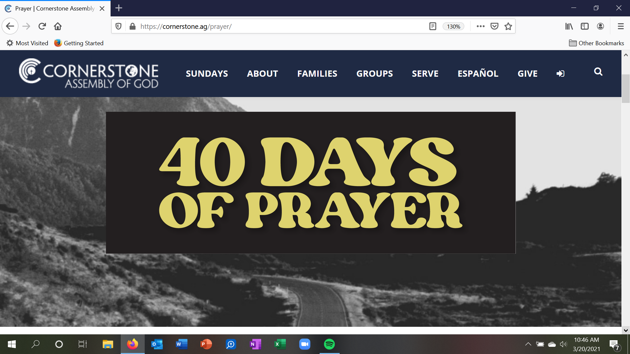
cornerstone.ag/prayer 8a, 12p, 7p
Notes:
Morning, noon and night
LAST WEEK
Not uncommon to struggle or be confused – Jesus teaches us

Slide 5
“And when you pray, do not be like the hypocrites, for they love to pray standing in the synagogues and on the street corners to be seen by men. I tell you the truth, they have received their reward in full.
Matthew 6:5
Don’t Make Prayer All About Yourself
Notes:
Yes – you are in it – but it starts and ends with God / not you
Show you how in a moment

Slide 6
But when you pray, go into your room, close the door and pray to your Father, who is unseen. Then your Father, who sees what is done in secret, will reward you.
Matthew 6:6
Focus on being with
your Heavenly Father
Notes:
You are not doing something for God to like
You are being with the God who loves you –
That’s why jesus says this – focus on the unseen
Slow down – got to slow down to spend time with someone

Slide 7
And when you pray, do not keep on babbling like pagans, for they think they will be heard because of their many words. Do not be like them, for your Father knows what you need before you ask him.
Matthew 6:7-8
Listen as much as you talk
Notes:
Ever with that person who talks and never listens – yes you have (you)
THEN GIVES US PRAY _THIS IS HOW YOU SHOULD PRAY
Read it with me

Slide 8
Our Father in heaven, hallowed be your name, your kingdom come, your will be done on earth as it is in heaven. Give us today our daily bread. Forgive us our debts, as we also have forgiven our debtors. And lead us not into temptation, but deliver us from the evil one. for yours is the kingdom and the power and the glory forever. Amen.
Notes:
This is actually a pattern you can use with God’s word
Notice handout

Slide 9
Prayer is being with God, Your Heavenly Father, by talking and listening, and, giving and receiving.
Learn To Pray | Mt 6:9-13
Notes:
Use any scripture and have a conversation with God that turns into a spiritual dynamic
What happened first dating – giving and receiving in your conversations, your time, your heart
RED – STOP AND FOCUS ON GOD YELLOW _ slowly go through your heart
GREEN – get ready to go and be used by God

Slide 10
The praise
He deserves
The spirit
We need
Notes:
No matter what he is doing
he is god
– he is your heavenly father – he loves you

Slide 11
The praise
He deserves
The spirit
We need
Our
Obedience
His
Peace
Notes:
Obedience always leads to peace – I will do as your word says
LISTENING TO HIS WORD

Slide 12
The praise
He deserves
The spirit
We need
Our
Obedience
His
Peace
Credit in
Midst of
hardship
Stronger
Faith &
perspective
Notes:
You are not cursed – he is working all things for good – give him credit
Let go of your attitude and receive stronger faith and perspective
Listening for what is good

Slide 13
Our
burdens
his
answers
Notes:
IN HIS TIMING
LISTNEING FOR HIS ANSWERS

Slide 14
Our
burdens
his
answers
Our
chaos
his
order
Notes:
That’s what sin is
That’s what’s messing up your relationships
That’s what’s giving you anxiety

Slide 15
Our
burdens
his
answers
Our
chaos
his
order
Our
surrender
his
future
Notes:
LISTEN AND OBEY

Slide 16
his
Fulfill-
ment
Our
day
Notes:
COME TO HEAL
FOLLOW TO BE TRANSFORMED
FISH – TO be fulfilled
One more truth – but first . . .

Slide 17
Questions about prayer
804-802-2717
Notes:
Matthew 7:7-8 / going to have keep praying and let things grow and develop
“Ask and it will be given to you; seek and you will find; knock and the door will be opened to you. For everyone who asks receives; he who seeks finds; and to him who knocks, the door will be opened.

Slide 18
“Be strong and courageous, because you will lead these people to inherit the land I swore to their forefathers to give them.
Joshua 1:6

Slide 19
Be strong and very courageous. Be careful to obey all the law my servant Moses gave you; do not turn from it to the right or to the left, that you may be successful wherever you go.
Joshua 1:7

Slide 20
Do not let this Book of the Law depart from your mouth; meditate on it day and night, so that you may be careful to do everything written in it. Then you will be prosperous and successful.
Joshua 1:8

Slide 21
Have I not commanded you? Be strong and courageous. Do not be terrified; do not be discouraged, for the LORD your God will be with you wherever you go.”
Joshua 1:9

Slide 22
Whose your one?
Easter, Sunday, April 4
8:45am Sanctuary & Online
10am Sanctuary & Online
11:15am Under The Tent

