Slide 1
Learning To Listen
Matthew 4:1-11 & 7:24-27
The Second Habit
Of A Follower Of Jesus

Slide 2
“everyone who hears these words of mine and puts them into practice is like a wise man who built his house on the rock. The rain came down, the streams rose, and the winds blew and beat against that house; yet it did not fall, because it had its foundation on the rock.
Matthew 7:24-25

Slide 3
But everyone who hears these words of mine and does not put them into practice is like a foolish man who built his house on sand. The rain came down, the streams rose, and the winds blew and beat against that house, and it fell with a great crash.”
Matthew 7:24-25

Slide 4
Your foundation
determines your finish.

Slide 5
You can finish well if you
will stop “hearing” Jesus
and start “listening” to Jesus

Slide 6
My sheep listen to my voice; I know them, and they follow me.
John 10:27

Slide 7
Jesus answered, “It is written: ‘Man does not live on bread alone, but on every word that comes from the mouth of God.’” Matthew 4:4
YOU NEED TO KNOW GOD’S WORD

Slide 9
As Jesus was saying these things, a woman called out, ‘Blessed is the mother who gave you birth.’ Jesus replied, ‘Blessed rather are those who hear the word of God and obey it.’ Luke 11:27-28
YOU NEED TO LIVE IT OUT EACH DAY

Slide 10
“God, I will, but first, I have to . . .”

Slide 11
“God, I will, but first, I have to . . .”
“God, I can’t because that person is . . .”

Slide 12
“I will, but first, I have to . . .”
“I can’t because that person is . . .”
“It doesn’t matter when I . . .”

Slide 13
Lord,
today I will do
Your will,
Your way, and
in Your timing

Slide 14
Jesus turned and said to Peter, “Get behind me, Satan! You are a stumbling block to me; you do not have in mind the things of God, but the things of men.” Matthew 6:23
YOU NEED THE RIGHT FEEDBACK

Slide 15
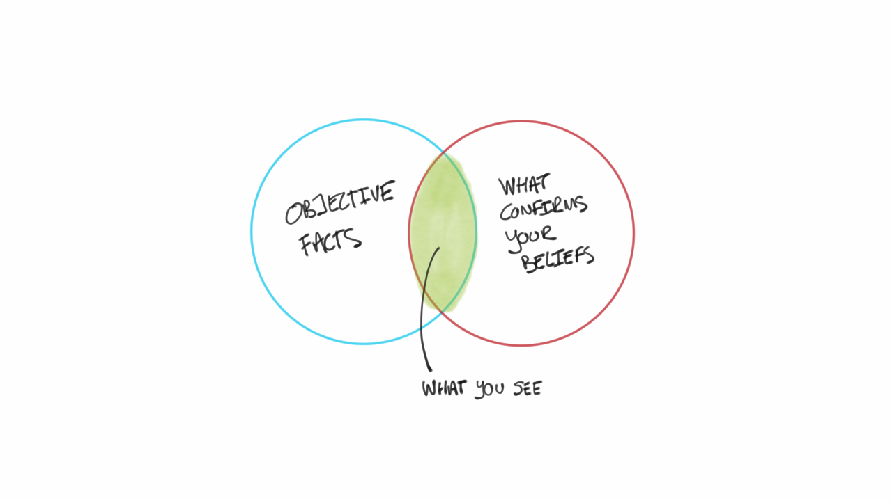
Confirmation bias is the tendency to search for, interpret, favor, and recall information in a way that confirms or supports what you already believe or value.

Slide 16
Mirror
Counselor
Spouse
Children
Coach
Magnet
How
To
Live
Out
God’s
Word
Accurately

Slide 17
This week’s question:
What will I do differently today?
(because of God’s Word to me)

Slide 18
This week’s action:
#AskForFeedback

Slide 19
Dear Heavenly Father, I want to become a follower of Jesus. I receive Jesus into my life. I believe He came to pay the price for my sin on the Cross. Please forgive me for living life my own way. I turn away from that life and I turn to follow Jesus from this day forward with Your help. Amen.

