Slide 2
The rejection of God
2-3 The wrath of God
3-7 The response of grace
The result of grace
9-11 The refusal of grace
12-16 The responsibilities of grace

Slide 3
Romans 12:1 (NASB2020)
Therefore I urge you, brothers and sisters, by the mercies of God, to present your bodies a living and holy sacrifice, acceptable to God, which is your spiritual service of worship.

Slide 4
Romans 12:2 (NASB2020)
And do not be conformed to this world, but be transformed by the renewing of your mind, so that you may prove what the will of God is, that which is good and acceptable and perfect.

Slide 5
Romans 12:3 (NASB2020)
For through the grace given to me I say to everyone among you: Do not think of yourself more highly than you ought, but rather think of yourself with sound judgment, in accordance with the measure of faith God has given you.

Slide 6
WHO CAN TELL ME . . .
1. Who I am?
What my purpose is?
How will I get there?

Slide 7
Romans 1:21 (NLT)
Although they knew God, they wouldn’t worship him as God or even give him thanks. And they began to think up foolish ideas of what God was like.

Slide 8
Romans 1:21 (NLT)
As a result, their minds became dark and confused. Claiming to be wise, they instead became utter fools.

Slide 9
Romans 1:21 (NLT)
And instead of worshiping the glorious Creator, they worshiped idols made to look like what God created. So God abandoned them to do whatever shameful things their hearts desired . . .

Slide 10
Jeremiah 1:5 (NLT)
“I knew you before I formed you in your mother’s womb. Before you were born I set you apart and chose your purpose.”

Slide 11
Jeremiah 29:11 (NIV)
“For I know the plans I have for you,” declares the LORD, “plans to prosper you and not to harm you, plans to give you hope and a future.”

Slide 12
WHO CAN TELL ME . . .
1. Who I am?
What my purpose is?
How will I get there?

Slide 13
Romans 8:28-29 (NLT)
And we know that God causes everything to work together for the good of those who love God and are called according to his purpose for them. For those God foreknew, he chose them to become like his Son . . .

Slide 14
Maturity
When you give
more than you take.

Slide 15
What do I do with . . .the stuff I have?
What do I do with the stuff God has given me?
What does God want me to do with the stuff He has given me?
What does God want me to give from the stuff He has given me?
What does God want me to keep from the stuff He’s given me?

Slide 16
Who do I want to be?
How can God help me be who I want to be?
How can I understand who God made me to be?
What can I do to help serve who God wants others to be?
How can I give my life so others will worship Him?

Slide 17
WHO CAN TELL ME . . .
1. Who I am?
What my purpose is?
How will I get there?

Slide 18
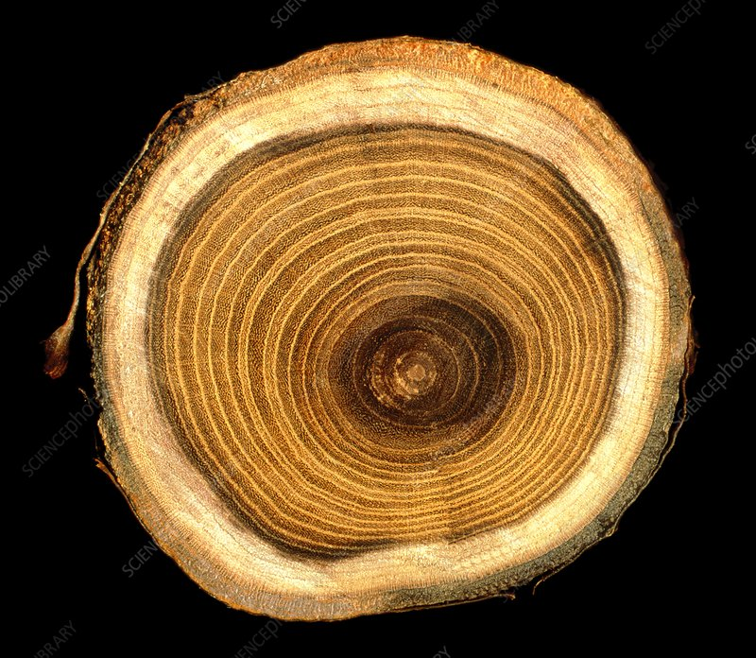

Slide 19
Romans 8:39-40 (ESV)
No, in all these things we are more than conquerors through him who loved us. For I am sure that neither death nor life, nor angels nor rulers . . .

Slide 20
Romans 8:40 (ESV)
nor things present nor things to come, nor powers, nor height nor depth, nor anything else in all creation, will be able to separate us from the love of God in Christ Jesus our Lord.

