Slide 1
Notes:
Looking at this week – seems like the nation is so divided it doesn’t know how to move forward.
Based on today’s scripture -you could say America has a pretty lukewarm on its future. – it doesn’t know how to choose hot or cold –
My biggest concern is not what political things will happen
My greatest concern is been the fear that is overwhelmed our nation and many of our hearts
People are in such fear about the who is elected, that other party, those people, their values, what thye will do,
(while people should have concerns -they should not live in a spirit of fear)

Slide 2
“For God did not give us a spirit of fear, but a spirit of power, of love and self-control.”
- 2 Timothy 1:7 (NIVr)
Notes:
Over the years – my greatest concern for people I care about is not suffering with pain – its people overwhelmed and suffering with fear
People can get through pain -with faith, hope and love

Slide 3
Fear is the opposite of
faith, hope and love.
It leads to a life of
darkness and torture
Notes:
But fear is the opposite of faith, it’s the opposite of love, it’s the opposite of fear.
Fear is the absence of the three the way darkness is the absence of light.
Fear sentences you to a dark, tortured life
And if there is anything Jesus is supposed rescues us -its from fear.
And yet – I see so many Christians just as fearful as the world right now.
Well today we finish our series on the seven churches of revelation.
And this last church has the worst rebuke from Jesus
and is the church that will be the most overwhelmed by fear
Because it has believed the three basic lies of Satan.
These three lies will cause you to live in fear and be torutrued and manipulated by it all of your life

Slide 4
Fear is a sign that you believe a lie
[trust, depend on, identify with]
Notes:
Wherever you believe a lie, you are a slave to fear.
{anywhere: in your marriage, your dating life, your career]
Jesus sets us free, satan enslaves us with lies

Slide 5
2
6
2
The
Deceived
Church
6
Notes:
Very rich city, center of banking – 45 miles away from Phila / earthquake in 62ad. They rebuilt the city with no help from Rome!
2. Very resourceful – built in a place where water had to be pumped in about 5 miles away – interesting fact – the water – warm
3. Very educated – particularly in medicine – known for its eye salve
4. Very cultured – exported a famous black wool – in black was new black
5. Very close to a city you know well – 10 miles Colosse (Colossians 4:10?)

Slide 6
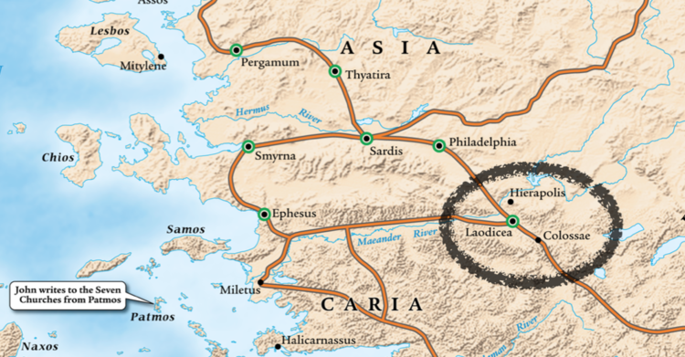
Notes:
Colossians 4:16 Paul writes
“After this letter has been read to you, see that it is also read in the church of the Laodiceans and that you in turn read the letter from Laodicea.”
This is important as we will find out because they weren’t just close geographically –they were also close in a lie they both believed.

Slide 7
“And to the angel of the church of the Laodiceans write, ‘These things says the Amen, the Faithful and True Witness, the Beginning of the creation of God: “I know your works, that you are neither cold nor hot. I could wish you were cold or hot.
- Revelations 3:14-16(NKJV)

Slide 8
“I could wish you were cold or hot. So then, because you are lukewarm, and neither cold nor hot, I will vomit you out of My mouth. Because you say, ‘I am rich, have become wealthy, and have need of nothing’—and do not know that you are wretched, miserable, poor, blind, and naked—”
- Revelations 3:16b-17 (NKJV)

Slide 9
“I counsel you to buy from Me gold refined in the fire, that you may be rich; and white garments, that you may be clothed, that the shame of your nakedness may not be revealed; and anoint your eyes with eye salve, that you may see.”
- Revelations 3:18 (NKJV)

Slide 10
“As many as I love, I rebuke and discipline. Therefore be zealous and repent. Behold, I stand at the door and knock. If anyone hears My voice and opens the door, I will come in to him and dine with him, and he with Me.”
- Revelations 3:19-20 (NKJV)

Slide 11
“To him [or her] who overcomes I will grant to sit with Me on My throne, as I also overcame and sat down with My Father on His throne. ‘He who has an ear, let him hear what the Spirit says to the churches.’”
- Revelations 3:21-22 (NKJV)

Slide 12
The three lies they believed
(and how it leads to a life of fear)
1 A “small” lie about who Jesus was
2. A “big” lie about who they were
3. A tragic lie about how to overcome

Slide 13
A “SMALL” LIE
“Jesus should be an
important part of your life”

Slide 14
“For by him all things were created, in heaven and on earth, visible and invisible, whether thrones or dominions or rulers or authorities—all things were created through him and for him. And Jesus is before all things, and in him all things hold together.
- Colossians 1:15-17 (NIV)

Slide 15
TRUTH #1
JESUS IS YOUR ENTIRE LIFE.
“To him who overcomes I will grant to sit with Me on My throne, as I also overcame and sat down with My Father on His throne.” (v21)
Notes:
He didn’t just create everything – he has defeated every enemy.
If he isn’t everything – then everything isn’t defeated in your life
If you live like he isn’t before all things
Than something that is front of him will fail you.
And you have a reason to fear

Slide 16
THE “BIG” LIE
“I should follow my heart
and believe in myself”
“you say, ‘I am rich, have become wealthy, and have need of nothing’—and do not know that you are wretched, miserable, poor, blind, and naked” (v17)
Notes:
The reason Jesus is on the outside – is because they are so full of themselves there is no room for him inside the church or their lives.

Slide 17
I am the light of the world . . . The man who walks in the dark does not know where he is going. . . I have come into the world as a light, so that no one who believes in me should stay in darkness.
- John 8:12, 12:35,46 (NIV)

Slide 18
TRUTH #2
TRUST THE ONE WHO MADE YOUR HEART
I counsel you to buy from me gold refined by fire, so that you may be rich, and white garments so that you may clothe yourself and the shame of your nakedness may not be seen, and salve to anoint your eyes, so that you may see.” (V18)

Slide 19
A TRAGIC LIE
“God will help me choose
the right side to be on”
I know your works, that you are neither cold nor hot. I could wish you were cold or hot. So then, because you are lukewarm, and neither cold nor hot, I will vomit you out of My mouth.(v15-16)

Slide 20
TRUTH #3
GIVE YOURSELF TO JESUS
AND NOT ANY SIDE
To him who overcomes I will grant to sit with Me on My throne, as I also overcame and sat down with My Father on His throne. (V21)

Slide 21
But you are a chosen race, a royal priesthood, a holy nation, a people for his own possession, that you may proclaim the excellencies of him who called you out of darkness into his marvelous light
- 1 Peter 2:9 (NIV)

Slide 22
“Those whom I love I rebuke and discipline. So be earnest, and repent.” (v19)
• Jesus should be an important part of my life
• I should follow my heart and believe in myself
• God will help me choose a side
Notes:
Love One Another –Open Door infront of you
NOTHING WILL OVERWHELM YOU
This week – the most eternally important decision
The choice you make that effects your future the most
Is not who holds a government office –its who holds your heart
Forgive as you have been forgiven.
Don’t live for another name or lable
Endure and be patient as Jesus is enduring and patient with you.
COMMUNION – HE overcame for us
In a moment – take that together

Slide 23
Play pentatonix
Amazing grace video here

