Slide 1
MISSION:
FOLLOWING JESUS TOGETHER

Slide 2
VISION:
We see a church filled with mobilized members who love helping others follow Jesus together.

Slide 3
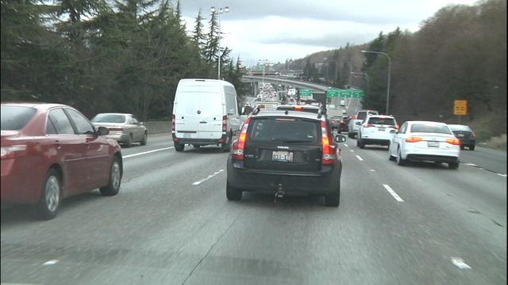
This Photo by Unknown Author is licensed under CC BY-NC-ND

Slide 4
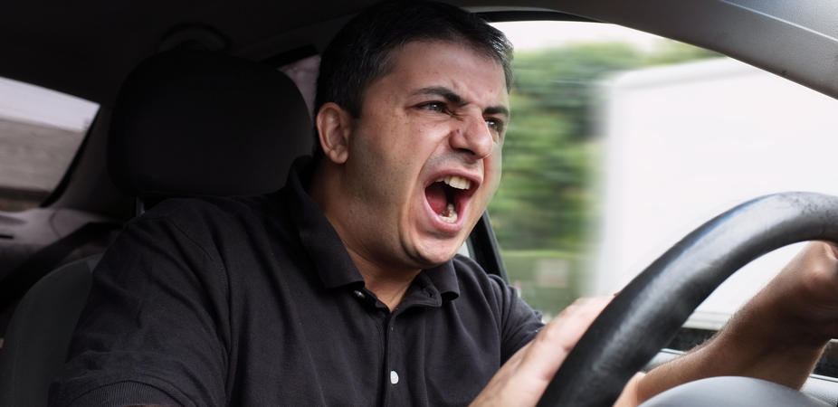
This Photo by Unknown Author is licensed under CC BY-ND

Slide 5
Following Jesus Together

Slide 6
Following Jesus Together
In Unity

Slide 7
One day as Jesus was walking along the shore of the Sea of Galilee, he saw two brothers—Simon, also called Peter, and Andrew—throwing a net into the water, for they fished for a living. ¹⁹ Jesus called out to them, “Come, follow me, and I will show you how to fish for people!” ²⁰ And they left their nets at once and followed him.
- Matthew 4:18-20

Slide 8
²¹ A little farther up the shore he saw two other brothers, James and John, sitting in a boat with their father, Zebedee, repairing their nets. And he called them to come, too. ²² They immediately followed him, leaving the boat and their father behind.
- Matthew 4:21-22

Slide 9
Jesus called out to them, “Come, follow me.”

Slide 10
When they dropped their nets, they left:
Their livelihoods
The day’s catch
What was comfortable and familiar
Source of security

Slide 11
“If anyone wants to follow after me, let him deny himself, take up his cross, and follow me.”
- Mark 8:34

Slide 12
This Photo by Unknown Author is licensed under CC BY

Slide 13
WE CAN’T TAKE UP OUR CROSS WHILE HOLDING ON TO OUR NETS!

Slide 14
NET = THE OLD

Slide 15
LOSE = GAIN
EXIT = ENTRANCE

Slide 16
Drop “the old”
Drop “the good”
Drop “it’s working”
Drop “the comfortable and familiar”
Drop “the religious”
Drop “what is safe”………To Follow Him!

Slide 17
How do you know what to drop?
You follow Jesus together in what He says is important.

Slide 18
DEPENDING ON GOD’S WORD
The Bible is the foundation for how we choose to live, the truth God has given us.
The Bible is the truth (without error) that God has lovingly given all people.
We trust it over our feelings, the world’s opinion, and the latest fads/trends.
It is the foundation for our understanding of our relationship to God, ourselves, and every part of life.

Slide 19
Experiencing God’s Presence
God’s presence is the purpose, power and the answer for us and the entire world.
We live in His presence by the gift of the Holy Spirit Jesus gives us.
It is not enough to learn about God. Each person is called to experience God for themselves.

Slide 20
Living Jesus-Centered
We are not self-centered but Jesus centered. We live for Him. Our lives our not our own.
This means we put Him first in our daily lives and in all we have and do.

Slide 21
Rediscovering God’s Family
God’s church is more than a service, organization, or group. Through Jesus we are one family with beautiful diversity.
Being family is the key way God heals, grows and prepares each believer for their future.
Together, we can rediscover God’s ways of being a loving family that cares for each other.

Slide 22
Focusing Outward
God longs for us to serve and share His love, answers, and salvation with others.
God’s heart is to care for those who do not know Him and invite them into His family.
We can’t know the heart and mission of Jesus without loving those around us.

Slide 23
Taking Next Steps
Jesus calls us to walk by faith and continue to grow.
Each of us must own the responsibility to seek Jesus for our next steps and give our best to them.
Part of the grace of Jesus is recognizing that we have to grow more and more into His healing, purpose and image.

Slide 24
Empowering Disciples
Our church family exists to help every member fulfill God’s purpose and potential.
God’s Gospel and Kingdom grows through each members’ everyday relationships and visions to serve others.
The church is the people, not the staff. The staff equips disciples to do the work of ministry.

Slide 25
TAKING TIME TO CELEBRATE
Partnering with God is more than just doing. It’s about being intentional to stop and celebrate God’s goodness
We realize that it’s only through Him all things are made possible.

Slide 26
Our Values
Depending on God’s Word
Experiencing God’s Presence
Living Jesus-Centered
Rediscovering God’s Family
Focusing Outward
Taking Next Steps
Empowering Disciples
Taking Time to Celebrate

Slide 27
1. New Routine: Sunday Morning
2. New Priority: Your Small Group
3. A New Attitude: “All Week Family”

Slide 28
Jesus says, “Follow me”
I am doing a new thing!
Are you willing to let go of the old?
Are you willing to follow Me to the new?

