Slide 1
God makes you different To Make A Difference The first five major stories of Moses
Notes:
Who has made the biggest difference in your life? (top 5)
All shared the same two characteristics:
Something in common / (2) Very different than you
Me: Sara / Elders / Wayne
World: different like me or think like me
But then we have the same wars with different perpatrators
Real difference is by someone God makes differently

Slide 2
MONDAY: BIRTH OF MOSES Exodus 1-2
Notes:
Charleton Heston / Mariah Carey & Whitney Houston – when you believe
Jewish baby sent to the nile and picked up by Pharoah’s daughter
Grows up in pharaoh’s court / he doesn’t fit anywhere – sees his people

Slide 3
After Moses had grown up, he went out to his own people . . . He saw an Egyptian beating a Hebrew . . . he killed the Egyptian (Exodus 2:11-12)

Slide 4
“Who made you ruler and judge over us? Are you thinking of killing me . . . When Pharaoh heard of this, he tried to kill Moses, but Moses fled to Midian (v14-15)
Notes:
And then runs to midian where he becomes a shepherd
Marries a black woman named Zipporah / 40 years just gets by
So jewish / Egyptian / midianite
Here is what is different / changes the world but how?

Slide 5
Moses’ difference is what God uses to make an eternal difference
Notes:
The way you feel different is what God is doing!!!
World: Be different as long as you think just like me
Hate culture
World thinks change comes from people who fit in – NOPE
So this idea of – you aren’t my color, so you can’t help solve
WRONG – that’s who God always uses
Dr King – white washed, uncle tom, other
Whites – liberal, brain washed, traitor to uncle sam
Made different to make a true difference

Slide 6
TUESDAY: THE BURNING BUSH Exodus 3-4
Notes:
After failing to cause change, being rejected, years of wandering and confusion
THEN GOD SHOWS UP

Slide 7
I have seen the way the Egyptians are oppressing them. . .I am sending you to Pharaoh to bring my people the Israelites out of Egypt.” (3:9-10)

Slide 8
God didn’t use Moses until he had three ingredients: pain, power, & feeling purposeless
Notes:
Not what the world says:
Failure and fed up are a part of greatness
Ministry, marriage, parenting, community, workplace
Once moses sees he can’t do it
THAT PEOPLE CAN’t DO IT
Then he says – I’m ready to use you
Place of wandering and feeling insignificant
DESERT PLACE OF TRANSFORMATION
Divorce, organizational change,

Slide 9
WEDNESDAY: THE TEN PLAGUES Exodus 6:28-11:10
Notes:
Different: what I escaped I’m supposed to confront
AFTER BURNING BUSH – NOT BEFORE

Slide 10
Then the LORD said to Moses, “Go to Pharaoh and say to him, ‘This is what the LORD says: Let my people go, so that they may worship me. (Exodus 8:1)
Notes:
CALLED TO GO BACK TO FREE OTHERS
Focus/Goal isn’t defeat of pharaoh, its worship of God
OPPOSITE

Slide 11
God calls Moses to confront the very place he had failed and escaped from
Notes:
After the burning bush
Your greatest purpose is often where you had the greatest pain

Slide 12
THURSDAY: THE PASSOVER Exodus 12:1-42
Notes:
Different in today - look

Slide 13
The LORD said to Moses . . . “Tell the whole community of Israel that . . . each man is to take a lamb for his family, one for each household. (12:1-3)
Notes:
Man forgets he is in God’s image
Man pursues the physical first
Man rejects his partnership with God (spiritual)
God’s response – story we are in right now

Slide 14
The blood [of the lamb] will be a sign for you . . . when I see the blood, I will pass over you. No destructive plague will touch you when I strike Egypt. (12:13)
Notes:
You need forgiveness – you deserve death / condemnation
Until you settle that with God
Your justice will only create more injustice

Slide 15
God required Moses to lead those who were wronged in recognizing their own need for forgiveness
Notes:
No real change or justice without it

Slide 16
FRIDAY: CROSSING THE RED SEA Exodus 13:17 - 14:31

Slide 17
Moses stretched out his hand . . . The Egyptians were fleeing toward it, and the LORD swept them into the sea. (14:27)
Notes:
God is the hero
Not republicans, democrats, old, young, black or white
DIFFERENT

Slide 18
Moses gives his entire life so God can be known as the real hero and deliverer!
Notes:
Didn’t fit in
Finished trying his way
Confronted what he ran from
Needed justice but needed forgiveness
God is the only hero (what if no one knows but God)
THIS WAS MOSES – THIS IS JESUS – AND US

Slide 19
Your attitude should be the same as that of Christ Jesus: Who, being in very nature God, did not consider equality with God something to be grasped :(Phil 2:5-6)
Notes:
Took his success – used it to serve

Slide 20
but made himself nothing, taking the very nature of a servant, being made in human likeness. And being found in the appearance as a man humbled himself… (Phil. 2:7-8 )
Notes:
Embraced instead of escaped from man’s failure and pain
If you escape your spouses pain – instead of embrace the healing for it – marriage will never get better

Slide 21
and became obedient to death - even death on a cross! Therefore God exalted Him to the highest place . . . (Phil. 2:9)
Notes:
Went throught the confusion and wandering of the Cross
AND CHANGED EVERYTHING FOR ETERNITY

Slide 22
God will truly change things when I am willing to be truly changed.

Slide 23
Your failure or pain Will you surrender it to God and believe it can be part of your purpose?
Notes:
God uses pain for greatest purpose
DIFFERENT – PAIN ?FAILURE IS CONDEMNATION
NOT IN GOD

Slide 24
Your success or power Have you surrendered it to God and will you use it to serve others?
Notes:
Different –success is for me
Success is so I can escape
I sacrificed for success so I don’t have to deal with things
They should work hard like me
God is opposite – your sacrifice/success is for others

Slide 25
Your wandering & confusion Will you surrender your need for answers and meet with the real God in a holy way?
Notes:
God uses your place of wandering to become a wonder
DIFFERENT = have to know everything now
NOT SPIRITUAL TO HAVE DOUBTS, QUESTIONS, LAMENTS

Slide 26
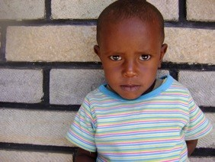
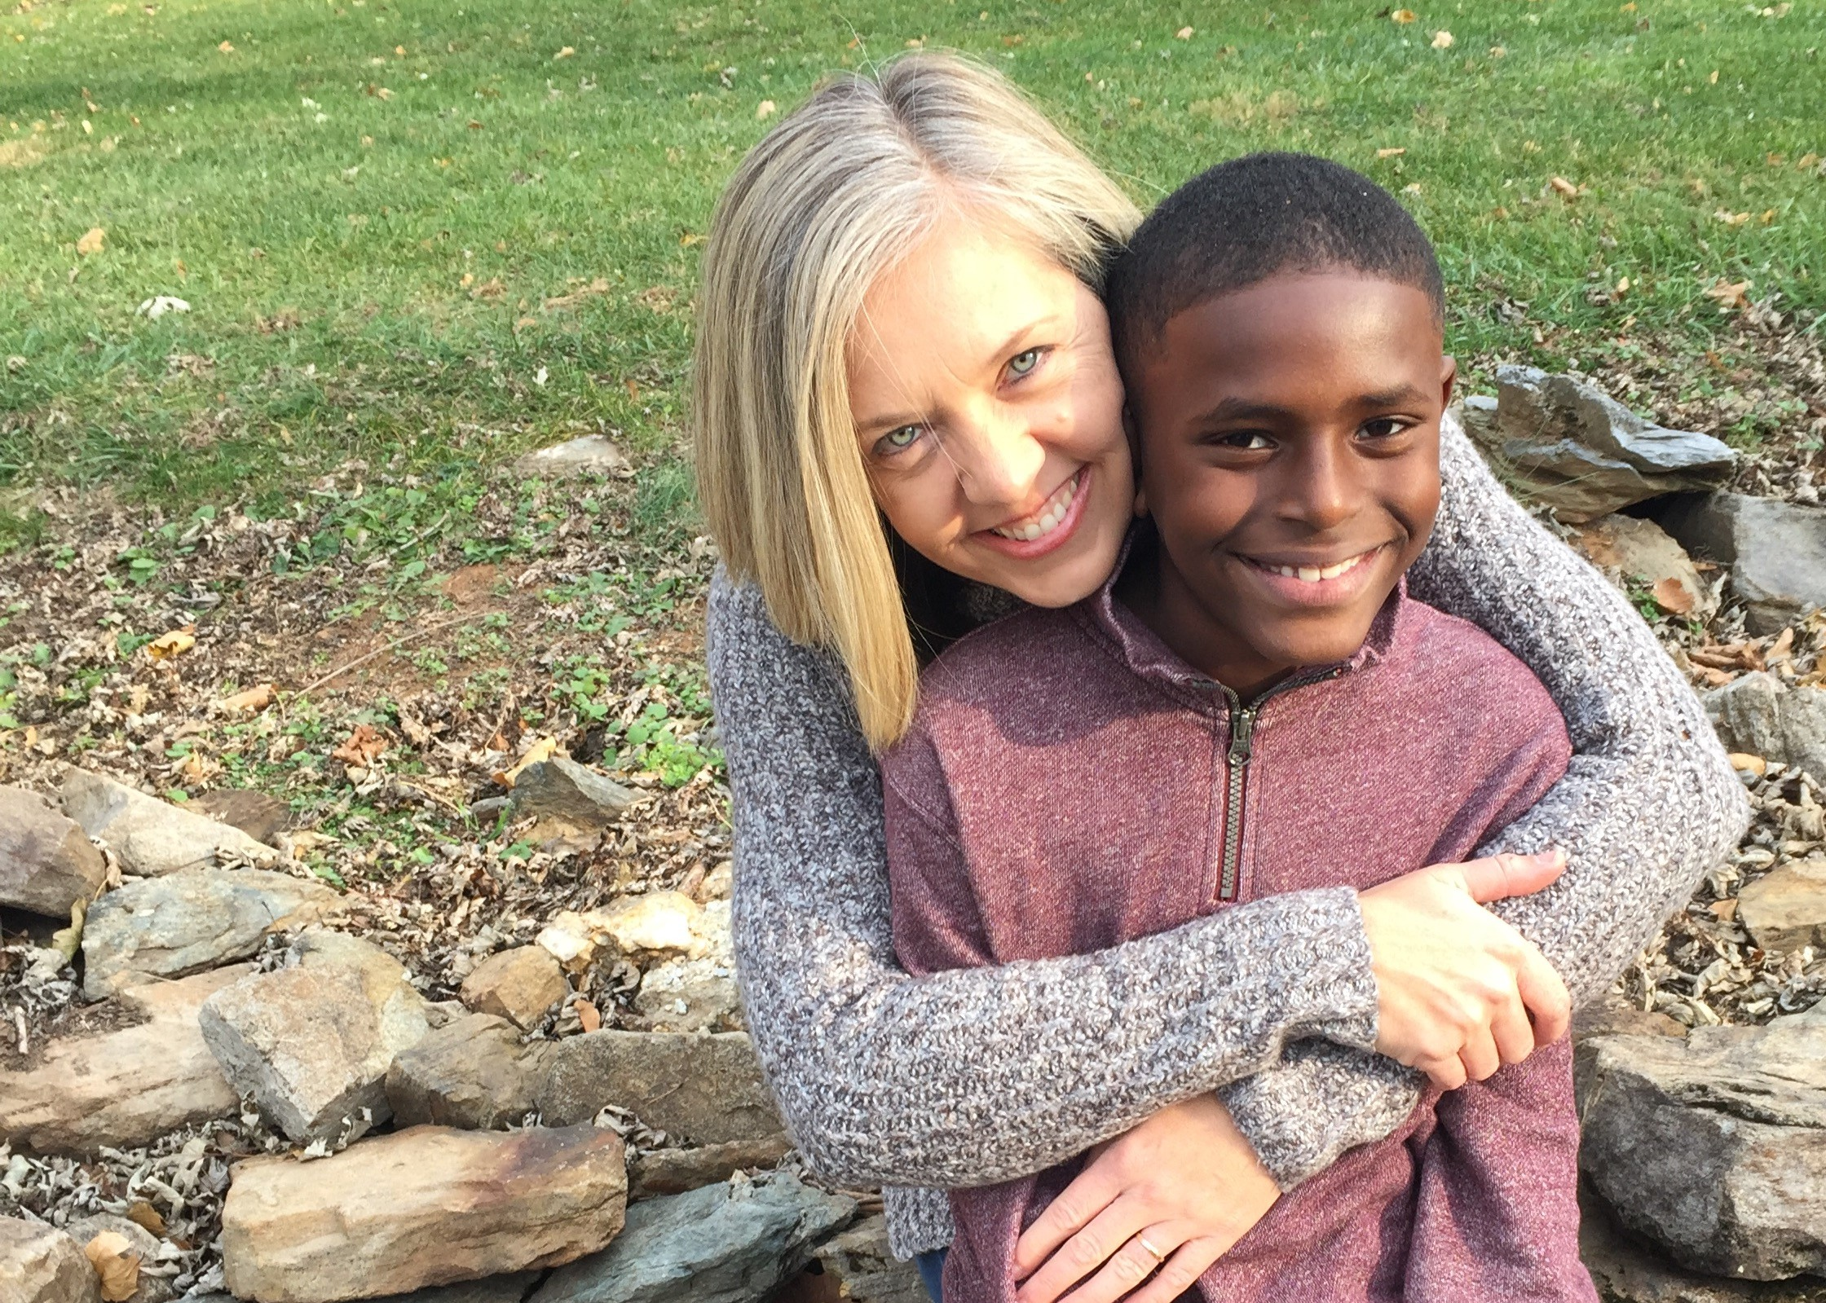
Notes:
Sign and a wonder / make people wonder
Feel the resistance to different
Maybe single parent, mixed, old, young

