Slide 1
Notes:
When you are alone, you are not alone.
When you are going to decide for yourself, you are not deciding by yourself
Right now – you are not thinking, feeling, by yourself

Slide 2
Put on the full armor of God so that you can take your stand against the devil’s schemes. For our struggle is not against flesh and blood, but against the rulers, against the authorities, against the powers of this dark world and against the spiritual forces of evil in the heavenly realms
- Ephesians 6:11-12
Notes:
PRAY FOR JESUS TO:
Cause our minds to see clearly
Cause our body’s to be restless
Cause our spirits to not be distracted, controlled

Slide 3
WEEK 3: SPIRITUAL RELATIONSHIPS
You were made for, and are always in, spiritual relationship which is powerfully influencing you.
Notes:
You were made to know God who is Spirit
SOMETHING IS WHISPERING TO YOUR SOUL
Either Whispering, demanding or absolutely controlling
SOMETHING IS GUIDING YOUR ADDICTION OR YOUR FREEDOM

Slide 4
Matthew 12:22-37 (NLT)
On earth, you choose between two types of spiritual relationship:
Jesus through the Holy Spirit, or
Satan through demons
Notes:
We were built for spiritual relationship – to relate to God
If not him – another spiritual relationship will take the place
Practically its not demons or angels – its demons or holy spirit
DEMONS ARE REAL AND REALLY DEFEATED
Jesus meets a man – so bound in relationship with a demon / he is possessed – owns the house
Here Jesus sets him free and talks about relationship with the Hily Spirit
Kingdom of Satan offers one way / Kingdom of God offers another

Slide 5
TRUTH #1 [v29, 43-44]
Jesus (and the Bible) teach that you are like a spiritual house that has to choose who to host
Notes:
Someone is coming to visit

Slide 6
when He, the Spirit of truth, comes, He will guide you into all truth. . . If anyone loves Me, he will obey my teaching. My Father will love him, and We will come to him and make our home with him.
- John 16:7,13
Notes:
Talk about when accept Christ – the holy spirit comes
So that the Father and son –can make their home in us

Slide 7
When an evil spirit leaves a person, it goes into the desert . . . it says, ‘I will return to the person I came from.’ So it returns and finds its former home empty, swept, and in order.
- Matthew 12:43-44
Notes:
But it can also be a place for other spiritual beings

Slide 8
Notes:
This is the picture of your relationship and power
Talked about last week (you decide who and how much you let in)

Slide 9
TRUTH #2 [v22,45]
Demons want access into our lives to get us to participate in [agree with] Satan’s plan to kill, steal and destroy.
Notes:
This man has a tragic relationship with a demon
His relationship is one of possession (house terminology)
In V45 – Satan’s goal is always to own your spiritual house

Slide 10
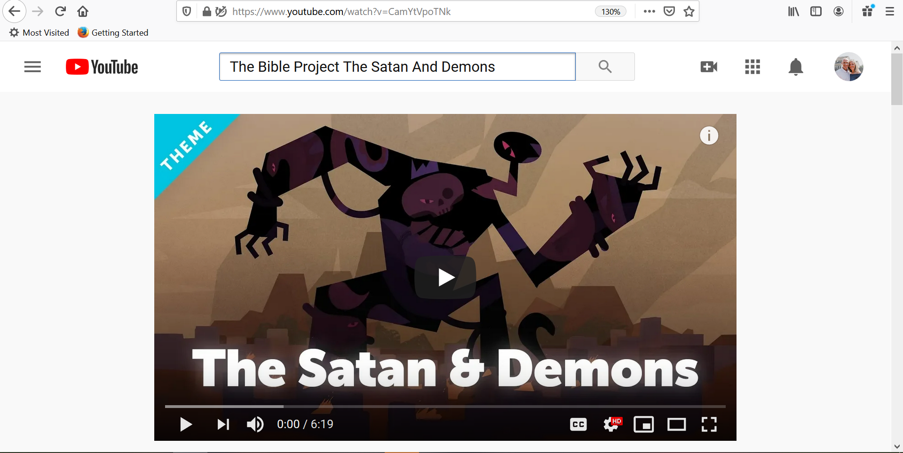
Notes:
They are not omniscient (key for intercession)
They cannot create (only twist)
Person without a body (need you to complete)

Slide 11
for Satan himself masquerades as an angel of light. It is not surprising, then, if his servants masquerade as servants of righteousness [offering solutions that seem right]
- 2 Corinthians 11:14-15
Notes:
Deceive with what appears to be the right solution to your problem or desire for pleasure

Slide 12
Foothold = leaving the door open
When we use sin to solve our problems we give demons permission to come in and speak confusion, fear and pride into our lives.
Notes:
I lied – got away with it, avoided the consequences
Now the door is open –
Someone actively speaking confusion, anxiety, pride, selfishness

Slide 13
Stronghold = living in the guest room
When we repeatedly trust sin to succeed in an area of life, we give demons a chance to consistently blind us and manipulate our everyday decisions.
Notes:
Runs the show in area of your life – still want/love jesus
Jesus still is the one you’ve made covenant commitment to
Can’t go in that room (area of your life) without dealing with them
Someone demanding BITTERNESS / ADDICTION
Someone blinding you to hope and what is right

Slide 14
Covenant = own your house
When we decide that sin is our identity we give control of what we see, feel and think (soul) to the enemy.
Notes:
Give yourself to sin as your identity
You believe you are worthless, deep self condemnation, blinding pride
Your soul is reprogramed – what you hope in will not last
Can lead to SUICIDE

Slide 15
TRUTH #3 [v23,28-29]
In Jesus we can be free from, and greater than, demonic influence because the Holy Spirit lives in us.
Notes:
Jesus purifies us from sin through His forgiveness and payment of sin

Slide 16
Therefore, if anyone is in Christ, he is a new creation; the old has gone, the new has come . . . Do you not know that your body is a temple [home] of the Holy Spirit, who is in you, whom you have received from God?
- 2 Corinthians 5:17, 6:16
Notes:
The picture of a follower of Christ

Slide 17
if I drive out demons by the Spirit of God, then the Kingdom of God has arrived among you. For who is powerful enough to enter the house of a strong man and plunder his goods? Only someone even stronger—someone who could tie him up and then take his possessions.
- Matthew 12:28–29
Notes:
The creator is stronger than the created

Slide 18
Notes:
We don’t center, fear, over-react
We are aware and understand our victory over them
SHUT THE DOOR /INVITE THE HOLY SPIRIT IN

Slide 19
TRUTH #4 [v30-31, 44-45]
There is no such thing as being spiritually neutral or empty. There is no such thing as being in control of sin.
Notes:
You are in relationship that is growing in some way
As a spouse, as a witness, as a family member
Student – future / senior –leaving a legacy

Slide 20
Anyone who isn’t with me opposes me, and anyone who isn’t working with me is actually working against me.
- Matthew 12:30
Notes:
TO CLEANSE YOURSELF OF WRONG SPIRITUAL RELATIONSHIP
(SAME THREE STEPS I SHARE EACH WEEK)
Crucify the flesh – remove sin & repent of selfishness
Submit to God’s word – renounce satan & his lies
Be filled with the Holy Spirit (here is why)

Slide 21
So it returns and finds its former home empty, swept, and in order. Then the spirit finds seven other spirits more evil than itself, and they all enter the person and live there. And so that person is worse off than before.
-Matthew 12:44-45
Notes:
If you’re leaving the door open or letting live
Someone inside of you is actively working against Jesus
Means someone is actively against life in you, fam
John 8 –sin. slave to sin. if the son sets you free

Slide 22
So I tell you, every sin and blasphemy can be forgiven—except blasphemy against the Holy Spirit, which will never be forgiven
- Matthew 12:30-31
Notes:
Unforgiveable to reject the life preserver when you are drowning.
Jesus is talking about permanent decision
You can change your mind right now

Slide 23
TRUTH #5 [Small Group Fair]
Right spiritual relationship
needs right practical relationships
Notes:
Begins with Jesus and then needs His family
What happens when you accept Jesus / covenant with Him
Renounce stronghold over your soul
Reject Satan’s enslavement over your body

Slide 24
RIGHT PRACTICAL RELATIONSHIPS . . .
Strengthen our spirit
Mature our soul
Direct our body
Notes:
First and foremost must accept Jesus Christ as Savior
(Doesn’t matter how much hand sanitizer if you’re already sick, spiritually)
Soul – needs to relearn like that man – teach him what to do with what he sees
Body = wise or foolish

Slide 25
Then a demon-possessed man, who was blind and couldn’t speak, was brought to Jesus. Jesus healed the man so that he could both speak and see. The crowd was amazed and asked, “Could it be that Jesus is the Son of David, God’s anointed one?”
- Matthew 12:22-23
Notes:
Jesus sets us free (body – remove sin)
(soul –renounce satan lies) (spirit – be filled)
You can see, you can share
CROWD can be amazed – family, work, friends

Slide 26
Lord’s Prayer Here

