Slide 2
Follow The Star Finding Joy In The Valley Matthew 2:1-12
Notes:
Next week we will talk about who they are
This week we will talk about where they went
Stand and follow along as I read it outloud

Slide 3
1. Going through the valleys is part of finding joy
Notes:
For you and I Valleys are very common during the holidays
Christmas can often be an enemy of joy – because of the loss and loneliness in our lives
Research and reports – Christmas can be the hardest time instead of a time of joy
The good news of Christmas is supposed to be a friend of joy
Often it feels like a magnifier of the valleys we are in
And there were at the first Christmas
The first wise men went through valleys to discover joy (verse 1-2 & 10)

Slide 4
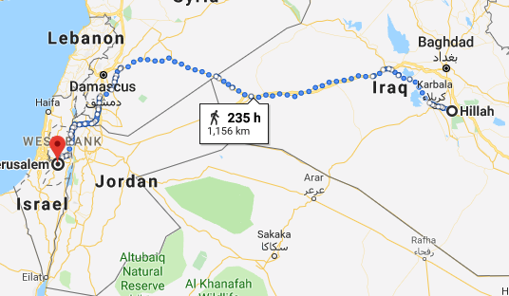
Notes:
Walked 8 hours a day – over a month
The Bible says they came from the East
And that they finished overjoyed.
But I want to encourage you
– they went through valleys to get to joy

Slide 5
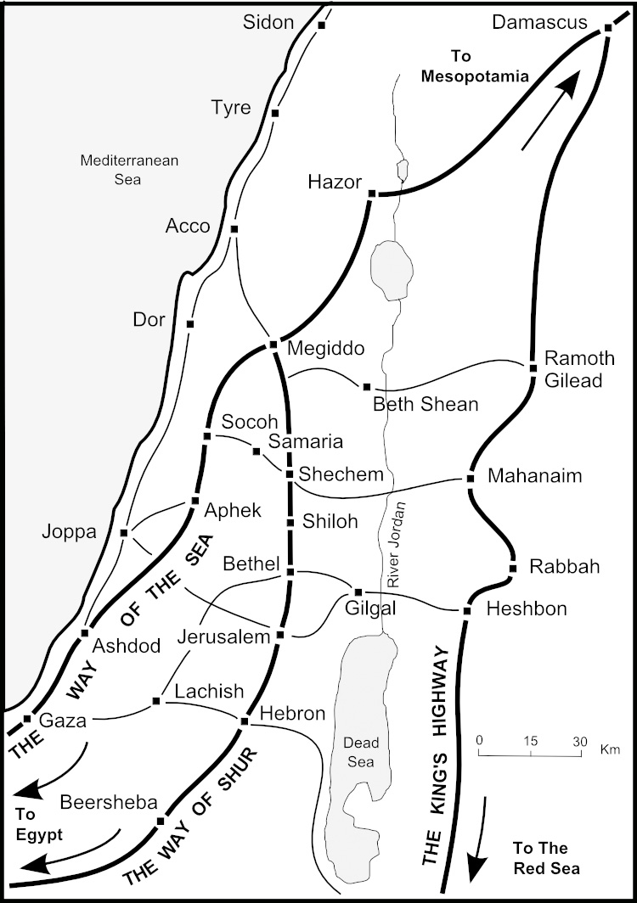
The wise men came down the King’s Highway
Notes:
the kings highway –valley where they would have crossed the Jordan
Valleys are places of vulnerability
Enemies come down and attack from every side
Through valleys we get to joy

Slide 6
O LORD my God, I called to you for help and you healed me. . . weeping may remain for a night, but joy comes in the morning. Psalm 30:2,5 (NIV)
Notes:
God’s plan is to give you joy in the valley

Slide 7
When I said, “My foot is slipping,” your love, O LORD, supported me. When anxiety was great within me, Your consolation brought joy to my soul. Psalm 94:18-19 (NIV)
Notes:
If you are in a valley – God knows the joy and strength you need

Slide 8
2. When you’re in the valley, it matters who is on the mountain top!
Notes:
The Kings Highway, crossed over near gilgal
And then they had to go up from Jericho to Jerusalem

Slide 9
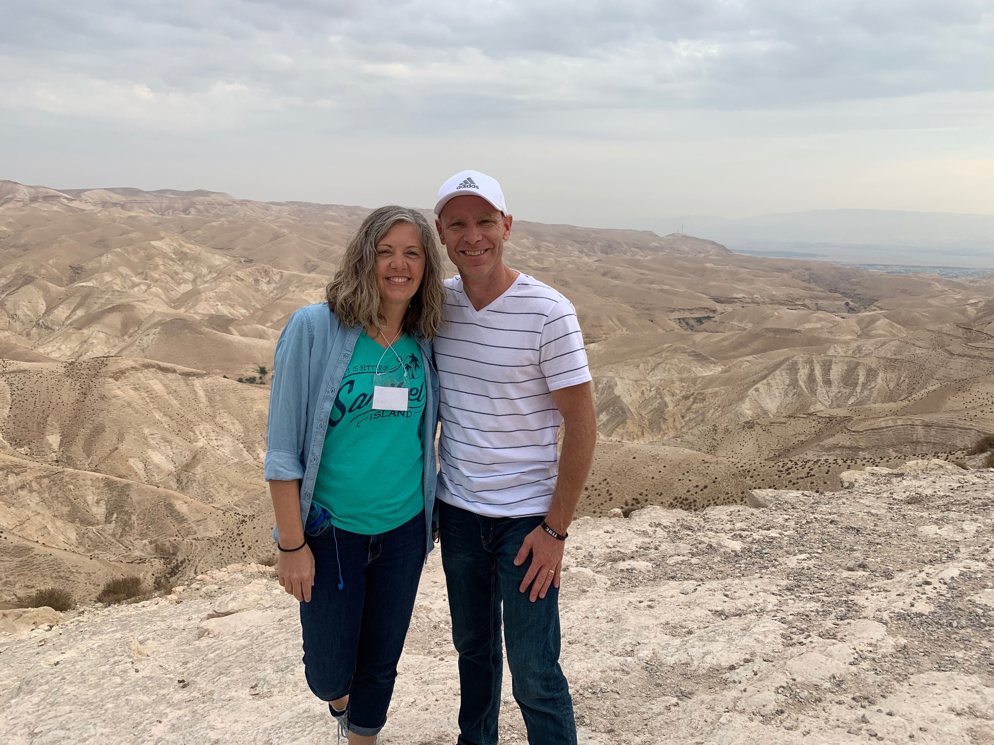
Notes:
road from Jericho to Jerusalem
known as the valley of the shadow of death – David
Reason is bandits could come from the mountaintops
All my time in Israel – visited all these sites – all cities on hills

Slide 10
“Whoever rules the mountains rules the valleys”
Notes:
Realized that this wasn’t about cities and military
This is about life –
the mountain tops of our lives are what have power over our valleys

Slide 11
The mountaintops of our lives have power over the valleys
Notes:
* What brings you joy on Friday night is your main hope on Monday morning or in Wednesdays pressures.

Slide 12
Whatever depend for joy is the power you have to get through the pain (if its strong enough)

Slide 13
If the power of your joy is less than the power of your pain you won’t get out of the valley

Slide 14
A Question Wisdom Would Ask You What brings you joy? (Will it sustain you in the hard times?)
Notes:
The joy determines how you get through the valleys you are in right now.

Slide 15
Your greatest problem in life isn’t the power of the valley, it’s the weakness of your mountaintops to rule over them
Notes:
If you trust in sinful, empty things – you have nothing to deal with the power of pain
If you trust in sin as your mountaintops – sin will enslave you in the valleys
If your joy is escaping pain through unhealthy romantic relationships, alcohol, espn, shopping, work
If that;s your joy – than that’s your curse
can’t give peace or hope in the hospital, at divorce court, in your addictions

Slide 16
To find eternal joy don’t escape from the pain, search for The Savior
Notes:
A wise person – finds their joy in finding Jesus

Slide 17
And the star guided them to Bethlehem. . . . they were filled with joy! They entered the house and saw Jesus with his mother, Mary, and they bowed down and worshiped him. Matthew 2:9-11 (NLT)
Notes:
Jesus always brings joy
Christmas is supposed to be source of joy
Not an enemy of it in your life!!!!

Slide 18
the angel said to them, “Do not be afraid. I bring you good news of great joy that will be for all the people. Today in the town of David a Savior has been born to you; he is Christ the Lord. Luke 2: 10-11 (NIV)
Notes:
Speaking of Jesus it says

Slide 19
3. When you’re in the valley, stars matter!
Notes:
The wise men didn’t start knowing Jesus
It was star that led them there – we need the same

Slide 20
And the star guided them to Bethlehem. It went ahead of them and stopped over the place where Jesus was. When they saw the star, they were filled with joy! They entered the house and saw Jesus . . . Matthew 2:9-11 (NLT)
Notes:
Stars guide us to where Jesus is at
Stars bring us joy because they show us that we can really know the king of Heaven

Slide 21
Stars guide us to where Jesus is and bring us great joy because they show us that: 1) The King exists 2) We can know Him 3) Nothing else has to define us
Notes:
[need some examples]

Slide 22
Do everything without complaining or arguing, so that you may become blameless and pure, children of God without fault in a crooked and depraved generation, in which you shine like stars in the universe as you hold out the word of life Philippians 2:14-16
Notes:
This is who we are supposed to be
This is who God uses to lead people to Jesus
(next week how you can be this)
But this week -question

Slide 23
A Question Wisdom Would Ask You Who has been your “star”? The person who showed you the way to Jesus for the first time or in a deeper way
Notes:
Connect don’t isolate this Christmas

Slide 24
4. When you’re in the valley, Jesus matters most!
Notes:
Communion being distributed
He was born in a valley – no room in the inn.
Born to nobodies – only shepherds were told in his own land
He was born – and that’s where he died – at the cross

Slide 25
Let us fix our eyes on Jesus, the author and perfecter of our faith, who for the joy set before him endured the cross, scorning its shame, and sat down at the right hand of the throne of God. Hebrews 12:2

Slide 26
“I have told you these things, so that in me you may have peace. In this world you will have trouble [valleys]. But take heart! I have overcome the world [valleys].” John 16:33 (NIV)
Notes:
READ OUTLOUD WITH ME

Slide 27
Jesus answered, “I am the way and the truth and the life. No one comes to the Father except through me. - John 14:6 (NIV)

Slide 28
A Question Wisdom Would Ask You How are you saying thank you? And turning Christmas into a friend of joy instead of an enemy of it

Slide 29
The best way through the valley is by giving thanks to God. It strengthens your focus on the promises God has made and the good God has done

Slide 30
NOW IS THE TIME . . . Thank you cards Words of encouragement Texting Tuesdays Bless & Invite To Services

