Slide 1
DOORS
Closed & Open Doors
Acts 16:6-10

Slide 2
Next Paul and Silas traveled through the area of Phrygia and Galatia, because the Holy Spirit had prevented them from preaching the word in the province of Asia that time.
ACTS 16:6-10

Slide 3
Then coming to the borders of Mysia the headed north for the province of Bithynia, but again the Spirit of Jesus did not allow them to go there. So instead, they went on through Mysia to the seaport of Troas.
ACTS 16:6-10

Slide 4
That night Paul had a vision: A man from Macedonia in northern Greece was standing there, pleading with him, “Come over to Macedonia and help us!”
ACTS 16:6-10

Slide 5
So we decided to leave for Macedonia at once, having concluded that God was calling us to preach the Good News there.
ACTS 16:6-10

Slide 6
Closed doors gives us hope and builds our faith that God has something greater for us.

Slide 7
Remember and trust the Lord with your lives completely. Only then will we be able to see how He speaks through closed and open doors.

Slide 8
God closes doors to protect us.
God closes doors to redirect us.
God closes doors to keep us from less than his best.

Slide 9
“Why is it good for me to appreciate closed doors”?

Slide 10
“Why should I appreciate God not giving me what I want”?

Slide 11
A check in the spirit

Slide 12
CLOSED #1
…because the Holy Spirit had prevented them from preaching the word in the province of Asia at the time.
verse 6

Slide 13
CLOSED #2
…but again the Spirit of Jesus did not allow them to go there.
verse 7

Slide 14
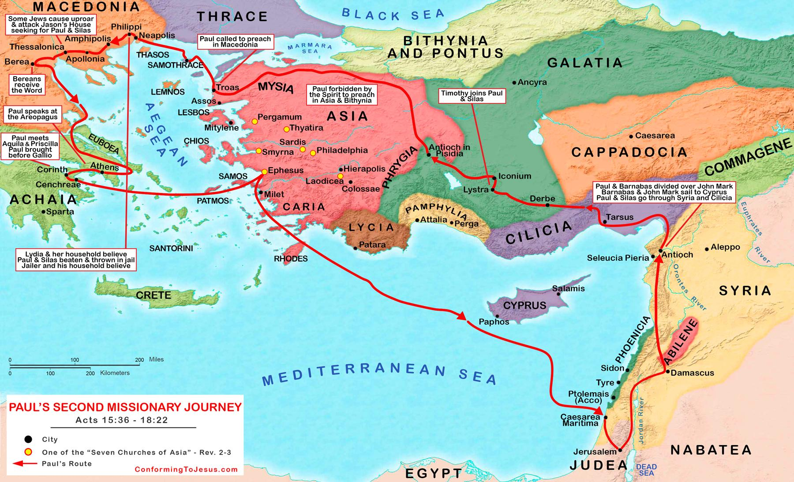
verse 7

Slide 15
#1 God closes doors to protect us

Slide 16
WE DON’T KNOW!!!

Slide 17
The more you focus on the “WHY GOD”, the less you focus on the “WHAT’S NEXT”

Slide 18
#2 God closes doors to redirect us.

Slide 19
God always shows the way by getting in the way

Slide 20
God is relationship over direction

Slide 21
#3
#3 God closes doors to keep us from less than his best.

Slide 22
What about the open door?

Slide 23
Lydia and her family was baptized (vs. 15)
Rebukes a demon possessed women(vs. 18)
Were beaten publicly and chained (vs. 22-24)
Opportunity to witness to prisoners (vs. 25)
-Witnesses a miraculous earthquake.

Slide 24
5. Set free from chains by earthquake (vs. 26)
6. Prevented someone from committing suicide (vs. 28)
7. Baptized the guard and his entire family (vs. 33)
8. Ate a good meal (vs.34)

Slide 25
"we cannot pray for open doors without accepting closed ones"

Slide 26
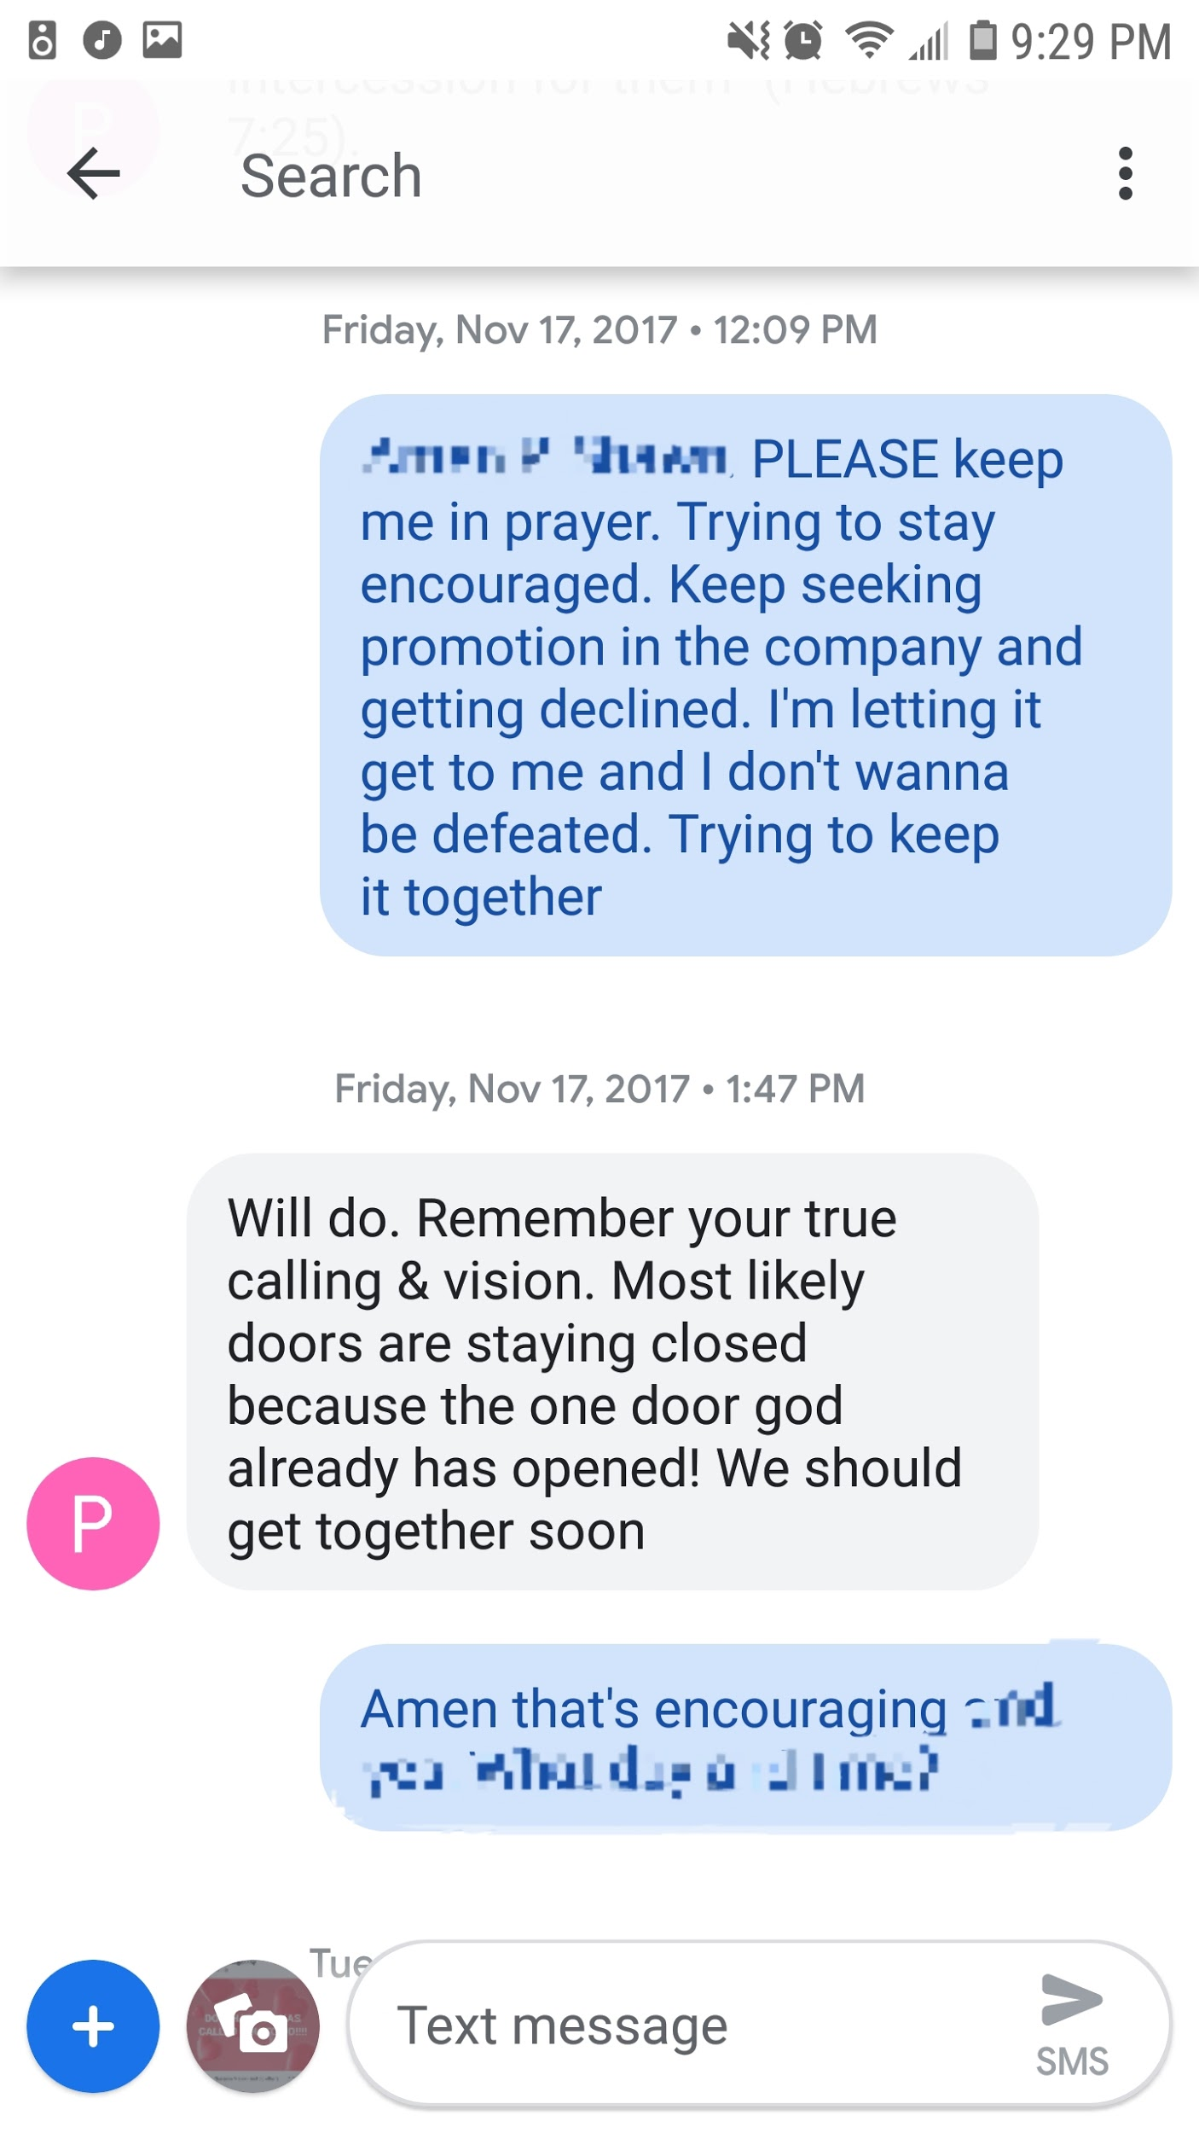

Slide 27
We want, what we want, when we want it

