Slide 1
Notes:
Series about learning to hear God’s voice
Using our prayer journals to focus on hearing god’s voice
Today – talk about the one area we have a hard time hearing from God about

Slide 2
“Necessary Endings” When Jesus tells us to let go so we can get started John 15:1-8 & 16:7,13-14
Notes:
Most of us resist God’s voice when it comes to having to change
It’s not that we don’t want our life to be better or blessed
We just want God to make it better without changing
Jesus is helping the disciples to make a change
For one season to end and another to begin – let’s read

Slide 3
God can change me but I have to be willing to make changes
Notes:
What God wants to change is deeper and different than what we think needs to change
For best things to come – good things have to end
You have to be willing to let Jesus lead you to necessary endings
In John 14-16 (lord’s supper, upper room)

Slide 4
“For us to ever get to a next level or new tomorrow something has to end. Life has seasons. And without the ability to end things well, we stay stuck and often we stay miserable.”

Slide 6
Notes:
Talks about how gardening and pruning work
Before
Never living in peace, prospering
Not that you can’t – its that you won’t

Slide 7
If we are going to get unstuck and become all God has planned, we have to realize when a season needs to end

Slide 8
Somebody Environment Attitude Schedule Objective Nice
Notes:
Somebody – feed my worst version of myself, feed lies and NO GROWTH MINDSET
- going a different direction – like Paul and Barnabas
Environment – travel sports needs to end
- watching fox news or cnn more than your bible
- politics or weekend parties
- kids in school – struggling –send them to help elementary
whatever you feed will lead – place not jesus centered
Attitude – towards someone
Unforgiveness & Entitlement
Victim mentality
Servanthood – my brother and sisters – I have to go first
Preference on how things get done
Schedule
– summer no basketball, Kaleb home – explore Richmond
Objective
– to make it like the good old days
- to survive (when its time to believe for more)
- money – God first (feels like loss be gain)
- yard or the kids – we want the kids to look good
Nice
– didn’t feel nice to go to the gym and workout / not have ice cream
start learning a language
Our church learning spanish

Slide 9
JOHN 15-16 / THREE TRUTHS WE NEED TO HEAR . In Jesus . . . 1. Growth means change 2. Change means loss (pruning) 3. Temporary loss leads to eternal gain

Slide 10
1. Growth means change But I tell you the truth: It is to your advantage that I am going away. (16:7)
Notes:
contrary to Hollywood, love songs and plastic surgery
nothing of this world lasts forever
We want life to be like a movie where one big fight leads to happily ever after
We want to always look like we are in our 20’s
Yet everything in our culture says – its always spring time or harvest time
-we all want an endless summer.
Some of us believe it will always be winter because of our disappointments and pain.
People try to have relationships and marriages that are always spring time – give up in winter
Finances, churches, communities, your relationships -including God

Slide 11
Then Jesus said to them all: “If anyone would come after me, he must deny himself and take up his cross daily and follow me. For whoever wants to save his life will lose it, but whoever loses his life for me will save it. - Luke 9:23-24
Notes:
Give up to go up
Giving up your life is exactly what Jesus is asking for
He gave up His
The tough thing about change – is it takes faith
Its hard to give up what you have
To believe for something that you can’t see

Slide 12
Now faith is being sure of what we hope for and certain of what we do not see . . And without faith it is impossible to please God, because anyone who comes to him must believe that he exists and that he rewards those who earnestly seek him. - Hebrews 11:1,6
Notes:
Reasons we fight ending the season we are in
Good (talk about this later)
Comfortable or control
Real healing makes things worse before they get better
New beginnings are often hard and don’t look as “Nice”
Ethiopia trip cancelled – go serve my brother
Bought a fixer upper –big time / foreclosure and vandalized
First day – wow / everything needs work and repair
Could tell it was overwhelming – new beginning was hard and not nice

Slide 13
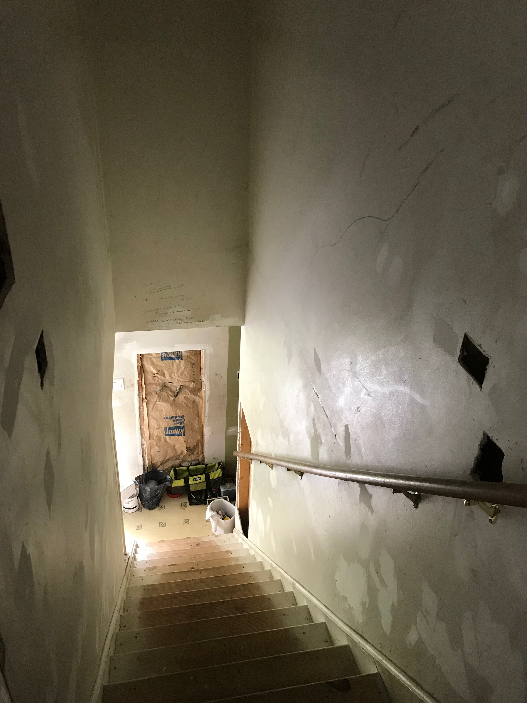
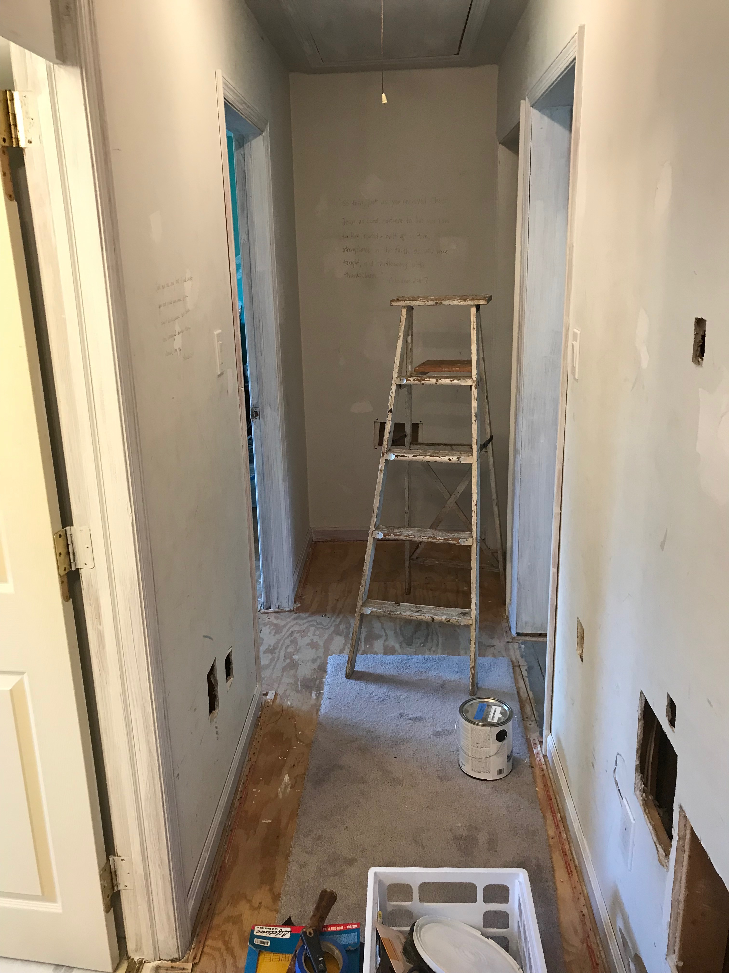
Notes:
Devotion second day – this is our lives – Jesus comes
Instead of looking at what needs to look better
Fixed our eyes on God’s promises

Slide 14
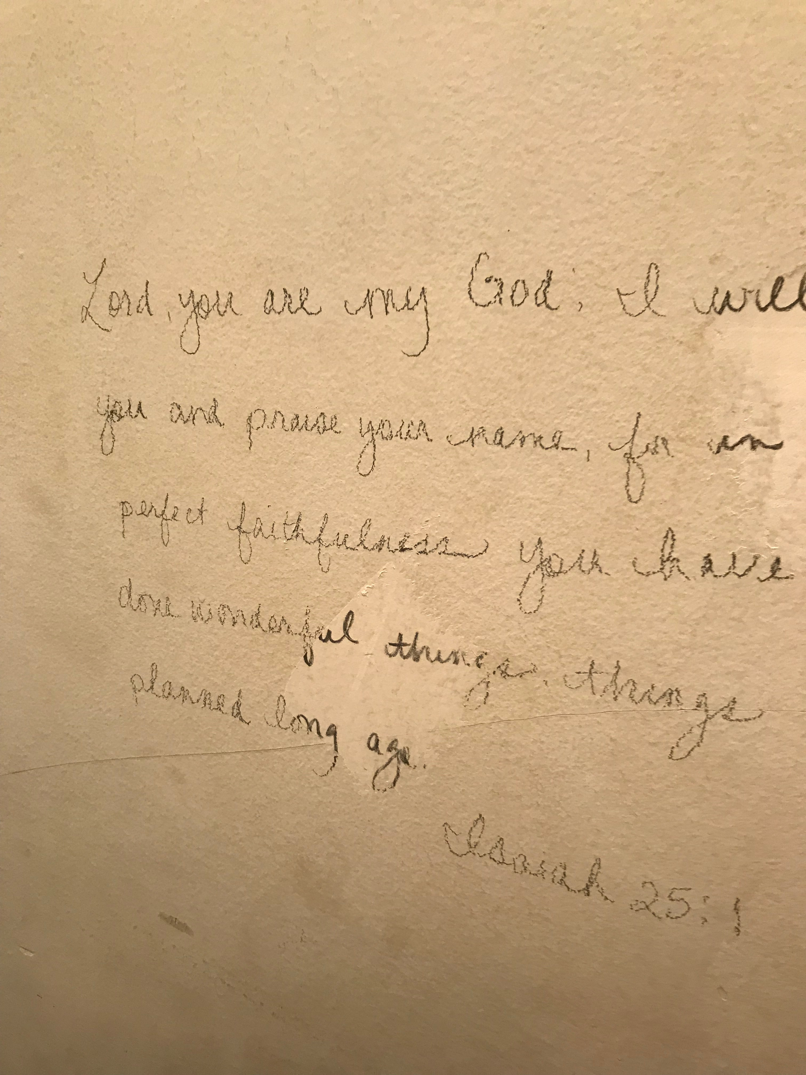
Notes:
Some of us need to see

Slide 15
2. Change means loss (pruning) He cuts off every branch in Me that bears no fruit, while every branch that does bear fruit He prunes so that it will be even more fruitful. (15:2)
Notes:
There are good reasons to end and let new things begin
The power of ending things to get unstuck

Slide 16
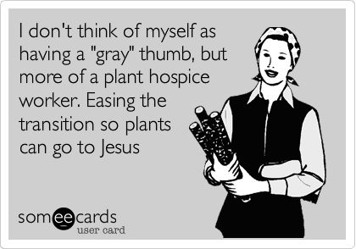

Slide 17
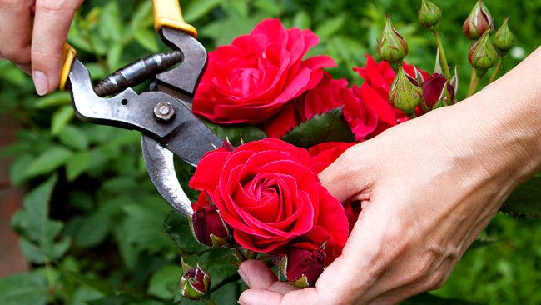

Slide 18
Reasons to Prune (15:2-) 1. Good but not best 2. Sick and not growing (fruitful) 3. Dead and in the way
Notes:
This world needs to see that God is different
This man had an expectation – God did something different. Something better.
This world wants God to make its sick broken life better
God wants to give a different life – eternal life
In that moment – God turned Peter’s answer into a sign and wonder
Something that made people wonder
Your life should make people wonder

Slide 19
How do I know what God wants to prune?

Slide 20
How do I know what God wants to prune? Before you change anything: Get In His Word Open To His Spirit Connect With His People

Slide 21
If you can’t abide in Jesus (His Word, His Spirit, His Body) and sustain that season at the same time …
Notes:
15:5
. . . Chop it!
Somebody Environment Attitude
Schedule Objective Nice

Slide 22
3. Temporary loss leads to eternal gain I tell you the truth, you will weep and mourn while the world rejoices. You will grieve, but your grief will turn to joy … Now is your time of grief, but I will see you again and you will rejoice, and no one will take away your joy.
Notes:
Our faith is all about endings leading to beginnings
The same God that does this . . . Calls us to believe in changes

Slide 23
For everything there is a season, and a time for every matter under heaven: a time to be born, and a time to die; a time to plant . . . a time to weep and a time to laugh . . . He has made everything beautiful in its time Ecclesiates 3:1-2,11

Slide 24
Notes:
We have to let fears end, isolation, unforgiveness, addictions
Do it by faith that God will make something beautiful
On the night Jesus was betrayed – he called them to communion
He knew growth meant change. Change meant loss
He wanted to assure them of his love and his power
Rem

Slide 25
Jesus took bread, gave thanks and broke it, and gave it to his disciples, saying, “Take and eat; this is my body.” Then he took the cup, gave thanks and offered it to them, saying, “Drink from it, all of you. This is my blood of the covenant, which is poured out for many for the forgiveness of sins. [Matthew 26:26]

Slide 26
I tell you, I will not drink of this fruit of the vine from now on until that day when I drink it anew with you in my Father’s kingdom.” When they had sung a hymn, they went out to the Mount of Olives. Matthew 26:29-30

