Slide 1
Notes:
Today’s sermon is for only a certain type of person – people with problems
Joke
Problems aren’t a joke – but they don’t have to be a curse
They can be where we hear God’s voice the most
Grab your bookmark
– don’t take notes – hear God’s voice at the end

Slide 2
OUR PROBLEMS GOD’S PLATFORM Acts 3:1-19,26
Notes:
Your problem is not an interruption to God’s plan
Your problem is not meant to be a distraction from God’s voice
It’s actually the place he can speak the loudest and use the most to create change
It’s the platform for him to speak to you and through you
READ – see pattern of how God uses problems

Slide 3
Problems are platforms to get people’s attention (v1-4)
Notes:
We think problems are interruptions, blockades to God’s voice and work
Think about all the places we see how great God is in the Bible - problems
Used by God – send you to a place where problems are
Why – attention
My grandfather –problem of colon cancer – platform of healing
People’s financial troubles – tithing – platform of God’s faithfulness over fear
Ethiopia– problems
Parents – your kids have problems – your chance
Work place
Your own life –
Our problem’s are God’s platforms
So we have to change our perspective . . .

Slide 4
The goal of life is not to get rid of all your problems. It’s about having the right problems!
Notes:
You can’t have a good life (abundant life) without problems
(Jesus in this world you will have problems but take heart)
Married – problems
Parenting – problems (average cost of raising a child is $233,000 (before colleg)
Promotion – problems
Coming to Jesus – give you all sorts of problems
Recover from addiction – problems
Lack of friends because I won’t commit sin
Do I have the right problem
If its because of sin & selfishness – platform to get life right
If it’s a right problem – its okay to suffer – God’s god t a good plan

Slide 5
if you should suffer for righteousness’ sake, you will be blessed. Have no fear nor be troubled, but in your hearts honor Jesus the Lord as holy, always being prepared to make a defense to anyone who asks you for a reason for the hope that is in you 1 Peter 3:14–15
Notes:
There are some things worth having problems about
There are some things to suffer for . . . To lose
Jim Elliot lost his life as missionary to south America
His wife lost a husband and his kids lost their dad

Slide 6
Notes:
Why gain the world and lose your soul
Problems can be platforms for God’s glory in your life
God wants to use your problems to speak to you and through you!

Slide 7
Problems are platforms to encounter God’s otherness (v4-9)
Notes:
This world needs to see that God is different
This man had an expectation – God did something different. Something better.
This world wants God to make its sick broken life better
God wants to give a different life – eternal life
In that moment – God turned Peter’s answer into a sign and wonder
Something that made people wonder
Your life should make people wonder

Slide 8
Here am I, and the children the LORD has given me. We are signs and wonders in Israel from the LORD Almighty, who dwells on Mount Zion. Isaiah 8:18 (NASB)
Notes:
Kaleb story
God wants to make signs and wonders of us
High school –don’t drink or smoke, sex before marriage,
Words we use at work or the attitude
Signs that we do things different
Not because we are better –we are just different
We’ve found life instead of death, blessing instead of curse, peace instead of anxiety
YOU CAN’T MAKE A DIFFERENCE AND NOT BE DIFFERENT
Problems are platforms for people encounter God’s surprises
Just like in Acts – should lead to . . .

Slide 9
Problems are platforms to explain God’s Son (v12-16)
Notes:
When people wonder – it should lead to the need for an explanation
We’ve got to be different – how we handle our problems
Peter – uses that moment to share Jesus

Slide 10
Men of Israel, why does this surprise you? Why do you stare at us as if by our own power or godliness we had made this man walk? . . . It is Jesus’ name and the faith that comes through him that has given this complete healing to him, as you can all see. Acts 3:12,16
Notes:
Story of Gas station
Sensing God wants to move by his spirit more / speak more
Problem – no time / give up some Wednesday nights for another group
Reading book on the Holy Spirit
Goes to 10 – still ahven’t gotten gas – on empty
Illustrates the last point
Chance for them to experience God’s blessing

Slide 11
Problems are platforms to experience God’s blessings (v17-19,26)
Notes:
What seemed a problem was the platform!!!
Notice how to do it

Slide 12
Repent therefore, and turn back, that your sins may be blotted out, that times of refreshing may come from the presence of the Lord Acts 3:17
Notes:
Repent and refresh
Turn around – stop going that way

Slide 13
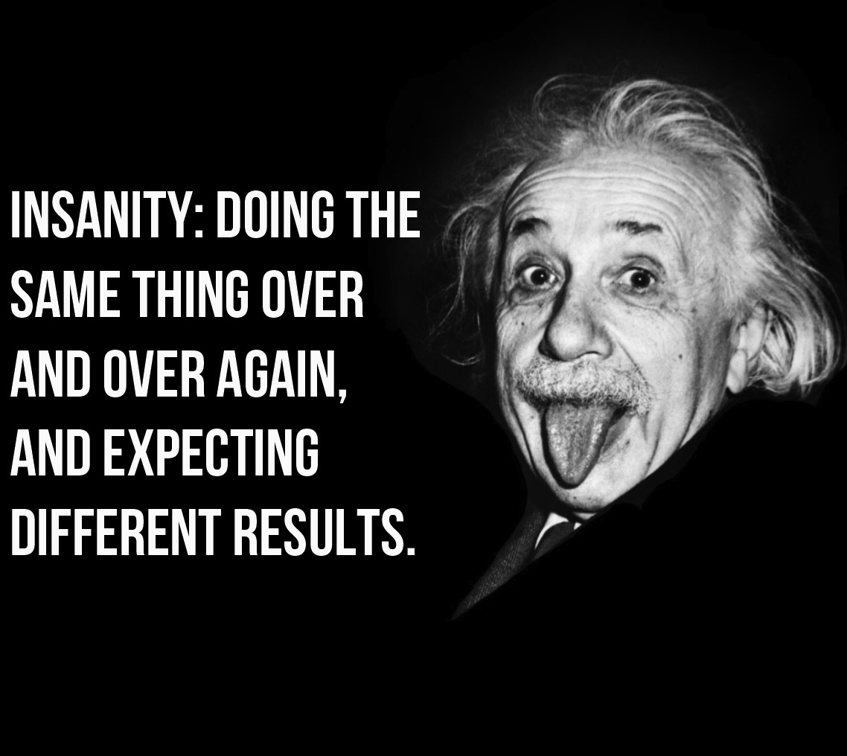
Notes:
We keep trying harder
Runner farther
Being more stubborn
More selfpity, more victim, more attitude
How about repenting

Slide 14
if you do not believe that I am the one I claim to be, you will indeed die in your sins [no change or relief] . . . If you hold to My teaching, you are really My disciples. Then you will know the truth, and the truth will set you free. John 8:24,32-33
Notes:
HURT VERSUS HARM
Truth will hurt but free you

Slide 15
Problems are platforms only if you hear God’s voice (v1,6)
Notes:
They were going to prayer – like you can everyday
“What I have I give”
Peter had the spirit and voice of God – following his promptings
Problems are platforms if you decide hearing God’s voice is what you need instead of all the other voices

Slide 16
Don’t fix your problem. Fix your ears on God’s voice. (then things will get fixed)
Notes:
Here is what God says

Slide 17
this is what I commanded them, saying, ‘Obey My voice, and I will be your God, and you will be My people; and you will walk in all the way which I command you, that it may be well with you.’ Jeremiah 7:23 (NLT)

Slide 18
Problems are platforms to:  get people’s attention  encounter God’s miracles  explain God’s son  experience God’s blessings
Notes:
Team come up
Pull out bookmark – answer this question

Slide 19
In which problem have you stopped listening for God’s voice?
Notes:
During song –and afterward
Then going to hear from God together
First –problem is Jesus isn’t the center – make that decision today – follow him
Second – hear from God – if you’ve spoken in last two weeks pray someone else will share – our church family has to grow to hear God’s voice and those of us who share often need to encourage others to hear and share

