Slide 1
And Jesus said, “The thief comes only to steal and kill and destroy. I have come that they may have life and have it abundantly.”
John 10:10
Notes:
Today we finish up our series never the same
So many have said – they will never look at their relationships the same
We committed to pray for 3 relationship that need to change
We recognized this verse
If Satan wants to destroy any part of our lives its our relationships – with God and each other

Slide 2
Notes:
Your life is only good as your relationships –a nd Jesus came to give you abundant life
So over the past few weeks we have looked at the drama triangle
That our sinful nature is prone to and satan is trying to deceive us into

Slide 3
Hero
Villain
No relationship works right when we relate to others
as a victim
Victim
Notes:
This is the way the world THINKS relationships work
It’s what every Disney and Hollywood movie are based on
And its good drama but a lousy life
When we respond to drama with one of these roles
We make life worse and we feed our sinful nature
And we looked at the life of Jesus
And how he modelled and commanded a new way of relationships

Slide 4
Empowered Servant
“A new command I give you: Love one another. As I have loved you, so you must love one another.
Empty Victim
Notes:
Jesus commands us to love AS HE DID
Jesus didn’t act like a victim –even to the cross
And he won’t let us live as a victim
But we tend to fall into this all the time . . .
Grew up with Bad patterns
So busy and consumed with the world’s priorities
Sometimes we just say things we don’t realize . . . Church last week

Slide 5
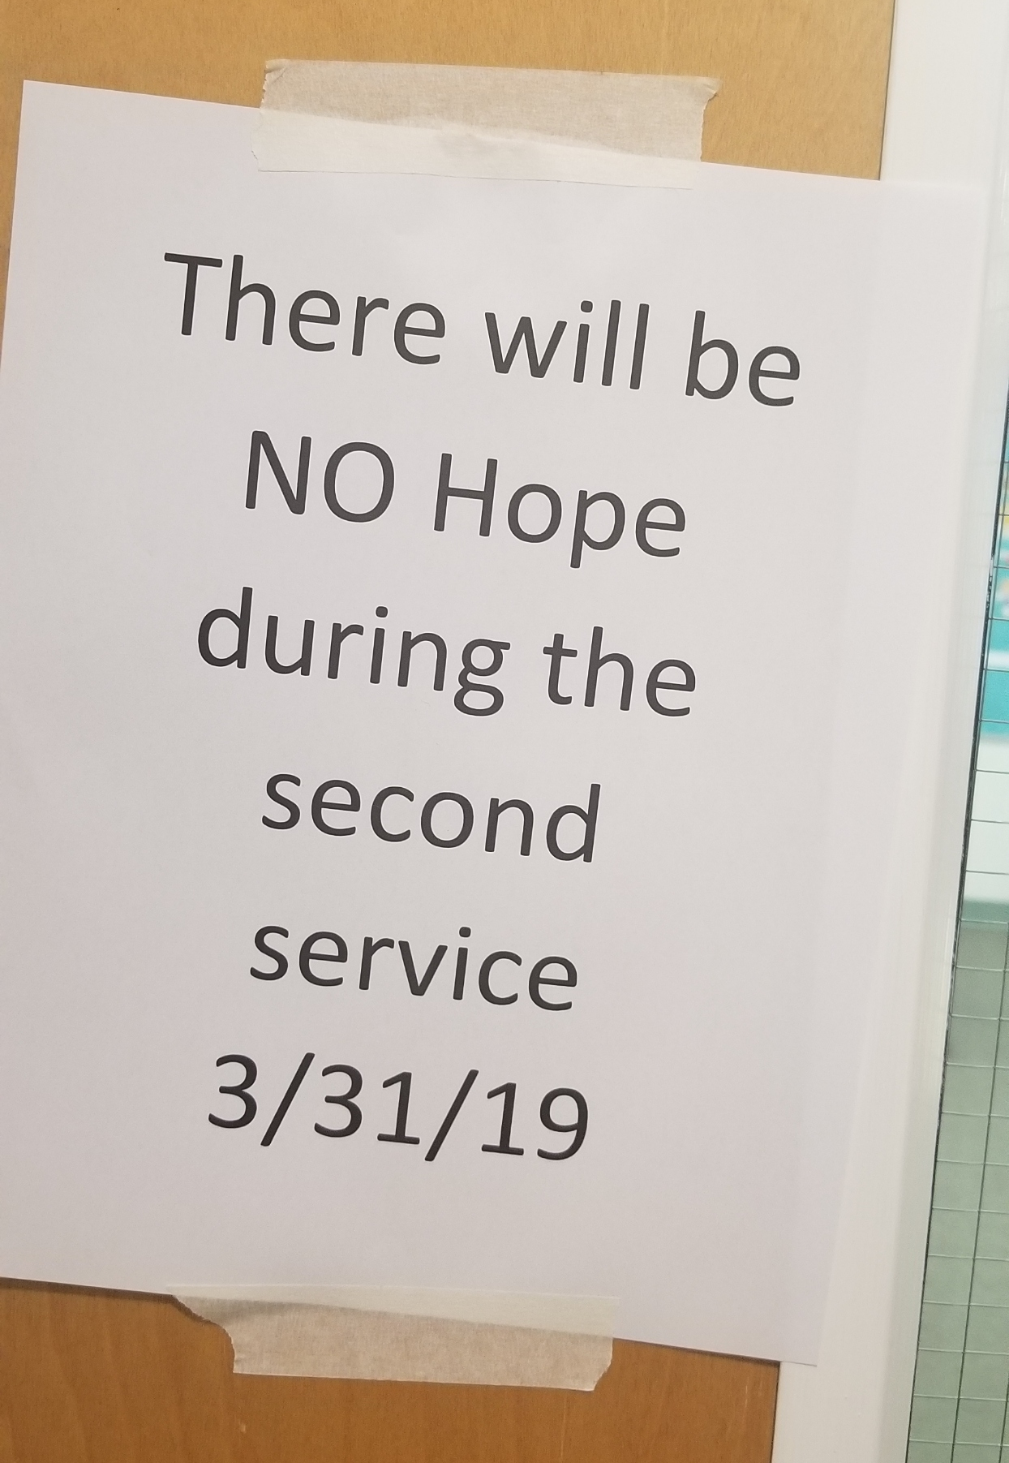
Notes:
Some of think there is no hope for relationships
We’ve prayed and quoted scriptures but we’ve been relating to people as victims
And here is a key truth in this series and for your life . . .

Slide 6
Empowered Servant
Jesus will never bless or help you live like a victim because He dies to free you from ever being one!
Empty Victim
Notes:
And yet people, go to church and worship and pray
But they do it all like a victim instead of an empowered servant
The enemy has deceived people into believing in Jesus who sets us free but still acting like victims in our relationships
[next slide] how jesus taughts us

Slide 7
Empowered Servant
Coach
Challenger
Notes:
So in the last two weeks
Pastor Brandon & Pastor Anedra did a great job teaching us how Jesus showed us how to live as coach and challenger
And yet, if you are like me
You still acted in the drama triangle more than divine triangle
Those 3 relationships may have not gotten any better yet?
Why? We can’t just know the Jesus thing to do
We have to have the power of Jesus to do it – the holy Spirit
And that’s what this last story of Jesus and the disciples is about in Acts 1:3-9
Because even when we know what is right
There are still so much of our broken and weak sinful nature that breaks the relationships around us

Slide 8
Saber lo que hay que hacer
no es lo mismo que tener el poder de hacer lo correcto.
Notes:
Knowing the right thing to do is not the same as having the power to do the right thing.
Why? We can’t just know the Jesus thing to do
We have to have the power of Jesus to do it – the holy Spirit
And that’s what this last story of Jesus and the disciples is about in Acts 1:3-9
They have the right revelation

Slide 9
Acts 1:3-9
Becoming An
Empowered Servant
Notes:
That’s where Acts 1 – Jesus comes in
The disciples have received revelation -Jesus is risen
But no one around them had changed
- rome still rules
- pharisees still lying and could get people killed
- the crowds still were willing to crucify other followers of Jesus
- The disciples are in the middle of drama / threats / cold-hearted people

Slide 10
the disciples asked Jesus, “Lord, are you at this time going to restore the kingdom to Israel?”
He said to them: “It is not for you to know the times or dates the Father has set by his own authority.
(Acts 1:6-7)
Notes:
Notice what the disciples want – do we win (v6 – do we get to be in charge, do we win and they lose)
Jesus says these words – its not about the drama triangle, its not about winning and losing
Its about being my witnesses, it’s about the promise that has been made

Slide 11
But you will receive power when the Holy Spirit comes on you; and you will be my witnesses in Jerusalem, and in all Judea and Samaria, and to the ends of the earth.”
(Acts 1:8)
Notes:
Empowered servant
(not just the right thing to do / the power to do it)
The power to do the good
(not just a little power)

Slide 12
“Do not leave Jerusalem, but wait for the gift my Father promised, which you have heard me speak about. For John baptized with water, but in a few days you will be baptized with the Holy Spirit.
(Acts 1:4-5)

Slide 13
(“baptized” / “baptizo”)
To dye a clothe, to be completely immersed, to be overflowing with
(Matt. 3:11, Mk 10:39, Lk 6:13, Jn 1:33)
Notes:
Baptized in the holy spirit (v5)
You need to be completely immersed and overflowing
The bapistm in the holy spirit is one of only five sayings or stories that is repeated in all four gospels
(birth, death, resurrection, 5 loaves) then baptism in holy spirit
Why? – because it is so key to living out the love and grace of Jesus
In fact it’s the only saying or story that is all four plus Acts
When it was quoted – John the Baptist – wasn’t speaking to the apostles or some special group
He was talking with his disciples about what the coming messiah would do for every person
It was connected to this old testament scripture

Slide 14
I will give you a new heart and put a new spirit in you . . .﻿﻿ And I will put my Spirit in you and move you to follow my decrees and be careful to keep my laws.
[Ezekiel 36:24-27]
Notes:
(not just know the law -power to live it out)
When we come to Christ, we are born again in the spirit
But our sinful nature keeps trying to take control again
The world tells us to live in the drama triangle is the only way
Satan is trying to steal, kill and destroy
We keep living in these Villian, Victim, Hero tendencies.
Some of the lies that keep hanging around
We can keep stepping back on them

Slide 15
LIES WE NEED THE POWER TO “LEAVES”
“My life is so unfair. Poor me”
“It’s not my fault. You fix it”
“I need a hero to do it for me”
“If other’s don’t change, I’m stuck.”
“I’m the answer / I need control”
Notes:
These lies – like the leaves in my backyard (not just a few)
Truckloads
When I first learn about drama triangle – try in my own power
LIKE THIS RAKE
Result – don’t get a lot done after tons of time
Can’t blow these lies, habits and hang ups away
Then my wife introduced me to this
2. ELECTRIC LEAF BLOWER
Finally relying on a power greater than mine
Promises more than it can do. No match for the greatness of the lies.
But I can do more / although I am limited how far I can go.
This is like religion or saying yes to Jesus but never growing in him.
Power source far from me but helping me.
I can blown away some of sinful nature tendencies / VICTIM behavior
But then someone showed me that is possible for even more power!
(GOING IN BACK, WHEN I SAY “AND HERE IT IS” TURN OFF MICRO)
3. POWER GAS BLOWER!!
A power that wasn’t at a distance – was going to be in me and be upon me
A power everyone would notice –
(blows everything away -leaves, rocks, small children, poorly rooted trees)
What took me so long, took me seconds
What tired me out, left me looking for more to do
That’s what Jesus is promising here
Something to blow away the fear that drives the drama triangle
Something that blows away the pride and selfishness
Jesus didn’t just die to forgive you of your sins and leave you clean but mepty of power
The baptism (immersed) of the Holy Spirit is for you today
To look at all those relationships and have the power to blow those sinful nature tendencies

Slide 16
Empowered Servant
What good does God want for me and others?
What seeds can be planted for that?
Coach
Challenger
Notes:
Now I have the power not only to ask the questions but the power to live out the answers

Slide 17
But you will receive power when the Holy Spirit comes on you; and you will be my witnesses in Jerusalem, and in all Judea and Samaria, and to the ends of the earth.”
[Acts 1:8]

Slide 18
Jesus gave them this command: “Do not leave Jerusalem, but wait for the gift my Father promised, which you have heard me speak about. For John baptized with water, but in a few days you will be baptized with the Holy Spirit.
(Acts 1:4-5)
Notes:
Place of: [1] Worship [2] Obedience to God’s Word [3] The Cross

Slide 19
“So I say to you: Ask and it will be given to you; seek and you will find; knock and the door will be opened to you. ﻿For everyone who asks receives; he who seeks finds; and to him who knocks, the door will be opened. [Luke 11:9-10]
Notes:
AFTER JESUS TEACHES THE LORD’S PRAYER

Slide 20
“Which of you fathers, if your son asks for a fish, will give him a snake instead? Or if he asks for an egg, will give him a scorpion?
[Luke 11:11-12]
Notes:
AFTER JESUS TEACHES THE LORD’S PRAYER

Slide 21
If you then, though you are evil, know how to give good gifts to your children, how much more will your Father in heaven give the Holy Spirit to those who ask him!” [Luke 11:9-13]
Notes:
AFTER JESUS TEACHES THE LORD’S PRAYER

