Slide 1
Better Together Sermon Series Slide
Notes:
School year theme – our commitment
God created us to become better together

Slide 2
God created families
to help each other
Know Jesus
Find Freedom
Discover Purpose
Make A Difference
Notes:
That’s what we want to do as a church family
We are not coming together every week to make a church great
We are coming together as a church family to help each other live great everyday lives for Jesus!

Slide 3
We Were Made For This Sermon Series Slide
Showed us how we were made
For purity, purpose and specific plan
Notes:
What we were made for
Requires a certainty of who Christ has made us to be
The work of the spirit
And a commitment to purity
And so here we come to November
And guess what we don’t need

Slide 4
Most of us don’t
need a new sermon
We need a new step or commitment to what we have already been taught
Notes:
God has made us so many incredible promises
That we are supposed to receive and live out by faith

Slide 5
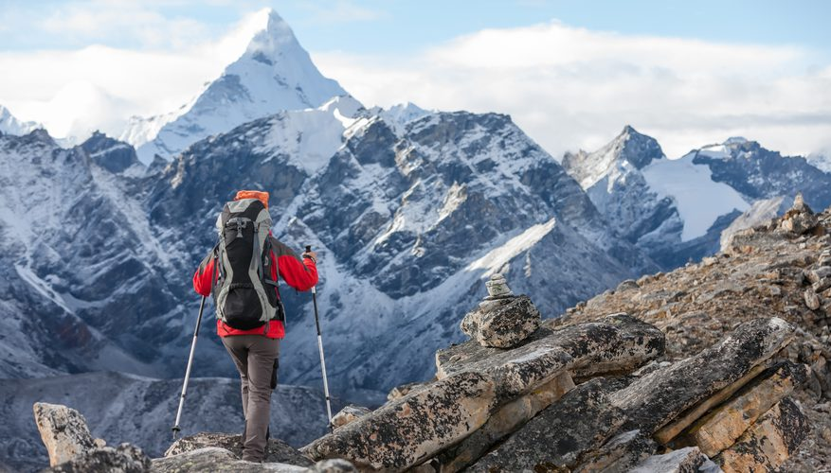
Where I Want To Be
Where I Am
Notes:
We’ve been made more than conquerors but most of us feel more like we’ve been conquered
We see where we would like to be versus where we are it seems a million miles away.
Its overwhelming to think of all the things we’d like to change.
Sara and look at our house – all the rooms that need to be painted, Projects to be done, things to be fixed.
So we tend to do nothing
So much to do – we do nothing
In every area of life.
Plus tv, advertising, social media – it all seems to tell us what we don’t have
Wants to sell us magic solutions – fixes that we can’t afford
Guess I will always be like this
– or my family, my job, my habits, my heart
As a parent, as a money manager, as professional
As a friend, as a follower of Christ, as
Not to work harder but to recognize Jesus has already done the hardest work for us!!!

Slide 6
Because Jesus has eliminated every barrier
I am free to eliminate every excuse
My progress in God’s promises begins today

Slide 7
We can stop making excuses
for what we can’t do
And start taking small step
in what we can do

Slide 8
We Can Start Today
Hebrews 12:1-2
Notes:
4 Steps To Starting
Countdown to what is most important of all

Slide 9
[4]
Take A Fresh Look
At What You Have
To Be Thankful for
“Therefore, since we are surrounded by so great a cloud of witnesses . . .”
Notes:
You are surrounded by things witnessing God’s goodness and faithfulness
God’s great victories start with small step
First step is thankfulness
Thankfulness is about looking at what we do have that is good
Not just all that we need to do
Not just about what we do not see
Plus tv, advertising, social media – it all seems to tell us what we don’t have
Wants to sell us magic solutions – fixes that we can’t afford
Guess I will always be like this

Slide 10
Give thanks in all circumstances; for this is the will of God in Christ Jesus for you. (1 Thes 5:18)
For all the promises of God find their Yes in Jesus.” (2 Cor 1:20)
Notes:
Every one of them is for you
God’s way in God’s time.
Every promise of God will beautiful in you in its time
You are more than a conqueror
Nothing can separte

Slide 11
Biblical Reality!
If you won’t see what you have to be thankful for,
you won’t see God’s answers that you’re looking for.
Notes:
So, if your eye is healthy, your whole body will be full of light,
23 but if your eye is bad, your whole body will be full of darkness
Matthew 6:22-23
You’ve got to train your heart to look for the good

Slide 12
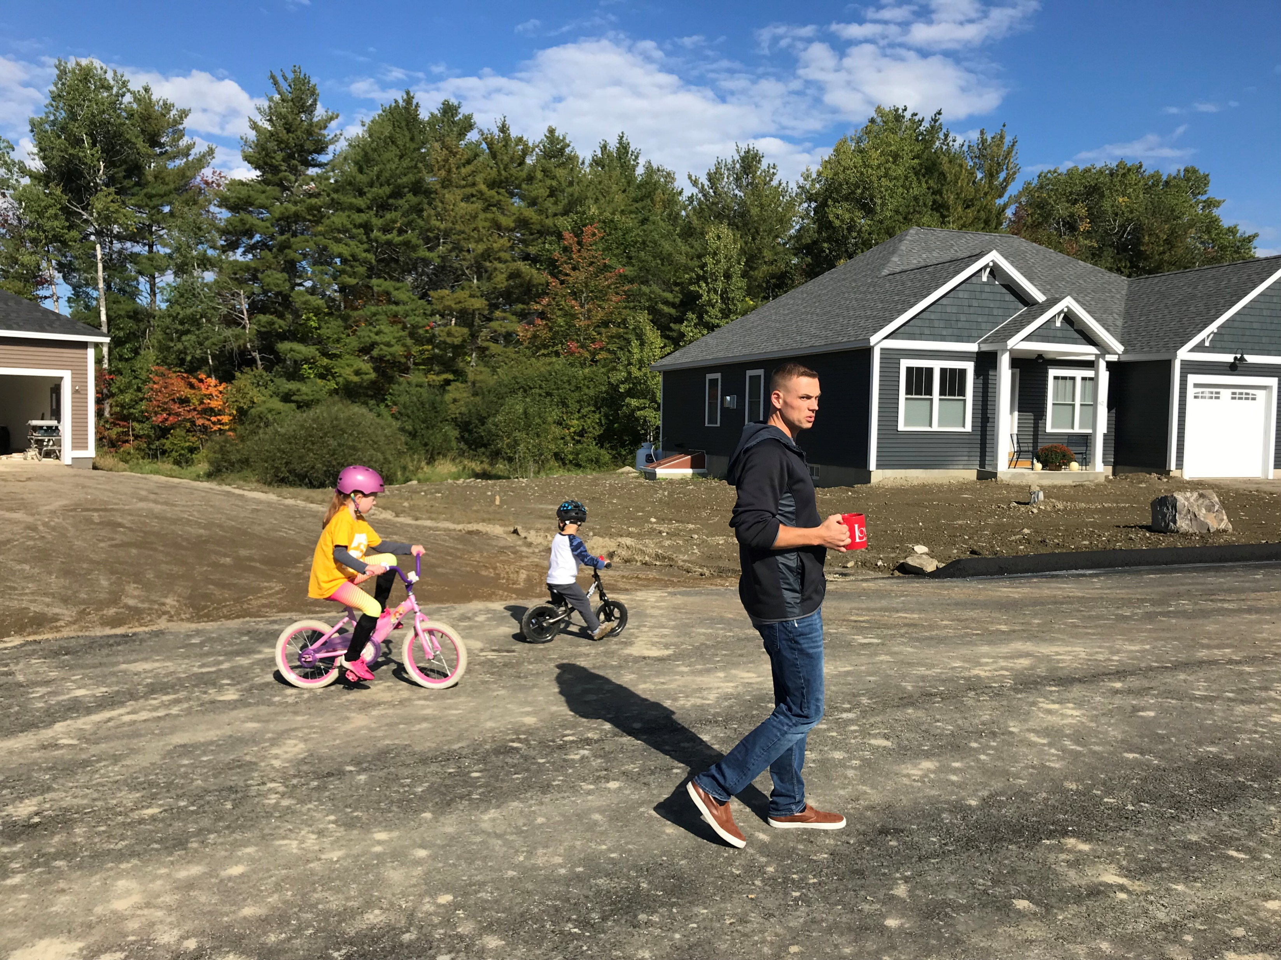
Notes:
My friend Jim
In his 35s there are his two kids
Army recruiter
He is a cancer survivor 2x over –
Last time it required stem cell work – chemo each time
That was five years
Last month he found out he has a more aggressive form of the same cancer and he’s not eligible most of what would cure patients with his cancer
Given him two choices – one option 50% for 3-5 years
Another option could give him longer but less than 20% chance of living through it
So far choosing to have 5 good years with his kids
And spend those 5 years sharing Jesus in miniistry
I been encouraging him

Slide 13
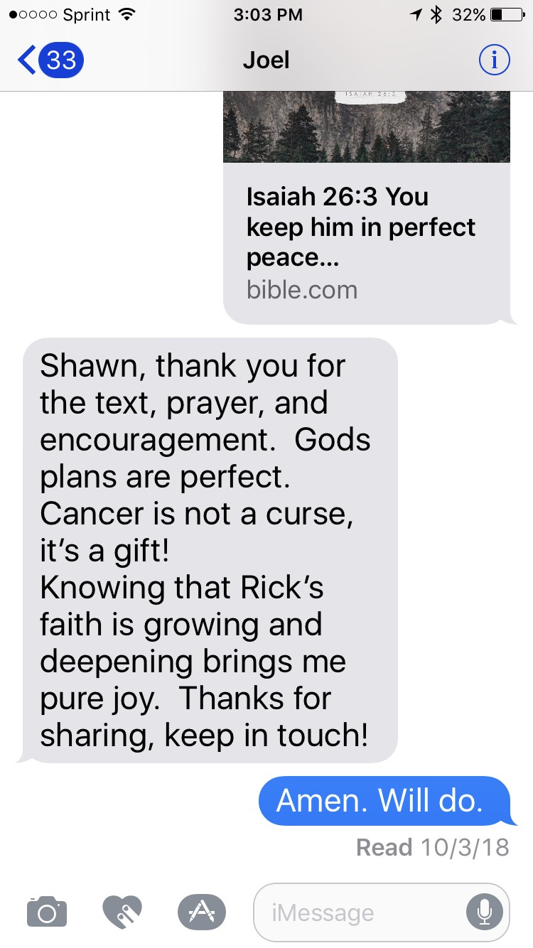
my brother’s
Notes:
Choose thankfulness
He is ready to see all the good will do
This month – develop that perspective
Don’t trust God for anything - don’t see God do anything

Slide 14
What habit of gratefulness could you commit to
starting today?
Notes:
Start off with giving good news not receiving bad news
Post everyday
What you are thankful for
A Scripture verse
Text someone different everyday – grateful for them
Don’t worry all the stuff to complain about won’t go away

Slide 15
[3]
Lay aside the lie that
your past is you or your future
“let us also lay aside
every weight, and sin . . .”
Notes:
This is the good news of Jesus
Your past ends at the cross
You’ve got to stop looking backwards
Once you’ve brought it to the cross completely

Slide 16
[A] Lay aside sin
Most of our sins come from habits we’ve formed over time
Notes:
Sin – is easy to understand we’ve done things wrong
Jesus is the answer – we don’t have to live like that – there is forgiveness and new beginnings
Most of our sins are built on bad habits we’ve built
Half of what you do each day are unconscious habits
So that’s why no excuse November is so important
We form our habits and then our habits form us
Form better habits for a better you
Thanksgiving is one / We’ll talk about others

Slide 17
[B] Lay aside “weight”
Burdens that prevent us
from moving forward
Notes:
Only time used in the NT
Easy to understand [next slide]

Slide 18
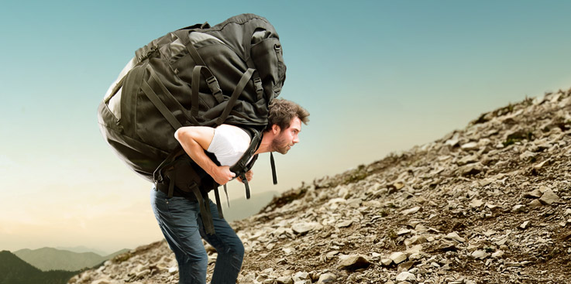
Notes:
Gonna get too tired out – never have the strength
God give me the strength
God says – give me your weights –stop controlling give to me
You can’t say to controlling things and unforgiveness and bad attitudes and try to do what God wants
What are they

Slide 19
[B] Lay aside “weight”
Burdens that prevent us
From moving forward
“fears and failures”
Notes:
Expectations of what didn’t happen, that relationship, my life, my job, my family, my kids
When we start to hope – disappointment – is like aburden
(personal example). Slows us down, tires us out too quick (guys bball in shape 😊 example)
And actually if you look at verse 2 – the real culprit is shame from our fears and failures

Slide 20
“let us also lay aside every weight, and sin which clings so closely . . . looking to Jesus, the founder and perfecter of our faith, who for the joy that was set before him endured the cross, despising the shame, and is seated at the right hand of the throne of God.”
Notes:
Jesus has no excuses and finishes the race how – despises shame – (kataphroneo”) how about you?
We all can feel shame about what we have to do:
The small steps we need to take
People who don’t come back to church (online)
Try agin in a recovery group
Go back to keep growing or a small group because you stopped
Paul says – lay it aside that weight that concern – don’t be concerned, don’t fear. Keep your eyes on jesus not fears of what people think – you’re you, a gift, there is victory.

Slide 21
What failed habit or commitment for God can you return to today?
Notes:
This is so important
Choose one and have no excuse
Lay aside the greatest weight of all – PRIDE
Get back to Keep Growing or the Minstry you love
Online – haven’t been to church – come on
What will people think –that’s its great to see you!
Call up that family member – that’s its been too long for

Slide 22
Because Jesus has eliminated every barrier
I am free to eliminate every excuse
My progress in God’s promises begins today

Slide 23
[2]
Stop comparing
yourself
to others
“and let us run with endurance the race that is set before us . . .”
Notes:
Your race is your race
Your race goes where it has gone – taken longer – touched more lives
Gone to valleys - but there are people in valleys that need to see you finish
Your race is like no one else’s so you can make a difference like no one else
Where sin abounds grace abounds more – don’t be afraid to run your race
Compare to other pastors, to family members, to friends
Don’t compare how fast, how pretty, how confident -

Slide 24
You can’t get to
greater days ahead
And live in comparison
Notes:
Your greater days are about your race
Not someone elses
You’ve got to be different to make a difference
No shame about your race
My favorite story

Slide 25
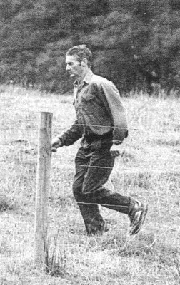
Notes:
You've probably never heard of the Westfield Ultramarathon, a race from Sydney to Melbourne, Australia, 543.7 grueling miles. But if you've heard of it, you've probably heard of Cliff Young,
Young was an Australian potato farmer with a 2,000 acre farm. He never had a coach, a trainer, or special equipment. He grew potatoes and chased around 2,000 sheep as his profession, sometimes for days at a time. In 1983, AT AGE 61, he arrived at the Westfield Ultramarathon to compete, wearing rubber rain boots and torn overalls. While runners stretched in their Nike and Adidas running gear, people laughed at Young, considering him a joke. But he insisted on running. Hours later he trailed by miles. But he didn't quit. All He did was just run his race. Literally all he did was run for 23 hours a day. While every one else stopped each day for the "normal" six hour recovery sleep, he slept only an hour at a time. Endurance and persistence defeated conventional wisdom.
Over five days later, the joke was on everyone else. The 61 year old farmer finished first, destroying the previous record, by two days.
When asked what his secret to his victory was he said “Well, love, I just didn’t stop!”
Run your race – not that classmate, neighbor, co-worker, facebook friend, Christian parent

Slide 26
What habit of comparison can you stop or change starting today?
Notes:
Get off of instaguilt / failbook & smackchat
– that’s what’s its producing
Creating guilt about what you haven’t done
Make you feel like a failure for not looking like them
Smack’s your wounds in the face and makes you depressed
You’ve got a race – you’ve got a grace for what Jesus has for you!!!
You can’t get to greater days ahead and live in comparison

Slide 27
[1]
Start committing to Jesus instead of thinking about Him
“looking to Jesus, the founder and perfecter of our faith. . .”
Notes:
This is #1
No excuse November – actually be able to time, schedule and be able to track your focus on Jesus
Build some habits that keep you looking at the cross not your disappointments, not comparisons
The list
Firstfifteen
Look at Jesus – remember the cross -there is joy to get through the fears, the pain to start again
(painful to start looking at what we have not been doing – let it go)
Look at jesus and just take a step in front of you
Don’t try to fix the big problem
Jesus take a step in the right direction
Invite Jesus to form a habit in you that will form your vctory for the future

Slide 28
“When you look at The Cross, what do you see? You see God's awesome faithfulness. Nothing, not even the instinct to spare His own Son, will turn Him back from keeping His word and promises to you!”
Notes:
Here is are important thoughts about habits
“The Coaching Habit” by Michael Stanier
To build a new habit you need:
[1] A reason – should be a vision of helping another
Lose weight to fit in that dress or to play with the grandkids
Serve at church to make God like you or to see next generation have what you didn’t
[2] A trigger – person, feeling, location, preceding action, time (night time)
Listen – holidays are coming – that’s a trigger!
Grief Share!!!
For some – Friday nights trigger for loneliness
Know what it is
[3] A micro habit – change direction -60 seconds
Trigger is turning on the computer
What will you do instead
Bad habit for thanksgiving and comparison
= wake up and look at phone
- Wake up grab phone – psalm of the day in bible app
[4] Effective practice – specific what you will do
What will you do after the
Effective prayer time – car before work
The Bible Project – don’t try to understand bible on your own
[5] A recovery plan – repeat Heb 12;1-2
You will fail one day / forget
What will you do –grace plan!
Others to support you
A Support group
- Small groups!
(stre
Example -
Story of no excuse -disappointment, anger,

Slide 29
What a habit that keep you
looking to The Cross can you commit to today?
Notes:
The List (in every room & on website

Slide 31
Because Jesus has eliminated every barrier
I am free to eliminate every excuse
My progress in God’s promises begins today
Notes:
Say it together
If you will choose one for each of these four steps

Slide 32
Building New Habits
A Reason
A Trigger
A Micro Habit
Clear steps
A Recovery Plan
+ . . . And Support
Notes:
Here is are important thoughts about habits
“The Coaching Habit” by Michael Stanier
To build a new habit you need:
[1] A reason – should be a vision of helping another
Lose weight to fit in that dress or to play with the grandkids
Serve at church to make God like you or to see next generation have what you didn’t
[2] A trigger – person, feeling, location, preceding action, time (night time)
Listen – holidays are coming – that’s a trigger!
Grief Share!!!
For some – Friday nights trigger for loneliness
Know what it is
[3] A micro habit – change direction -60 seconds
Trigger is turning on the computer
What will you do instead
Bad habit for thanksgiving and comparison
= wake up and look at phone
- Wake up grab phone – psalm of the day in bible app
[4] Effective practice – specific what you will do
What will you do after the
Effective prayer time – car before work
The Bible Project – don’t try to understand bible on your own
[5] A recovery plan – repeat Heb 12;1-2
You will fail one day / forget
What will you do –grace plan!
Others to support you
A Support group
- Small groups!
(stre
Example -
Story of no excuse -disappointment, anger,

Slide 33
We Can Start Today!
Communion (remembering)
A Clear Decision About Jesus
A Clear Commitment For Nov.
Make It Public
Place Your Sticker
Notes:
Distribute communion now!!!!

Slide 34
“Here a great number of disabled people used to lie—the blind, the lame, the paralyzed. One who was there had been an invalid for thirty-eight years. . .
(John 5:4-5)
Notes:
So bad for so long
So defeated for so long

Slide 35
“When Jesus saw him
lying there and learned that
he had been in this condition
for a long time, Jesus asked him,
“Do you want to get well?”
(John 5:6)
Notes:
Notive the questions
Not why aren’t you well

Slide 36
“‘Sir,’ the invalid replied, ‘I have no one to help me into the pool when the water is stirred. While I am trying to get in, someone else goes down ahead of me.’
(John 5:7)
Notes:
The man - excuses

Slide 37
“Then Jesus said to him, ‘Get up! Pick up your mat and walk.’ At once the man was cured; he picked up his mat and walked. The day on which this took place was a Sabbath [today]”
(John 5:8-9)
Notes:
Jesus – no excuses
Get to it
Why? Jesus being insensitive
Jesus knows what He has done for Him!
NO BARRIER – COME ON

