Slide 1
God’s Word For Us Today
“Your places of frustration
will become places of fulfillment
IF you will follow Me
by faith not familiarity”
Notes:
We want follow God in the way we always have
God wants to grow us to victory we have never had
In other words,
God is trying to grow and take you to greater days
But you have to face and overcome things you are not good at
Things you have never dealt with
Things that will make you frustrated right now
But will one day lead you to fulfillment
You can try to follow Jesus the way you always have
Or follow Jesus the way He is leading (by faith, into the new)

Slide 2
Psalm Of Ascents (120-134)
The prayers and steps of faith of those longing to grow closer to the presence and promises of God. They are willing to leave what is familiar to meet God in a new way (a key characteristic of faith).
Notes:
Notice Psalm 127-128 in your handout
As the pilgrim continues his (or her) journey away from what is usual and familiar in order to experience more of the presence of God, he (or she) begins to realize that his usual and familiar priorities and patterns in everyday life need to change. God’s definition of success is different than what he has been living.

Slide 3
In areas of frustration . . .
You have to let go of the familiar and follow Jesus into the new.
There you will find fulfillment!
Notes:
You can try to keep doing it your way
You can try to keep telling God He isn’t doing it right
(or how he used to)
You can stay frustrated or you can let God grow you into something new
Basketball - set shot / jump shot -frustrating to go stop using what success
Business - the saying - what got you there can't keep you there
Life coaches - you have to give up to go up
Jesus - he who loses his life will find it
Marriage - new seasons need new expressions of love in
can try to keep demanding God get it right like He used to

Slide 4
Growth Mindset
Fixed Mindset
Notes:
The Bible talked about this well before the world
World calls it a growth – mindset
The Bible calls it – living by faith
And in Psalm 127 & 128
God calls us people who are frustrated with results
To have a growth mindset
To rethink about what to depend on and aim for in life

Slide 5
 | Psalm 127 | Psalm 128
Goal (same) | “Blessed” | “Blessed”
Experience | Frustration | Fulfillment
Writer | King Solomon | Unknown
Success | The Source | The Key
Notes:
These psalms – being blessed – success of God in your life
And that's what these two psalms are about
Psalm 127 describes truth with frustration
Psalm 128 describes truth with fulfilment
Ps 127 is written by solomon - the most outwardly successful person on earth
Ps 128 - is written by a nobody who is never known
Ps 127 – reveals the truth about the source (but doesn’t have the Key)
Ps 128 – the key and the results
Both are inspired by the Holy Spirit
Both reveal the signs/results of true success
bUt only one holds the key.
So let's look at these two psalms together
As we invite Holy Spirit to speak to us today
How do you go from frustration to fulfilmment
READ PSALMS

Slide 6
Am I depending on
the right source for success?
Do I have
the right attitude for success?
Am I aiming for
the right results of success?
Notes:
WHEN FRUSTRATED YOU SHOULD

Slide 7
THE SOURCE OF TRUE SUCCESS
God’s Presence (127:1)
“Unless the Lord builds the house, its builders labor in vain. Unless the Lord watches over the city, the watchmen stand guard in vain.”

Slide 8
THE SOURCE OF TRUE SUCCESS
God’s Presence (127:1-2)
Without the Lord, I cannot succeed
With the Lord, I will not fail.
Notes:
You’ve got to choose what you are having faith in

Slide 9
“Do not let your hearts be troubled. Trust in God; trust also in me. . . . I am the way and the truth and the life.”
(JOHN 14:1, 6)

Slide 10
“No servant can serve two masters. Either he will hate the one and love the other, or he will be devoted to the one and despise the other. You cannot serve both God and Money.”
(Luke 16:13)
Notes:
Jesus said we have to choose
You can try to build a business, a career, a family, a romantic relationship, a meaningful life
Without God - but it you won't succeed
For weeks, years, decades - you can look like its working, world can say its working
But you can't have life with the one who is life
You can try to make chicken soup without chicken - but is not really chicken soup
Every person - as different as we are
Only has one real dilmena in life - do I believe God is the only sourse of true life
Book - Halftime
Succesful christian business man
In his forties - what's the real meaning and fulfilment in lfie
Atheist life coach - top consultant in the world
"I've listend to you talk for hours - all the things you care about and want to do in life"
Here's the question - "What's in the box?"
Your box - what's the one thing you want to live and die for
What's the one thing that is most important to you -and you believe in more than anything else
"Sounds like you want to out money and Jesus Christ in the box"
But you can't put two things in the box - make a choice
I decided Jesus Christ

Slide 11
No matter who we are or how different we feel from others, all of us have one real dilemma in life:
Do I believe Jesus is the only source of true life (& success)?
Notes:
Tell story

Slide 12
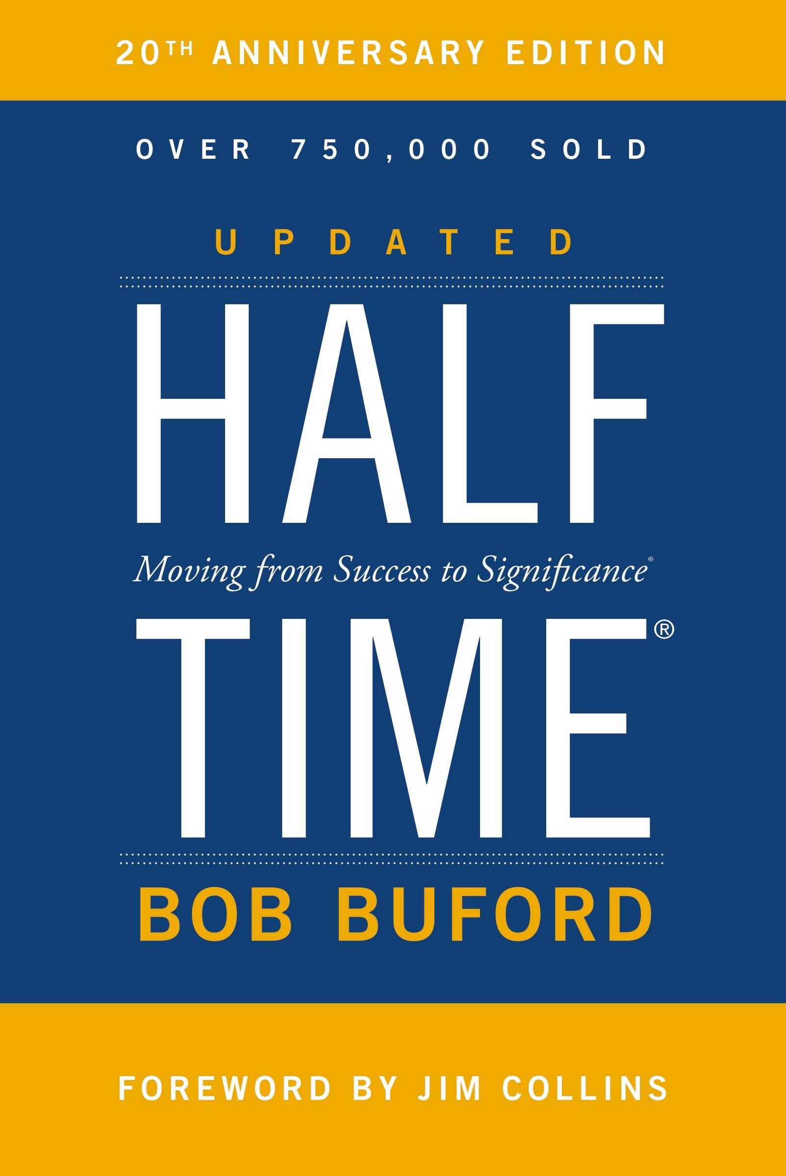
What’s in your box?
Notes:
Trying to go in more than one direction in life is frustrating to you and to everyone around you. One person can’t live for two goals (gods) in this life.

Slide 13
THE SOURCE OF TRUE SUCCESS
The Presence of God
“Jesus, who I am needs
more of who you are!”

Slide 14
THE KEY TO TRUE SUCCESS
The Fear Of The Lord
“Blessed are all who fear the Lord,
who walk in his ways. . . Thus is the man blessed who fears the Lord.”
(Psalm 128:1,5)
Notes:
Can’t just know the source
Have to know the key to unlock it
(Have all these online accounts – forgotten your password)
What good is the source without the key?
Here is the key – The Fear of the Lord
Whatever you value the most you fear the most
Why?
You fear oxygen - no I don't - I love oxygen
You fear being without it
You know you'll die without it
You know you won' t experience life without it
So you fear it - you make all your decisions because of it
It's the one thing you don't want to be far from
That's the fear of the Lord
Without him I won't experience life
Solomon - wrote 127 / he had wisdom, power
He didn't fear the lord
We are going to see the 3 signs of success in life
Solomon failed at all of them
Not because he didn't know -
Because he didn't fear
Didn’t have the password
When I fear God he becomes the key to all the decisions I make
The pilgrim -realized – I haven’t done that
Reading in the prophets – you have the source but not the key
Our world – believe but don’t fear God / don’t worship him as greatest

Slide 15
“The Bible isn’t much interested in whether we believe in God or not. What it wants to know is our response to God. Do we fear Him? Will we let God . . .”
Notes:
A Long Obedience in the same direction –pg 120
The key to success is to fear the lord not favor him.
If you do, you'll go after results that are far different than the world
Look at what the results/goals of success are

Slide 16
“ . . . be as he is, majestic and holy, vast and wondrous, or will we always be trying to whittle God down to the size of our small minds and limits of this broken world?”
Notes:
A Long Obedience in the same direction –pg 120
The key to success is to fear the lord not favor him.
If you do, you'll go after results that are far different than the world
Look at what the results/goals of success are

Slide 17
THE RESULTS OF TRUE SUCCESS
(Fulfillment in Psalm 128)
(v3a) Your spouse flourishes
(v3b) Your children live with honor
(v5) God’s Kingdom advances
in your lifetime

Slide 18
Your Spouse Flourishes (v3a)
God planted your spouse next
to you so he/she would flourish
Notes:
What to lay down your life
What are you doing to make sure the enemy

Slide 19
Your Spouse Flourishes (v3a)
God planted your spouse next
to you so he/she would flourish
“Success is when the people who know you the best, love and respect you the most”
Notes:
What to lay down your life
What are you doing to make sure the enemy

Slide 20
Your Children Live With Honor
“Success is not about your greatness but the greatness of God is in your children.”
Notes:
olomon wrote about it - but failed at it
His sons warred and divided from each other
In the city gate - legal and business situations
Picture that they are strong and sharp in the future
Two keys - nurture - olive shoot
Raise them up
Arrows - sharp and pointed strength
Send them out
Want to be a success - nurture the right foundation
Prepare them to be sent out -
I can give them the foundation can't eliminate the journey
Through fear, world, sin -equip not enable
Prepare but not intefere
We can't protect our kids from God
Parenting by reaction - tell me when something is wrong
Isn't preparing them for what's ahead
I din;t well - wihtout the lord can't succed
With him you will not fail
5 loaves and 2 fish over 18 years or 18 months will due just fine

Slide 21
Your Children Live With Honor
“Success is not about your greatness but the greatness of God is in your children.”
Nurture your “olive shoots” (128:3)
Prepare your arrows to be sent (127:4)
Notes:
olomon wrote about it - but failed at it
His sons warred and divided from each other
In the city gate - legal and business situations
Picture that they are strong and sharp in the future
Two keys - nurture - olive shoot
Raise them up
Arrows - sharp and pointed strength
Send them out
Want to be a success - nurture the right foundation
Prepare them to be sent out -
I can give them the foundation can't eliminate the journey
Through fear, world, sin -equip not enable
Prepare but not intefere
We can't protect our kids from God
Parenting by reaction - tell me when something is wrong
Isn't preparing them for what's ahead
I din;t well - wihtout the lord can't succed
With him you will not fail
5 loaves and 2 fish over 18 years or 18 months will due just fine

Slide 22
God’s kingdom advances
in your lifetime (128:5)
“May the Lord bless you from Zion all the days of your life; may you see the prosperity of Jerusalem”

Slide 23
God’s kingdom advances
in your lifetime (128:5)
“Only one life, twill soon be past,
Only what's done for Christ will last.“
~ Missionary Charles Studd
Notes:
You can’t help be a true success in all of life if you focus on these three results
10 year into marriage
14 years – changed the lives and this church and actually the world
How will it advance
Tell story of sara and project hope – show pic
Fear the lord
Focus on your family
Trust in His faithfulness

