Slide 2
Summer Road Trip (Pilgrimage)
A journey with different people, to a different place, to know God’s presence in a greater way.

Slide 3
Our First Step
Deciding to pray
“Jesus, who I am
needs more of who you are.”

Slide 4
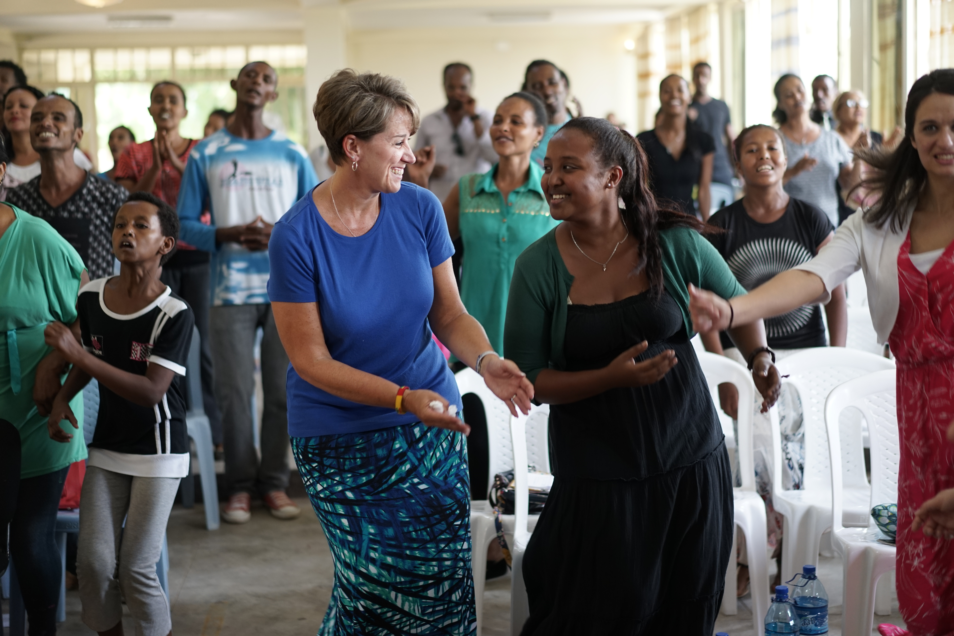

Slide 5
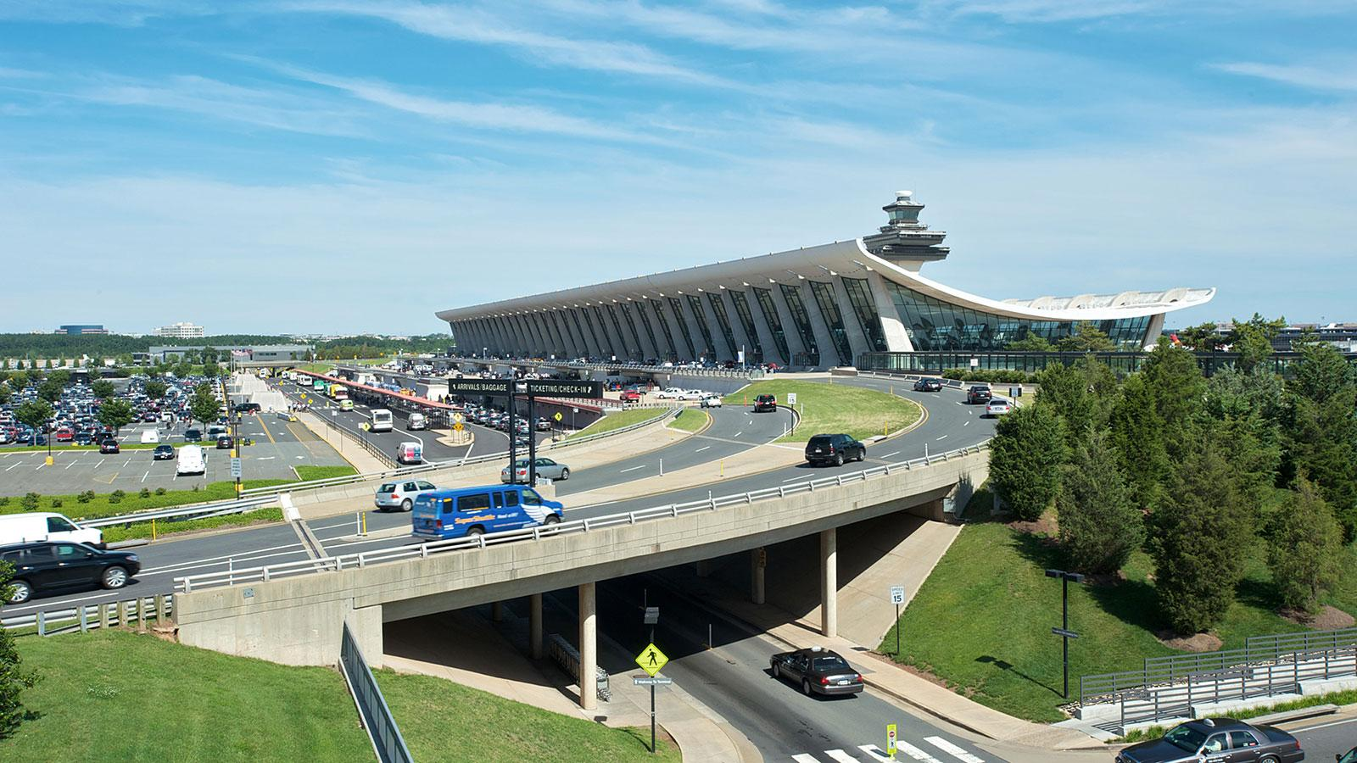

Slide 6
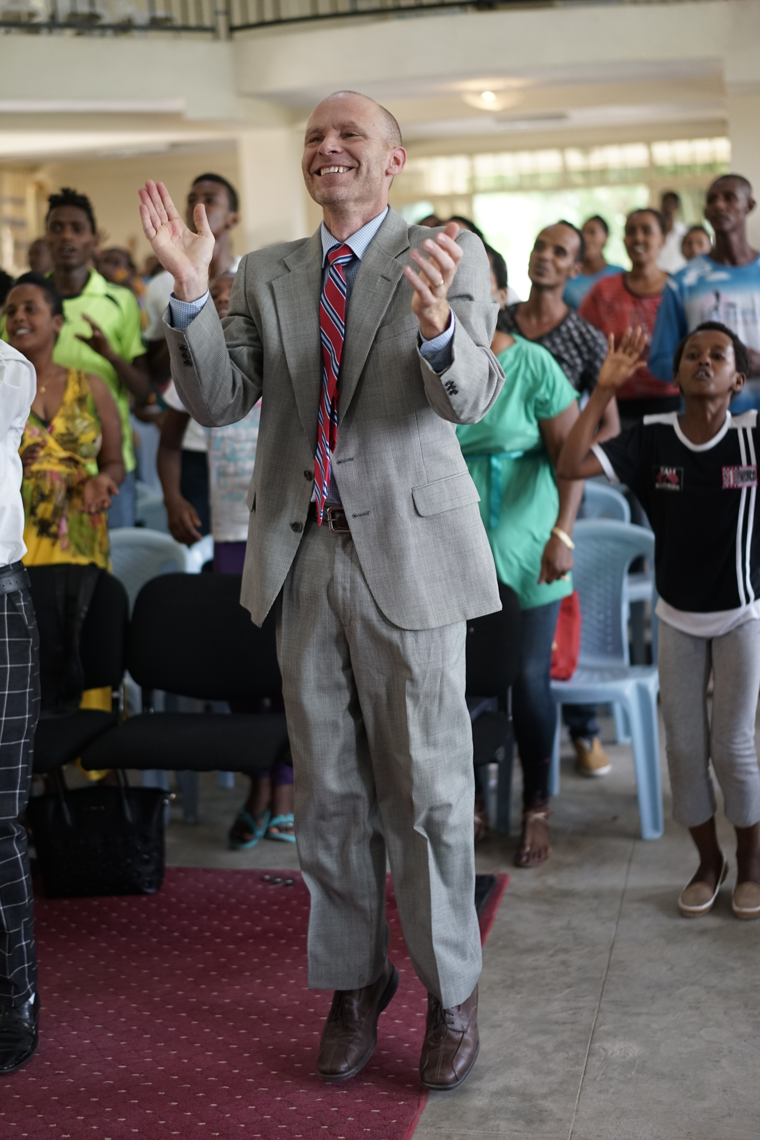
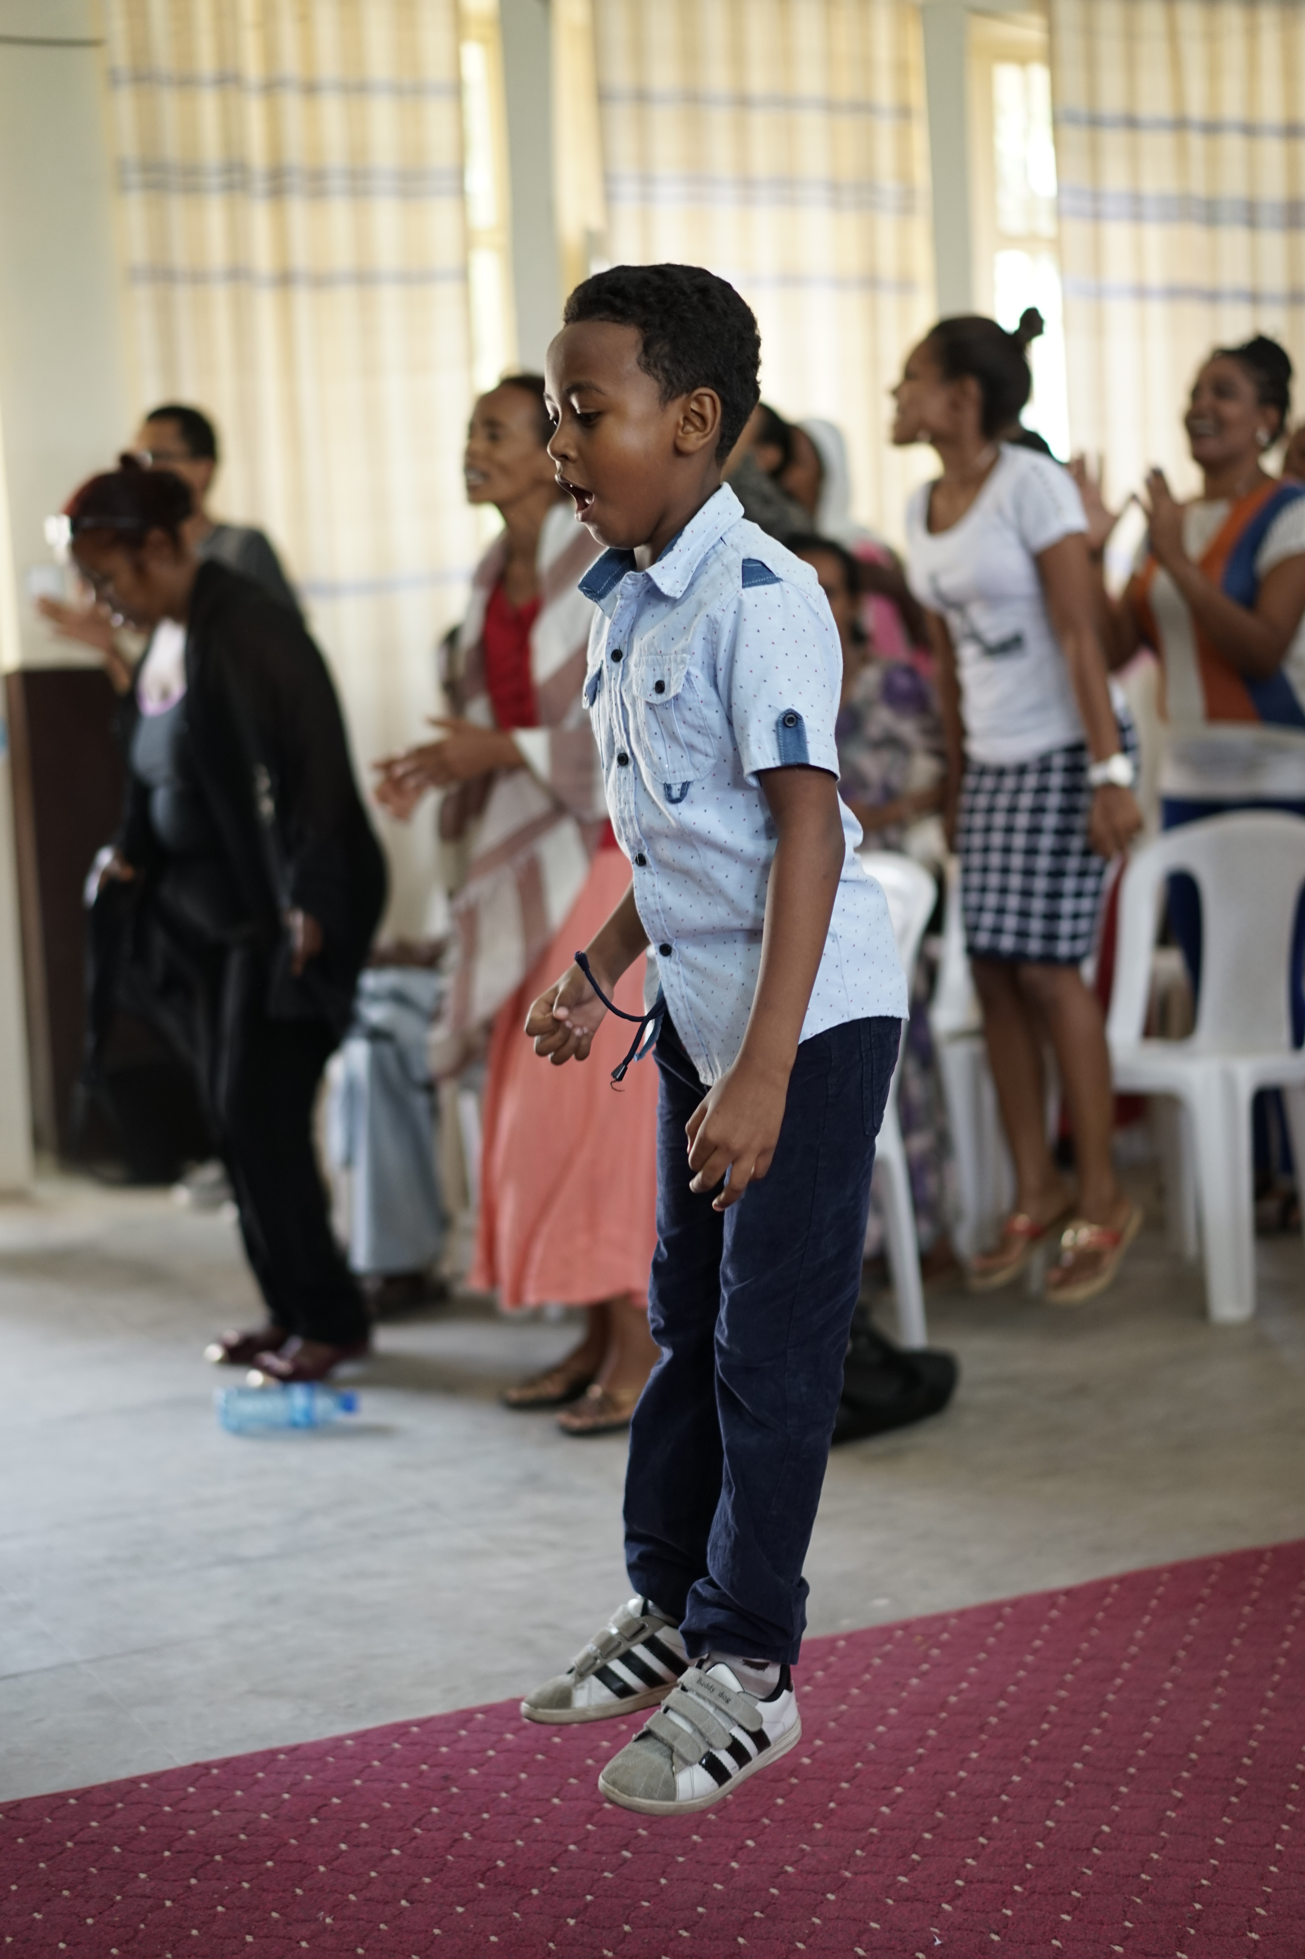
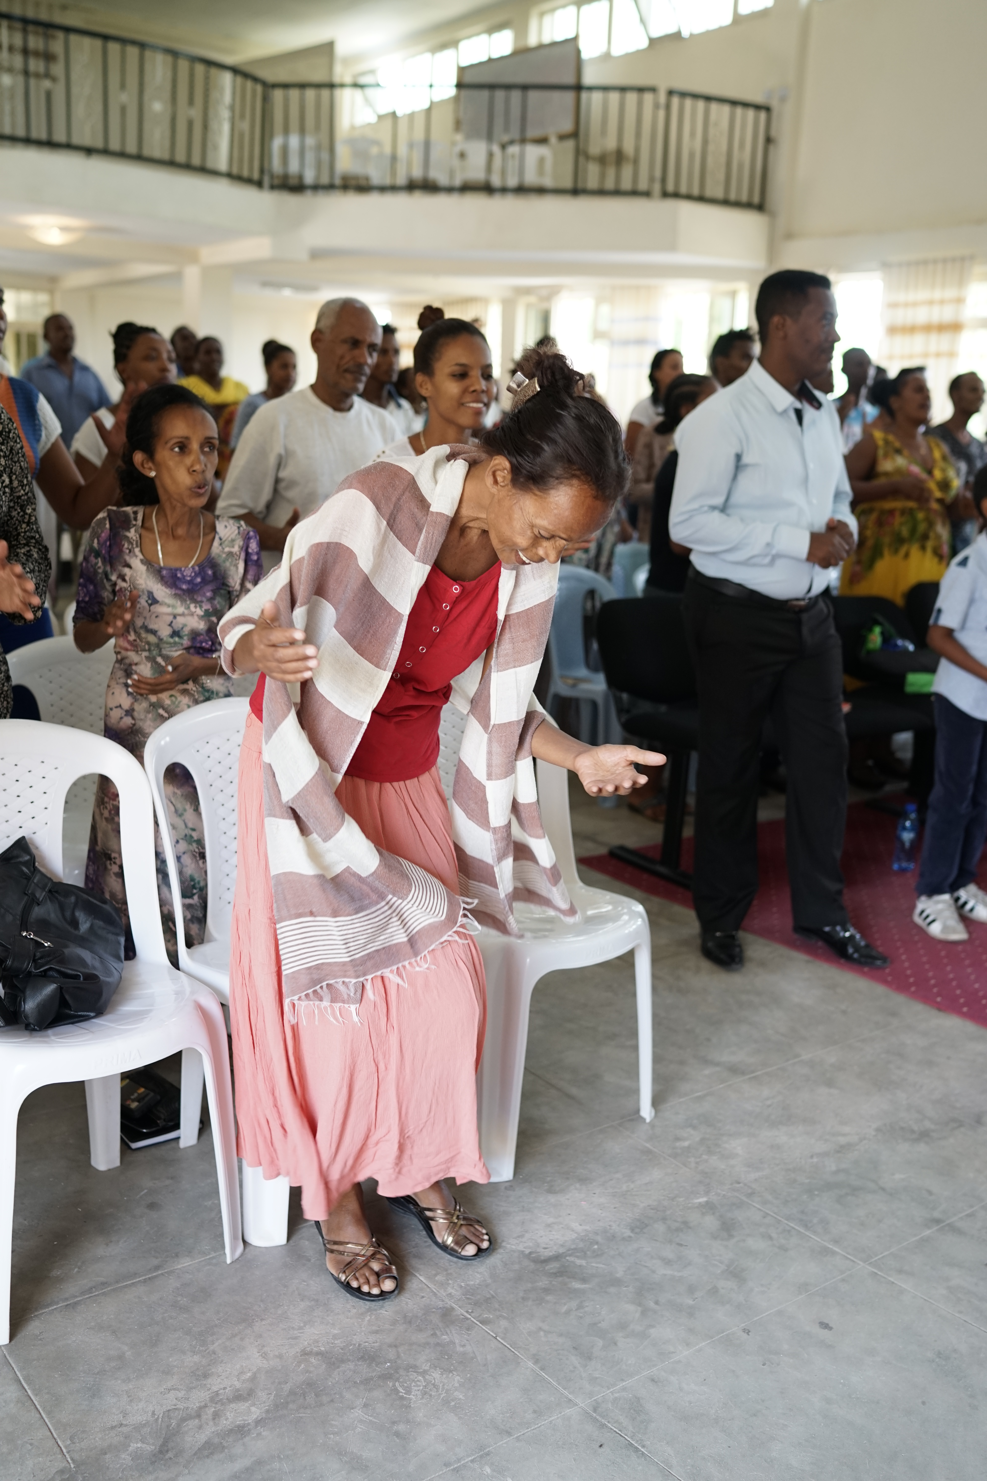

Slide 7
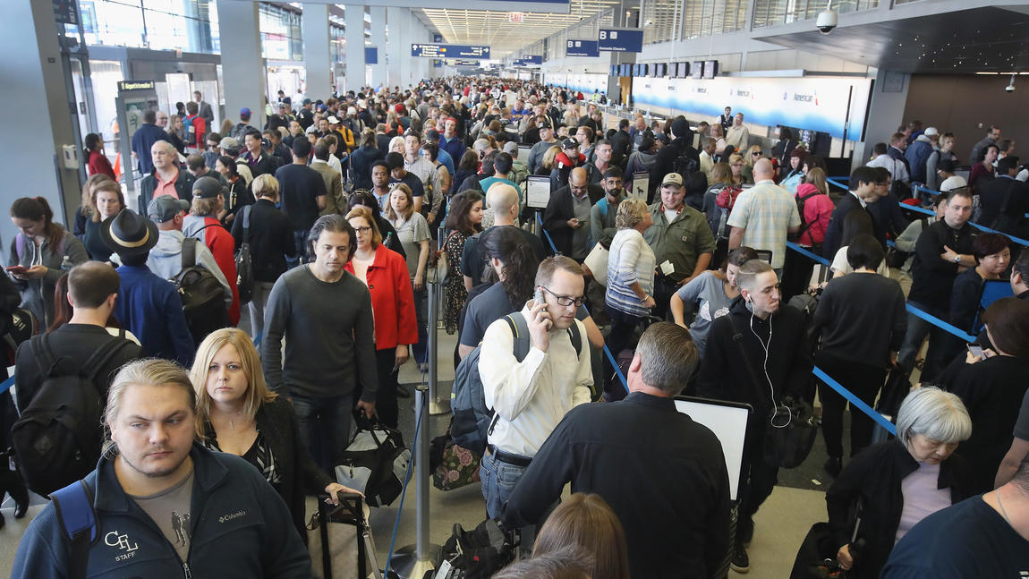

Slide 8
Psalm 122
+ Entering Jerusalem, not the Temple
+ A city in need of peace (5x)
+ A Psalm of David ?
+ A place of blessing & trouble

Slide 9
God's presence is in places that are blessed & greatly troubled
“I rejoiced with those who
said to me, ‘Let us go
to the house of the LORD.’”
Notes:
God’s presence is in the middle of all of it
David believes God’s greater presence is there
He doesn’t believe God’s presence, joy and victory – is in a place void of problems
He rejoices to go there – to find God’s presence
And that is the key to our journey as well.

Slide 10
YOUR NEXT STEP
From Seeing to Believing
You can’t reach God’s
greater presence or peace
by “looking” for it

Slide 11
We live by faith, not by sight.
(2 CORINTHIANS 5:17)

Slide 12
Jesus answered, “The work of God is this: to believe in the one he has sent.”
(JOHN 6:29)

Slide 13
So we fix our eyes not on what is seen, but on what is unseen. For what is seen is temporary, but what is unseen is eternal.
(2 CORINTHIANS 4:18)

Slide 14
In the gospel a righteousness from God is revealed, [one] that is by faith from first to last, just as it is written: “The righteous will live by faith.”
(ROMANS 1:17)

Slide 15
We think seeing is better
than believing
“Jesus said to them,
“How foolish you are, and how
slow of heart to believe”
(Luke 24:25)

Slide 16
In this world
believing is better than seeing
Then Jesus said, “Did I not tell you that if you believed, you would see the glory of God?”
(JOHN 11:40)

Slide 17
Now faith is being sure of what we hope for and certain of what we do not see.
(Hebrews 11:1)

Slide 18
Even though I walk through the valley of the shadow of death, I will fear no evil for you are with me;
(PSALM 23:4)

Slide 19
As he approached Jerusalem and saw the city, he wept over it and said, “If you had only known on this day what would bring you peace – but now it is hidden from your eyes
(Luke 19:41-42)

Slide 20
Where is God in this?

Slide 21
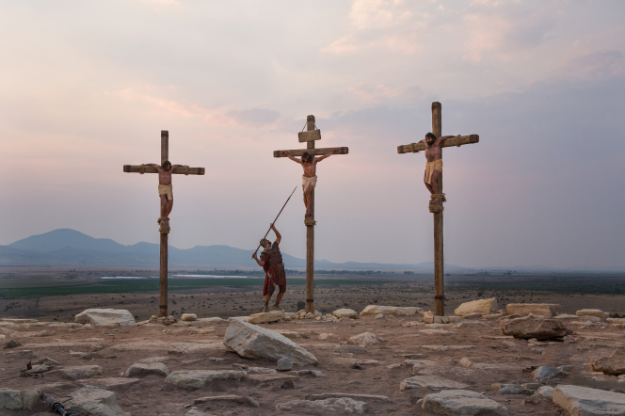

Slide 22
In whatever you are going through:
“Focus. Don’t see.”

Slide 23
Jesus cried out in a loud voice, “My God, my God, why have you forsaken me?”
(MATTHEW 27:45-46)

Slide 24
Jesus called out with a loud voice, “Father, into your hands I commit my spirit.” When he had said this, he breathed his last.
(LUKE 23:46)

Slide 25
So we fix our eyes not on what is seen, but on what is unseen. For what is seen is temporary, but what is unseen is eternal.
(2 CORINTHIANS 4:18)

