Slide 1
Notes:
Begin with reading the first two psalms of ascent (background later)
If you’ve ever:
(1) faced a challenge (2) realized things need to change
(3) had to start again or face what’s next
(4) facing an uphill climb in a part of your life
(5) you know you’re getting too comfortable and apathetic in life
THIS TWO PSALMS ARE FOR YOU!
They are about someone – a pilgrim / Who decides they need to begin a new journey to God
And they decide that they are going to travel to Jerusalem
Most of it an uphill climb / To the temple where God’s presence is
And so this is how they start the journey
And its how you and I should start ours [READ IT HERE]
120 - says I’ve been in the wrong place for too long
I need to go to God for peace
121 – but Jerusalem is up in the hills – I don’t think I can get there
Even though he feels this way
he makes a decision (that we need to make today)
Whatever it takes I need more of the presence of God (get in the game!)

Slide 2
We have to decide to pray for
more of His presence
“Jesus, who I am needs
more of who You are”
Notes:
We don’t need God to give us more things
Or Do more things for us
We don’t need more religion or programs
What we need is more of His Presence
Not his miracles, not his wisdom
What we need most is his presence
PRAY THIS WITH ME –
The Bible is all God being with us
That true life is found in His presence

Slide 3
“The thief comes only to steal and kill and destroy. I have come that they may have life and have it abundantly.” (John 10:10)
“You have made known to me the path of life; you will fill me with joy in your presence, with eternal pleasures at your right hand.” (Psalm 16:11)
Notes:
He came so we could have it
Nothing about doing it – just if he is with us we will have it
Psalm 16 – not the outward that is going to give us peace

Slide 4
“When my enemies turn back, they stumble and perish because of your presence.” (Ps 9:3)
“For I know the plans I have for you, declares the LORD, plans for welfare and not for evil, to give you a future and a hope.” (Jeremiah 29:11)

Slide 5
2. We have to decide to pursue His presence
“If anyone would come after me, let him deny himself and take up his cross daily and follow me.” (Luke 9:23)
“Blessed are those whose strength is in you, who have set their hearts on pilgrimage.”
(Psalm 84:5)
Notes:
All of us are pursuing something
We’re giving our time, our money, our relationships to it.
Blessed is the one who has a heart to go on a journey to find more of God
Sara Pfister – everything and more –I was so filled with insecurities, fears and inner vows - I literally loved seeing her – but I almost gave up
We’re doing that with God
We’re playing it safe – not pursuing because of the disappointments or distractions in our lives

Slide 6
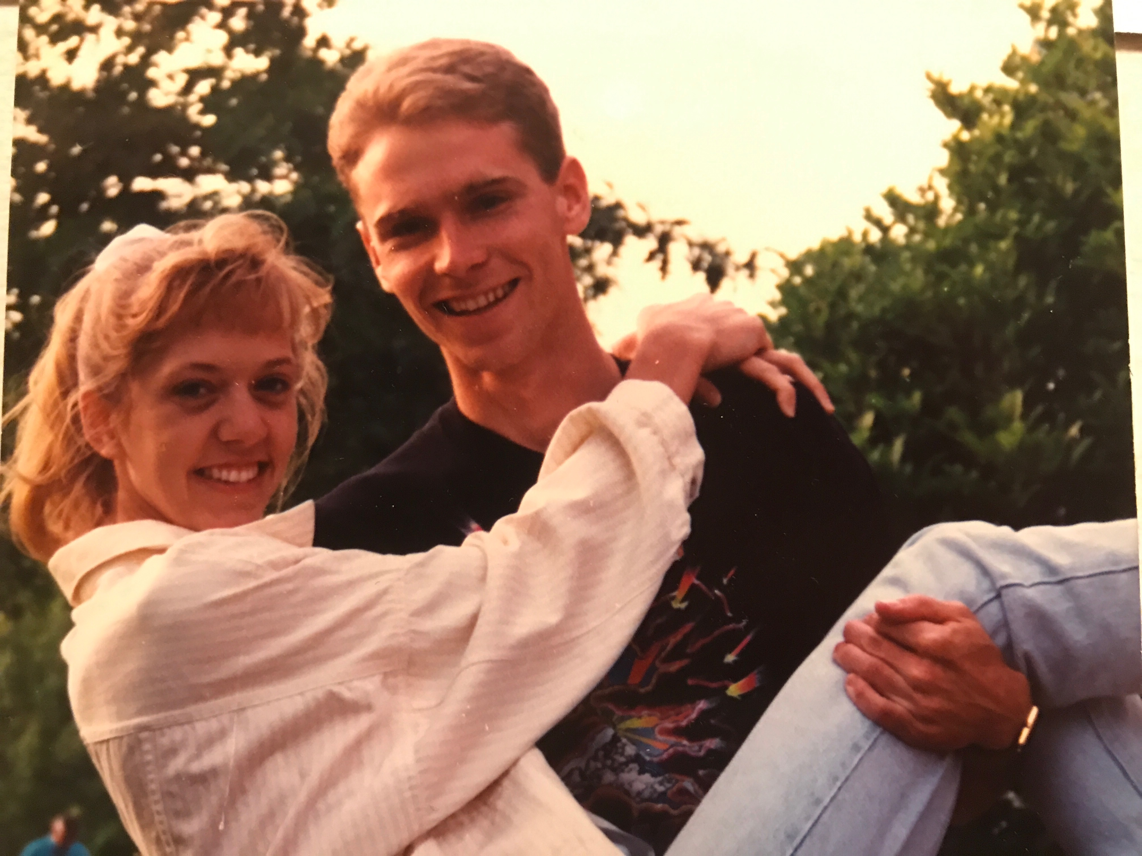

Slide 7
2. We have to decide to pursue His presence
“If anyone would come after me, let him deny himself and take up his cross daily and follow me.” (Luke 9:23)
“Blessed are those whose strength is in you, who have set their hearts on pilgrimage.”
(Psalm 84:5)
Notes:
All of us are pursuing something
We’re giving our time, our money, our relationships to it.
Blessed is the one who has a heart to go on a journey to find more of God
Tina Love – pursued her / new what classroom, locker, stairs
- just to see her – be in her presence
Sara Pfister – everything and more –I was so filled with insecurities, fears and inner vows - I literally loved seeing her – but I almost gave up
We’re doing that with God
We’re playing it safe – not pursuing because of the disappointments or distractions in our lives
We have to pursue Jesus
What it says in Luke 9:23
What we heard in Psalm 84:5
Pilgrimage is a decision to purse God’s presence in a certain way

Slide 8
Pilgrimage: a journey with different people, to a different place, to see God in a different way.
Psalm of Ascents (Ps. 120-134):
The songs/prayers of those on pilgrimage to Jerusalem - when they (literally) went up to Jerusalem to be in the presence of God at The Temple and offer sacrifices.
Notes:
I had to work past my lies and put myself in a new place doing something out of my normal
Fear made my normal my prison, my routine my blinders
Psalm of Ascents - they are the steps people took to go to jerusalem
“Do not worship the LORD your God in the way that these people worship their gods. 5 Out of the territory of all your tribes the LORD will choose the one place where the people are to come into his presence and worship him.” Deuteronomy 12:4-7

Slide 9
We have to choose to pursue His presence
whether we feel victorious, defeated, faithful or a failure in life
“Woe to me that I dwell in Meshech, that I live among the tents of Kedar!” (120:5)
Notes:
In Psalm 120 – this person is a believer who feels far from God
Woe to me that I dwell in Meshech, that I live among the tents of Kedar! (v5)
Here’s where those two places were in the ancient world

Slide 10
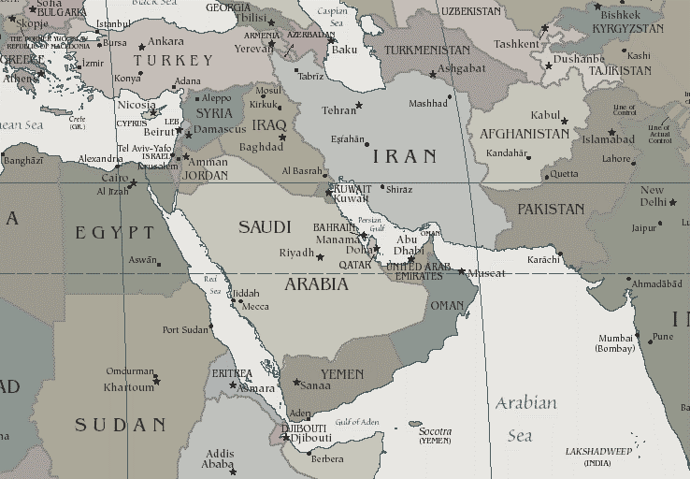
Notes:
They were as far as you could get from Jerusalem in the ancient world.
This psalm is a poem So he’s not being literal – he’s saying
I feel as far from God as possible
And yet, this is where this psalm of ascents
This pilgrimage starts
It starts far away.
It starts with him not feeling close to God
When I can’t imagine getting there
And knowing
God, who I am needs more of who YOU ARE
So some practical wisdom today

Slide 11
Some practical wisdom
You don’t change, if you won’t change.
Notes:
Your normal pattern is your prison
Your busyness is your blinders
Most people want to change
But they want to change
They want to be different
But they don’t want to do anything different
God is magic instead of spiritual
God just change me while don’t do anything different in my life
And so we need ot hear this

Slide 12
Some practical wisdom
You don’t change, if you won’t change.
“To change who I am,
I must begin to change
something I do every day.”

Slide 13
Your pilgrimage is a Jesus-centered decision to take time this summer to change: (1) who you are with, (2) where you are, and (3) what you are focusing on.
1. We are who we imitate
2. We are where we are
3. We are what we focus on
Notes:
If you want to grow you have to change some people, places and power in your life
Show me your friends – find a new leader (but they aren’t like me – exactly)
New places new graces – step out
What are you focusing on - reactionary / responsibilities / how about adding growth, new, more
Halftime / feels like another appointment you don’t have time for

Slide 14
3. We have to decide to pay the price for
more of His presence
Change from Delay To Decision

Slide 15
PAY THE PRICE FOR HIS PRESENCE:
1. The Security of Comfort and Familiarity
“Woe to me, that I dwell in Meshech” (v5)
“Too long have I lived among those . . . “ (v6)
Notes:
The pain of staying where I am has to be greater than the problems I face to move towards my future (prodigal son principle)
We have to get a holy discontent
We have to come to the end of ourselves
Decide we have to change
Are you content with livng this way and being this person for the rest of your life?
Pay the price of security and familiarity
Be grateful –but only worship God
About decision – so look at these steps – back of page

Slide 16
#MyNextStep #SummerRoadTrip
Choose a small group
Stay connected with you’re away
3. Make it as personal as possible
Notes:
Encourage one another

Slide 17
PAY THE PRICE FOR HIS PRESENCE
2. The Deception of Self Pity & Blaming Others
“Save me, O Lord from lying lips” (v2)
“What will God do to you . . .” (v3)
“I am a man of peace but . . . they are” (v7)
Notes:
Change never begins with blaming others
You can’t ask God to change Meshek – you’ve got to change
You can’t change mesheck – but you can change you
Decide who God wants you to be
Its not your kids responsibility to lead you in time

Slide 18
PAY THE PRICE FOR HIS PRESENCE
3. The Risk of Failure and Fatigue
“I will lift my eyes up to the hills” (121:1)
“My help comes from the Lord. . .” (121:2)
“He watches over you will not slumber” (121:3)
Notes:
Distribute communion
Jerusalem – uphill – how am I going to get there

Slide 19
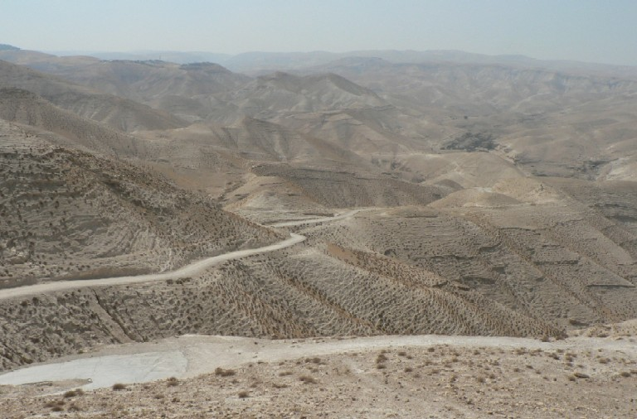
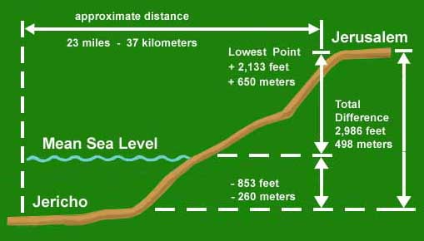
Notes:
Road to Jerusalem from Jericho
23 miles / half mile up hill –winded going upstairs in your house/apt
Pilgrim – looks up / how am I going to get there
He would sing this psalm
How are you going to get to where you need ot be
Its uphill / its too hard / impossible / you can’t see it
Recite
Don’t just recite it –remember Jesus
Jesus went up – not to bring a sacrifice

Slide 20
As the time approached for him to be taken up to heaven, Jesus resolutely set out for Jerusalem. ⁵² And he sent messengers on ahead, who went into a Samaritan village to get things ready for him; ⁵³ but the people there did not welcome him, because he was heading for Jerusalem. (Luke 9:51-53)
Notes:
Not to bring a sacrifice but to be the sacrifice
He did this
He did this for you and for me – He recited this when it seemed impossible

Slide 21
As the time approached for him to be taken up to heaven, Jesus resolutely set out for Jerusalem. ⁵² And he sent messengers on ahead, who went into a Samaritan village to get things ready for him; ⁵³ but the people there did not welcome him, because he was heading for Jerusalem. (Luke 9:51-53)
For you, Jesus didn’t delay.
He decided.
Notes:
Not to bring a sacrifice but to be the sacrifice

Slide 22
I lift up my eyes to the hills— where does my help come from? 2 My help comes from the LORD, the Maker of heaven and earth. 3 He will not let your foot slip— he who watches over you will not slumber; 4 indeed, he who watches over Israel will neither slumber nor sleep.
Notes:
Jesus did this for –He held on to these same promises
5 times - the lord watches us
V3- he who watches over you will not slumber
- never tire of you / He never had enough
He never comes to end - so you don't have to end
V4 – Indeed he who watches over Israel (not just you) will neither sleep nor slumber - never off duty, get his attention
(we wonder what he is doing_)
(certain - god is at work - never off duty) (Jesus said - he is working still)

Slide 23
5 The LORD watches over you— the LORD is your shade at your right hand; 6 the sun will not harm you by day, nor the moon by night. 7 The LORD will keep you from all harm— he will watch over your life; 8 the LORD will watch over your coming and going both now and forevermore.
Notes:
V5 - watches over you / keeper
Feeling the pressure in the day time
V6 nor the moon by night
Struggle at tnight - fear, anxiety and struggles
V7 - Jesus experienced the pain for us
(but came through it - kept from all evil)
V8 - watch over coming of going
Not just big moments but in the every day moments
Which is better – now or forever more!

