Slide 1
Notes:
Welcome – excited to share a message from God’s Word
That will touch and change many hearts
We are in the series “Grateful2God
study the book of Philippians –where in prison Paul tells us
Read it outloud with me –should be on your fridge at home

Slide 2
“Rejoice in the Lord always. I will say it again: Rejoice! Let your gentleness be evident to all. The Lord is near. Do not be anxious about anything, but in everything, by prayer and petition, with thanksgiving, present your requests to God.”
Philippians 4:4-6
Notes:
On your refrigerator
Today is Pentecost Sunday
The beginning of the church in Acts 2
The day Jesus poured out His Spirit on all believers

Slide 3
Today is Pentecost Sunday (Acts 2)
The day God began The Church by pouring out His Spirit & restoring His original design:
The Image of God
now filled with
The Spirit of God
Notes:
Through the sacrifice and forgiveness of Jesus
People who were made in the image of God
Now have the presence of God with them again
From that first day – the church has always been diverse

Slide 4
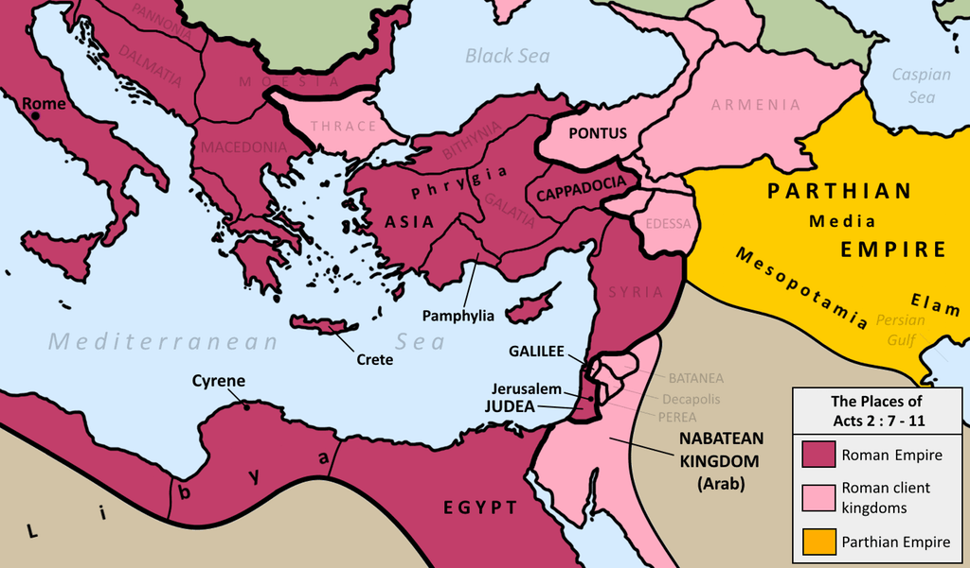
“Now
there
were
staying in
Jerusalem God
-fearing Jews from
every nation (‘ethnos’) under heaven.” ~ Acts 2:5
Notes:
On the first day of the church
God took people from every ethnic background
And filled them with His Spirit and a love for one another
He did this because He was restoring His image in the world
No one culture or ethnic group can represent His image
But by the time we get to the book of Philippians
The church’s diversity is being attacked by some lies of the world covered up in religious language

Slide 5
Philippians 3
(Paul rebukes the Judaizers)
Judaizers claim, “you can’t be a Christian if you don’t get the Jewish circumcision like we have.”
Notes:
In Phil 3 – Guy who is telling us to rejoice
Gets confronts and rebukes a group of people
Group: judiazers – former Jews who believe in Jesus
Now telling new believers –
You can’t be a Christian if you don’t get the jewish circumcision we have
You can’t be what God wants you until you become like us
You’re not normal, worthy or welcome until you are like us
Read what He says about this claim

Slide 6
Philippians 3
(Paul rebukes the Judaizers)
Judaizers claim, “you can’t be a Christian if you don’t get the Jewish circumcision like we have.”
You’re not normal, acceptable or important
to us or to God until you are like us
Notes:
You can’t be what God wants you until you become like us
You’re not normal, worthy or welcome until you are like us
All of us tend to only trust and see the best in people who are like us (in group preference)
Most of us tend to distrust and see the worst in people who aren’t like us (out group bias)
But what really is normal
- 93% of women don’t trust their husbands to do the laundry correctly. - 75% of us store our dollar bills in order with singles leading up to higher denominations. - 50% admit they regularly sneak food into movie theaters to avoid the high prices of snack foods. - 80% of us have suffered from hemorrhoids. - 46.5% of men say they ALWAYS put the seat down after they've used the toilet,
- 56% of women do the bills in a marriage. - 66% of women have used a mix to cook and taken credit for doing it from scratch. - 90% of us depend on alarm clocks to wake us. - 71% can drive a stick-shift car. - 66% of us speed up at a yellow light. - 80% sing in the car.

Slide 7
Finally, my brothers, rejoice in the Lord! It is no trouble for me to write the same things to you again, & it is a safeguard for you.
² Watch out for those dogs, those men who do evil, those mutilators of the flesh. ³ For it is [not them, but] we who are the true circumcision, we who worship by the Spirit of God, who glory in Christ Jesus, and who put no confidence in the flesh
Notes:
Paul starts with gratefulness – again – be grateful to God
It will safeguard you – against what – false teachers and perspective
What false perspective/teaching?
Those who teach that your confidence or value comes from your flesh
Its what you look like – that matters
These judaizers -think that God values what your body looks like more than your heart

Slide 8
If anyone else thinks he has reasons to put confidence
in the flesh, I have more:
circumcised on the eighth day,
of the people of Israel,
of the tribe of Benjamin, a Hebrew of Hebrews; in regard to the law, a Pharisee; ⁶ as for zeal, persecuting the church; as for legalistic righteousness, faultless.
(race)
(region)
(social class)
(language)
(education)
(cultural passion)
(criminal record)
Notes:
1. circumcised on 8th day – born jewish (race)
African, caribbean, anglo, hispanic, Asian
2. people of isreal – (region) north south, city, suburbs, rural
3. tribe of Benjamin – (class) white colar, working class, blue blood
4. hebreew of Hebrews (language) Spanish, sign language,
You’re not normal – if you’re not of my race, region, class, language
Prejudice of performance
1. in regard to the law – pharisee (education)
2. zeal, persecuting the church- (culture and heritage) music, dance,
3. legalistic righteous – (criminal record)
These are all things people judge us by, divide us and oppress us
V7-9 – non of it is what matters most
Not saying you can’t be grateful for these things
But none of them make you right with God or with others
None them should determine how you are treated
Judaizers are saying – you’re not important to God or us
If you’re not like us

Slide 9
“All the believers were together and had everything in common. Selling their possessions and goods, they gave to anyone as he had need. Every day they continued to meet together in the temple courts. They broke bread in their homes and ate together with glad and sincere hearts, praising God and enjoying the favor of all the people. And the Lord added to their number daily those who were being saved.” [Acts 2:44-47]
Day Of
Pentecost
& Forward
Notes:
Paul remembers the story of Pentecost – how people from all these different places
Came together and served one another, helped one another, suffered with one another
The only normal was love for Jesus
All were acceptable because they were made in the image of God
The needs and sufferings of each of them was important to them
They became God’s family – not by the flesh but by the spirit
And every type of person was drawn back to a relationship with God.
See these judaizers – taking away the very heart of what God is trying to do
That the gospel isn’t just about getting saved – its about getting a family
Christians hear Paul’s warning -not to put confidence in the flesh

Slide 10
Don’t put “confidence in the flesh”
Don’t let “your normal” be mistaken for . . . * God’s standard
* Your prison
* Life’s ending point
Notes:
Because there is so much more
But we have to start watching how we start seeing everything from our normal
Video – hang in there
The final line is the best

Slide 11
https://youtu.be/gPhuYG2_gQk

Slide 12
“In Group Preference”
We are more likely to trust, feel positively towards, and serve/care about those most like us. We form community & relationship rules to strengthen & expect my normal from others
“Out Group Discrimination”
We are more likely to distrust, interpret negatively, and neglect/avoid those who aren’t like us. We form community & relationship barriers & suppression towards what is different.
Notes:
Call Spanish for soccer party
Go to Kaleb’s barber shop
Why – because the sinful nature worships self
But look at Paul
“I want to know Christ – not normal”
“I want to press on”
“I want to know him more”

Slide 13
⁷ But whatever was to my profit I now consider loss for the sake of Christ. ⁸ What is more, I consider everything a loss compared to the surpassing greatness of knowing Christ Jesus my Lord, for whose sake I have lost all things. I consider them rubbish, that I may gain Christ …
¹⁰ I want to know Christ and the power of his resurrection and the fellowship of sharing in his sufferings, becoming like him in his death…
Notes:
Consider the loss for . . .
My normal isn’t all Christ wants for me
He wants me to follow him past it
Where the rest of image and heart of God is
Consider the lose compared to . . .
My normal is nothing compared to life in Christ
Life is so much more than my normal
Nothing is close to as great as him
Consider them rubbish . . .
There is no value in holding them when I could have him
I can be grateful but they can’t be God
I want to know Christ- not my normal
Power to overcome the fear and resistance
Suffer loss of comfort or mistakes
I want to be like Him who
Philippians 2:6-8
⁶ who, though he was in the form of God, did not count equality with God a thing to be grasped, ⁷
but emptied himself, by taking the form of a servant, being born in the likeness of men. ⁸ And being found in human form,
he humbled himself by becoming obedient to the point of death, even death on a cross

Slide 14
The Word of The Lord For Us Today
“Press Past Your Normal To Know More Of Christ!”
but I press on to take hold of that for which Christ Jesus took hold of me. 13 Brothers, I do not consider myself yet to have taken hold of it. But one thing I do: Forgetting what is behind and straining toward what is ahead, 14 I press on toward the goal…

Slide 15
How?
Intentionally build relationships
with people who are in the image of God but not in the image of you!

Slide 16
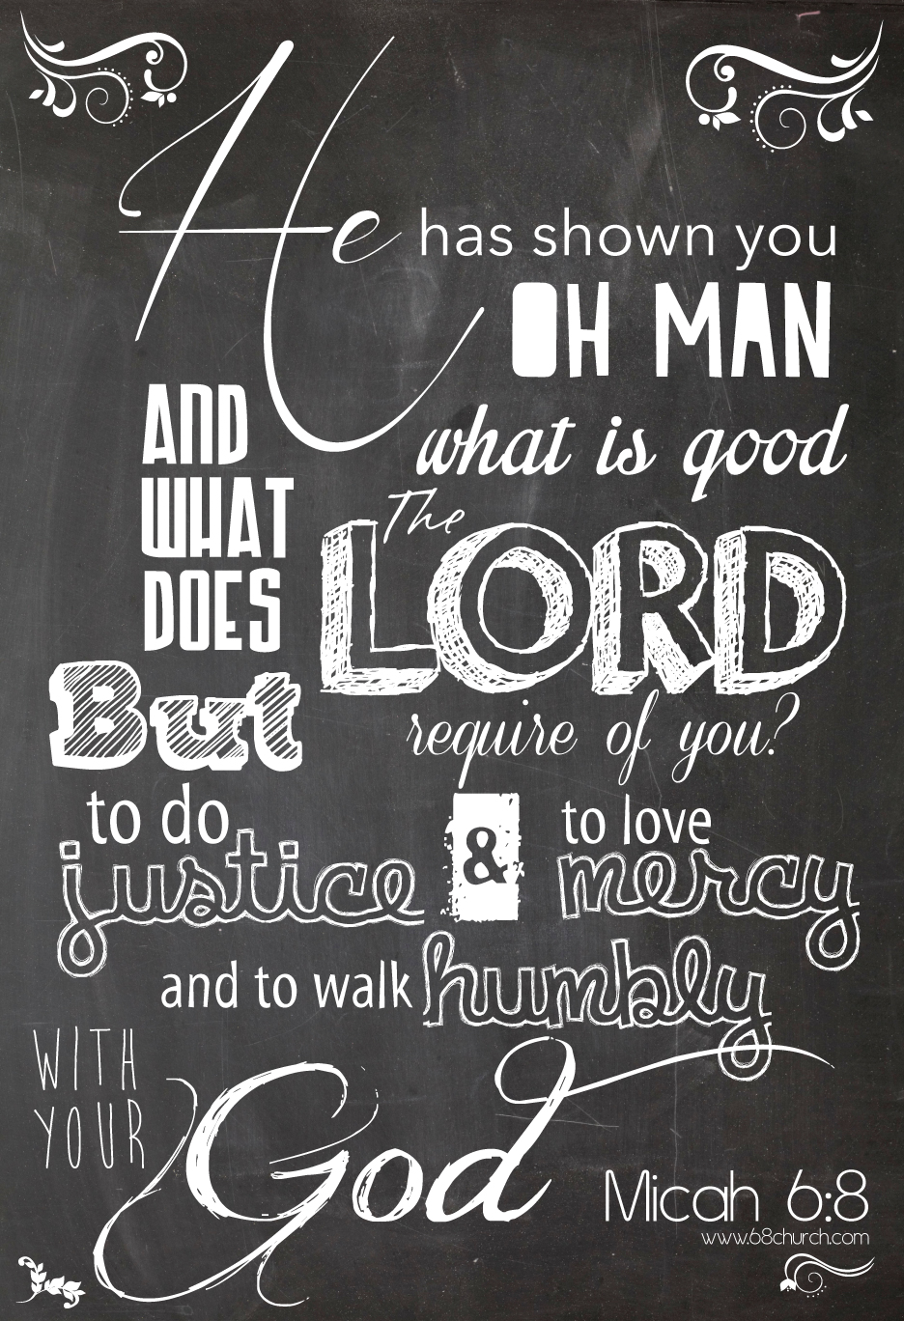
The Micah 6:8
Commission
Notes:
Where?
Right here at Cornerstone and in our community

Slide 17
Ways to press past your normal
1. “11am” Documentary, June 30th
2. Cross-cultural Worship & Prayer Night June 21st
Regional “Be The Bridge Prayer Day” June 1st
Crowning Glory Hair Event - Oct 13th
‘Be The Bridge’ Discussion Small Group in the Fall
Summer Road Trip Small Groups about Understanding The Gospel & Justice

Slide 18
Notes:
Starts out with hot button issues
Group here in Richmond –trying to press past their normal –especially in church
And know more of Christ
Intentionally build relationships
with people who are in the image of God but not in the image of you!

Slide 19
https://youtu.be/uEtLqhm82w4
From start to 2:20

Slide 20
Press past your normal @ Cornerstone
1. Regional “Be The Bridge Prayer Day” [June 1]
2. Cross-cultural Worship & Prayer Night [June 21]
3. “11am” Documentary [June 30]
Crowning Glory Hair Event [Oct 13]
‘Be The Bridge’ Discussion Small Group [Fall]
Summer Road Trip Small Groups
Understanding The Gospel & Justice

Slide 22
⁷ But whatever was to my profit I now consider loss for the sake of Christ. ⁸ What is more, I consider everything a loss compared to the surpassing greatness of knowing Christ Jesus my Lord, for whose sake I have lost all things. I consider them rubbish, that I may gain Christ …
¹⁰ I want to know Christ and the power of his resurrection and the fellowship of sharing in his sufferings, becoming like him in his death…
Notes:
Consider the loss for . . .
My normal isn’t all Christ wants for me
He wants me to follow him past it
Where the rest of image and heart of God is
Consider the lose compared to . . .
My normal is nothing compared to life in Christ
Life is so much more than my normal
Nothing is close to as great as him
Consider them rubbish . . .
There is no value in holding them when I could have him
I can be grateful but they can’t be God
I want to know Christ- not my normal
Power to overcome the fear and resistance
Suffer loss of comfort or mistakes
I want to be like Him who
Philippians 2:6-8
⁶ who, though he was in the form of God, did not count equality with God a thing to be grasped, ⁷
but emptied himself, by taking the form of a servant, being born in the likeness of men. ⁸ And being found in human form,
he humbled himself by becoming obedient to the point of death, even death on a cross

Slide 23
The Word of The Lord For Us Today
“Press Past Your Normal To Know More Of Christ!”
but I press on to take hold of that for which Christ Jesus took hold of me. 13 Brothers, I do not consider myself yet to have taken hold of it. But one thing I do: Forgetting what is behind and straining toward what is ahead, 14 I press on toward the goal…

