Slide 1
Notes:
As we begin holy week today with Palm Sunday
And journey to the cross after service today
We have already been looking at the last hours of Jesus
Last week – fear in relationships
(Palm Sunday – crowd celebrates & crucifies)
Today – Fear of the unknown
The fear that tempts us to betray Jesus the most
We all struggle with it (college, relationship, job, change, healing)
Sara and I – fear of a bad medical report when she was pregnant
Moving from PA to Cornerstone – didn’t know anyone
Choosing adoption when we already had a great family
Switching careers. Moving schools for the kids
Confronting sin in people we loved
Starting a small group. Going to a new church.
Seeking counseling for sinful habits
We struggle for God to show us what to do with what’s next
None of us are good at waiting
We fear the unknown so tend to push god away
And take control
But there is apart of our life – we have to face that fear
So did Jesus

Slide 2
Notes:
Jesus had to face the unknown
He had to do something he had never known before
He wasn’t defeated by it –but he did face it
To take on sin
To be forsaken by father
To have wrath of God
His humanity has to face the unknown
He knows father will be faithful
But he has to face the fear of the unknown with faith
And He did it with victory

Slide 3
Most of us will choose what is
familiar & comfortable
over what requires
faith & courage
even when it means
living in defeat & discouragement
Notes:
You and I – the fear of the unknown
Most of us will choose what is familiar and comfortable
Than what is faith and courage
If you look at the last 36 hours of Jesus life
The disciples were facing so many unknowns and they were afraid
John 14 – Do not be afraid. You trust in God. Trust also in me.
But instead of trusting in Jesus
They do what we all do – they tried to take control
Judas – unknwon – sells jesus out
Peter – chops off the ear of servant at arrest – then denies
Face the unknown –we try to take control
Instead of staying true to god and let him be in control
Problem is our control creates chaos)
To know the victory and joy of God in this life we have to
Overcome the fear of the unknown

Slide 4
Now to Him who is able to do immeasurably more than all we ask or imagine, according to his power that is at work within us [Eph 3:20]
No eye has seen, no ear has heard, no mind has conceived what God has prepared for those who love him [1 Cor. 2:9]
Notes:
We live by faith, not by sight. 2 Cor 5:7

Slide 5
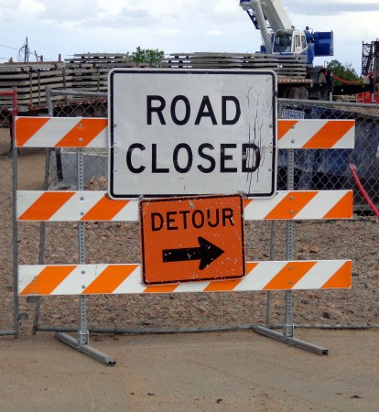
Satan uses fear to detour us from God’s great victories
“But thanks be to God, who gives us the victory through our Lord Jesus Christ.”
[1 Cor 15:57]
Notes:
Jesus us shows us the path through fear of unknown

Slide 6
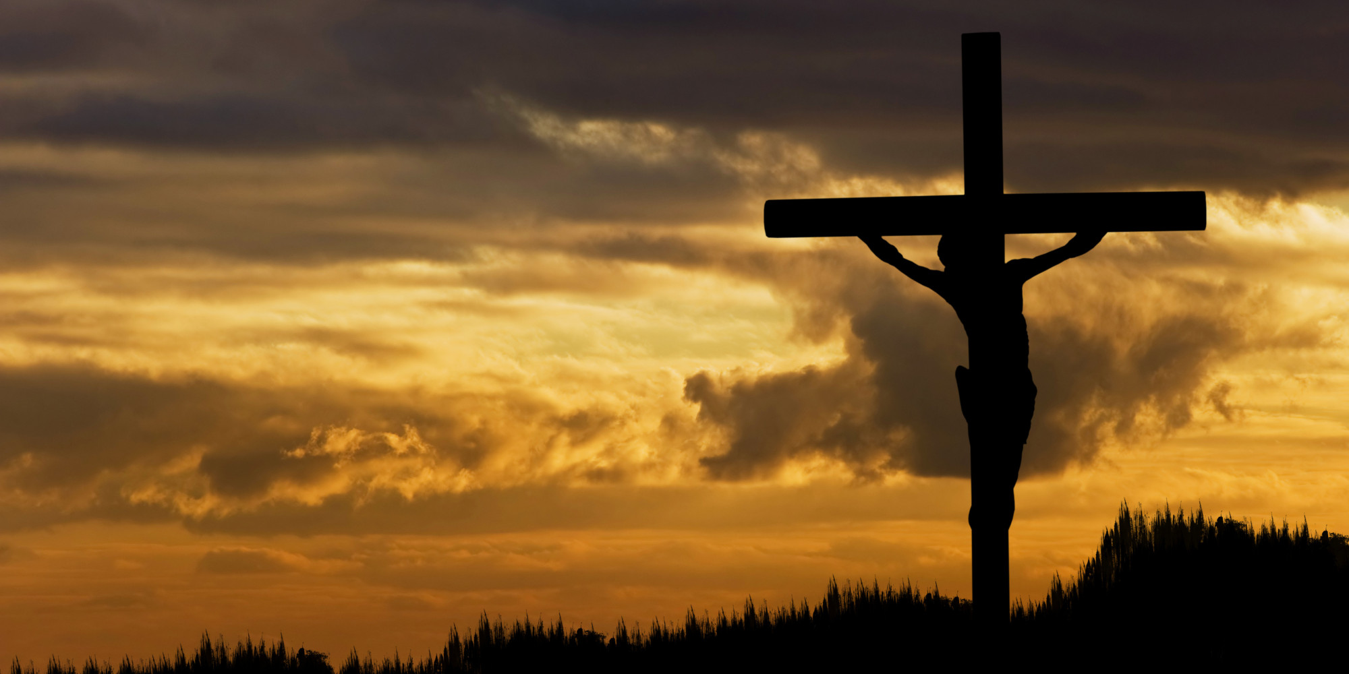
Jesus called out with a loud voice, “Father, into your hands I commit my spirit.” When he had said this, he breathed his last.
(Luke 23:46)

Slide 7
Psalm 31:24
Be strong, and let
your heart take courage,
all you who wait for the LORD!
Notes:
That’s been God’s call to us. Not just a sermon series – word of God to us His people
And before we see how Jesus himself – walked through the unknown
I think we need to hear God’s word to us again
One of our members showed me this song
Song of this season

Slide 8
SONG lyrics here

Slide 9
Be strong, and let your heart take courage, all you who wait for the LORD!
[Psalm 31:24]
How do we wait on God?

Slide 10
Be strong, and let your heart take courage, all you who wait for the LORD!
How do we wait on God?
Waiting is not passive or weak. It is actively winning in what you know of God as God unfolds the unknown

Slide 11
Isaiah 40:31
but they who wait for the LORD shall renew their strength; they shall mount up with wings like eagles; they shall run and not be weary; they shall walk
and not faint.
Notes:
That’s been God’s call to us. Not just a sermon series – word of God to us His people
And before we see how Jesus himself – walked through the unknown
I think we need to hear God’s word to us again
One of our members showed me this song
Song of this season

Slide 12
Hebrew word for waiting is“qavah”. It means . . .
“to bind together like a cord.”
Notes:
”– kav-waw’
it’s the process of making a rope by twisting or weaving small strings together to form the rope.
The more strands that are twisted or woven together in a rope, the greater is its strength.
A piece of string cannot lift very much weight because it does not have very many strands in it.
A piece of rope however can lift hundreds of pounds because it is made up of many strands.
The literal definition of “qavah” implies strength through numbers.
The more strands in your rope, the greater its strength.
Just as a rope's strength comes from being made of many strands, so our strength comes through being united with Christ. The “rope” of our lives gains strength by being twisted or woven or bound together with the Father, Son, and Holy Spirit

Slide 13
Waiting On God
To gather more of God’s strength by weaving (binding) more of God’s Word & ways around your life
Notes:
”– kav-waw’
it’s the process of making a rope by twisting or weaving small strings together to form the rope.
The more strands that are twisted or woven together in a rope, the greater is its strength.
A piece of string cannot lift very much weight because it does not have very many strands in it.
A piece of rope however can lift hundreds of pounds because it is made up of many strands.
The literal definition of “qavah” implies strength through numbers.
The more strands in your rope, the greater its strength.
Just as a rope's strength comes from being made of many strands, so our strength comes through being united with Christ. The “rope” of our lives gains strength by being twisted or woven or bound together with the Father, Son, and Holy Spirit

Slide 14
We binding more of God’s Word & ways around us by . . .
Praying it. Saying it. Doing it.

Slide 15
[1] “Father, forgive them” Forgive
Notes:
”– kav-waw’
it’s the process of making a rope by twisting or weaving small strings together to form the rope.
The more strands that are twisted or woven together in a rope, the greater is its strength.
A piece of string cannot lift very much weight because it does not have very many strands in it.
A piece of rope however can lift hundreds of pounds because it is made up of many strands.
The literal definition of “qavah” implies strength through numbers.
The more strands in your rope, the greater its strength.
Just as a rope's strength comes from being made of many strands, so our strength comes through being united with Christ. The “rope” of our lives gains strength by being twisted or woven or bound together with the Father, Son, and Holy Spirit

Slide 16
[1] “Father, forgive them” Forgive
[2] “be with me in paradise” Care for others
Notes:
”– kav-waw’
it’s the process of making a rope by twisting or weaving small strings together to form the rope.
The more strands that are twisted or woven together in a rope, the greater is its strength.
A piece of string cannot lift very much weight because it does not have very many strands in it.
A piece of rope however can lift hundreds of pounds because it is made up of many strands.
The literal definition of “qavah” implies strength through numbers.
The more strands in your rope, the greater its strength.
Just as a rope's strength comes from being made of many strands, so our strength comes through being united with Christ. The “rope” of our lives gains strength by being twisted or woven or bound together with the Father, Son, and Holy Spirit

Slide 17
[1] “Father, forgive them” Forgive
[2] “be with me in paradise” Care for others
[3] “Woman, behold your son” Be faithful to family
Notes:
”– kav-waw’
it’s the process of making a rope by twisting or weaving small strings together to form the rope.
The more strands that are twisted or woven together in a rope, the greater is its strength.
A piece of string cannot lift very much weight because it does not have very many strands in it.
A piece of rope however can lift hundreds of pounds because it is made up of many strands.
The literal definition of “qavah” implies strength through numbers.
The more strands in your rope, the greater its strength.
Just as a rope's strength comes from being made of many strands, so our strength comes through being united with Christ. The “rope” of our lives gains strength by being twisted or woven or bound together with the Father, Son, and Holy Spirit

Slide 18
[1] “Father, forgive them” Forgive
[2] “be with me in paradise” Care for others
[3] “Woman, behold your son” Be faithful to family
[4] “why have you forsaken me?” Stay in His Word
Notes:
”– kav-waw’
it’s the process of making a rope by twisting or weaving small strings together to form the rope.
The more strands that are twisted or woven together in a rope, the greater is its strength.
A piece of string cannot lift very much weight because it does not have very many strands in it.
A piece of rope however can lift hundreds of pounds because it is made up of many strands.
The literal definition of “qavah” implies strength through numbers.
The more strands in your rope, the greater its strength.
Just as a rope's strength comes from being made of many strands, so our strength comes through being united with Christ. The “rope” of our lives gains strength by being twisted or woven or bound together with the Father, Son, and Holy Spirit

Slide 19
[1] “Father, forgive them” Forgive
[2] “be with me in paradise” Care for others
[3] “Woman, behold your son” Be faithful to family
[4] “why have you forsaken me?” Stay in His Word
[5] “I thirst.” Be honest abt needs
Notes:
”– kav-waw’
it’s the process of making a rope by twisting or weaving small strings together to form the rope.
The more strands that are twisted or woven together in a rope, the greater is its strength.
A piece of string cannot lift very much weight because it does not have very many strands in it.
A piece of rope however can lift hundreds of pounds because it is made up of many strands.
The literal definition of “qavah” implies strength through numbers.
The more strands in your rope, the greater its strength.
Just as a rope's strength comes from being made of many strands, so our strength comes through being united with Christ. The “rope” of our lives gains strength by being twisted or woven or bound together with the Father, Son, and Holy Spirit

Slide 20
[1] “Father, forgive them” Forgive
[2] “be with me in paradise” Care for others
[3] “Woman, behold your son” Be faithful to family
[4] “why have you forsaken me?” Stay in His Word
[5] “I thirst.” Be honest abt needs
[6] “It is finished.” Stay obedient
Notes:
”– kav-waw’
it’s the process of making a rope by twisting or weaving small strings together to form the rope.
The more strands that are twisted or woven together in a rope, the greater is its strength.
A piece of string cannot lift very much weight because it does not have very many strands in it.
A piece of rope however can lift hundreds of pounds because it is made up of many strands.
The literal definition of “qavah” implies strength through numbers.
The more strands in your rope, the greater its strength.
Just as a rope's strength comes from being made of many strands, so our strength comes through being united with Christ. The “rope” of our lives gains strength by being twisted or woven or bound together with the Father, Son, and Holy Spirit

Slide 21
[1] “Father, forgive them” Forgive
[2] “be with me in paradise” Care for others
[3] “Woman, behold your son” Be faithful to family
[4] “why have you forsaken me?” Stay in His Word
[5] “I thirst.” Be honest abt needs
[6] “It is finished.” Stay obedient
[7] “Into your hands I commit” Declare trust
Notes:
”– kav-waw’
it’s the process of making a rope by twisting or weaving small strings together to form the rope.
The more strands that are twisted or woven together in a rope, the greater is its strength.
A piece of string cannot lift very much weight because it does not have very many strands in it.
A piece of rope however can lift hundreds of pounds because it is made up of many strands.
The literal definition of “qavah” implies strength through numbers.
The more strands in your rope, the greater its strength.
Just as a rope's strength comes from being made of many strands, so our strength comes through being united with Christ. The “rope” of our lives gains strength by being twisted or woven or bound together with the Father, Son, and Holy Spirit

Slide 22
In the face of the unknown,
do you believe that . . .
God wants to make an unbreakable life to hold an impossible victory

