Slide 1
Protect One Another
Brought To You By: Cassie Davis

Slide 2
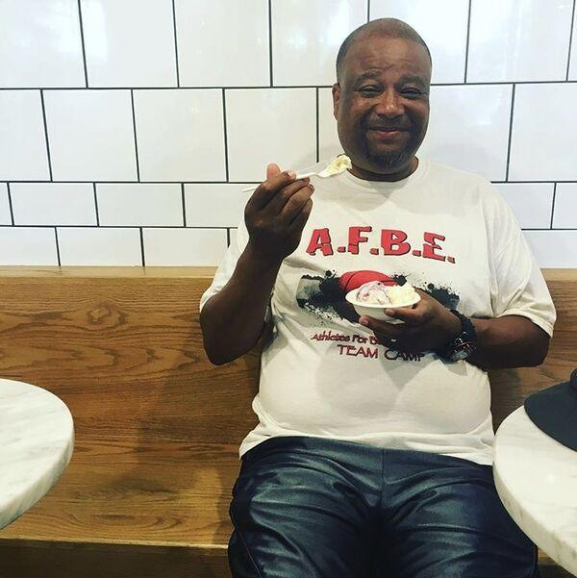
My Dad!

Slide 3
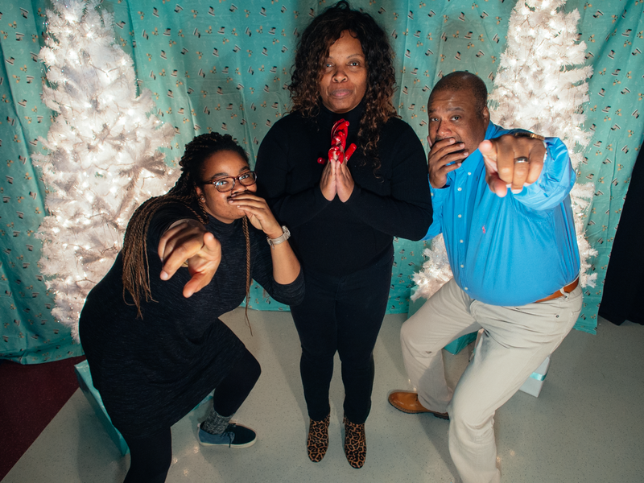

Slide 4
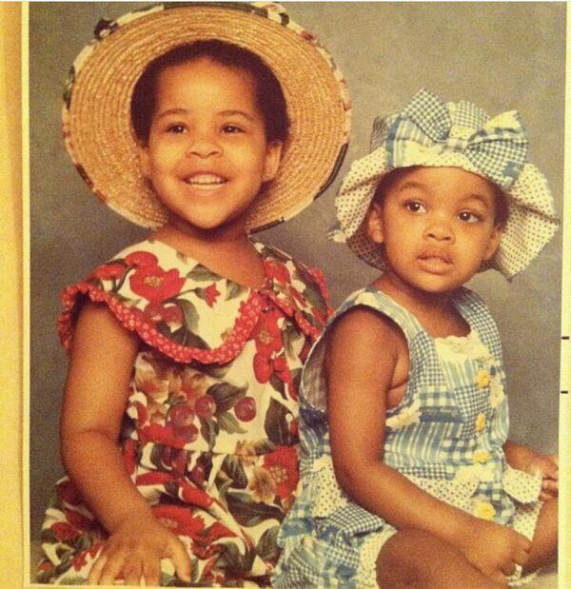
My sister and I!

Slide 5
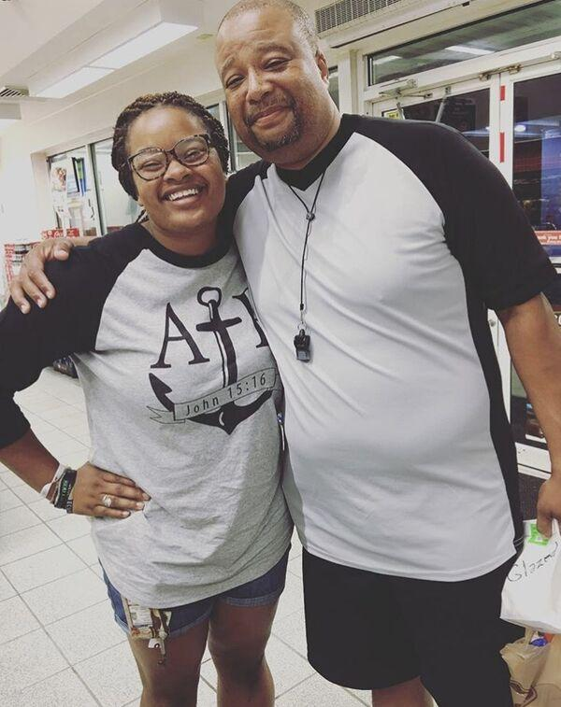
My Dad and I!

Slide 6
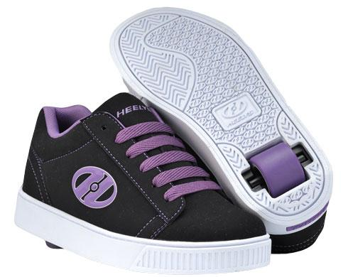
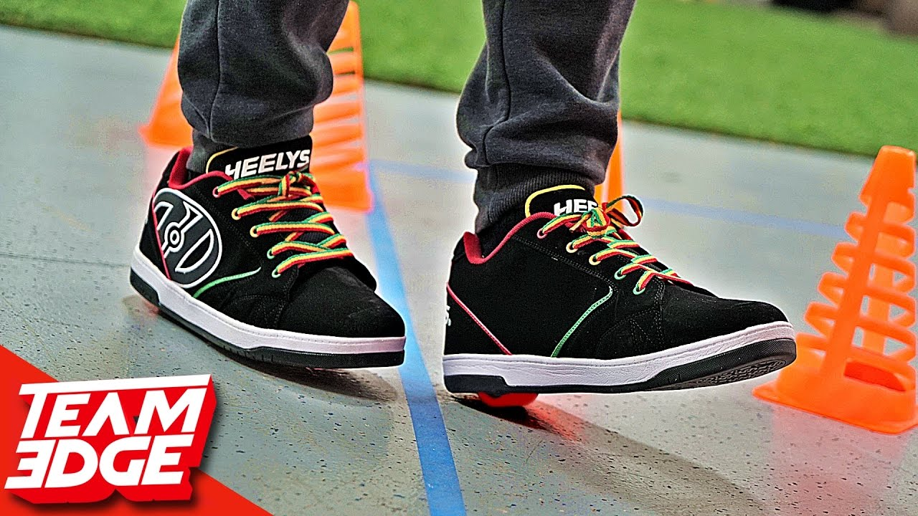

Slide 7
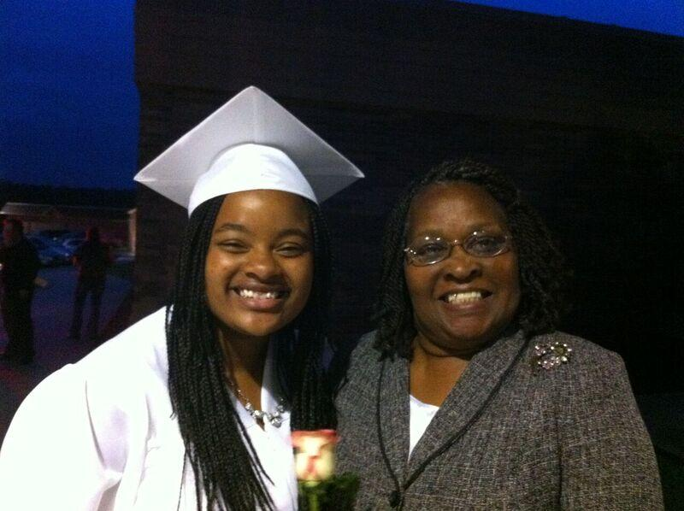
Grandma!

Slide 8
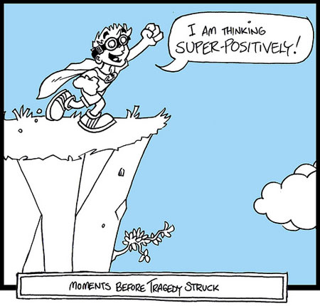
We Protect before the cliff.
P R O T E C T

Slide 9
I love you, Lord, my strength. The Lord is my rock, my fortress and my deliverer; my God is my rock, in whom I take refuge,my shield and the horn of my salvation, my stronghold. I called to the Lord, who is worthy of praise,and I have been saved from my enemies. Psalm 18:1-7

Slide 10
4 The cords of death entangled me;the torrents of destruction overwhelmed me.
5 The cords of the grave coiled around me; the snares of death confronted me.

Slide 11
6 In my distress I called to the Lord; I cried to my God for help.
From his temple he heard my voice; my cry came before him, into his ears.
7 The earth trembled and quaked, and the foundations of the mountains shook; they trembled because he was angry.

Slide 12
We Preserve after the cliff.
P R E S E R V E

Slide 13
We Love one another with:
Eyes to protect and a Heart to Preserve

