Slide 1
Notes:
Intro: Video of mom
Hello church family both here and online
We’re in this series #Grateful2God
So grateful for our moms
Video – a reminder for our moms to not miss the miracle of what you do everday
That’s what our Sermon is about today

Slide 2
Don’t miss the miracle God is working in your life!
God’s Word For Us Today
Notes:
Not missing the Miracle God is working in your life
Hear that again
Don’t miss the miracle God is working in your life
A world that can hide it
Because that’s what the enemy wants in your life
Because without faith – that is what we do
[story of mom and missing]
We can’t miss out
We are called to a life of faith
Without faith we will miss the miracles – God has for us

Slide 3
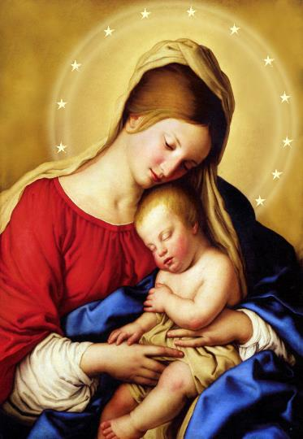
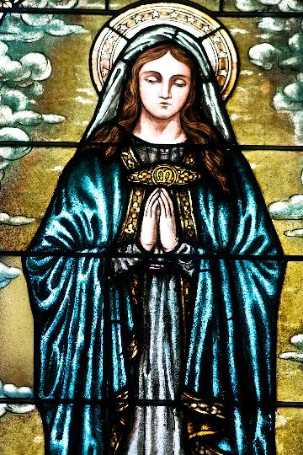
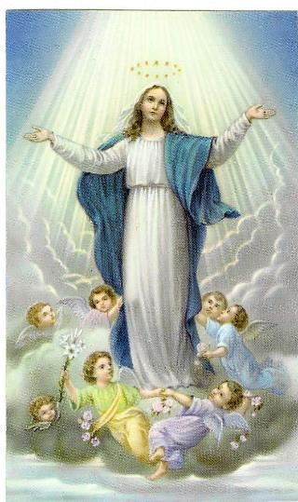
Notes:
And that’s I want to focus us on the story of Mary, the mother of Jesus
She is one of the most important models of faith in the Bible
And the Most famous (mom) 1.2 Billion Catholics – (former catholics here)
They wrongly worship her, but rightly honor her
Out of all the mother’s in the history of history
Of all the millions of women in the world – God chose her
He created and saw in her a greatness of faith) no one else had
Faith to entrust her with raising the salvation of the world!!!!
People think that she lived life like this but in reality she lived like this

Slide 4
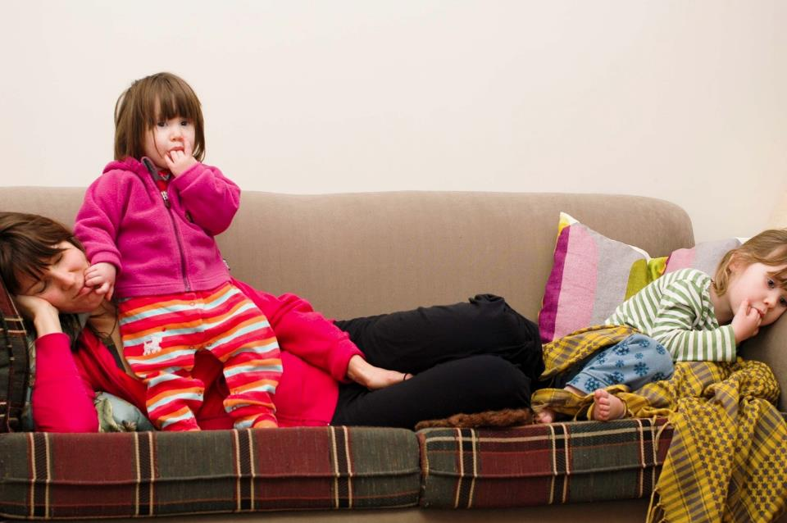

Slide 5
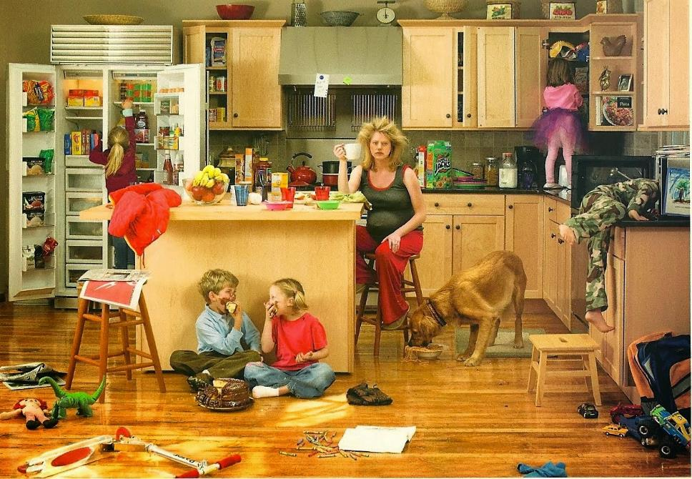

Slide 6
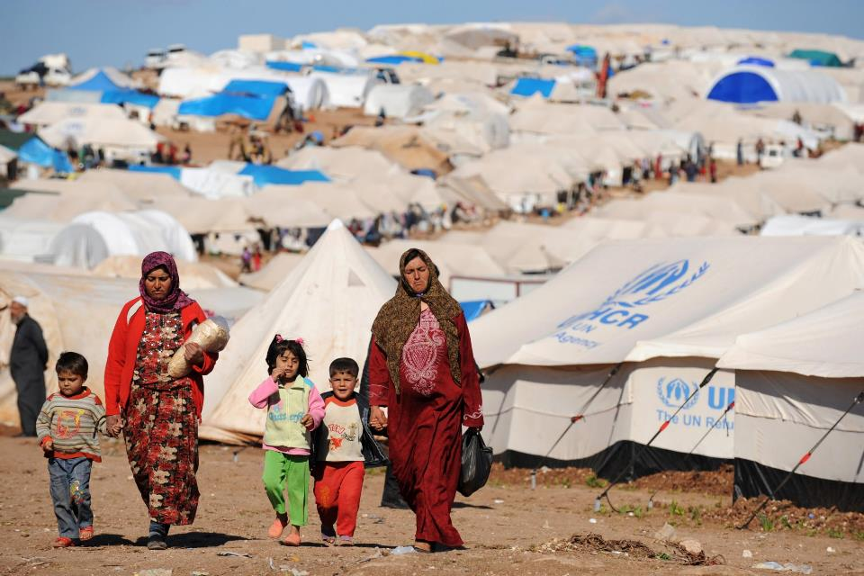

Slide 7
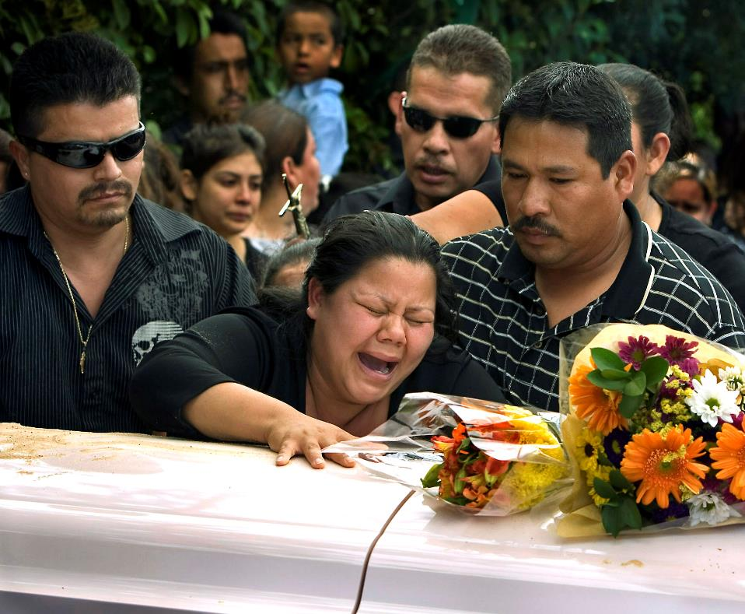

Slide 8
The Story of Mary’s Life - a model of faith for all of us - a picture of faith in different seasons - a person who didn’t miss God’s miracle
Notes:
And you and I need to learn from her faith
1-3
So let’s look at her life – a life not of religious saint, the life of a woman with faith
Who went through the same things as we go through
Here is her story

Slide 9
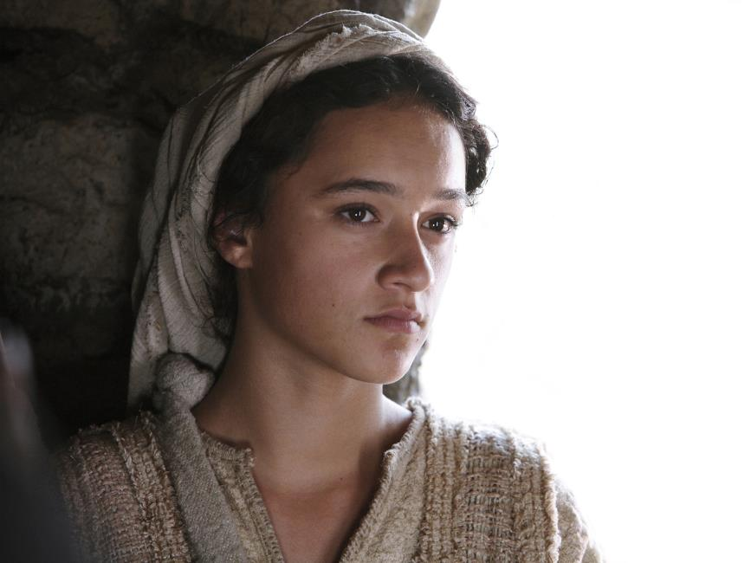
Notes:
We first meet Mary when she is about 14/15 years old
[How many teenagers are in the room right now?]
She is engaged to Jospeph, which in that day happened for a jewish girl after puberty
Tradition says she is daughter of Joachim & Anne of the village of Nazareth
History would tell us she is most likely illiterate, though not unintelligent
The only education she has is religious education – and she knows her Scriptures
She lives in a poor working class village on a hillside of about 400
It is 10 miles south from a major roman city building project in Galilee called Sepphoris
20 miles away from the sea of galilee and the city of capernum
Here we see Mary’s first act of faith
She encounters an angel who tells her

Slide 10
the angel said, “Do not be afraid, Mary, for you have found favor with God. And behold, you will conceive in your womb and bear a son, and you shall call his name Jesus... Mary said to the angel, “How will this be? [Luke 1:30-31,34]
Notes:
Go to next slide after scripture read

Slide 11
the angel said, “Do not be afraid, Mary, for you have found favor with God. And behold, you will conceive in your womb and bear a son, and you shall call his name Jesus... Mary said to the angel, “How will this be? [Luke 1:30-31,34]
Faith Challenge: Invisible Promise
Notes:
MARY’S FAITH BEGINS WITH – AN INVISIBLE PROMISE
A promise that she can’t see and seems impossible
Nothing in her circumstances, her feelings, or her world says God can do this in her
She is just like you and I – she doesn’t have some heavenly eyesight or way of knowing
She has to choose to have faith in a promise that she can’t see
She has to trust when nothing she sees says its going to be okay! [EVER BEEN THERE? NOW?}
But because she knows and loves God’s word notice her answer

Slide 12
She responds with SURRENDER
And Mary said, “Behold, I am the servant of the Lord; let it be to me according to your word.” (v38)
Notes:
Response: Mary surrenders to God’s word and God’s will
She surrenders the plans of her life.
She surrenders what people will think of her.
She surrenders her fears
She doesn’t just believe – she surrenders
This is how faith starts and always continues
God calls us to believe in His good news we can’t see yet
[Heb 11:1] Now faith is being sure of what we hope for and certain of what we do not see.
Mary lives out this faith – even though she can’t see it in herself or in her world
It’s invisible but not blind faith – because she is trusting God’s word
Mary doesn’t wait for her senses or her circumstances
She grabs hold of the miracle God is working in her life even though its invisible

Slide 13
She responds with SURRENDER
And Mary said, “Behold, I am the servant of the Lord; let it be to me according to your word.” (v38)
We miss God’s miracle
when we wait to see it!
Notes:
Mary knows the miracle of God
The God who is unseen works miracles that start unseen
You and I: WE MISS THE MIRACLE WHEN WE WAIT TO SEE IT
(you build the ark before the flood, stand up to Goliath before the victory,
Say a prayer of salvation before you are filled with Him)
Faith says yes before it sees yes! Surrenders before it sees certainty
She begins to live it out in relationships and with her time
Today – God has spoken promises over you too
The Devil wants you to miss them – believe before you receive (not opposite)
Study god’s word this week – and surrender to it
But that’s not all faith looks like or feels like

Slide 14
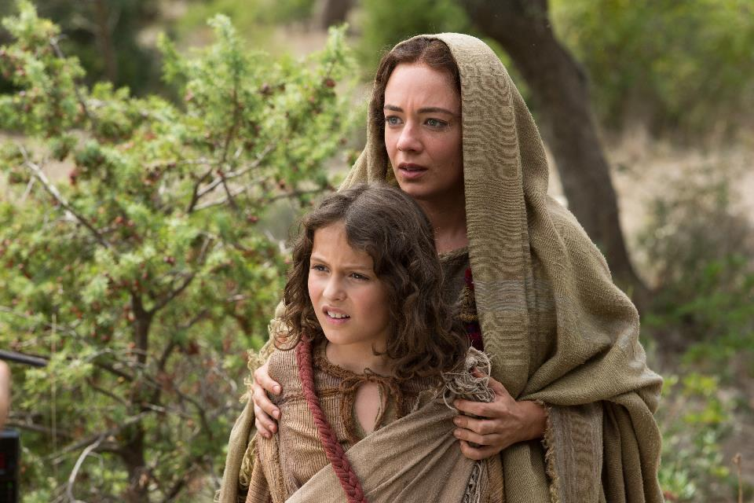
Notes:
We now come to Mary at about 27. She has been married about 11 years now
(raise hand)
Since we last saw her:
she has seen the wise man come answer all her financial needs
Then she fled to Egypt (refugee from her government) – lost most everything
She & Joseph moved back to Nazareth – 27 year old back in her old town
Jesus is now 12 year old boy
Not much is going right for mary – but every year mary goes to Jerusalem for Passover
She’s consistent in what’s important
Here we see her next challenge of faith
The chance to miss the miracle of what God is doing
Mary & Joseph leave a crowded Jerusalem after Passover – with a caravan
They don’t realize Jesus is missing until a day travel.
It takes them three days to find Jesus and He is in the temple

Slide 15
And Jesus [12 years old] said to them, “Why were you looking for me? Did you not know that I must be in my Father’s house?” 50 And they did not understand the saying that he spoke to them. [Luke 2:49-50]
Notes:
IT’S BEEN almost 13 years since God’s promise
She’s survived more than anything else for those 13 years
And this is what she gets - a tween she doesn’t understand
“Save the world? How about pay attention and don’t leave us!?”
“Help the lost – how about don’t get lost?!”
Mary is facing the challenge of faith most of us face the most
The challenge of “Insignificant Progress” – next slide
What does she have to show for her faith and her keeping a positive attitude”
11 years always going to Passover to be faithful to God
No one notices her? Almost no progress.
There are seasons where nothing seems to be happening
And she doesn’t understand

Slide 16
And Jesus [12 years old] said to them, “Why were you looking for me? Did you not know that I must be in my Father’s house?” 50 And they did not understand the saying that he spoke to them. [Luke 2:49-50]
Challenge: Insignificant Progress
Notes:
What does she have to show for her faith and her keeping a positive attitude”
11 years always going to Passover to be faithful to God
No one notices her? Not even her son. Almost no progress. No appreciation.
There are seasons where nothing seems to be happening
And she doesn’t understand
Look at mary’s right response {we need to follow this)
“Mary treasured . . . in her heart” (v51)

Slide 17
She responds with PERSISTANCE
Jesus went down with them ...and was submissive to them. And his mother treasured up all these things in her heart (v51)
Notes:
Mary keeps doing what God asked her to do - & Jesus submits
It says Mary “treasured” – same word for . . .
Word treasure – “to keep oneself from, to abstain”
Response: Mary doesn’t give in to her doubts – persistant
“Word is about giving in”
She is persistant she abstains from self-pity, giving in
She stays persistent to the will of God – be the parent she is supposed to be
Times – especially parenting – don’t see the results (like the video)
At jobs – when do I get recognized
At recovery – when will it get easier
At relationships – saying no – when yes
With health – one problem then the next
Mary is 27 – this isn’t the life or the progress I was hoping for!
Galatians
Let us not become weary in doing good, for at the proper time we will reap a harvest if we do not give up. ﻿10﻿ Therefore, as we have opportunity, let us do good to all people, especially to those who belong to the family of believers. Ga 6:9-10
Mary has been promised a miracle
The God who starts as a baby has given her baby sized progress

Slide 18
She responds with PERSISTANCE
Jesus went down with them ...and was submissive to them. And his mother treasured up all these things in her heart (v51)
We miss God’s miracle
when we keep measuring it
Notes:
You and I
WE MISS THE MIRACLE WHEN MEASURE IT
Don’t measure – just magnify God!!!!
The proof isn’t in the pudding – its in the promise
The proof is ahead – not now
Don’t miss the miracle of what you are doing – stay persistent
Mom – parenting
Young adult – not sleeping around
Grandparent – praying
Miracle waiting for you – God has not changed his plan of victory for you
This is Mary –
She’s believed before she received
She magnifies instead of measures
And let’s look at how life goes

Slide 19
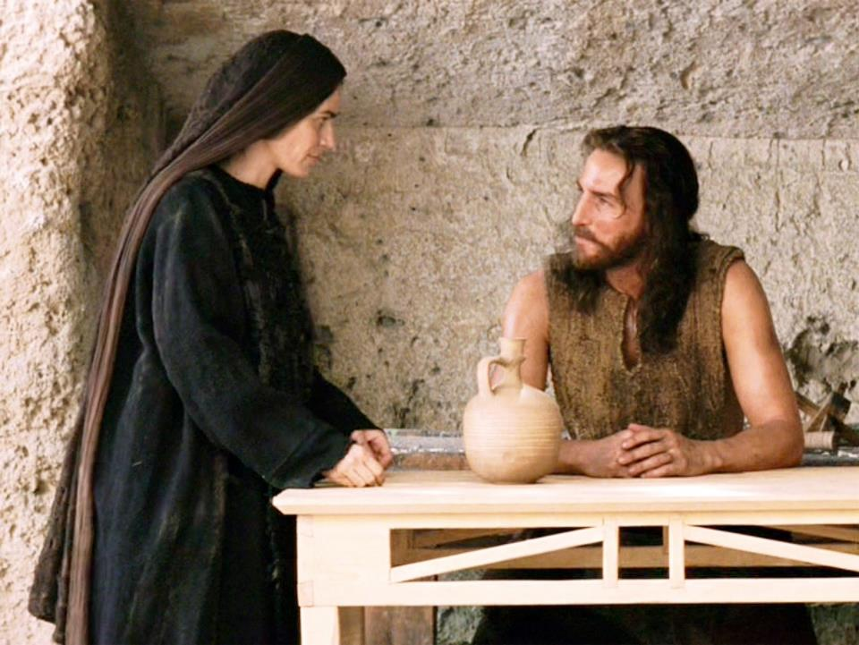
Notes:
The next time we see Mary – she’s in her mid forties. Mom of at least 7 and a widow
Since then – we’ve seen her last – Joseph has died (probably in her thirties)
She’s lost her husband – we don’t know how
That meant Jesus was responsible for the family provision
He was a carpenter and probably worked in the Roman city of Sepphoris
But at 30 Jesus begins his ministry
At first it was great – Mary told Jesus to help with the wedding at Cana
Jesus turned water into wine and she was beaming with pride
But Jesus has also faced opposition
In John 7 – he is called the son of the devil
Probably referring to the rumors that Jesus was born out of wedlock
Mary is probably crushed that her past has come back to haunt her
And Jesus, he is gather a crowd and powerful enemies.
The Phariees hate him – they have powerful allies – like her own synagogue leader
In mark 3 – Jesus returns to his home town to preach.
Eventually he is kicked out almost stoned! In the town Mary has lived in!!!!
We don’t know exactly when but at some point – Mary makes a pretty big mistake

Slide 20
Then Jesus went home, and the crowd gathered again, so that they could not even eat. And when his family heard it, they went out to seize him, for they were saying, “He is out of his mind.” [Mark 3:20-21]
Notes:
We know from verse 31 – that Jesus is part of the family coming to seize him
She believes in Jesus as the Messiah – 30 years ago God said that was who he was
But instead of saving her people, most of her people (the jews) hate him
This isn’t how it is supposed to happen
She thinks Jesus is wrong (like we all do)
She needs to get a hold of Jesus and tell him what he should be doing!
Ever have a time where you want to tell Jesus to stop doing things wrong
You believe in Him but He isn’t doing things right?
If Jesus would just listen to you -than He could be who He is supposed to be
Well that’s how Mary feels
She assumes Jesus, is doing what He is supposed to do wrong
And that’s the next challenge of faith we all face:

Slide 21
Then Jesus went home, and the crowd gathered again, so that they could not even eat. And when his family heard it, they went out to seize him, for they were saying, “He is out of his mind.” [Mark 3:20-21]
Challenge: Incorrect Expectations
Notes:
The challenge of incorrect expectations
I struggle with this one all the time.
Like Mary, I’ve walked by faith for over 40 years.
I’ve been through a lot
By now I pretty much know how things go
I’ve followed God – why hasn’t God healed me yet? Why have I had to see hardship in my family? Why did my loved one die?
Why aren’t I more successful?
God I expected your blessing to look a certain way
And that’s when Jesus tells me what He eventually tells Mary in v35
“It’s not about your wants. Its about my will.”
Jesus is mildly rebuking Mary and his brothers – not out of bitterness – but betterment
Mary, Mom, Spouse, Leader, Friend – its not about what we want (what we expect)
It’s about His will.
And our response to this challenge of our immature expectations should be this: grow up

Slide 22
She responded by choosing to
KEEP GROWING
“But Keep Growing in the grace and knowledge of our Lord and Savior Jesus Christ” 2 Peter 3:18
Notes:
my expectations were formed by this world not by God – I’ve got to grow up
The Equation of Expectations: 5-4 = means you need one

Slide 23
She responded by choosing to
KEEP GROWING
“But Keep Growing in the grace and knowledge of our Lord and Savior Jesus Christ” 2 Peter 3:18
29:11-55:8=3:18
Notes:
The Equation of Expectations: 5-4 = means you need one
29:11 + -55:8 = 3:18
His good plans + not your thoughts = keep growing!!!
or I know the plans I have for you,” declares the Lord, “plans to prosper you and not to harm you, plans to give you hope and a future. (Je 29:11)
For my thoughts are not your thoughts, neither are your ways my ways,” declares the Lord. ﻿9﻿ “As the heavens are higher than the earth, so are my ways higher than your ways and my thoughts than your thoughts. Is 55:8-9
“But Keep Growing in the grace and knowledge of our Lord and Savior Jesus Christ” 2 Peter 3:18
We all have to do this
That’s why we are here as a church
That’s what you have to keep doing

Slide 24
She responded by choosing to
KEEP GROWING
“But Keep Growing in the grace and knowledge of our Lord and Savior Jesus Christ” 2 Peter 3:18
We miss God’s miracle
When we don’t stay a student
Notes:
You’ll miss God’s miracle if you don’t stay a student / mission is to maintain
(trust God’s lifelong process)
That’s faith – Mary at 45 has to do – I have to do it too.
But will all of those challenges to faith
Mary’s ending is even better than her beginning
And I want you to see how

Slide 25
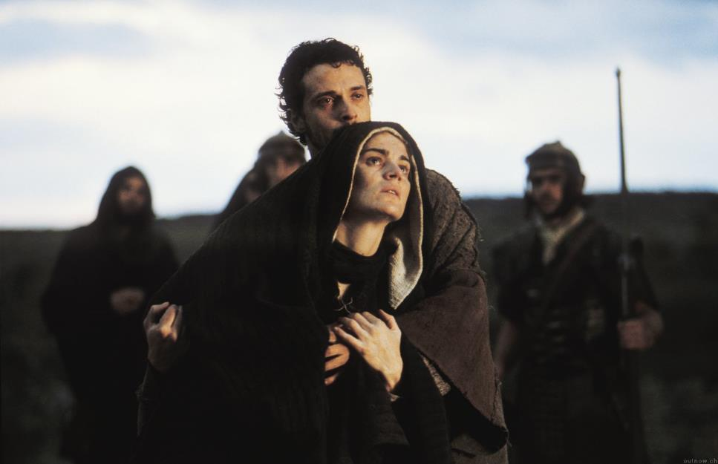
Notes:
It’s probably a year and half later.
Let’s estimate that Mary is about 48 or so.
She’s seen the highs and lows of Jesus ministry.
For the past year Jesus has stopped focusing on the crowds
The opposition has gotten great
But then as Passover comes – Jesus swells with popularity.
For the past 30 years Mary always goes to Jerusalem for Passover
We don’t know how often she did it with Jesus and the disciples
At least one time she didn’t because her brothers still were against Jesus
But this time, when jesus is 33 years old – she is with him
She sees the triumphal entry
She sees the confrontations in the temple
And then she sees her worst nightmare
A nightmare the Prophet Anna told her 31 years ago would happen
She sees her own son crucified!
Does she understand what is going on? We don’t know
It doesn’t change what she is feeling
The son she nursed and played with
The son she taught, the hands she held
They are now cruficied on a cross
And she is there – right there
She isn’t far away. She is right there – seeing every painful breathe
And she can’t do anything for Him
The soldiers are laughing and torturing her son
And there she is
She may have heard Jesus explain his sacrifice
It doesn’t change the pain
I wonder how bad she feels about her immature expectations
The time her son knew that she thought he was out of his mind
I wonder how much she regrets when she failed
I wonder how much she wished she was an even better mother
I wonder if she wonders – does her son still love her
And then her faith finds not a challenge but a change that she will never forget
On the cross, we read:

Slide 26
When Jesus saw his mother and the disciple whom he loved standing nearby, he said to his mother, “Woman, behold, your son!” ... And from that hour the disciple took her to his own home. [John 19:25-27]
Notes:
When she was a teenager – she believed in an invisible promise
When she was a young mom – she believed in a miracle with insignificant progress
When she was set in her ways – she dealt with her incorrect expectations

Slide 27
When Jesus saw his mother and the disciple whom he loved standing nearby, he said to his mother, “Woman, behold, your son!” ... And from that hour the disciple took her to his own home. [John 19:25-27]
INCONCEIVABLE GRACE!
Notes:
She sees: inconcevieable grace!
Her son, hasn’t only forgiven her past mistakes
Her savior isn’t only forgiving her for eternity
Her lord, is taking care of her immediate future
On the cross – He is providing for her
She doesn’t have to look back and wish she saved more
She doesn’t have to look back and wish Joseph was still alive
She doesn’t have to look back and wish she lived a different life
Jesus tells her “Behold, your son (behold your future)

Slide 28
She chooses to
“Say yes & not look back!”
“Behold [to realize, experience, to know]”
Notes:
That word behold (ide) in the greek
“to have realized, to have experienced, to have known – so you can move forward
On the cross – Jesus tells mary she doesn’ have to look back
On the cross – Jesus shows her, His future answer for her – he wants he to know it
Because the right response is to inconceivable grace is this: “Say yes and don’t look back!”

Slide 29
She chooses to
“Say yes & not look back!”
“Behold [to realize, experience, to know]”
We miss God’s miracle
by looking back!
Notes:
Don’t miss the miracle by looking back!
There is joy after pain
There is life after death
There is new family after old has died
There is grace for your mistakes
There is inconceivable grace for years of loss
There is a miracle you are not supposed to miss!
But you can’t figure grace out – you just have to accept it
You have to persist – not in giving in
But in not giving it away
Don’t let the enemy, people or this world tell you to give away what Jesus is giving you!!!
Don’t miss the miracle!!!
And as good as that is – its not the end!!!
It’s not the end of the miracle – not the best part

Slide 30
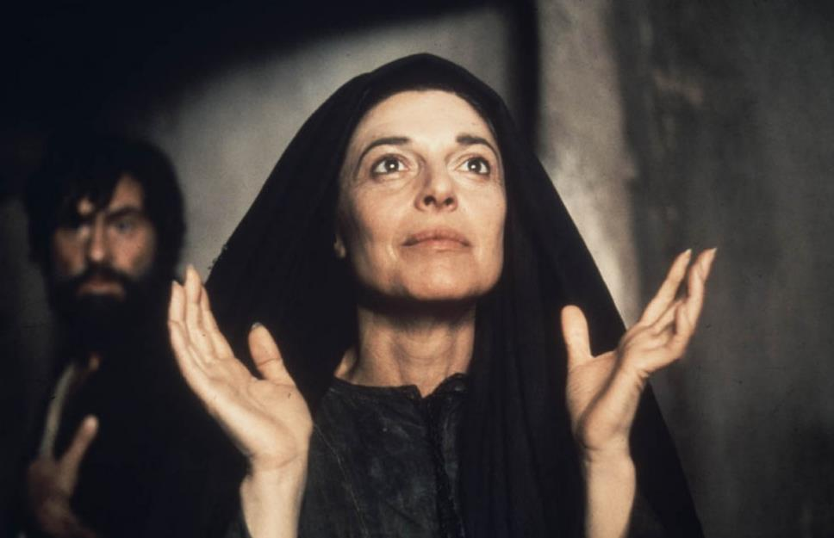
Notes:
Because 50 days later – we read about Mary for the last time
Here she is
She’s walked through the crufixion
She has seen her son raised from the dead
Does she hug him or bow down to him?
He’s not knocking and opening the door when he comes in?
He still cooks some tasty fish
He has been true to all God promised
34 or so years – what God first asked to believe in small village
She is living out in the capital city
There was a beginning of invisible promises
There were so many years of insignificant progress
She almost seemed to ruin it all with immature expectations
And everything changed when she received inconceivable grace
But that wasn’t the end of her story
You see the last time we ever hear Mary’s name in the Bible is Acts 1:14

Slide 31
All these [disciples] with one accord were devoting themselves to prayer, together with the women and Mary the mother of Jesus, and his brothers.
[Acts 1:14]

Slide 32
All these [disciples] with one accord were devoting themselves to prayer, together with the women and Mary the mother of Jesus, and his brothers.
[Acts 1:14]
INCREASED/INCREDIBLE FAITH!!!
Notes:
As a teenager – she started with faith for an invisible promise
But closing in on 50 – she was living for an increased/enormous faith
She was there on the day of pentecost
She was there when 3,000 was saved
After all she has gone through – you chooses not to miss what is next. What is greater!

Slide 33
The Miracle Mary started out with great faith for herself.
Notes:
She starts with great faith for her own lfie
She ends up with greater faith for the whole world
Not greater comfort, success, control – just greater faith
That’s this life – greatest miracle of all
She started with faith for herself
She finished with greater faith for others
She didn’t miss the miracle because she didn’t stay focused on herself
That’s the greatest miracle of all – the one God is calling you to today
Give me faith

Slide 34
The Miracle Mary started out with great faith for herself. She finished with even greater faith for the world!
Notes:
Don’t miss God’s miracle in your life by focusing on yourself.
You’ll miss the greatest miracle of all
If you choose to focus on yourself.

Slide 35
Don’t miss the miracle! Invisible promises Insignificant progress Incorrect expectations Inconceivable grace Increased faith for others
Notes:
The righteous will live by faith from start to finish
Where are you missing the miracle today?

