Slide 2
The victory of Jesus . . .
starts in hope,
requires a change,
and follows His plan.

Slide 3
On a Sabbath Jesus was teaching in one of the synagogues, ^{﻿11﻿} and a woman was there who had been crippled by a spirit for eighteen years. She was bent over and could not straighten up at all. ^{﻿12﻿} When Jesus saw her, he called her forward and said to her, “Woman, you are set free from your infirmity.” ^{﻿13﻿} Then he put his hands on her, and immediately she straightened up and praised God. [Lk 13:10-13]

Slide 4
“From that time on Jesus began to preach, ‘Repent, for the kingdom of heaven is near.”
[Mt 4:17]
“Repent”: to change one’s mind
and direction

Slide 5
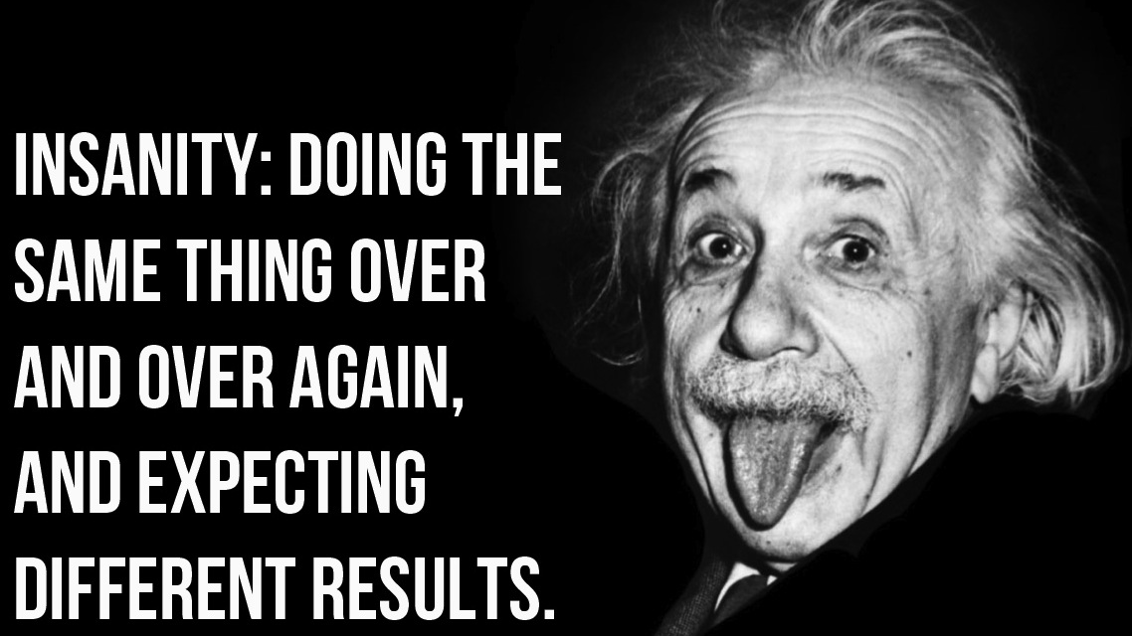

Slide 6
God’s Plan For Victory Is This . . .
PUT GOD FIRST
[“First Love”]
“But seek first his kingdom and his righteousness, and all these things will be given to you as well.” [Mt. 6:33]

Slide 7
First of The Ten Commandments
“You shall have no other gods
before me.” [Exodus 20:2–3]

Slide 8
Tithe: First Of Our Income
“Bring this tithe to My place of worship—Doing this will teach you always to honor the LORD your God and put Him first in all things.”
[Deut. 14:23, LB]

Slide 9
The First Church In Revelations
“Yet I hold this against you: You have forsaken your first love. ﻿Remember the height from which you have fallen! Repent and do the things you did at first.
[Revelations 2:4-5]

Slide 10
“First Love” is about putting God first
“Order matters in your life”
“What you put first determines your future”
“Respond to worry by seeking Him first”
“What you go to first is what you depend on”
PRAYFIRST

Slide 11
Your greatest problem [defeat] in life is not how people are treating you, how circumstances are against you, or what you don’t have . . . It’s what you’re putting first in your life

Slide 12
1. Put God First In Your Week
“We form our habits
and then our habits form us.”

Slide 13
2. Put God First In Your Day
“The first connection of the day is the most powerful”
“First Fifteen”

Slide 14
3. Put God First Over Your Greatest Fear
“ . . . your heavenly Father knows that you need them. But seek first his kingdom and his righteousness, and all these things will be given to you as well. Therefore do not worry . . .”

