Slide 2
Daniel 1 / Oct 9 Culture’s plan – rename you
Daniel 3 / Oct 16
Culture’s test – trust in God
Daniel 4 / Oct 30
Culture’s problem – insanity of pride
Daniel 5/ Today
Culture’s pattern & the church’s response

Slide 3
Daniel 5:1,3-4
King Belshazzar gave a great banquet for a thousand of his nobles. . . they brought in the gold goblets that had been taken from the temple of God in Jerusalem, and the king and his nobles, his wives and his concubines drank from them. As they drank the wine, they praised their gods . . .”
Notes:
Daniel 4 – King Nebuchandnezzer
King of Babylon – symbol of pride
[next slide]

Slide 4
Daniel 5:5-6
Suddenly the fingers of a hand appeared and wrote on the plaster of the wall . . . The king watched the hand as it wrote. ^{﻿6﻿} His face turned pale and he was so frightened that his knees knocked together and his legs gave way.

Slide 5
Daniel 5:8-9
Then all the king’s wise men came in, but they could not read the writing or tell the king what it meant. ﻿9﻿ So King Belshazzar became even more terrified and his face grew more pale. His nobles were greatly confused and worried.”

Slide 6
Daniel 5:13-15
So Daniel was brought before the king, and the king asked, “Are you Daniel, one of the exiles ... from Judah? ﻿^{14﻿} I have heard that the spirit of the gods is in you and that you have insight, intelligence and outstanding wisdom. ﻿^{15﻿} The wise men and enchanters were brought before me to read this writing and tell me what it means, but they could not explain it.

Slide 7
Daniel 5:16
Now I have heard that you are able to give interpretations and to solve difficult problems. If you can read this writing and tell me what it means, you will . . .be made the third highest ruler in the kingdom.”

Slide 8
Culture’s Pattern & The Church
Culture is prideful
and the local church is disregarded
Today’s Sign: Churchlessness

Slide 9
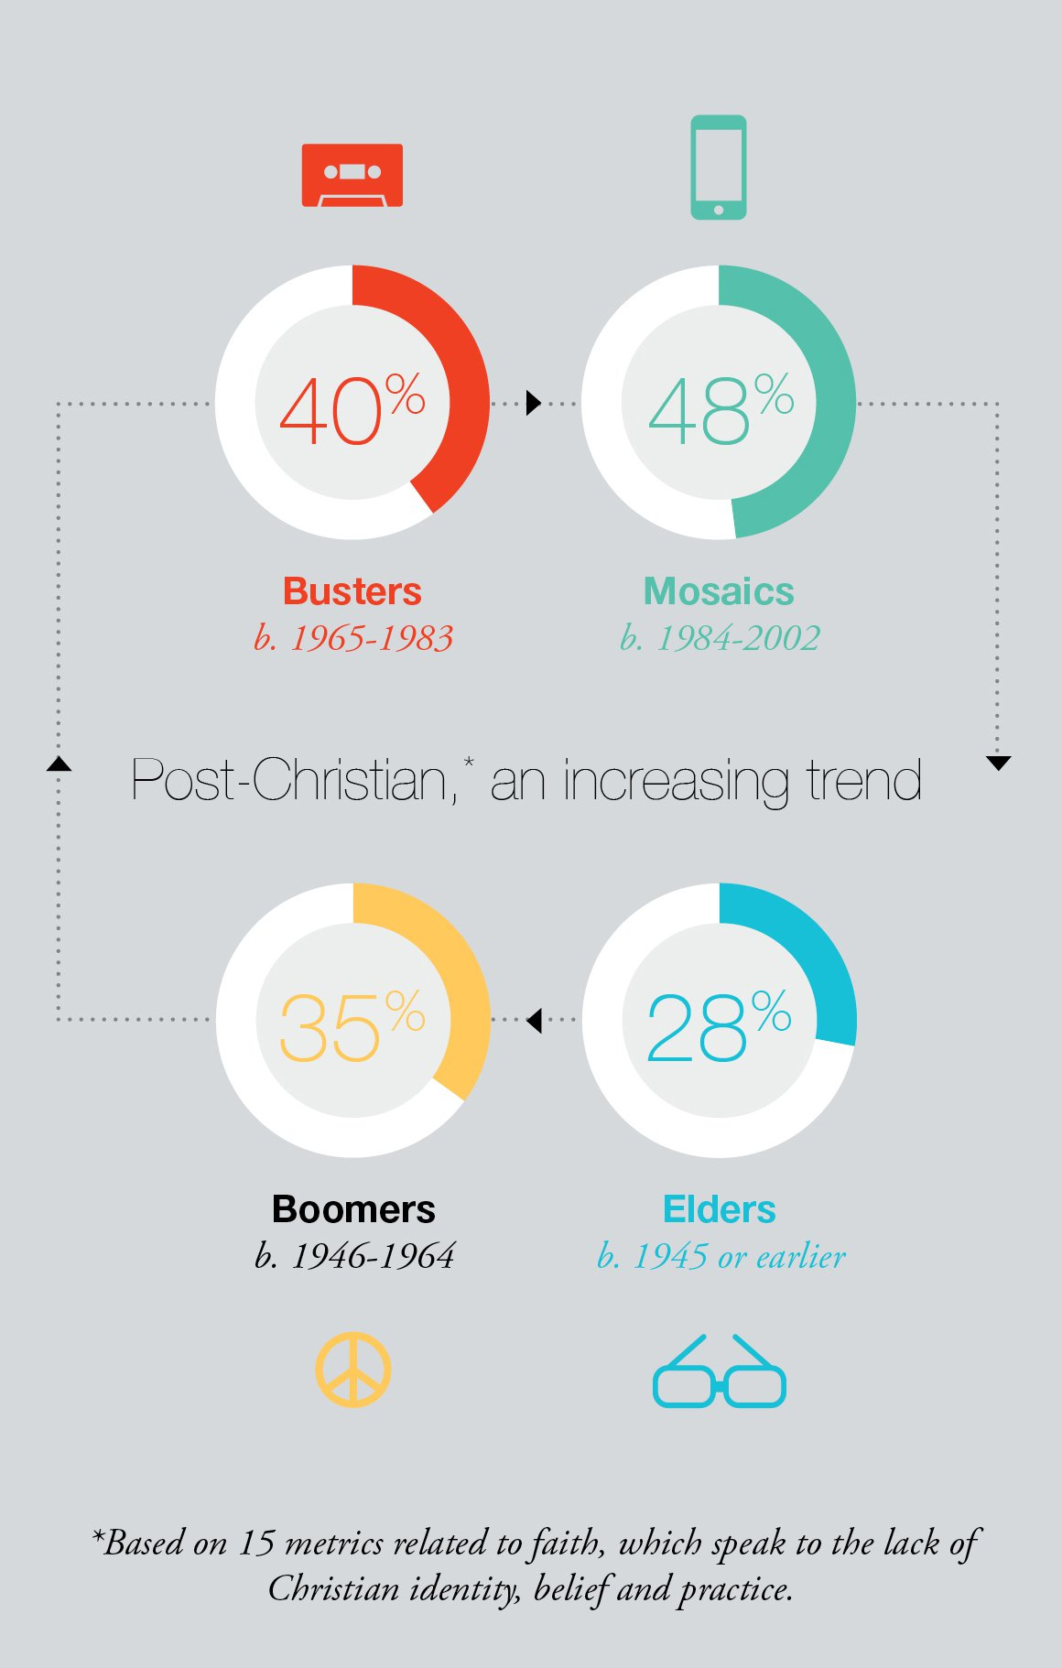
Unchurched Adults
48% of mosaics (32-14)
40% of busters (51-33)
35% of boomers (70-52)
28% of elders (71+)
37k within 5 miles of cornerstone
47k in South Richmond (5 miles)

Slide 10
Culture’s Pattern & The Church
Culture is prideful
and the local church is disregarded
Sign: Churchlessness
Response: Strengthen the local church
Notes:
But that pride (in us, nebuchudnezzar, in our culture)
Leads to our greatest problem

Slide 11
Wednesday, Nov 16th / 7p in Room 201
Sunday, Nov 20th / 12:30p at Ministry Café

Slide 12
Culture’s Pattern & The Church
Culture is confused
and the local church is needed
Today’s Sign: National unrest & strife
Notes:
But that pride (in us, nebuchudnezzar, in our culture)
Leads to our greatest problem

Slide 13
“You are the light of the world. A city on a hill cannot be hidden . . .let your light shine before men”
Mt 5:14-16

Slide 14
Culture’s Pattern & The Church
Culture is confused
and the local church is needed
Sign: National unrest & strife
Response: MULTIPLY the local church
Notes:
But that pride (in us, nebuchudnezzar, in our culture)
Leads to our greatest problem

Slide 15
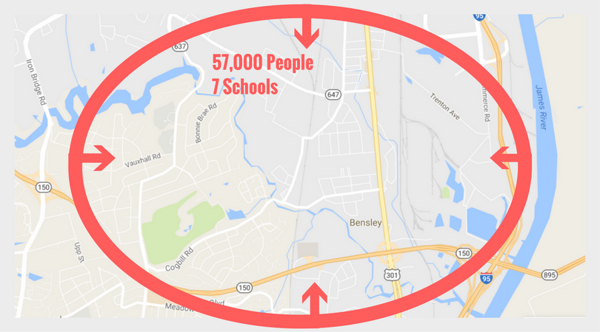
Cornerstone
Church
Plant
Offering
Dec 11th

Slide 16
Daniel 5:22-24
“But you his son, O Belshazzar, have not humbled yourself, though you [have seen God’s mighty acts]. ^{﻿23﻿} Instead, you have set yourself up against the Lord of heaven . . . you did not honor the God who holds in his hand your breath and all your ways. ^{﻿24﻿} Therefore He sent the hand that wrote the inscription.” ﻿

Slide 17
Daniel 5:25-27
“This is the inscription that was written: MENE, MENE, TEKEL, PARSIN﻿”
Mene﻿: God has numbered the days of your reign and brought it to an end.
﻿Tekel﻿﻿: You have been weighed on the scales and found wanting.
﻿Peres﻿﻿: Your kingdom is divided and given to the Medes and Persians.”

Slide 18
Culture’s Pattern & The Church
Culture is confronted
and the local church offers grace
Notes:
But that pride (in us, nebuchudnezzar, in our culture)
Leads to our greatest problem

Slide 19
Culture is confronted
Mene: “Numbered” (2x)
You only have so many days of God’s mercy
Tekel: “Weighed”
You are out of God’s balance and order
Peres: “Divided”
Your ways divide & destroy so they must end
Notes:
But that pride (in us, nebuchudnezzar, in our culture)
Leads to our greatest problem

Slide 20
We are called to finish writing the story of God’s grace
Exodus 31:18
“God gave Moses the two tablets of the Testimony ... inscribed by the finger of God”
Daniel 5:5
John 8:6
Notes:
But that pride (in us, nebuchudnezzar, in our culture)
Leads to our greatest problem

Slide 21
Culture’s Pattern & The Church
Culture is confronted
and the local church offers grace
Response: BE THE CHURCH!
Write Jesus’ grace on someone’s life
Notes:
But that pride (in us, nebuchudnezzar, in our culture)
Leads to our greatest problem

Slide 22
“I’m with you!”

