Slide 1
Election Edition

Slide 2
Background: Mark 12:13-17
Partisan politics: Pharisees, Herodians
Painful protests: Tribute tax, rebellion
Immoral leaders: High Priest, Rome

Slide 3
All become amazed as Jesus...
1. Rejected political supremacy & simplicity
2. Affirmed political engagement & witness

Slide 4
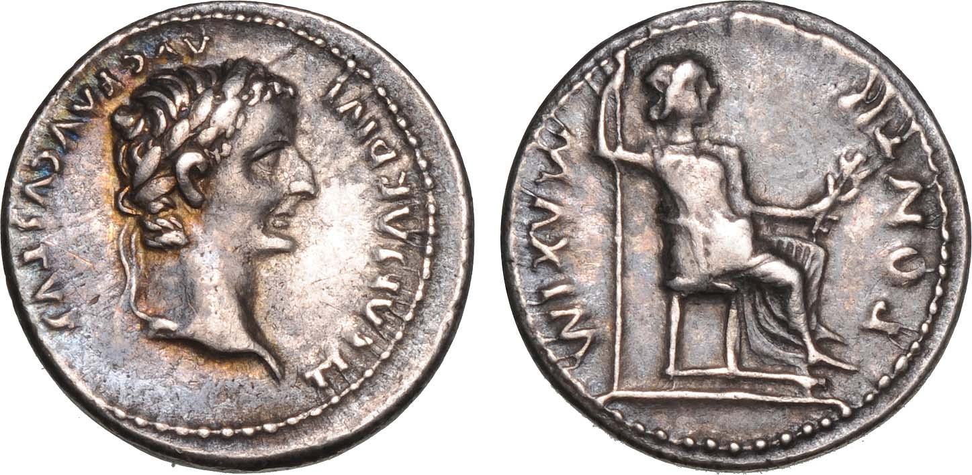
Jesus is glorified when we REJECT political supremacy

Slide 5
Question I should be asking myself:
What do I truly trust in for peace?
TUESDAY’S VOTE: PRAY FIRST !
➲ Psalm 145 (M), 146 (Tu), 147 (W) . . .

Slide 6
Jesus is glorified when we REJECT political over-simplification
“The most important commandment is this . . . Love the Lord your God with all your heart and with all your soul and with all your mind and with all your strength.’ The second is this: ‘Love your neighbor as yourself.’”

Slide 7
Question I should be asking myself:
Am I voting in fear or faith?
TUESDAY’S VOTE: RESEARCH SECOND !
➲ Google: “2016 Party Platforms”

Slide 8
Jesus is glorified when you politically engage for His glory
“For to us a child is born, to us a son is given,
and the government will be on his shoulders.
And he will be called Wonderful Counselor, Mighty God, Everlasting Father, Prince of Peace.” - Isaiah 9

Slide 9
Question I should be asking myself:
How should I influence my nation?
TUESDAY’S VOTE: VOTE GRATEFULLY
➲ January 11th – Chesterfield BOS Prayer

Slide 10
Jesus is glorified when you declare His Good News in politics
“Blessed are you who are poor, for yours is the kingdom of God. Blessed are you who hunger now, for you will be satisfied. Blessed are you who weep now, for you will laugh. Blessed are you when men . . . reject you . . . because of the Son of Man.”

Slide 11
Question I should be asking myself:
Am I going to use my voting day glorify Jesus?
TUESDAY’S VOTE: WITNESS CLEARLY !
➲ Bring your Bible & pray at the booth

Slide 12
PRAY FIRST
“And they were amazed at Jesus.”
RESEARCH SECOND
VOTE GRATEFULLY
WITNESS CLEARLY

