Slide 2
First Purpose Of Any Family
Know Jesus
To be forgiven & reunited
with God who created you
Notes:
Any family
Especially God’s family
We are family
Praise reports – know jesus
That’s been happening every week this September
Usually in every service
Thank you for being a family that is inviting others –for hosting other
(A matter of fact – felt led to offer water baptism again)
#2 Finding Freedom
Moms – finding freedom in their life stage
Young adult –free from heroin
Today –we are going to talk about discovering purpose
But here is where I need to eat some humble pie
Last Sunday, . . .
So I am sorry and I hope you’ll forgive me
If you do repeat after me
“Pastor Shawn” “we forgive you” “you’re a knucklehead” and we love you
Well now we are working on discovering and living in our purpose for Sunday mornings
We also need to look at how we help each other discover our God-given purpose
When Jesus was on his way to Jerusalem for the final time to give his life away. Luke

Slide 3
Second Purpose Of Any Family
Find Freedom
To be delivered from slavery and addictions through God’s people
Notes:
Any family
Especially God’s family
We are family
Praise reports – know jesus
That’s been happening every week this September
Usually in every service
Thank you for being a family that is inviting others –for hosting other
(A matter of fact – felt led to offer water baptism again)
#2 Finding Freedom
Moms – finding freedom in their life stage
Young adult –free from heroin
Today –we are going to talk about discovering purpose
But here is where I need to eat some humble pie
Last Sunday, . . .
So I am sorry and I hope you’ll forgive me
If you do repeat after me
“Pastor Shawn” “we forgive you” “you’re a knucklehead” and we love you
Well now we are working on discovering and living in our purpose for Sunday mornings
We also need to look at how we help each other discover our God-given purpose
When Jesus was on his way to Jerusalem for the final time to give his life away. Luke

Slide 4
Third Purpose Of Any Family
Discover Purpose
Restored to your God-given purpose by following Jesus with others
Notes:
A lot of us have given up on our purpose
Praise reports – know jesus
That’s been happening every week this September
Usually in every service
Thank you for being a family that is inviting others –for hosting other
(A matter of fact – felt led to offer water baptism again)
#2 Finding Freedom
Moms – finding freedom in their life stage
Young adult –free from heroin
Today –we are going to talk about discovering purpose
But here is where I need to eat some humble pie
Last Sunday, . . .
So I am sorry and I hope you’ll forgive me
If you do repeat after me
“Pastor Shawn” “we forgive you” “you’re a knucklehead” and we love you
Well now we are working on discovering and living in our purpose for Sunday mornings
We also need to look at how we help each other discover our God-given purpose
When Jesus was on his way to Jerusalem for the final time to give his life away. Luke

Slide 5
When you live in your
God-given purpose, its powerful, good things multiply in your life!
When you don’t, its painful.
More effort doesn’t mean progress.

Slide 6
For we are God’s workmanship, created in Christ Jesus to do good works, which God prepared in advance for us to do
(Eph. 2:10)

Slide 7
GOD’S WORD TO US TODAY
Many of our troubles would
go away, or lose their power,
if we were growing in our
God-given purpose

Slide 8
“I praise you because I am fearfully and wonderfully made . . . your eyes saw my unformed body. All the days ordained for me were written in your book before one of them came to be.
(Psalm 139:14–16)

Slide 9
God created your purpose before He created you.
God shaped you
like no one else for
a unique eternal purpose

Slide 10
S piritual gifts
H eart (passion)
A bilities
P ersonality
E xperiences

Slide 11
And we know that in all things God works for the good of those who love him, who have been called according to his purpose.
(Romans 8:28)

Slide 12
If we don’t discover our purpose, we will never finish healing because we are addressing symptoms
not the source
Notes:
Hamstring
Relationship. That job. That addiction.
We work on the place of pain
But never address the source of pain
So we get the place of pain in order only to find another place pop up

Slide 13
“Referred Pain”
The place of your pain is not the actual source of
your problem
Notes:
Hamstring
Relationship. That job. That addiction.
We work on the place of pain
But never address the source of pain
So we get the place of pain in order only to find another place pop up

Slide 14
When we don’t know, or live in, our God-given purpose
we have
1. Relationship Pain
Notes:
Purpose of dating is not the purpose of marriage
When we confuse the two – pain is the result
But more than that – as try to love any family we have to remember this
Love language
Insecurity – purpose - comparison

Slide 15
You were shaped for a purpose like no one else
You can’t press or assume
your shape on anyone else
Notes:
God said – “I will deliver you”
You can’t perform surgery on yourself
Self can’t help you with self pity or self centeredness
You’ve got to follow someone else to find freedom
You are the last person you should

Slide 16
Acts of Service
Affirming Words
Quality Time
Physical Touch
Gifts
Notes:
God said – “I will deliver you”
You can’t perform surgery on yourself
Self can’t help you with self pity or self centeredness
You’ve got to follow someone else to find freedom
You are the last person you should

Slide 17
When we don’t know, or live in, our God-given purpose
we have
2. Financial Pain
Notes:
Love language
Insecurity – purpose - comparison

Slide 18
“No servant can serve two masters. . . You cannot serve both God and Money.”
Luke 16:13
Notes:
Budget – god’s purpose

Slide 19
Money is supposed to be a servant of God’s purposes
in your life, not a master
over your life!
Notes:
Budget – god’s purpose

Slide 20
When we don’t know, or live in, our God-given purpose
we have
3. Church Pain
Notes:
Love language
Insecurity – purpose - comparison

Slide 21
“God has combined the members of the body . . . so that there should be no division in the body, but that its parts should have equal concern for each other”
1 Cor. 12:24–25

Slide 22
When we don’t know, or live in, our God-given purpose
we have
4. The Pain of Hopelessness
Notes:
Love language
Insecurity – purpose - comparison

Slide 23
We are hard pressed on every side, but not crushed; perplexed, but not in despair; persecuted, but not abandoned; struck down, but not destroyed.
(2 Corinthians 4:8–9)

Slide 24
How do we
discover that
God-given purpose
Notes:
It’s a journey
Jesus talked about it

Slide 25
“Then Jesus said to them all:
‘If anyone would [1] come after Me, [2] he must deny himself and
[3] take up his cross daily and
[4] follow me.’”
(Luke 9:23)

Slide 26
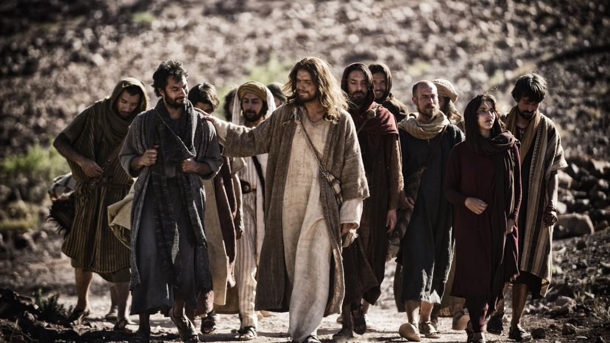

Slide 27
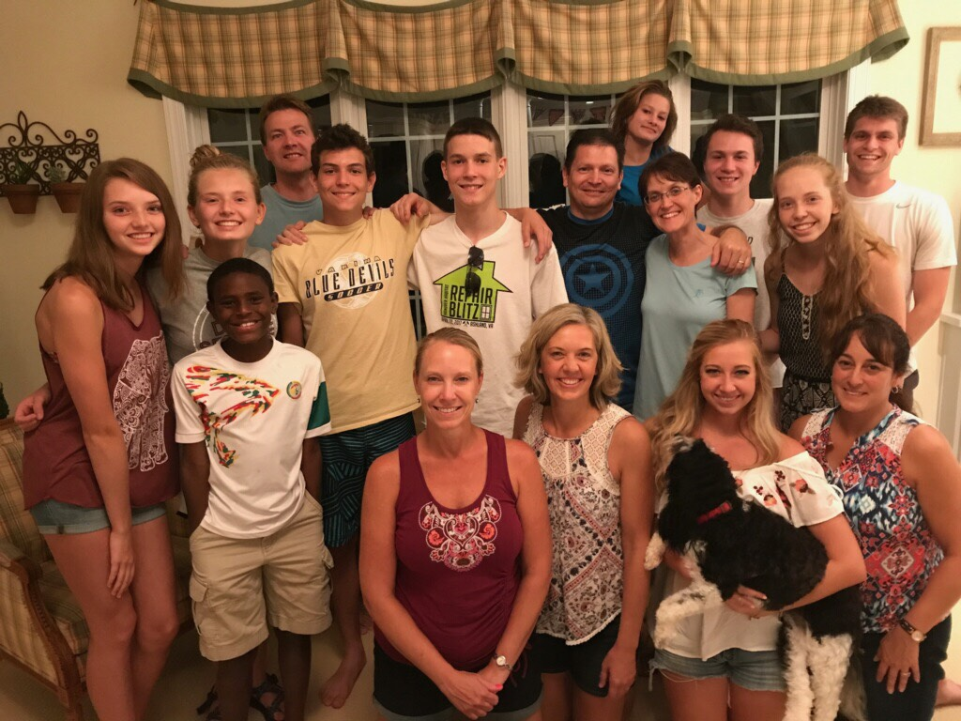

Slide 28
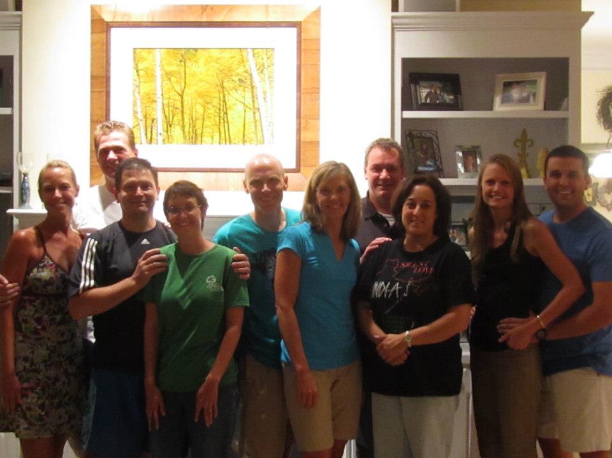

Slide 29
You get to your purpose
By following Jesus
One step at a time
One relationship at a time

Slide 30
In God’s family . . .
It’s okay not to be okay

Slide 31
In God’s family . . .
It’s okay not to be okay
But its not okay to be alone

Slide 32
God designed
life to get
BETTER TOGETHER
Notes:
Someone needs our light

Slide 33
“follow Me”
It’s all about taking a next step
You step. He multiplies.
Notes:
You are the last person you should trust when you are not feeling well
Actually pick up what’s painful and let someone else crucify it in you

