Slide 1
Why the
“Gospel of Jesus Christ” really is good news
for every person?
Mark 1:1,14-15

Slide 2
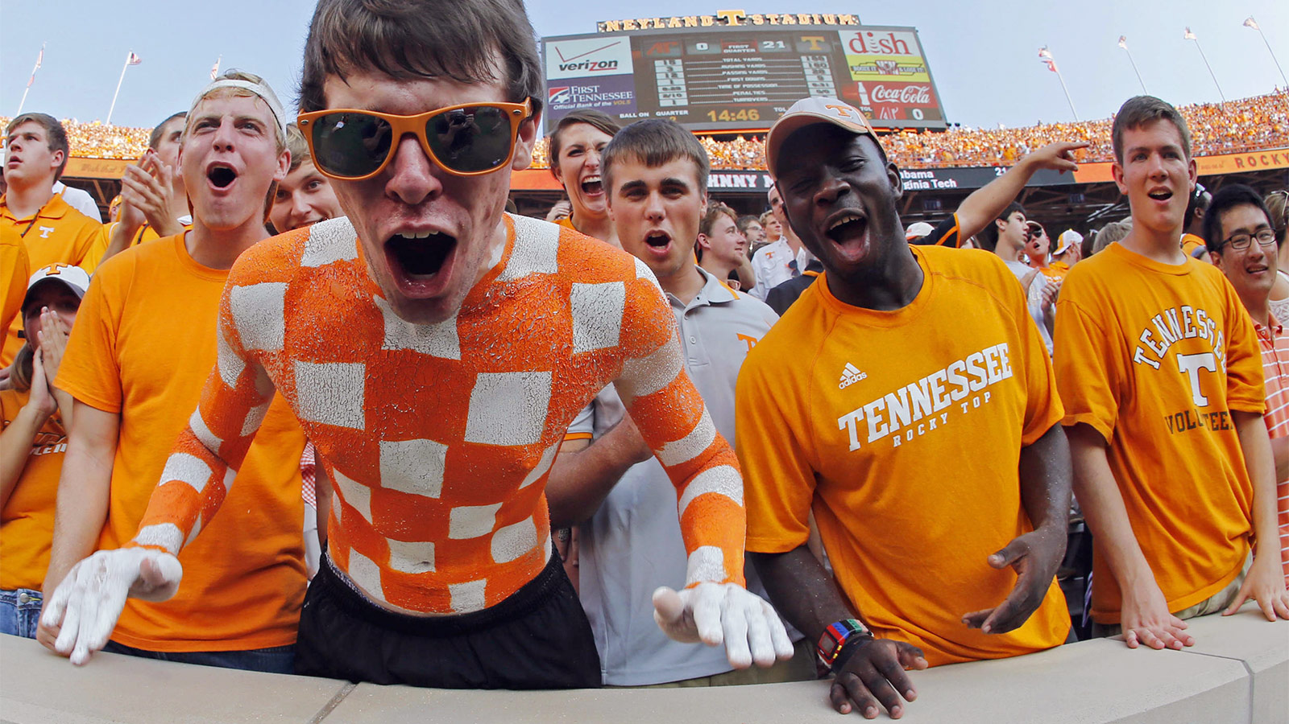

Slide 3
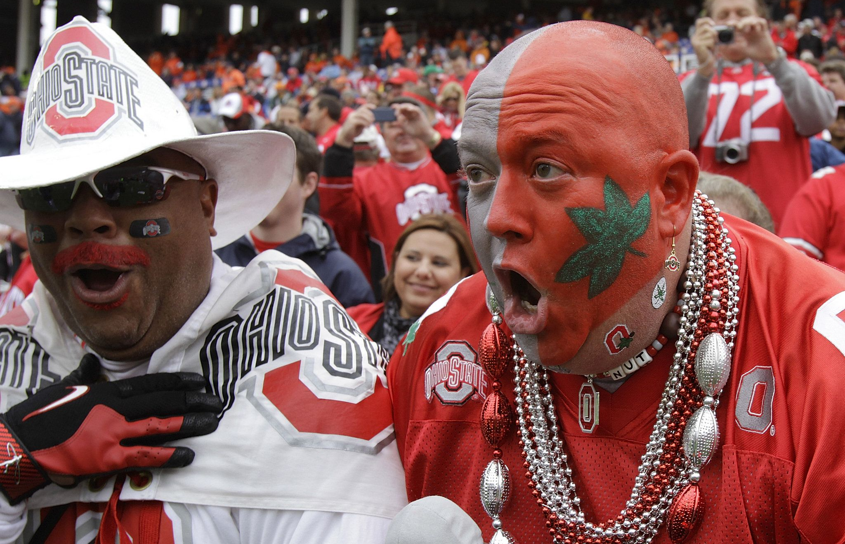

Slide 4
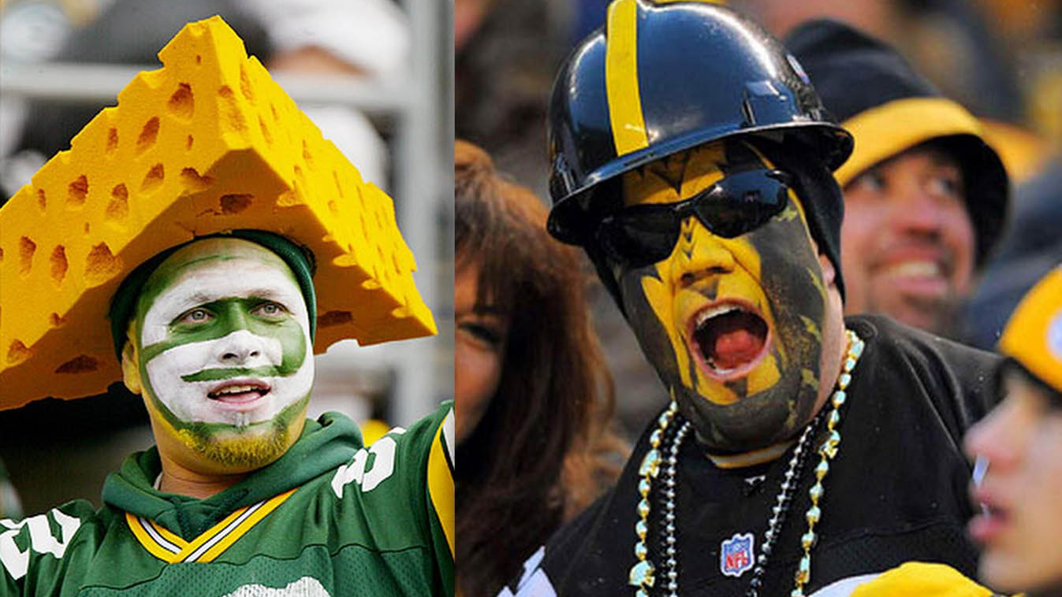
Notes:
Part of my identity and purpose was that home
God made families to have a home

Slide 5
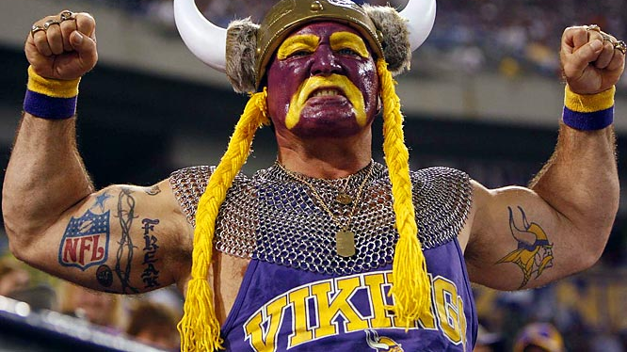

Slide 6
Notes:
Purposefully blank

Slide 7
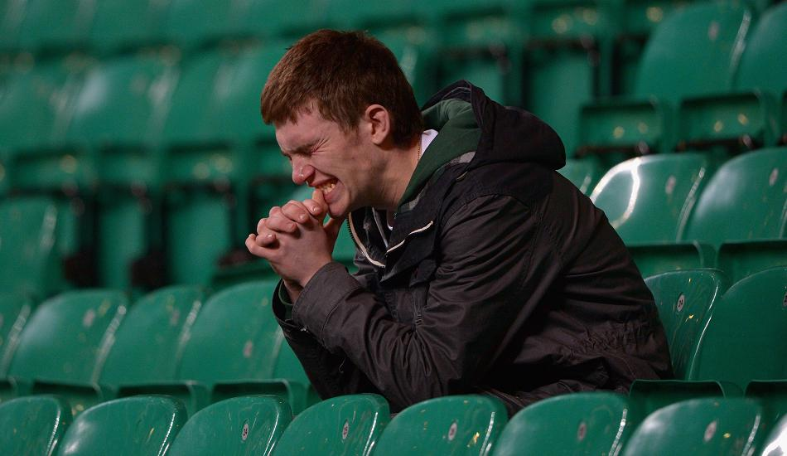

Slide 8
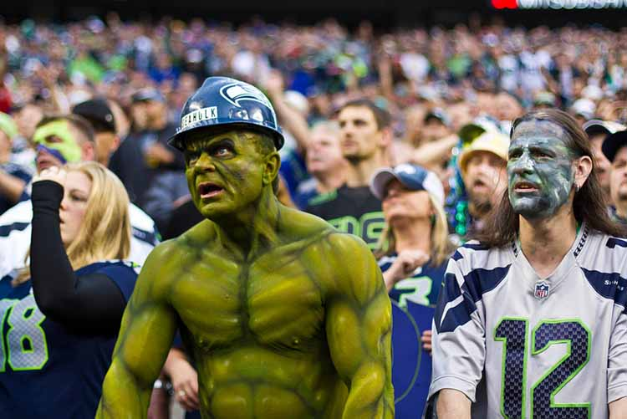

Slide 9
There is something deep
Within us that needs victory

Slide 10
All of us can feel defeated in life
Or feel the pressure of battles we face

Slide 11
“How long must I struggle with anguish in my soul, and fight sorrow in my heart every day? How long will my enemy have the upper hand? “ (psalm 13:2, gnb)
Notes:
We don’t need to go to a church to know there are battles in life and unseen enemies that try to steal our peace, joy and love in life
But the answer to it is found in church

Slide 12
Victory over every enemy of this life you may face is the first and the main message Jesus when he came to earth
Called “the Gospel” of Jesus Christ
Notes:
Tell Roman & Greek Times

Slide 13
“The beginning of the gospel about Jesus Christ, the Son of God.”
“Jesus went into Galilee, proclaiming the good news of God. “The time has come,” he said. ‘The kingdom of God is near. Repent and believe the good news!’”
Mark 1:1, 14-15

Slide 14
The Gospel Message Of Jesus
The good news that every enemy that wants to enslave and conquer you
has been defeated for you by Jesus

Slide 15
But thanks be to God,
who gives us the victory
through our Lord Jesus Christ.
1 Cor 15:57

Slide 16
As Savior, Jesus Gives Us
Victory Over Selfishness
“She will give birth to a son, and you are to give him the name Jesus, because he will save his people from their sins."
(Mt. 1:21)

Slide 17
As Healer, Jesus Gives Us
Victory Over Pain
“and Jesus healed all the sick. This was to fulfill what was spoken through the prophet Isaiah: He took up our infirmities and carried our diseases. . . and by His wounds we are healed." (Mt. 8:16-17, Is. 53:4-5)

Slide 18
As Sanctifier, Jesus Gives Us
Victory Over Addiction
“Jesus replied, ‘I tell you the truth, everyone who sins is a slave to sin. . . So if the Son sets you free, you will be free indeed." (John 8:34-36)

Slide 19
As Baptizer In The Holy Spirit, Jesus Gives Us Victory Over Fear
“Peace I leave with you; my peace I give you. I do not give to you as the world gives. Do not let your hearts be troubled and do not be afraid."
(John 14:27)

Slide 20
As Soon Coming King, Jesus Gives Us Victory Over Injustice
“Behold, I am coming soon! My reward is with me, and I will give to everyone according to what he has done.”
(Revelation 22:12-13)

Slide 21
The Gospel of Jesus
Jesus Is . . | Champion Over. . .
Savior | Selfishness
Healer | Pain
Sanctifier | Addiction
Baptizer in H.S. | Fear
S.C. King | Injustice
Notes:
But Not good news unless he is two other things
One today – the other next week

Slide 22
“When Jesus had finished washing their feet . . . “Do you understand what I have done for you?” he asked. “You call me ‘Teacher’ and ‘Lord,’ and rightly so, for that is what I am. Now that I, your Lord and Teacher, have washed your feet, you also should wash one another’s feet. I have set you an example that you should do as I have done for you.”
John 13:12–15 (NIV84)

Slide 23
Here is why Jesus is really good news
Jesus As . . . | Can Wash Off Your . .
Savior | Selfishness
Healer | Pain
Sanctifier | Addiction
Baptizer in H.S. | Fear
S.C. King | Injustice

Slide 24
You can say yes
to the gospel of Jesus Christ
no matter what battles
you’ve already lost in this life
You can say yes to making Jesus the center of your everyday life

Slide 25
“King Jesus, today I ask you to wash ________ from my life and teach me to live in victory over it forever. I believe in You. I trust You. I am sorry what I have done.”

Slide 26
A TIME OF PRAYER
Jesus Is . . | Champion Over. . .
Savior | Selfishness
Healer | Pain
Sanctifier | Addiction
Baptizer in H.S. | Fear
S.C. King | Injustice
Feel Free To Come Up For Prayer
Notes:
But Not good news unless he is two other things
One today – the other next week

