Slide 1
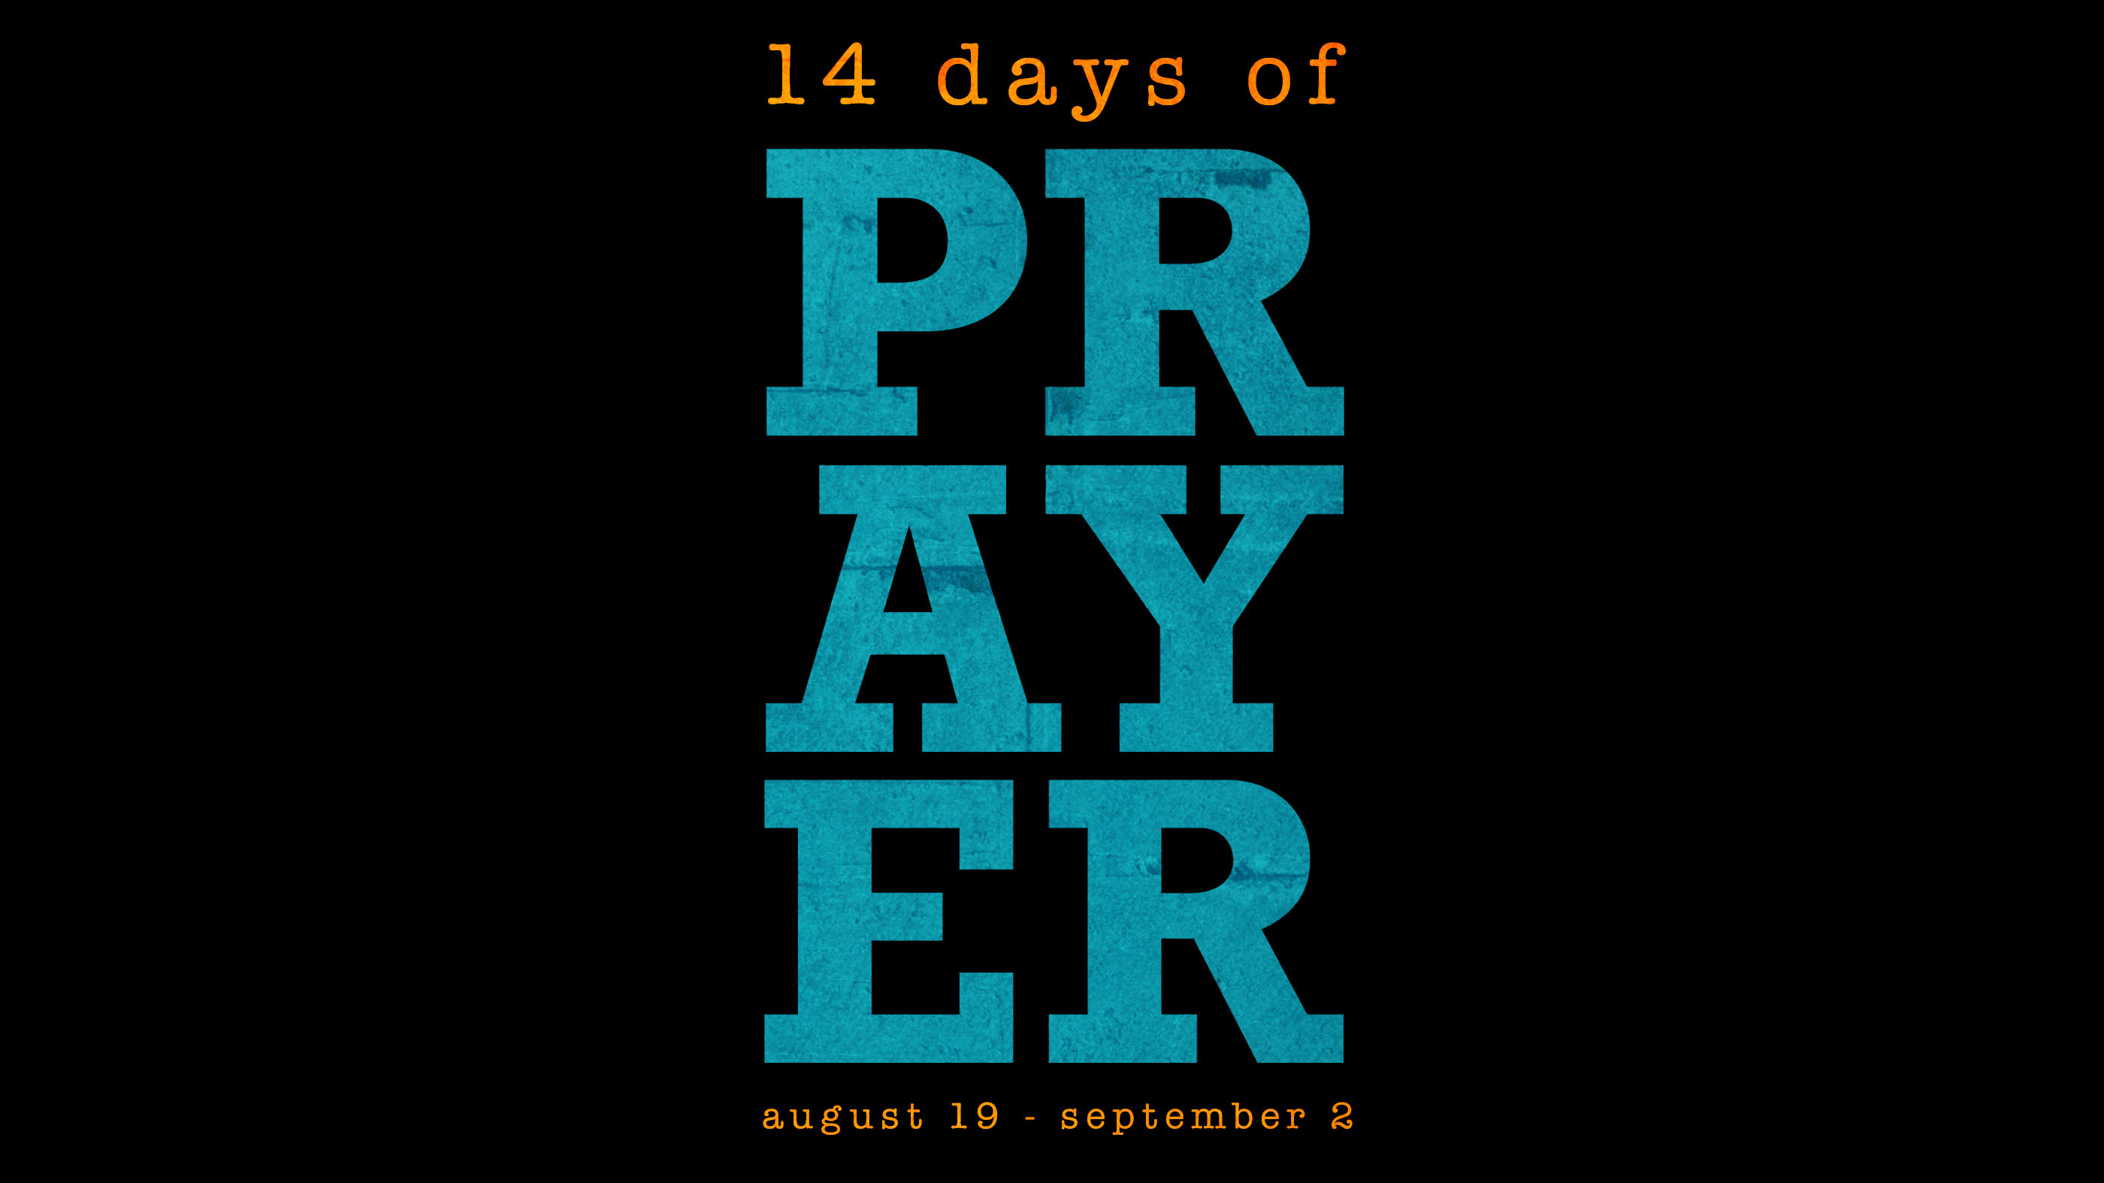

Slide 2
2 Chronicles 7:14
If my people, who are called by my name, will humble themselves and PRAY and SEEK my face turn from their wicked ways, then I will hear from heaven and I will forgive their sin and heal their land.

Slide 3
1 Thessalonians 5:16
Rejoice always, PRAY continually, give thanks in all circumstances; for this is God’s will for you in Christ Jesus.

Slide 4
Jeremiah 29:13
You will SEEK me and find me when you SEEK me with all of your heart.

Slide 5
Matthew 7:7
ASK, and it will be given to you. SEEK, and you will find. KNOCK, and the door will be opened to you. For everyone who ASKS receives, and the one who SEEKS finds, and to the one who KNOCKS the door will be opened.

Slide 6
John 15:1-16
I am the true vine, and my Father is the gardener. He cuts off every branch in me that bears no fruit, while every branch that does bear fruit he prunes so that it will be even more fruitful. You are already clean because of the word I have spoken to you. Remain in me, as I also remain in you. No branch can bear fruit by itself; it must remain in the vine. Neither can you bear fruit unless you remain in me.

Slide 7
John 15:1-16
I am the vine; you are the branches. If you remain in me and I in you, you will bear fruit; apart from me you can do nothing. If you do not remain in me, you are like a branch that is thrown away and withers; such branches are picked up, thrown into the fire and burned. If you remain in me and my words remain in you, ask whatever you wish, and it will be done for you. This is to my Father’s glory, that you bear much fruit, showing yourselves to be my disciples.

Slide 8
John 15:1-16
As the Father has loved me, so have I loved you. Now remain in my love. If you keep my commands, you will remain in my love, just as I have kept my Father’s commands and remain in his love. I have told you this so that my joy may be in you and that your job may be complete. My command is this: Love each other as I have loved you.

Slide 9
John 15:1-16
Greater love has no one than this: to lay down one’s life for one’s friends. You are my friends if you do what I command. I no longer call you servants, because a servant does not know his mater’s business. Instead, I have called you friends, for everything that I learned from my Father I have made known to you. You did not choose me, but I chose you and appointed you so that you might go and bear fruit – fruit that will last – and so that whatever you ask in my name the Father will give you.

Slide 11
Tabernacle Prayer
Give thanks to God
Focus on the Cross
Offer every part of your lives to God
Invite the Holy Spirit
Claim the promises of God – Pray the Word
Worship
Intercede for others

