Slide 2
14 Days of Prayer
August 19-September 1, 2018

Slide 3
Come, bless the Lord, all you servants of the Lord… Lift up your hands to the holy place and bless the Lord!
May the Lord bless you from Zion, he who made heaven and earth!
(Psalm 134)

Slide 4
Pray in the Spirit in every situation. Use every kind of prayer and request there is.
(Ephesians 6:18 GW)

Slide 5
Have the people of Israel build me a holy sanctuary so I can live among them. You must build this Tabernacle and its furnishings exactly according to the pattern I will show you.
(Exodus 25:8-9 NLT)

Slide 7
“Do not think that I have come to abolish the Law or the Prophets; I have not come to abolish them but to fulfill them.”
(Matthew 5:17)

Slide 8
Inside the Tent of Meeting, the LORD would speak to Moses face to face, as one speaks to a friend.
(Exodus 33:11 NLT)

Slide 10
THE OUTER COURT
1. Give God Thanks

Slide 11
Enter his gates with thanksgiving and his courts with praise;
give thanks to him and
praise his name.
(Psalm 100:4)

Slide 12
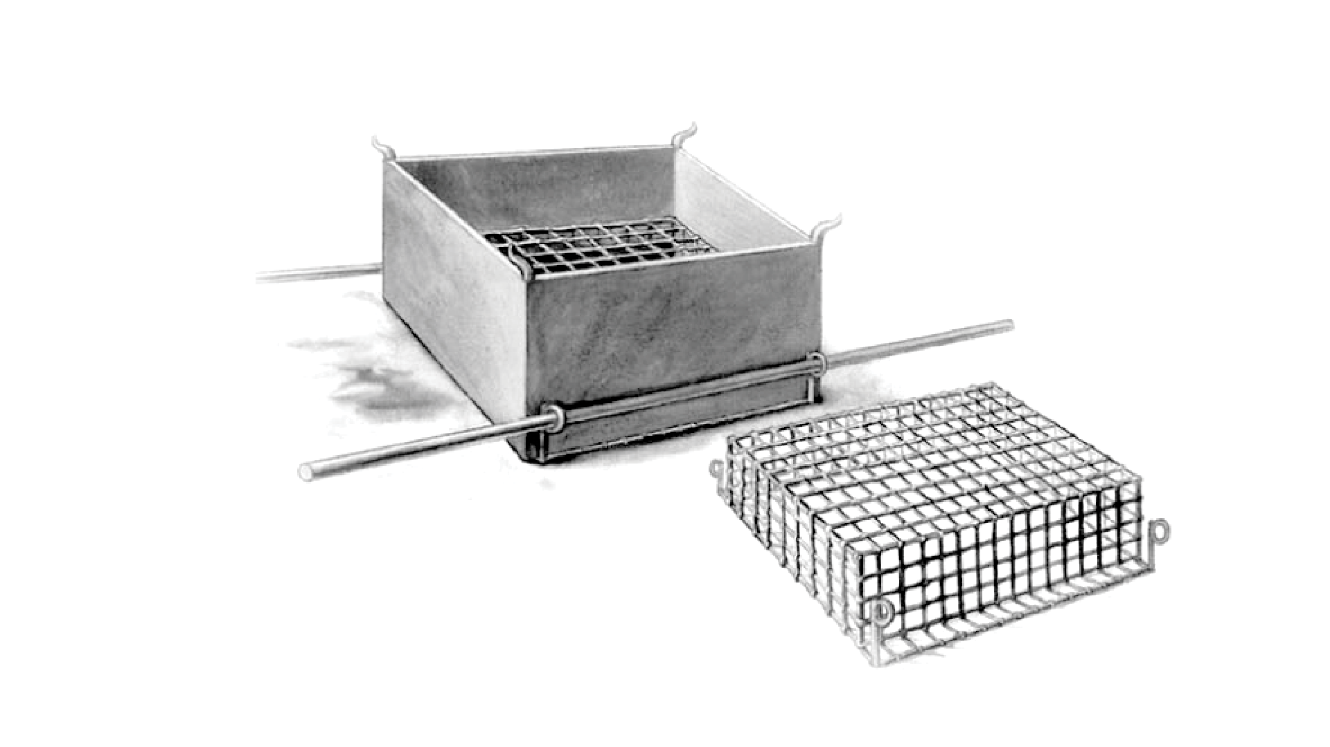

Slide 13
THE BRAZEN ALTAR
2. Focus on the Cross.

Slide 14
But he was pierced for our transgressions, he was crushed for our iniquities; the punishment that brought us peace was on him, and by his wounds we are healed.
(Isaiah 53:5 NLT)

Slide 15
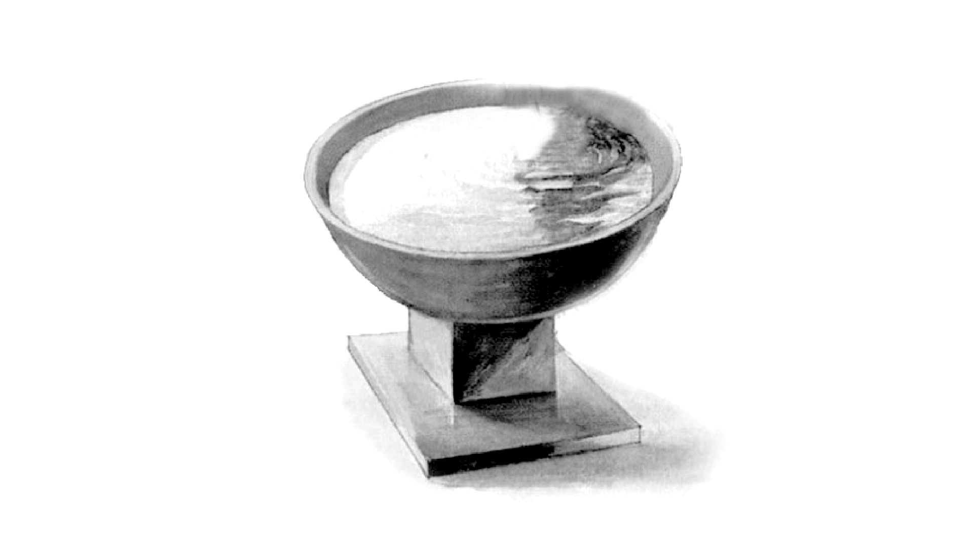

Slide 16
THE LAVER
3. Offer every part of our lives to God.

Slide 17
Therefore, I urge you, brothers, in view of God’s mercy, to offer your bodies as living sacrifices, holy and pleasing to God--this is your spiritual act of worship.
(Romans 12:1)

Slide 18
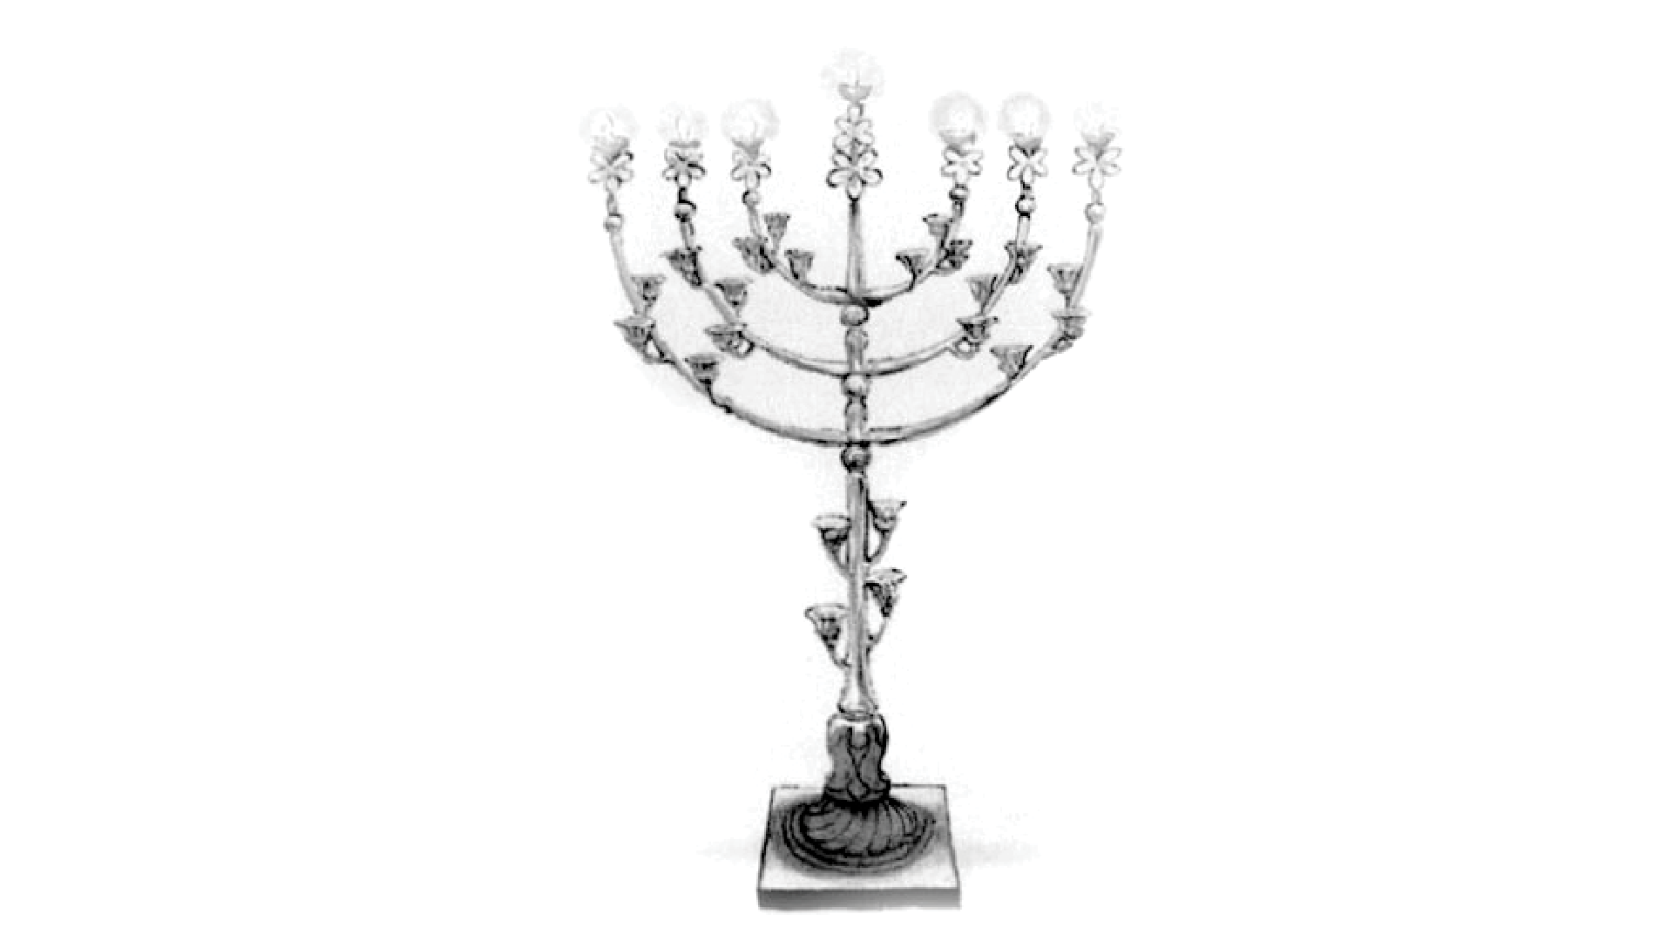

Slide 19
THE CANDLESTICK
4. Invite the work of the
Holy Spirit in my life.

Slide 20
This is why I remind you to fan into flames the spiritual gift God gave you when I laid my hands on you.
(2 Timothy 1:6-7 NLT)

Slide 21
For God has not given us a spirit of fear and timidity, but of power, love, and self-discipline.
(2 Timothy 1:6-7 NLT)

Slide 22
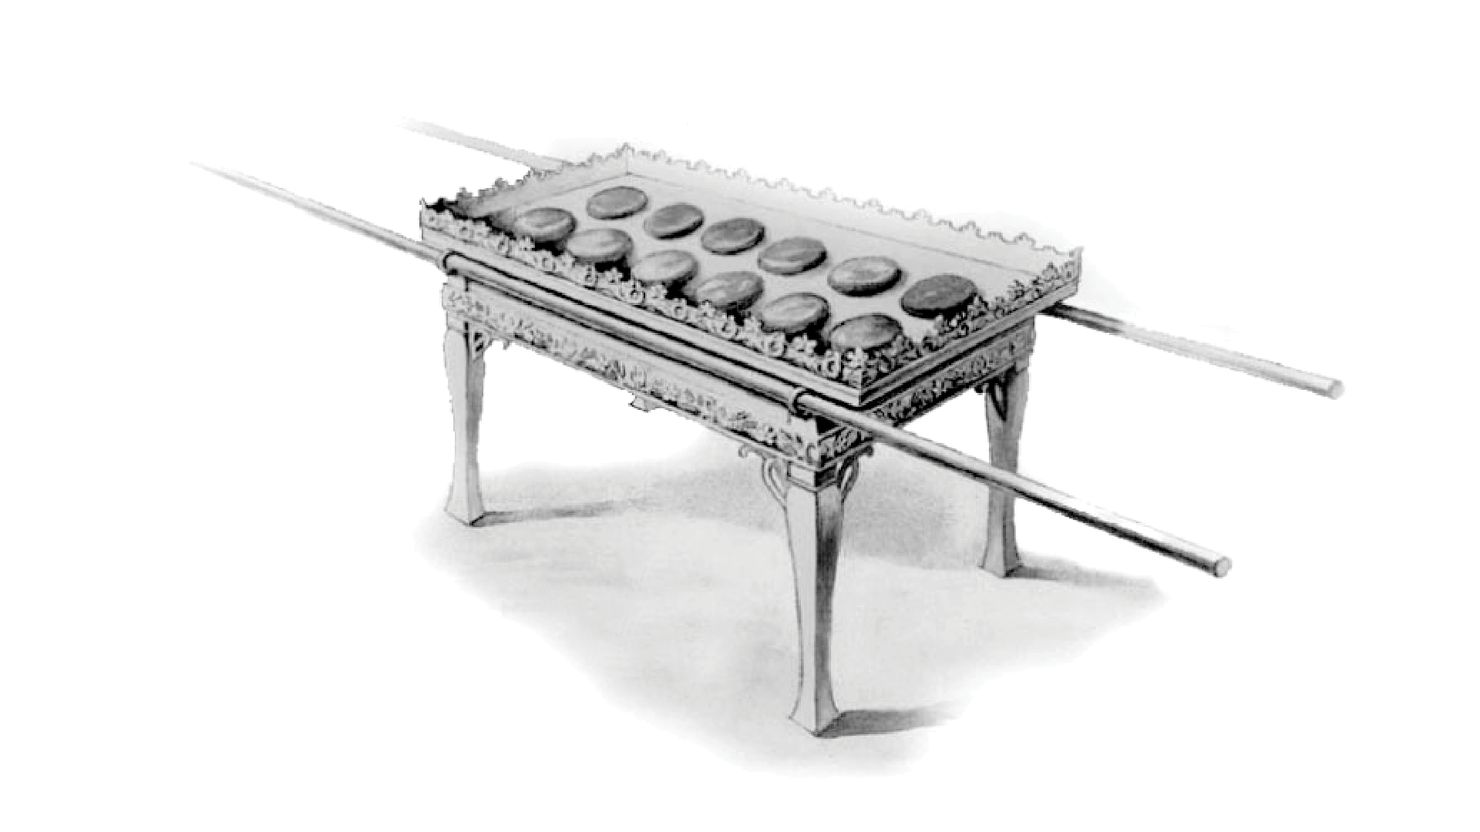

Slide 23
THE TABLE OF SHEWBREAD
5. Claim the promises in God’s Word.

Slide 24
Jesus answered, “It is written: ‘Man shall not live on bread alone, but on every word that comes from the mouth of God.’”
(Matthew 4:4)

Slide 25
You have searched me, LORD, and you know me.
Even the darkness will not be dark to you;
(Psalm 139: 1,12)

Slide 26
Your eyes saw my unformed body; all the days ordained for me were written in your book before one of them came to be.
(Psalm 139: 16)

Slide 27
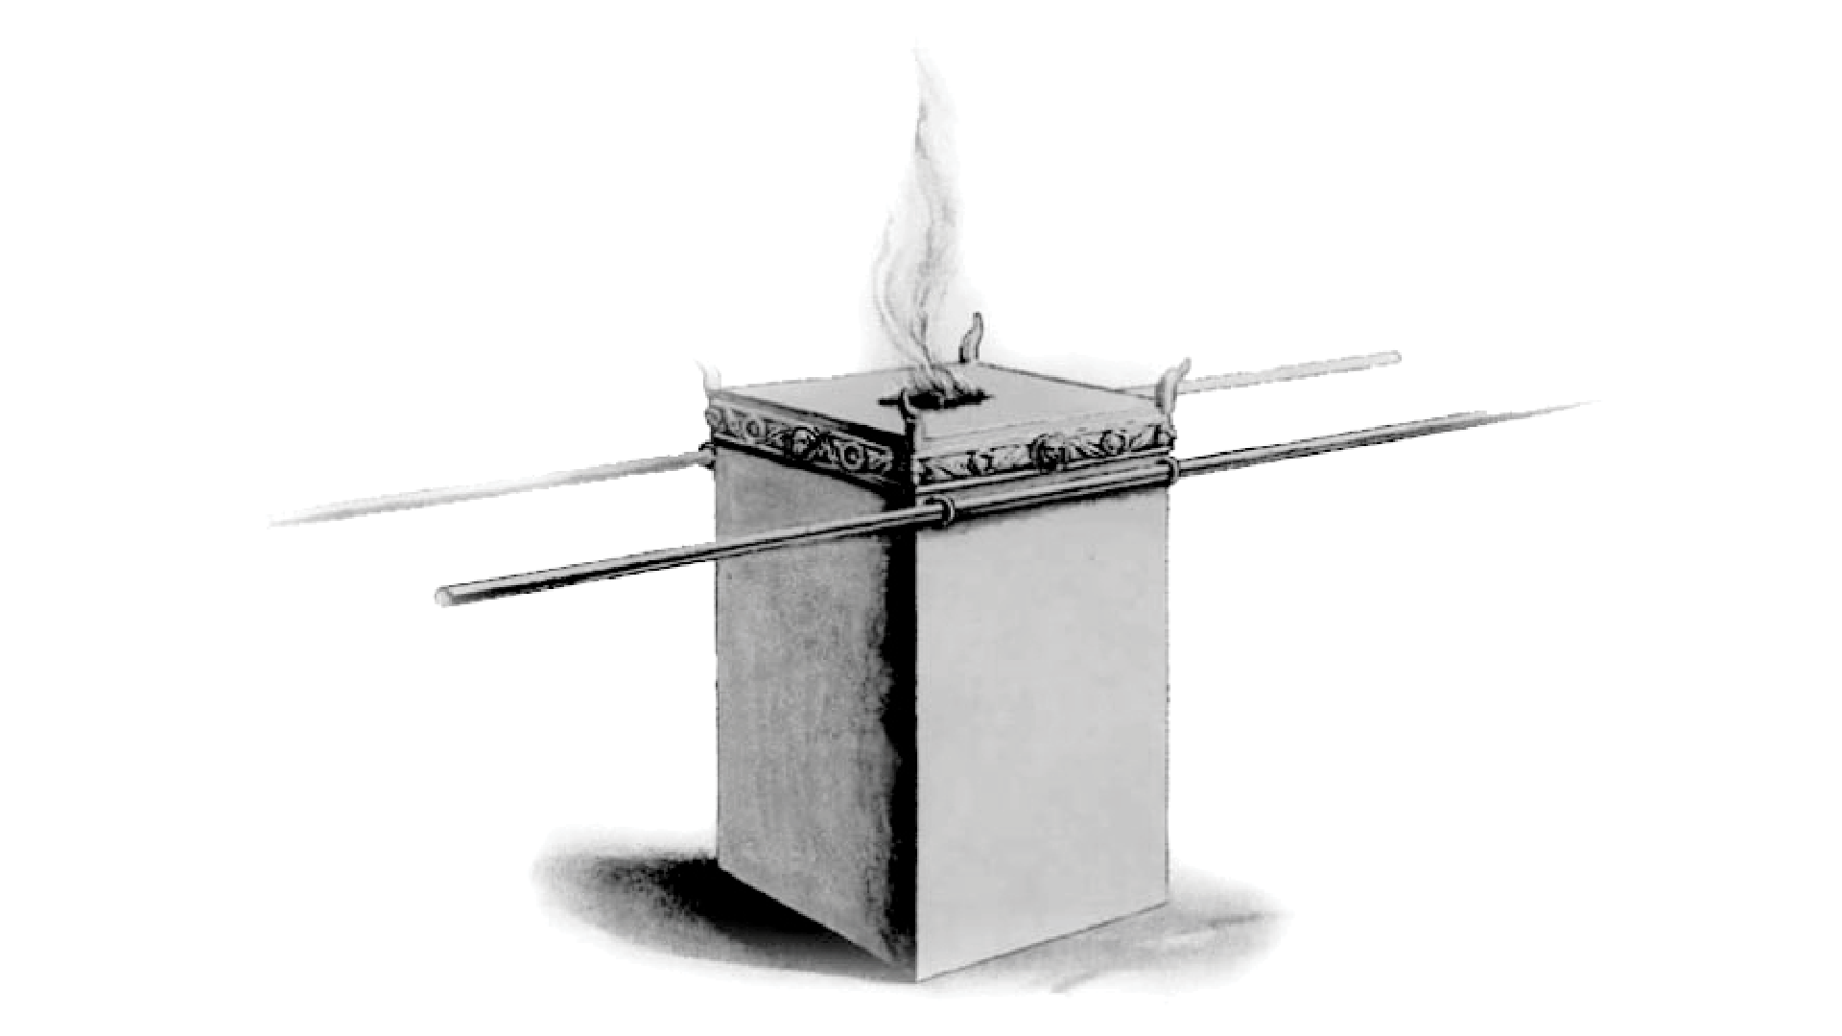

Slide 28
THE ALTAR OF INCENSE
6. Worship His Name

Slide 29
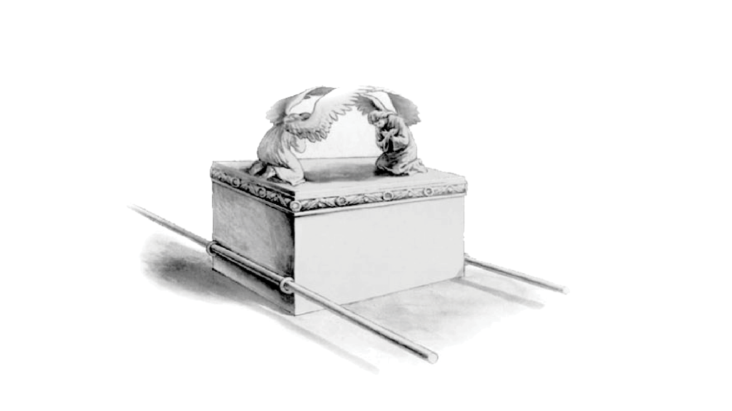

Slide 30
THE ARK OF THE COVENANT
7. Intercede for others

Slide 31
I urge, then, first of all, that petitions, prayers, intercession and thanksgiving be made for all people—for kings and all those in authority, that we may live peaceful and quiet lives in all godliness and holiness.
(1 Timothy 2:1-2)

Slide 32
Prayer should be our first response, not our last resort.

Slide 33
14 Days of Prayer
August 19-September 1, 2018

