Slide 2
Video Here
Summary video
https://vimeo.com/258462701

Slide 3
Ezekiel 22:30
“I looked for a man among them who would build up the wall and stand before me in the gap on behalf of the land so I would not have to destroy it, but I found none.”

Slide 4
God’s Word For Us Today
“I’m asking you to stand in the gap, not fix the gap. If you’ll be faithful to show up, I will be faithful to bring you joy.”

Slide 5
#1. Show Up
“Do not let your hearts be troubled. Trust in God; trust also in me. . . . I am the way and the truth and the life.” (John 14:6)
Notes:
Show up where its bigger than you.
Read about God leading Esther to show up

Slide 6
#2. See God Work
“Now to him who is able to do immeasurably more than all we ask or imagine, according to his power that is at work within us”
(Ephesians 3:20)

Slide 7
#3: Share His Joy
“You prepare a table before me in the presence of my enemies. You anoint my head with oil; my cup overflows. Surely goodness and love will follow me all the days of my life”
(Psalm 23:5-6)

Slide 8
1st Service

Slide 9
Pam / Teacher

Slide 10
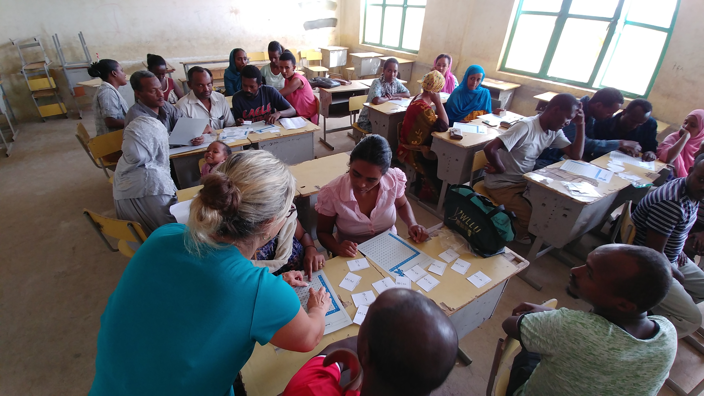

Slide 11
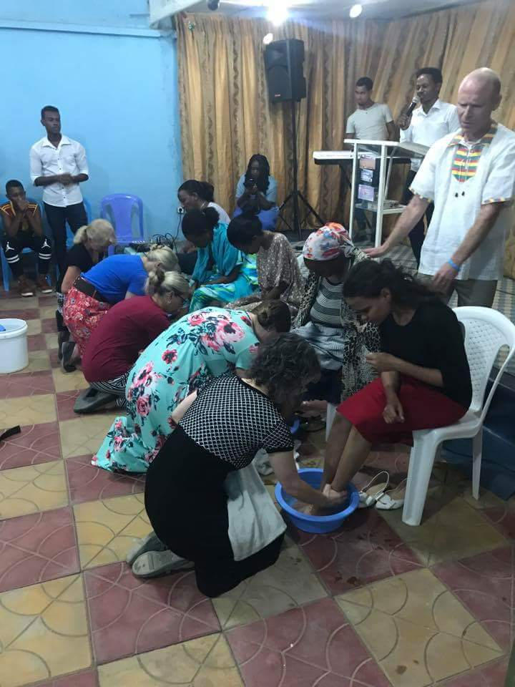

Slide 13
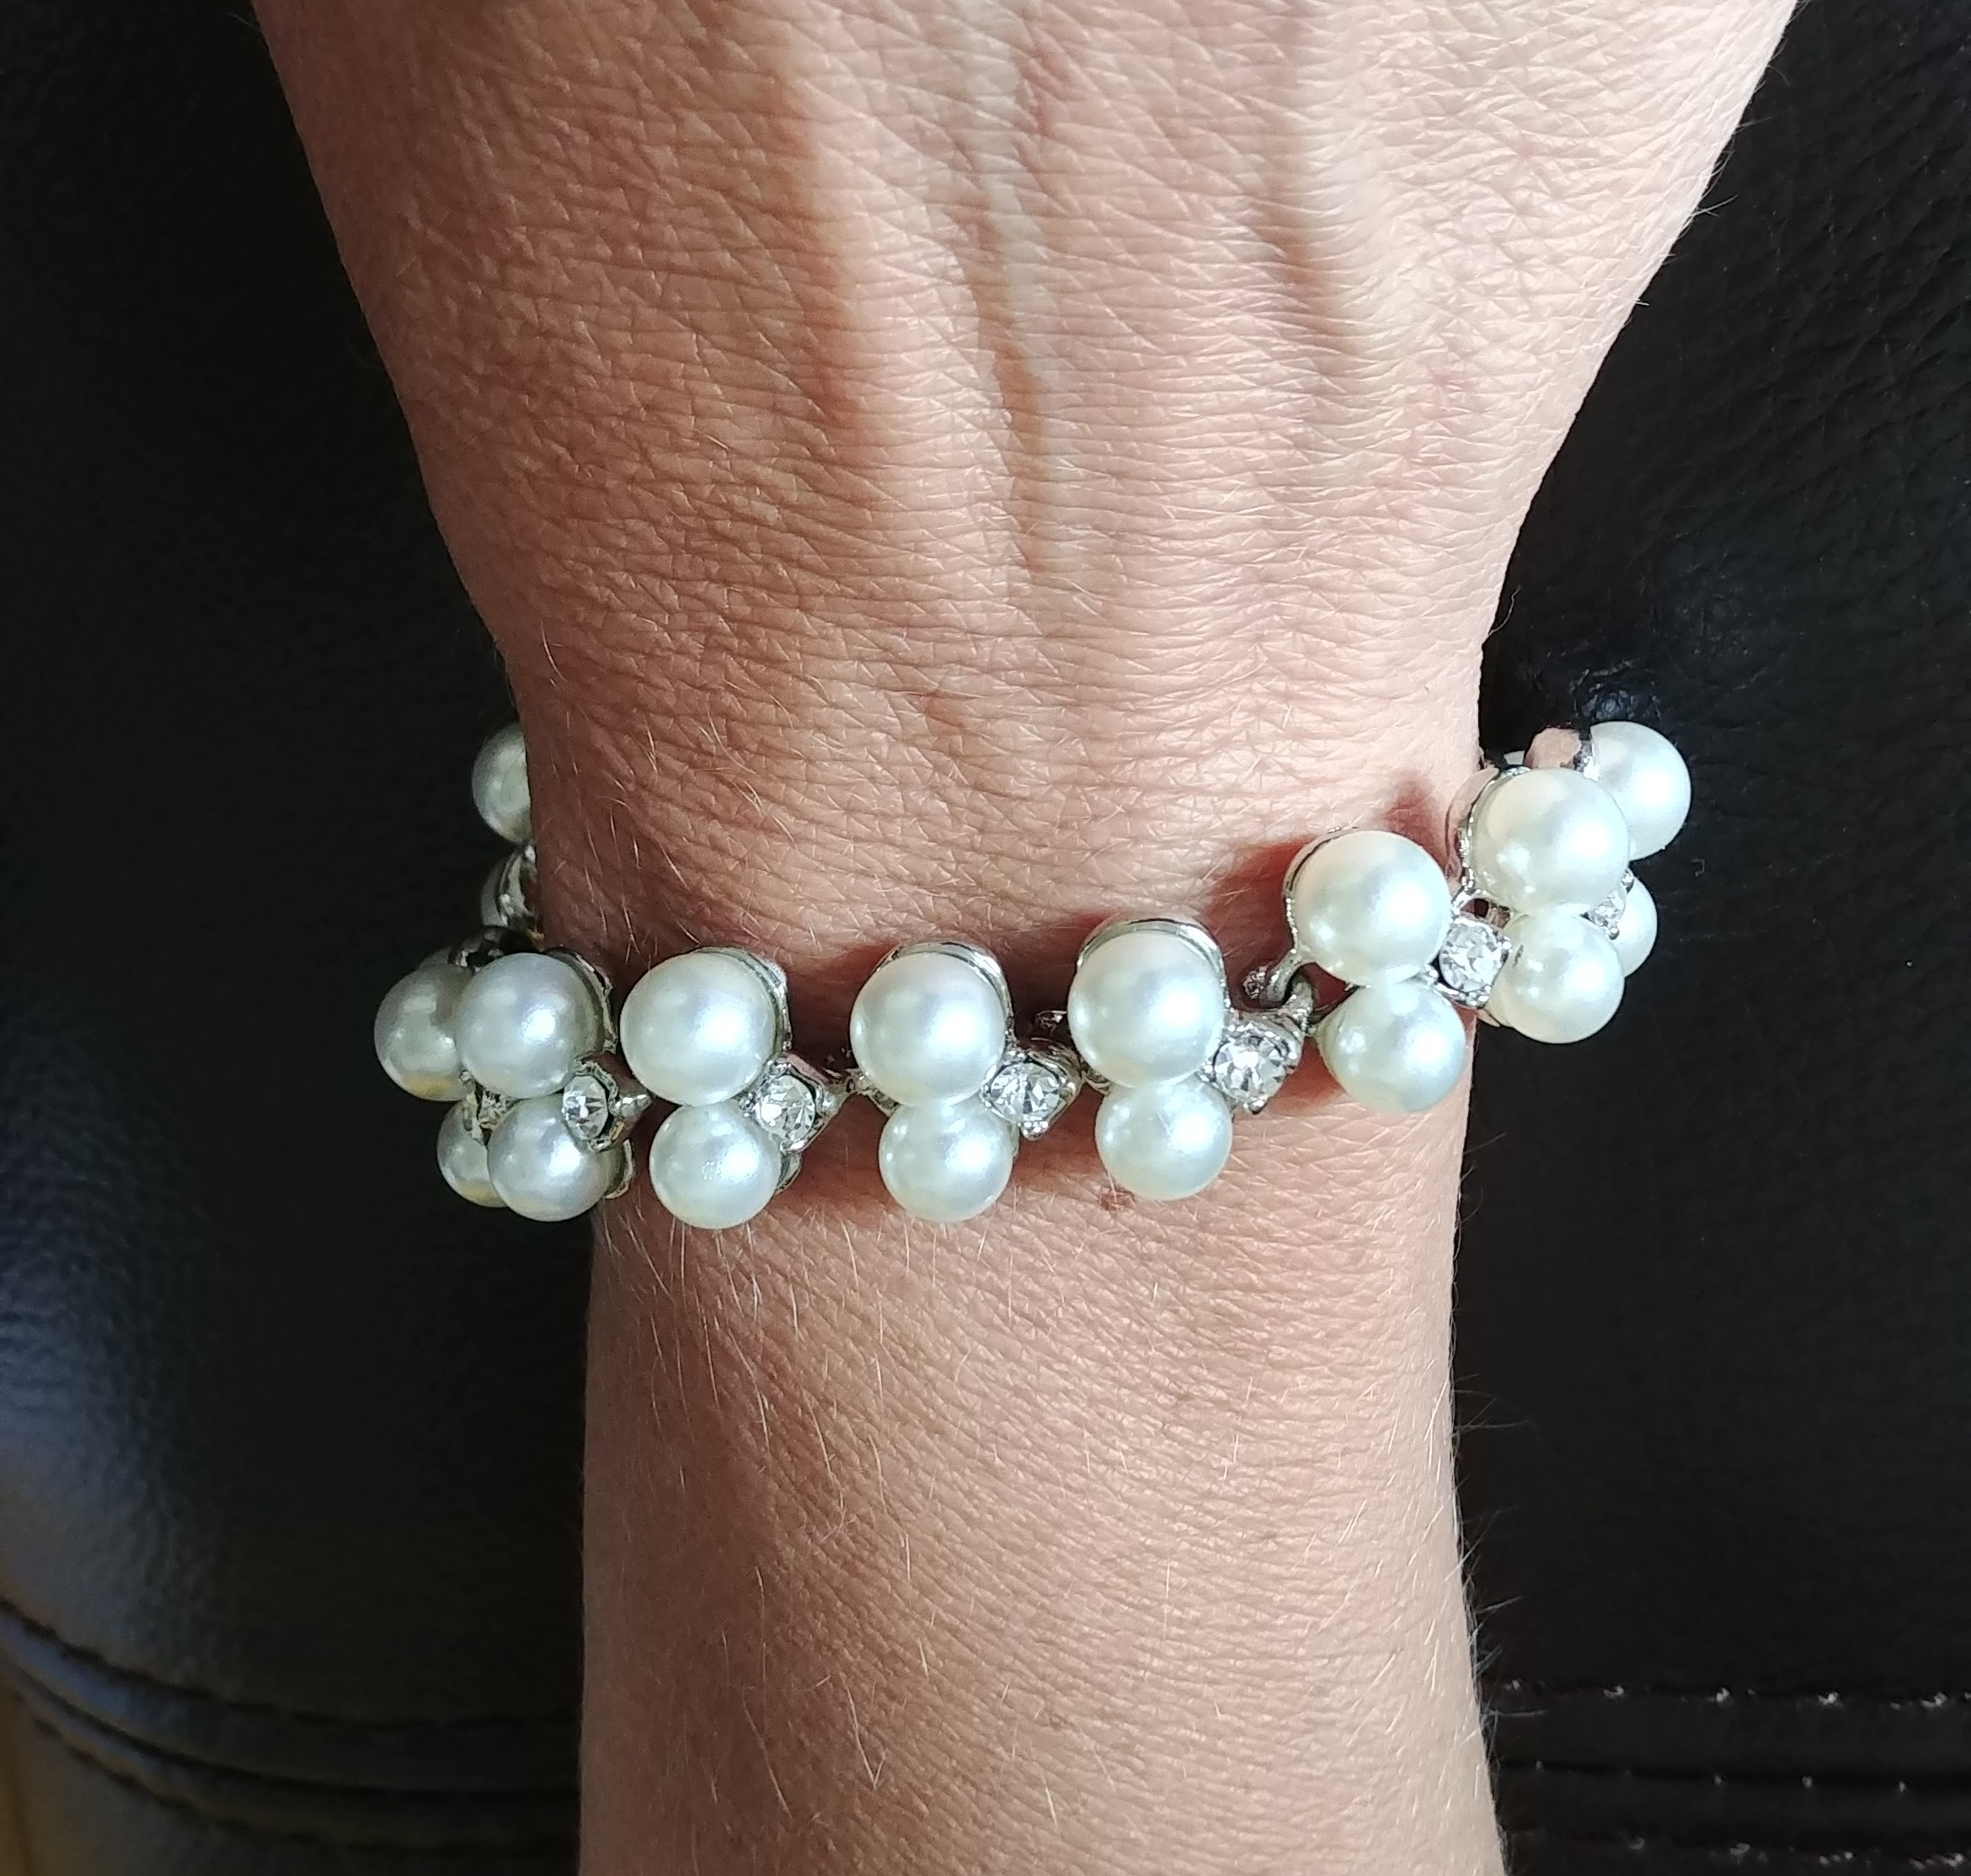

Slide 14
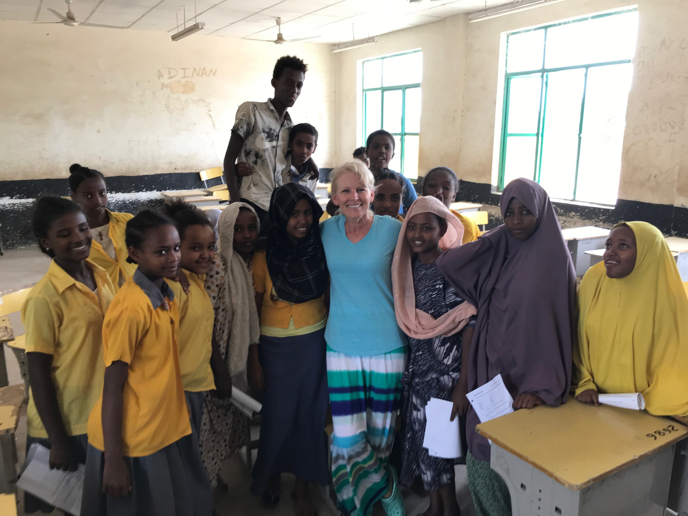
Beth / Teacher

Slide 15
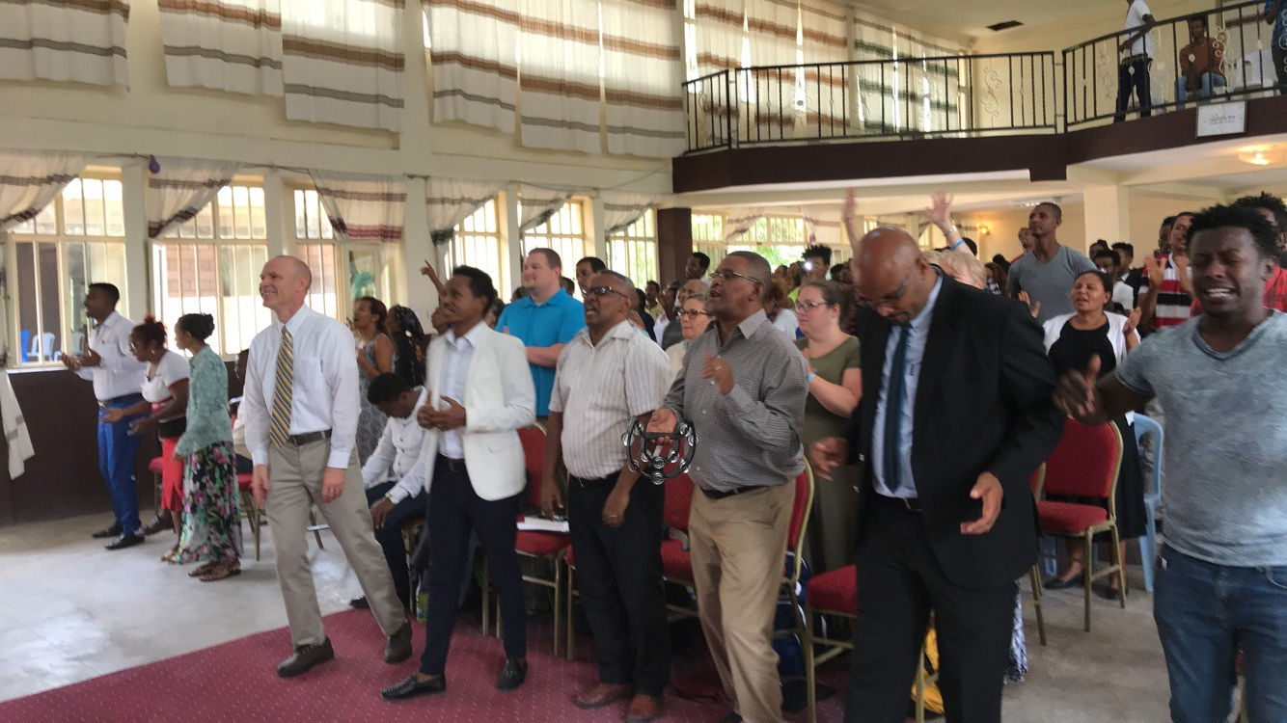

Slide 16
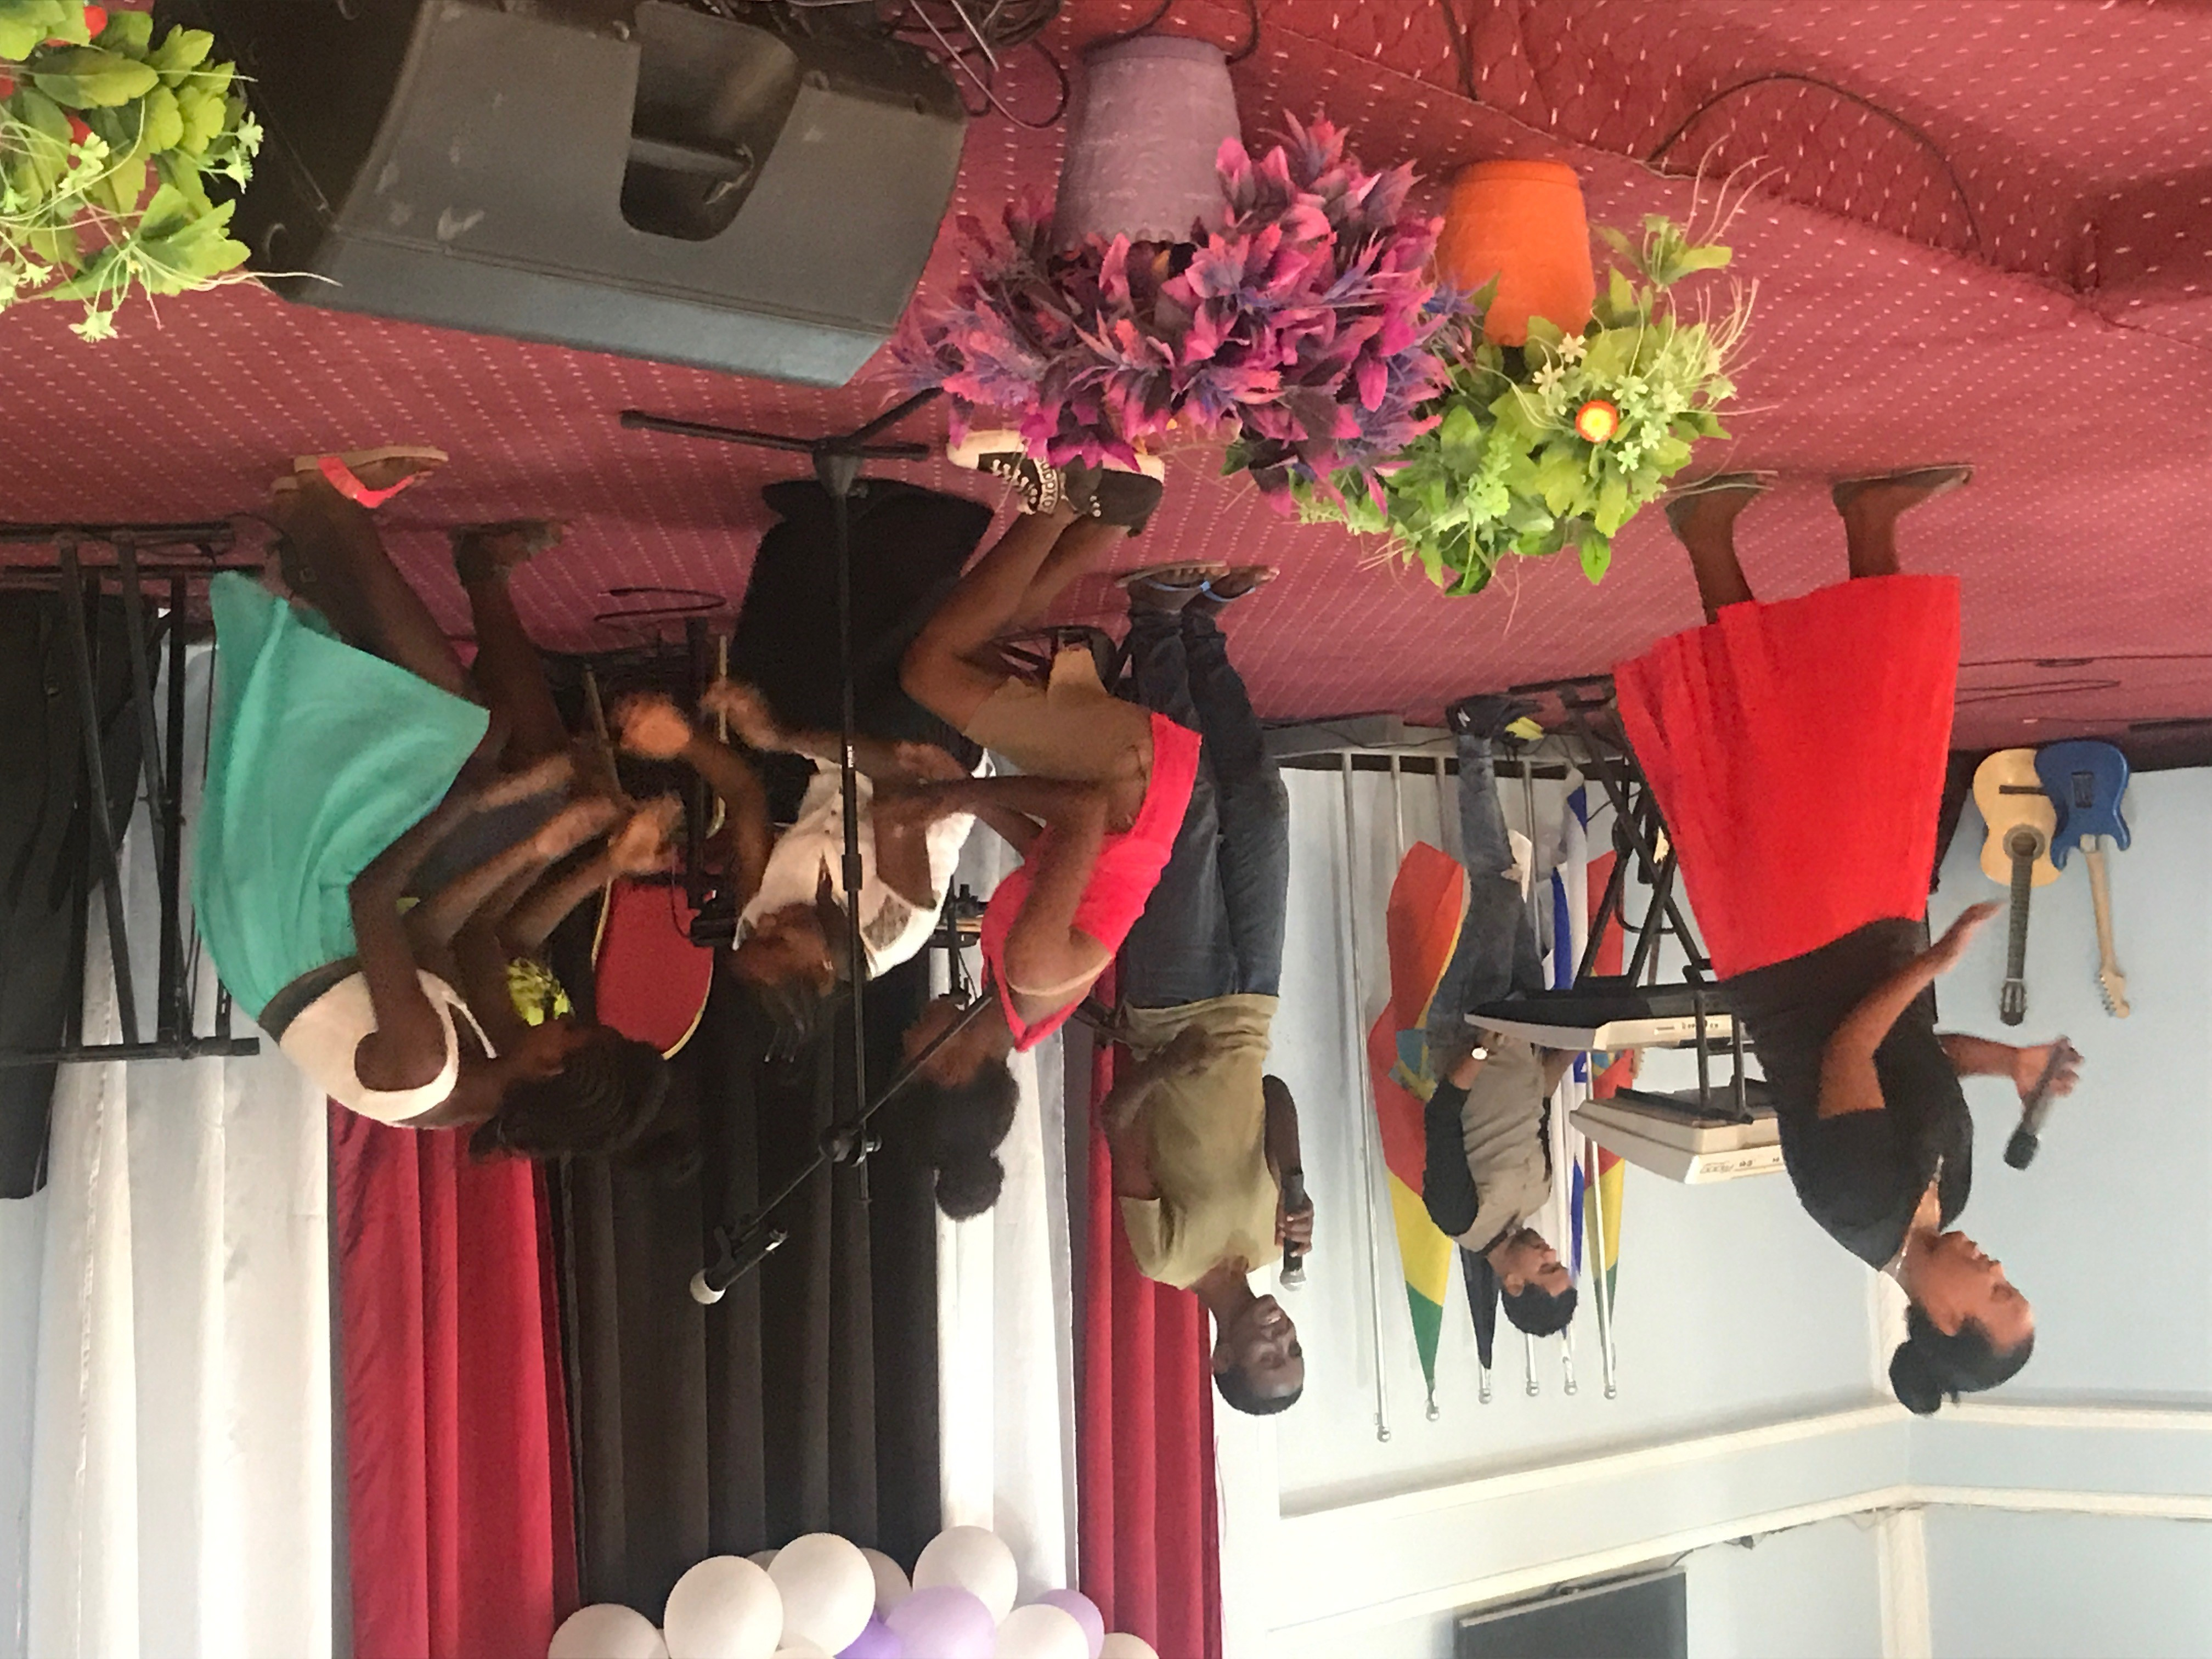

Slide 17
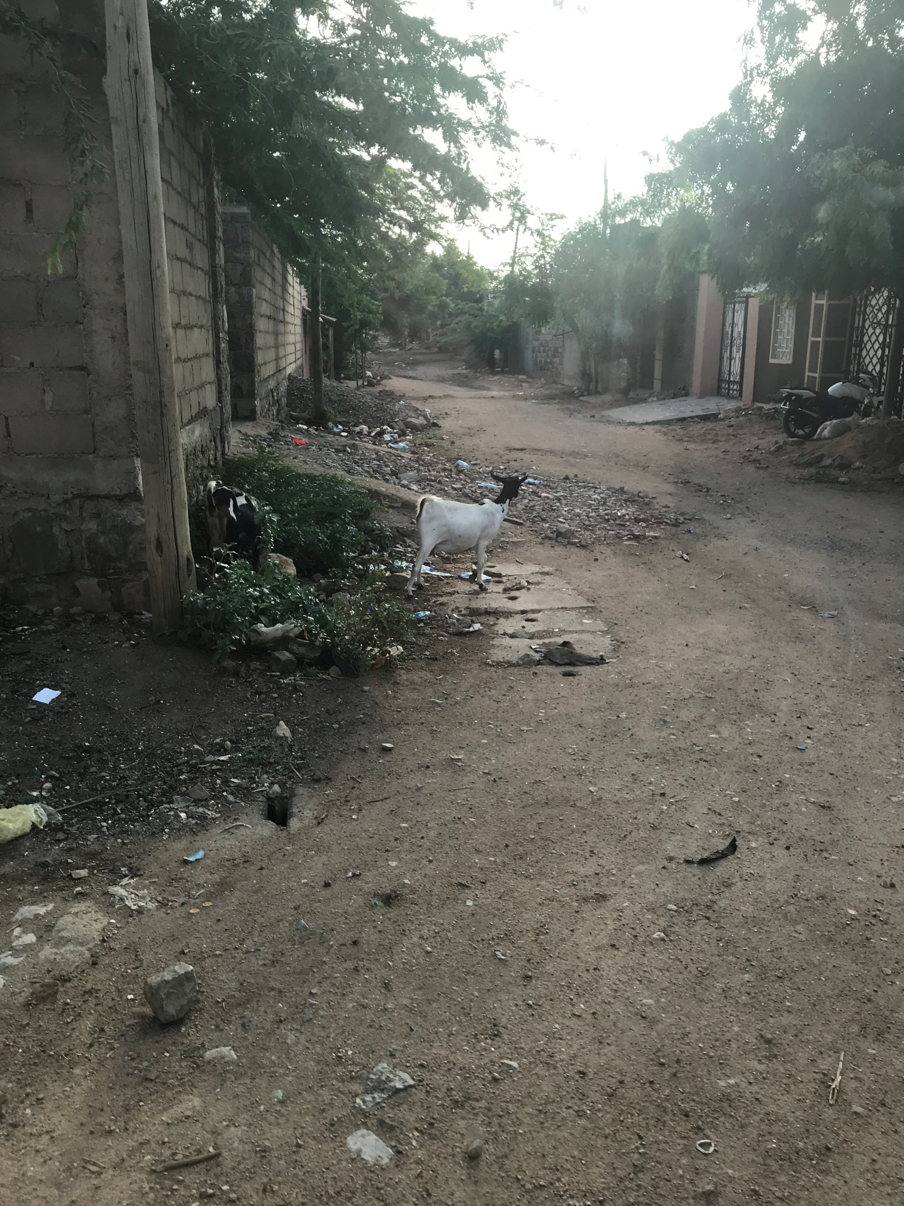

Slide 18
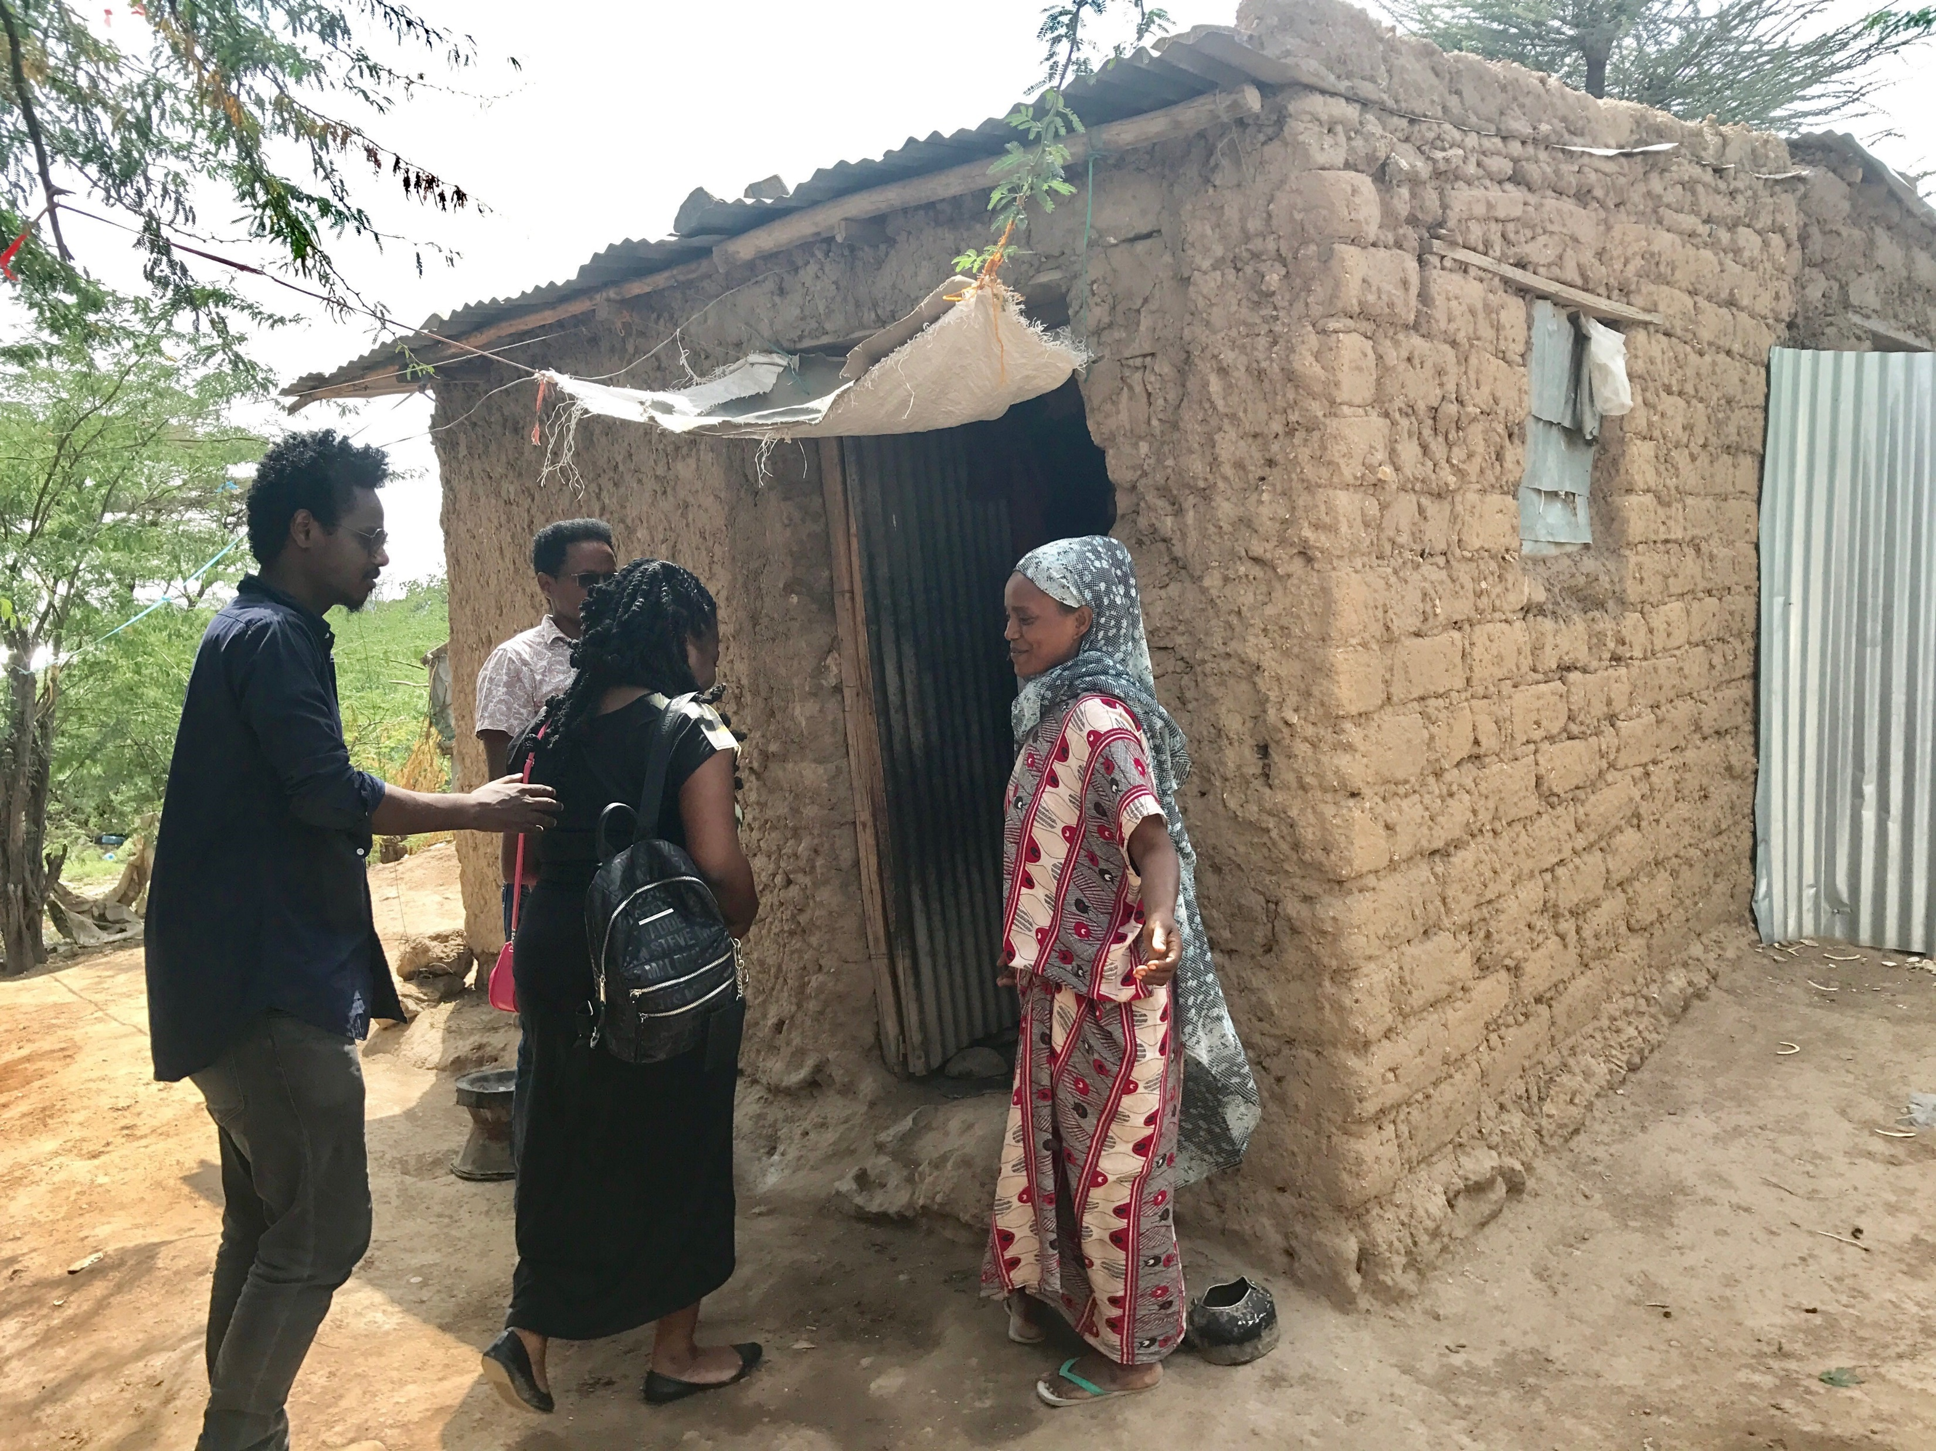

Slide 19
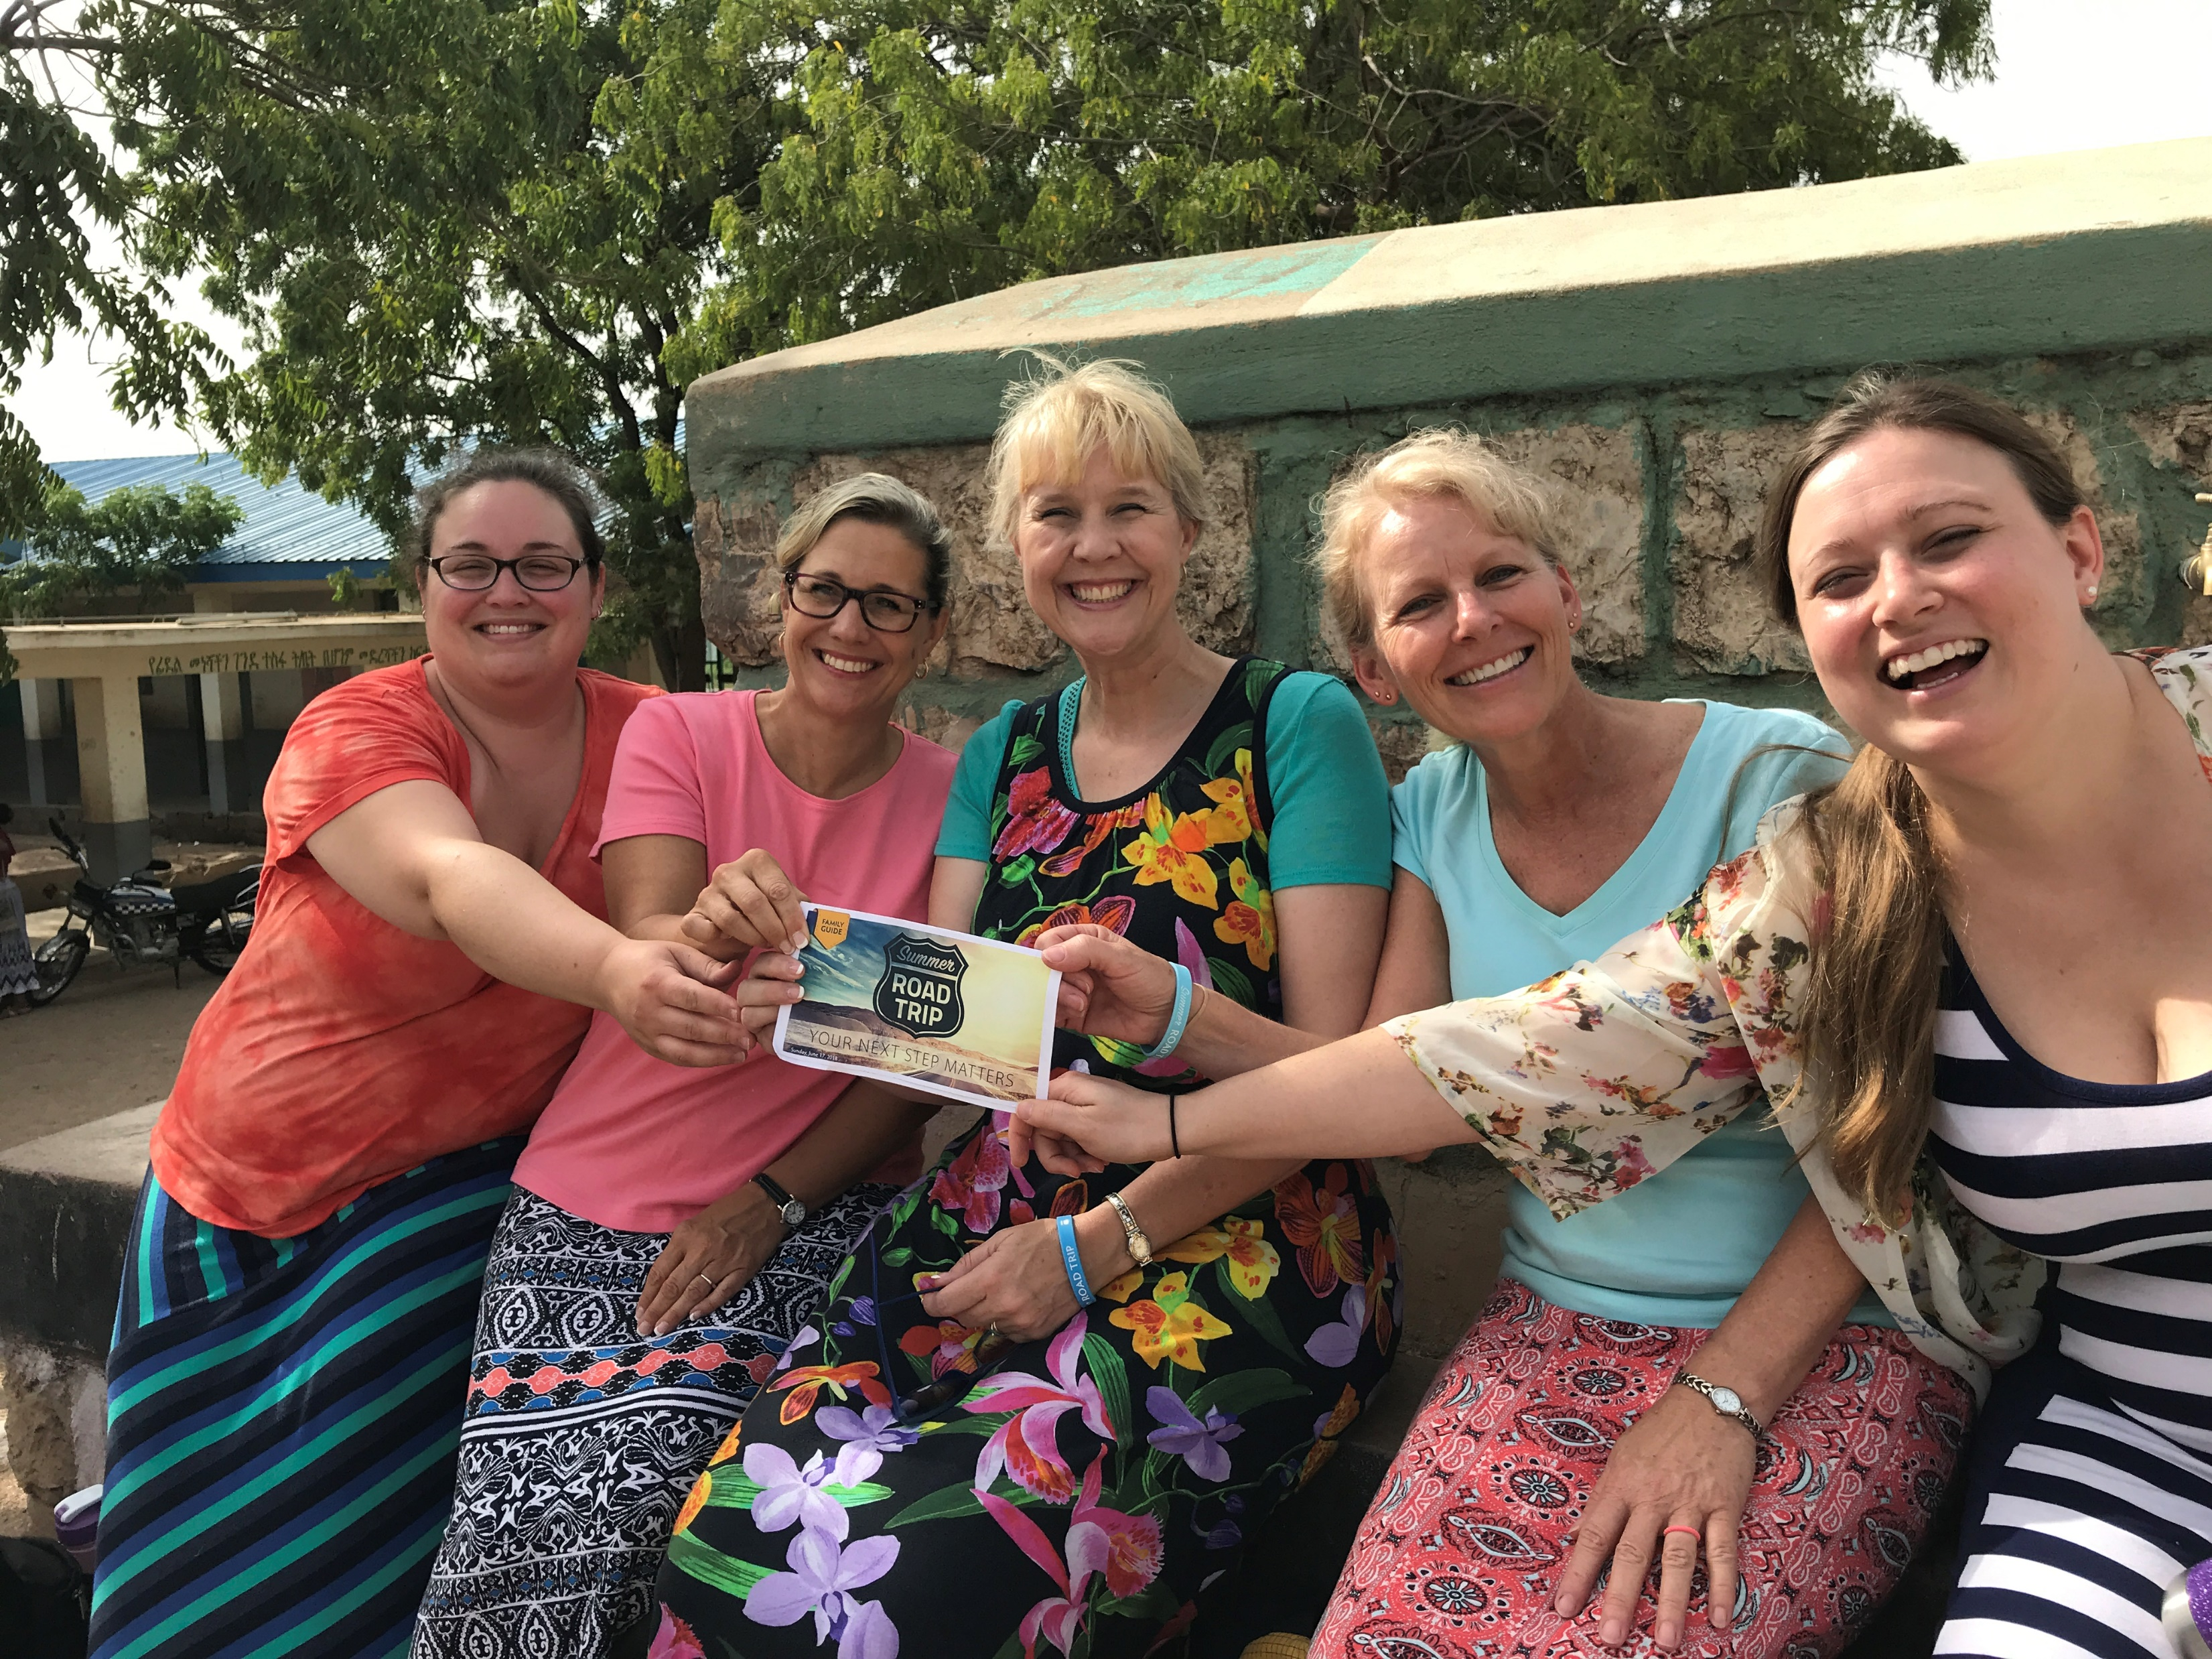

Slide 20
Stacie / Teacher

Slide 21
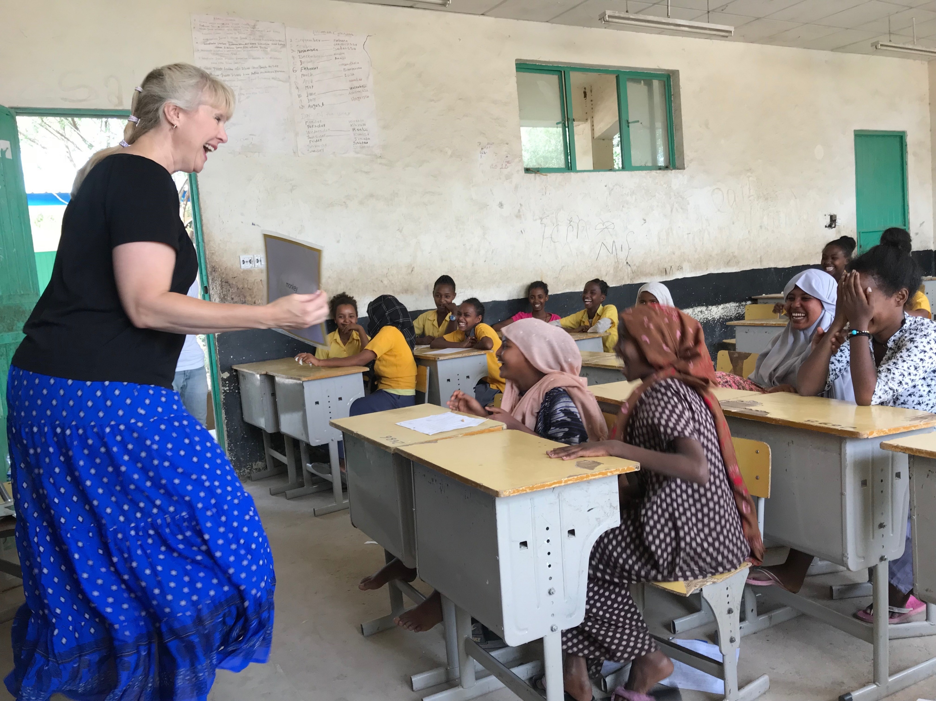

Slide 23
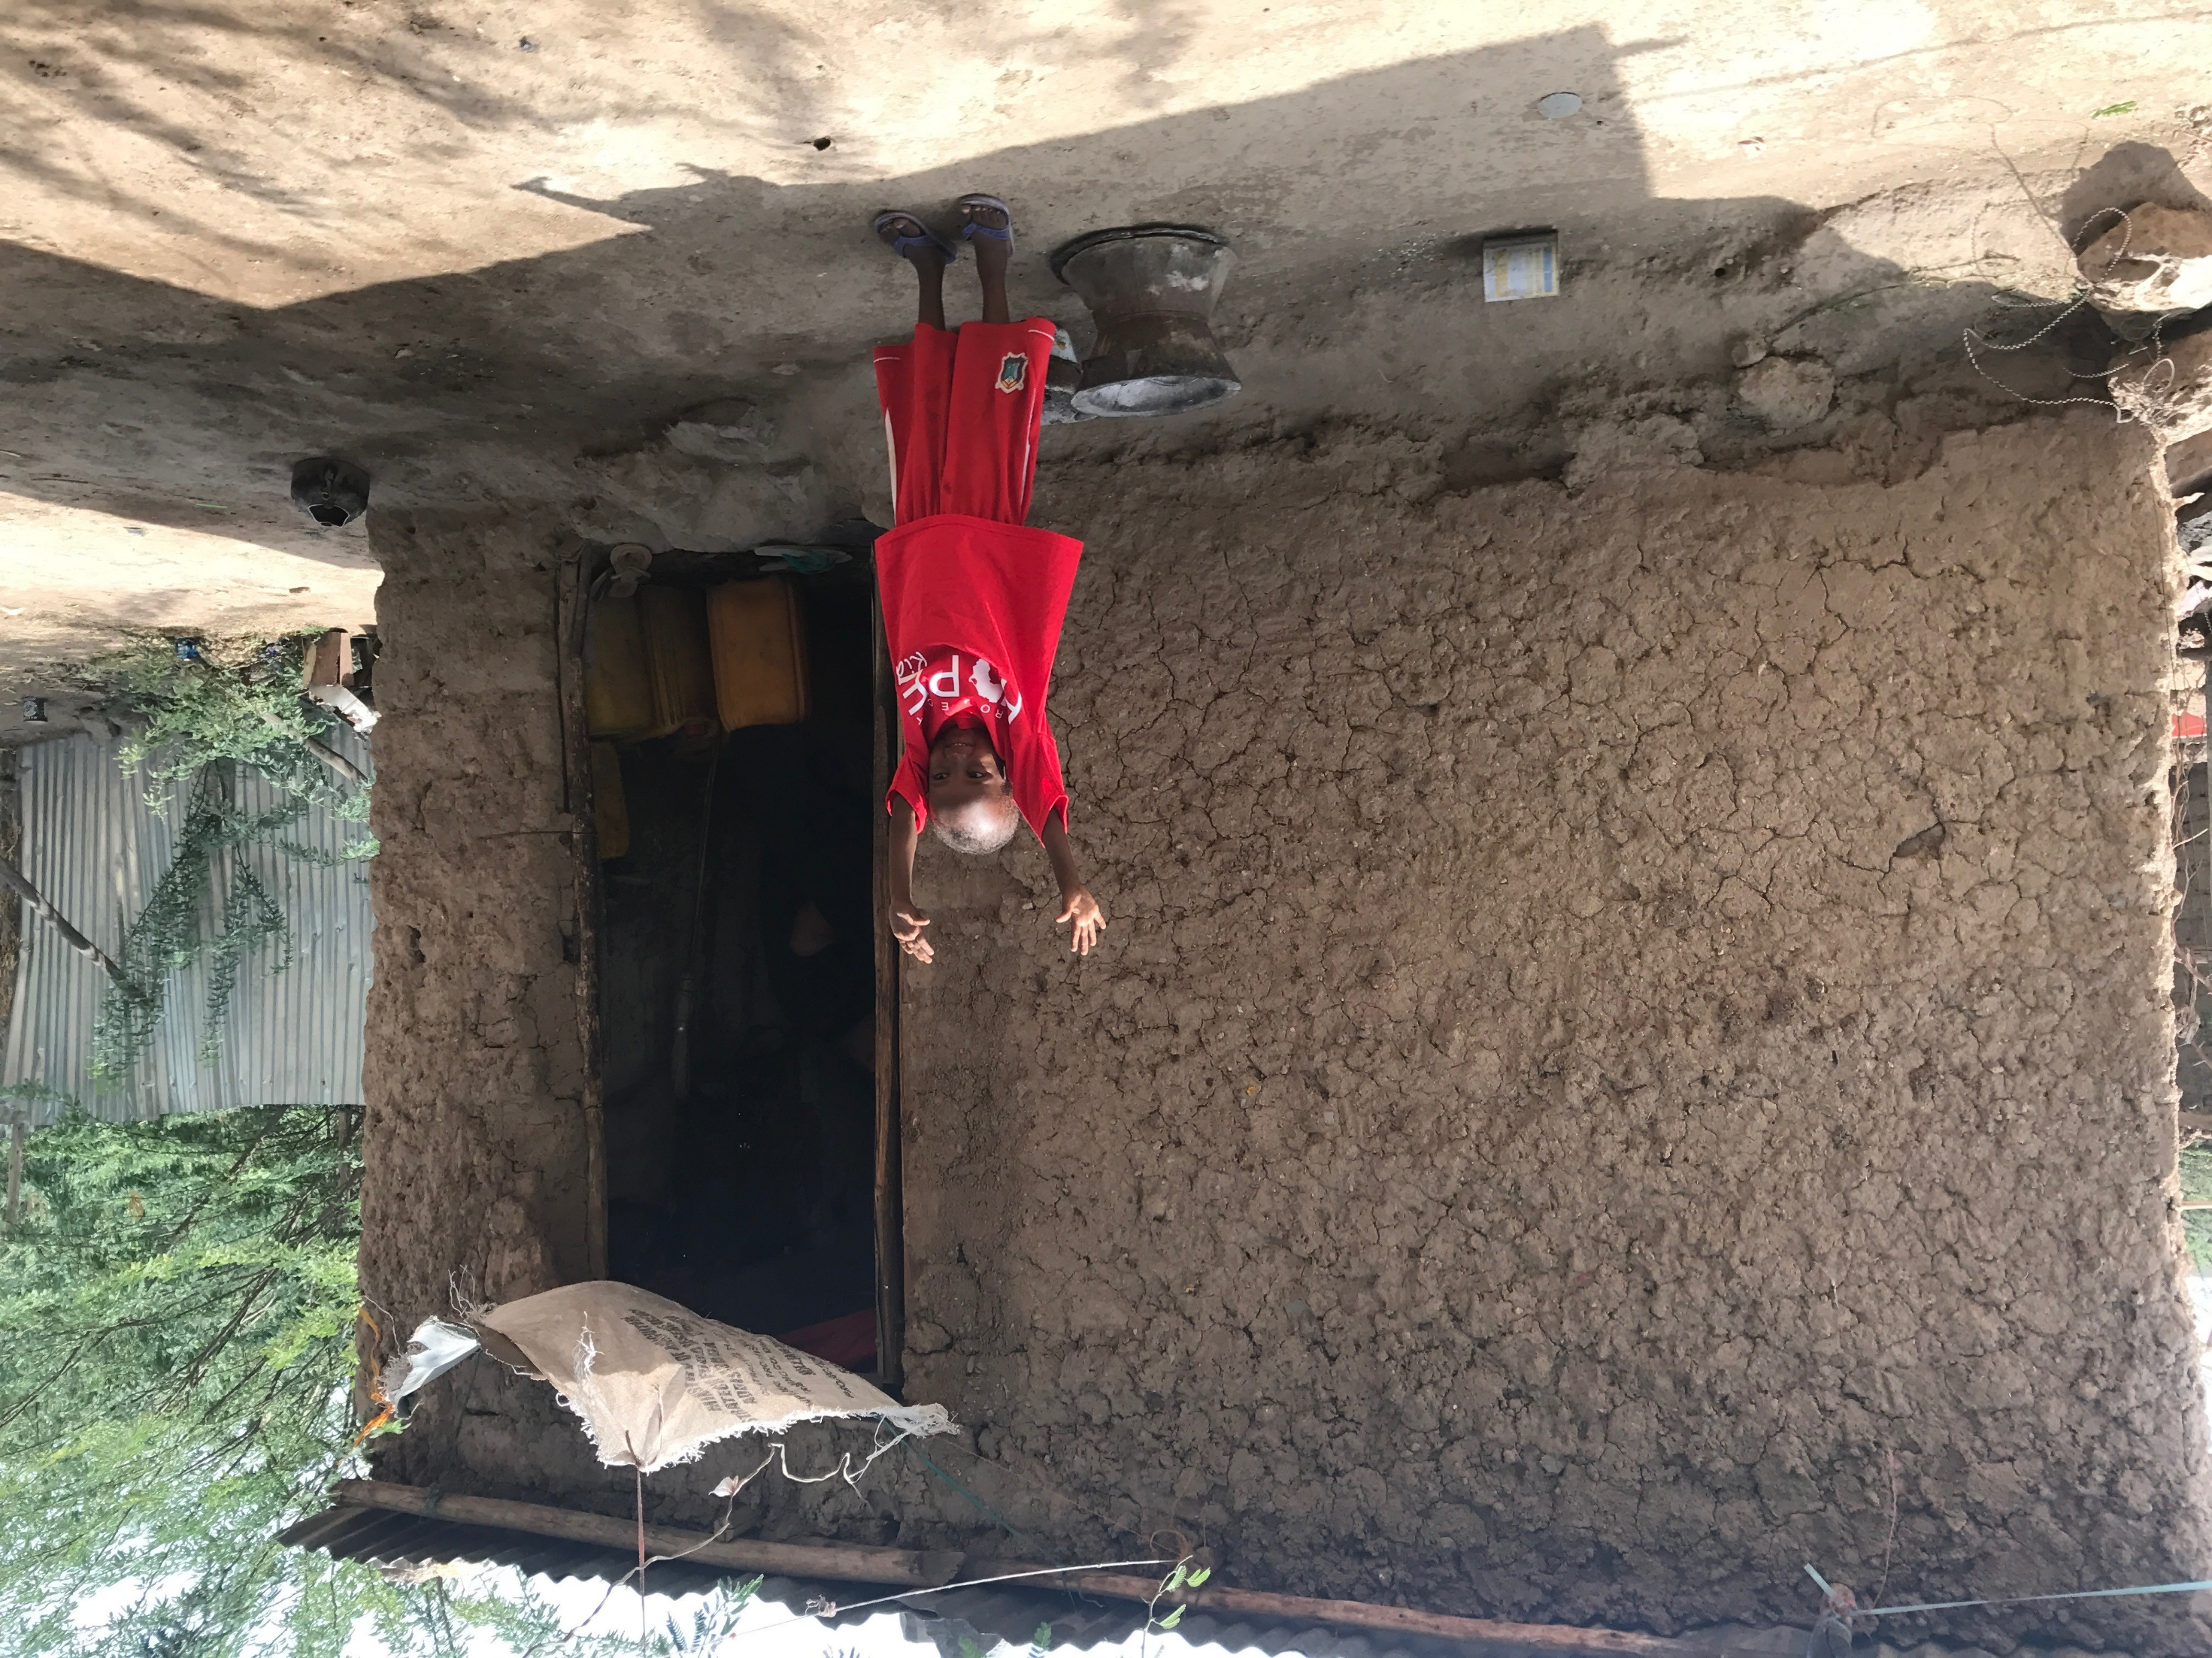

Slide 24
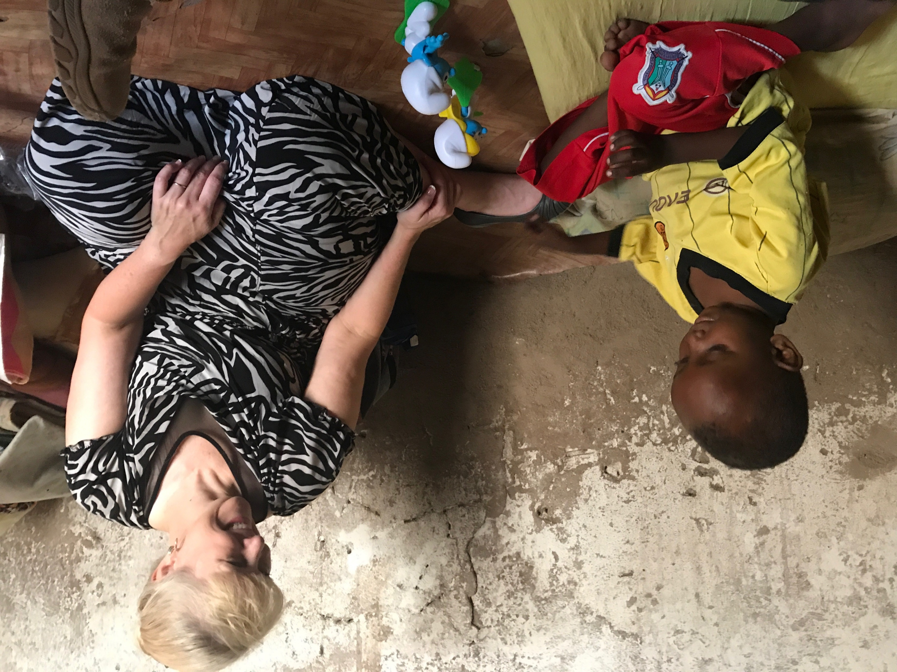

Slide 25
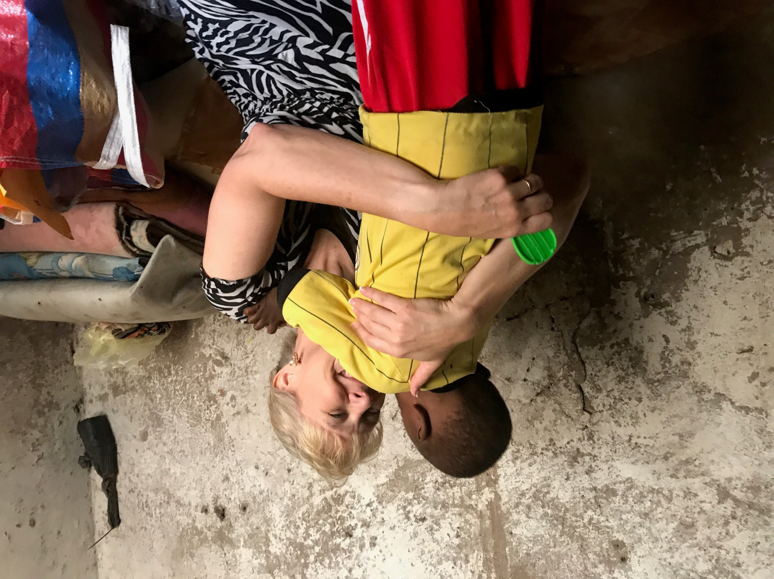

Slide 26
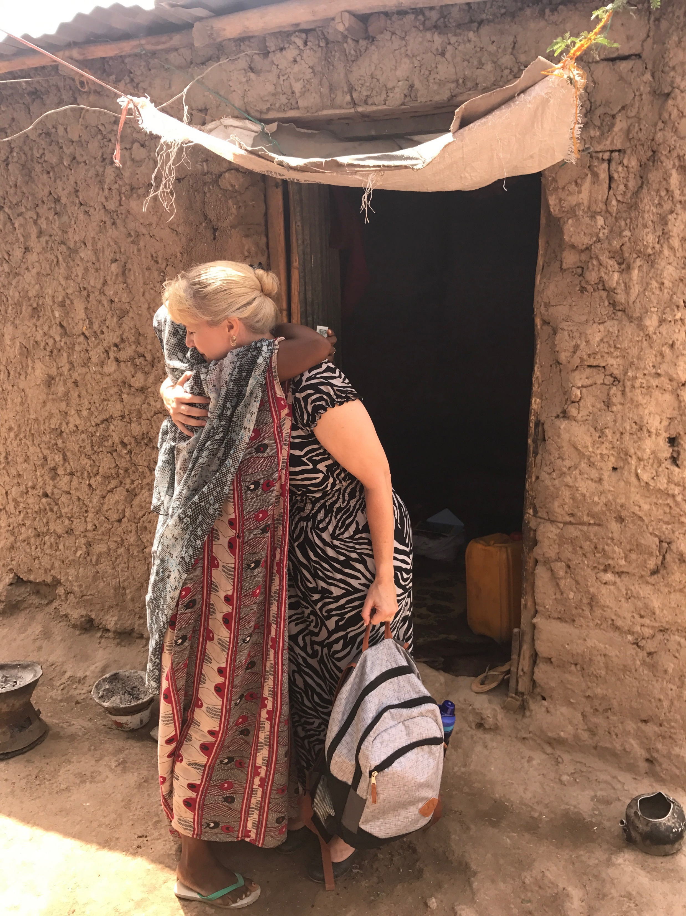

Slide 27
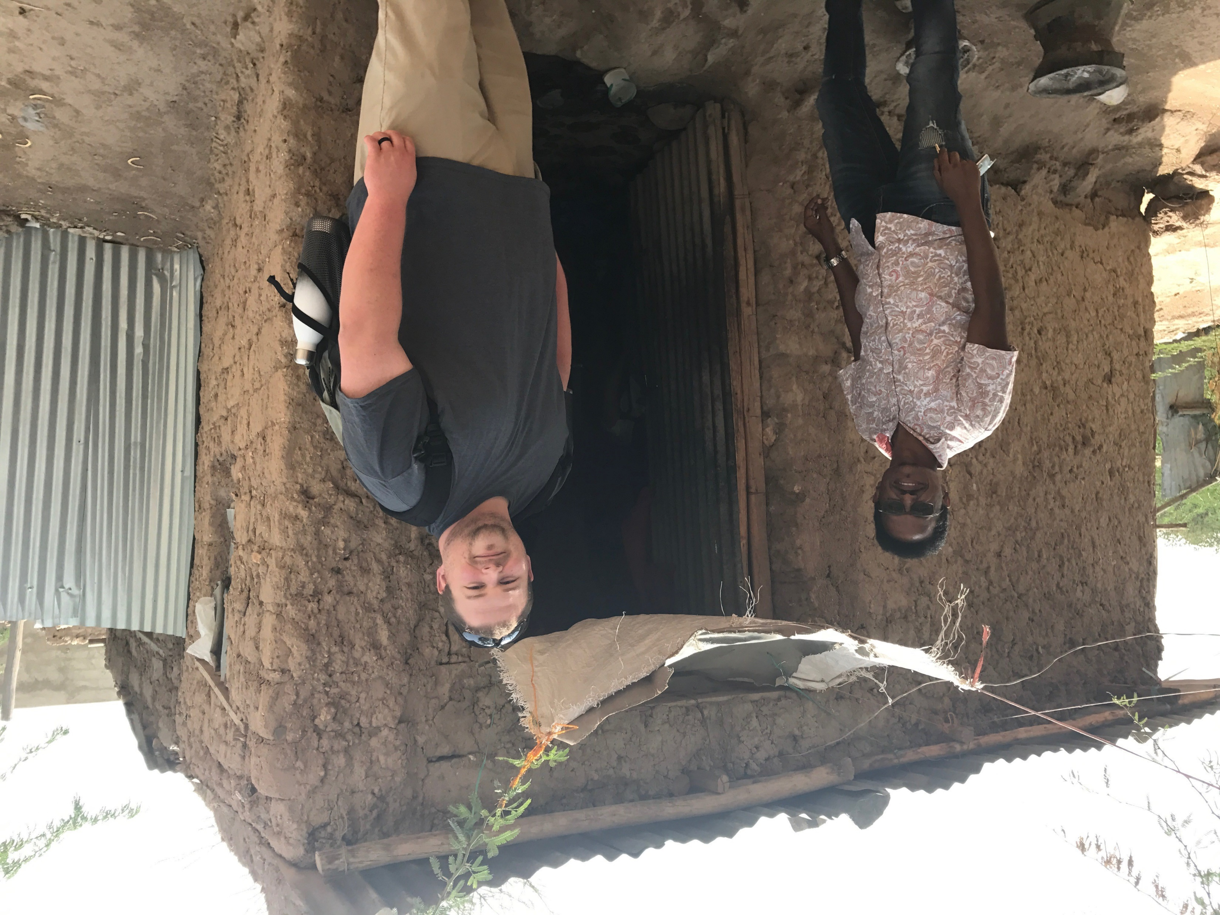
Jordon / Non Profit
Reporting & Training

Slide 28
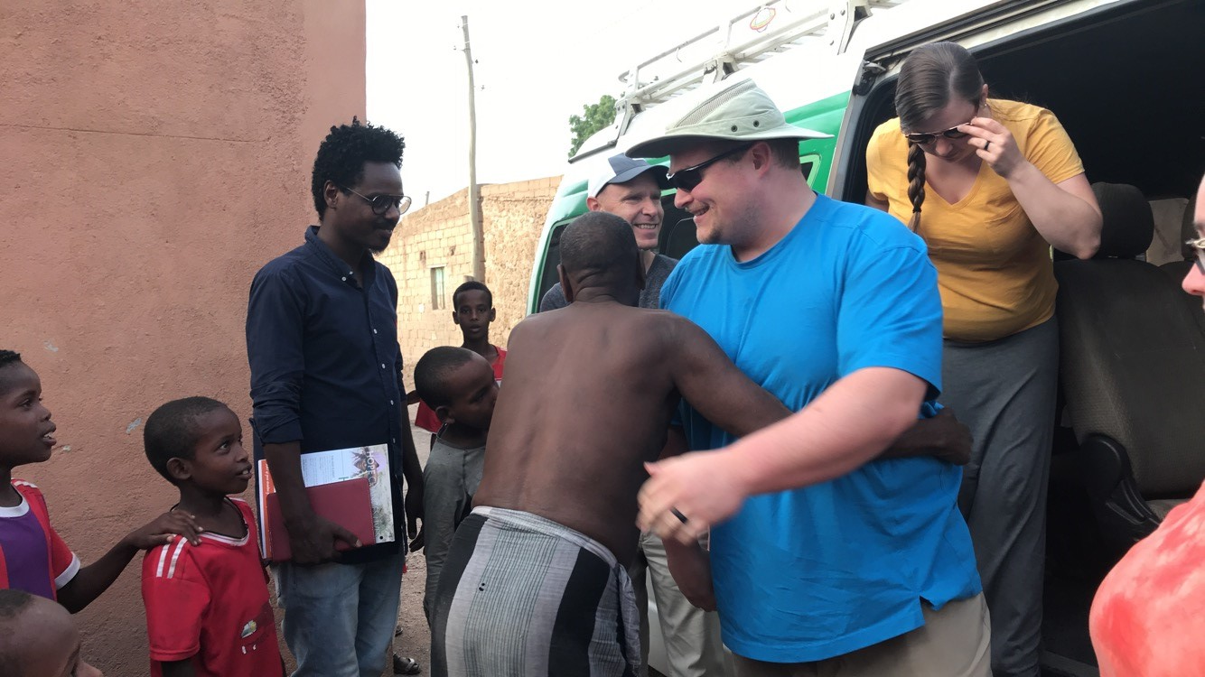

Slide 29
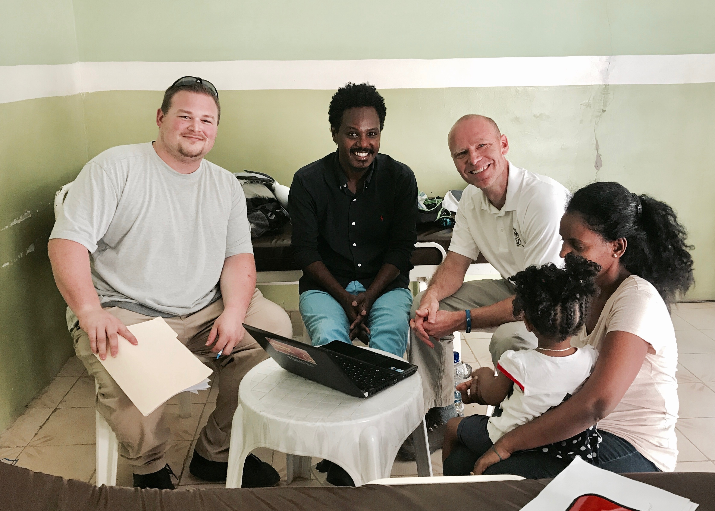

Slide 30
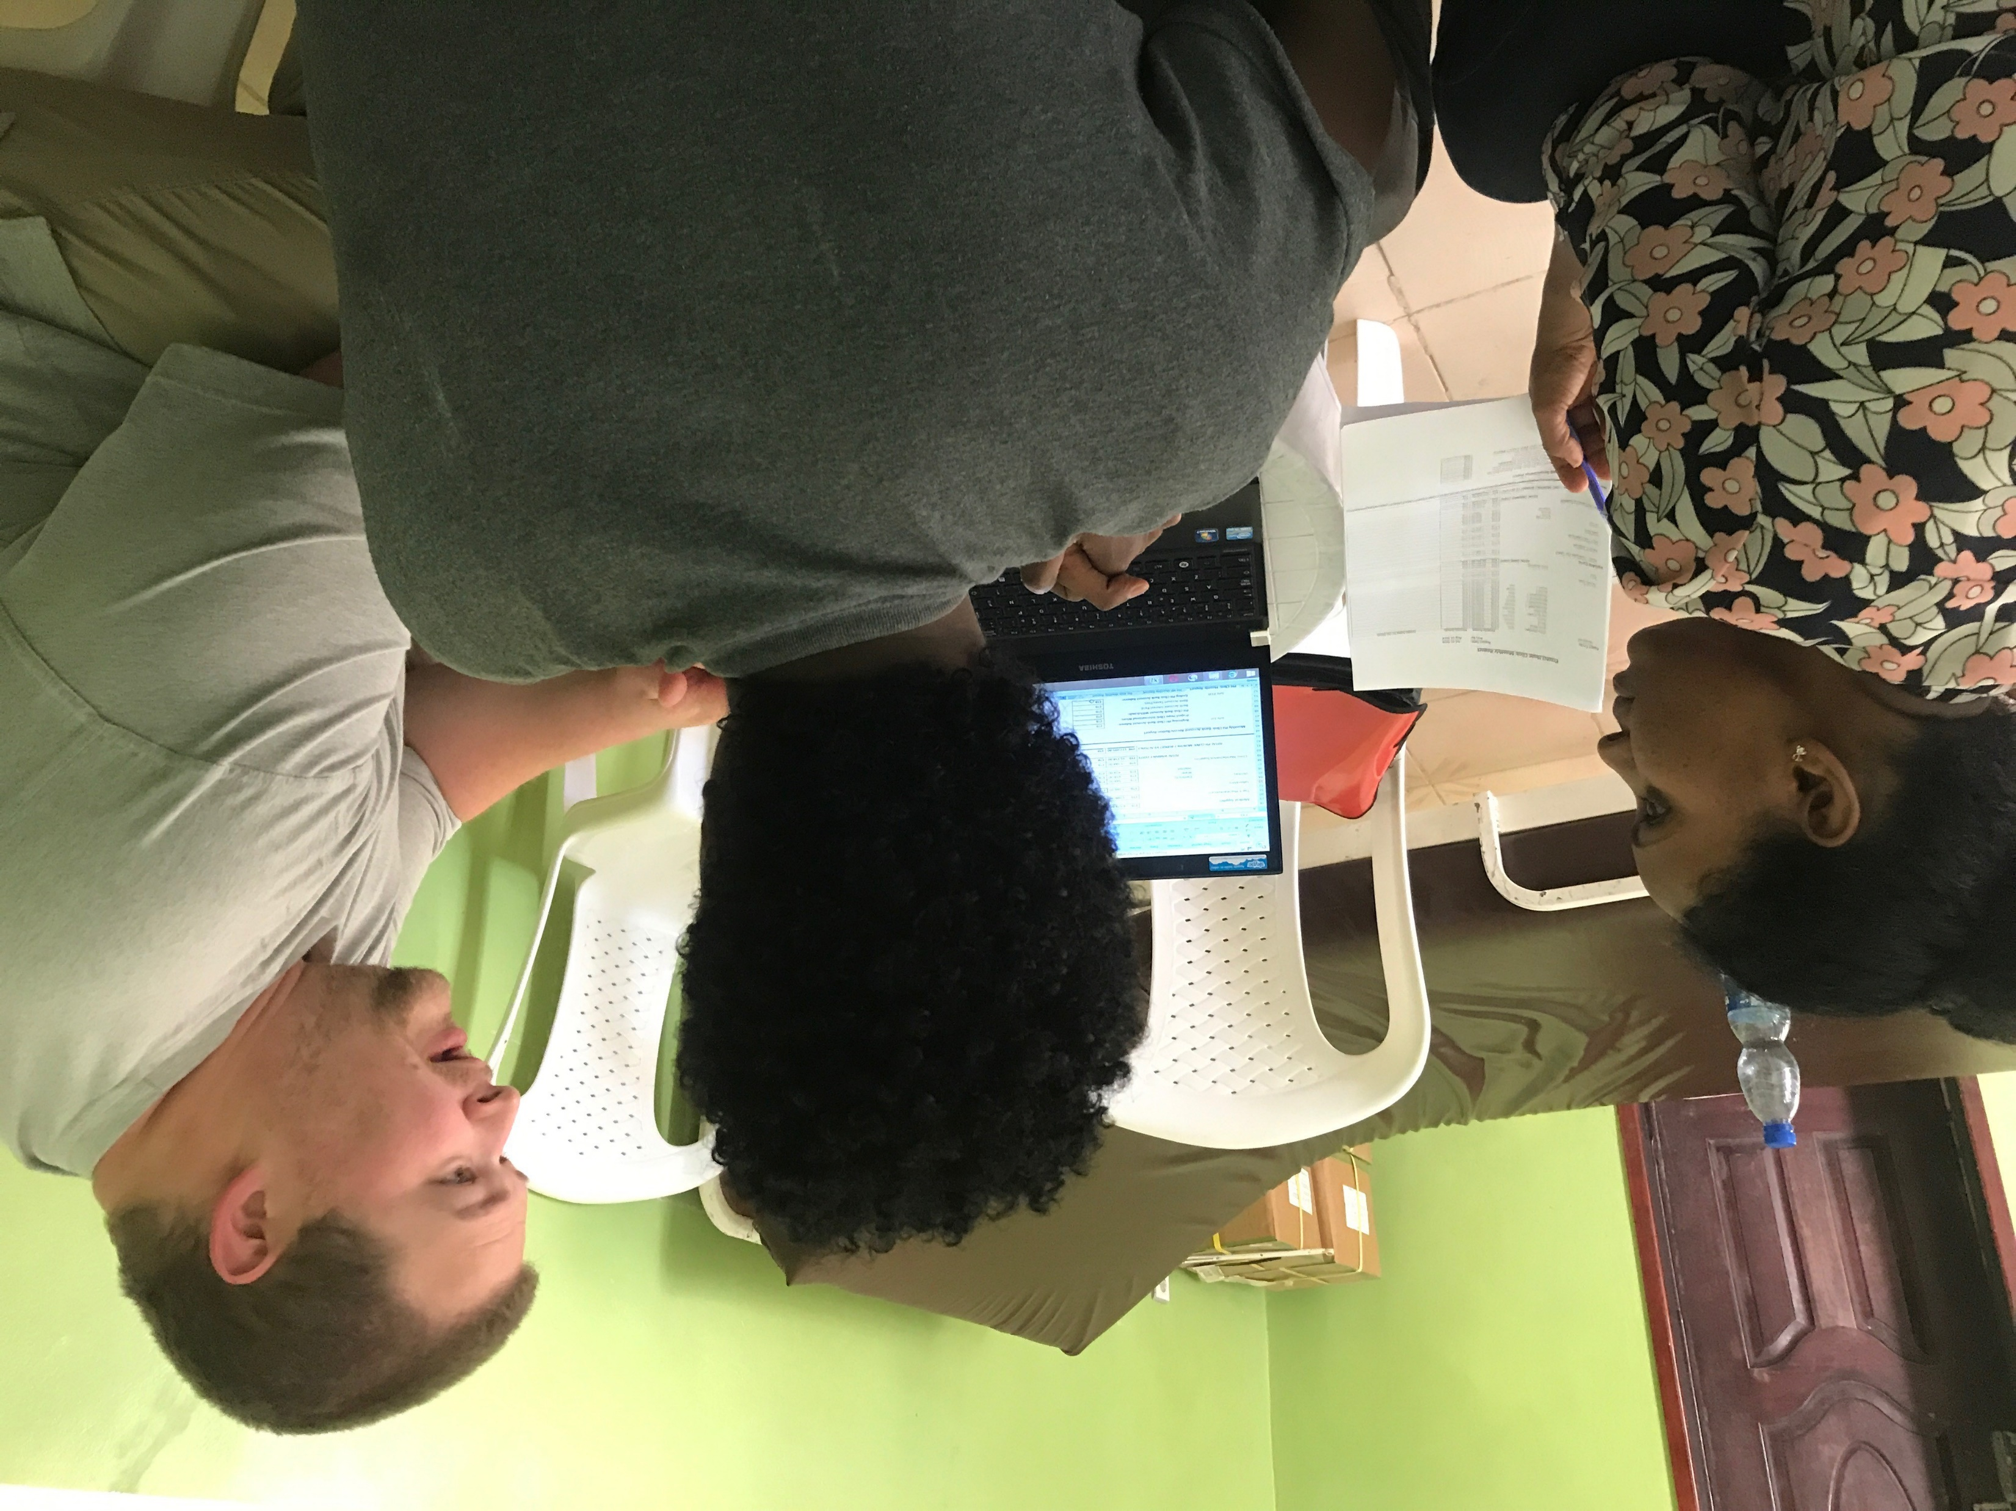

Slide 31
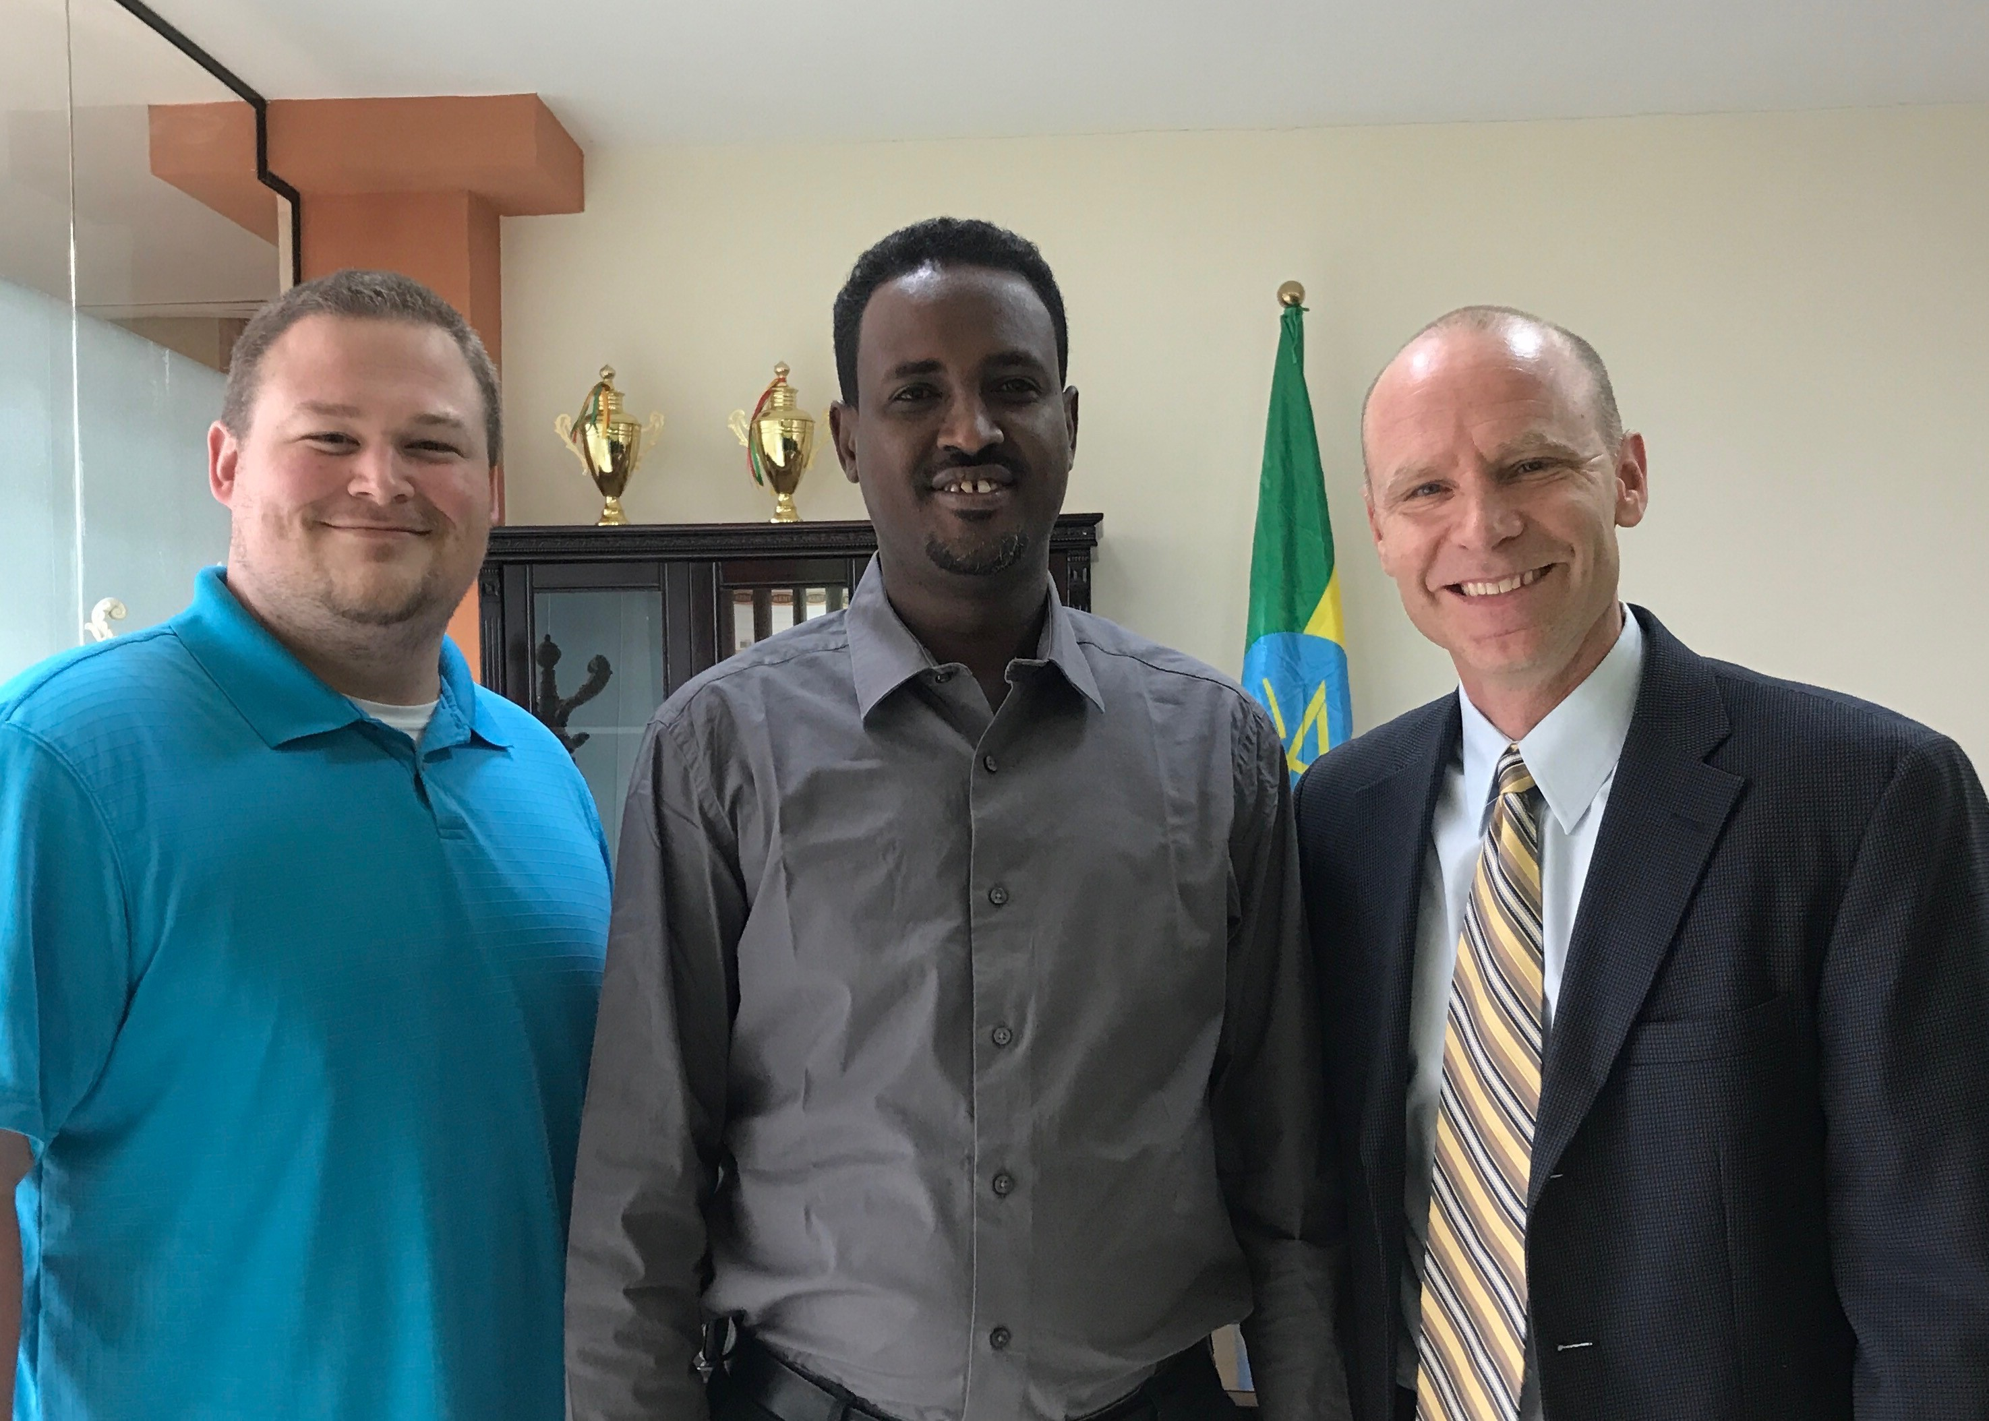

Slide 32
2nd Service

Slide 33
Maya / Videographer

Slide 34
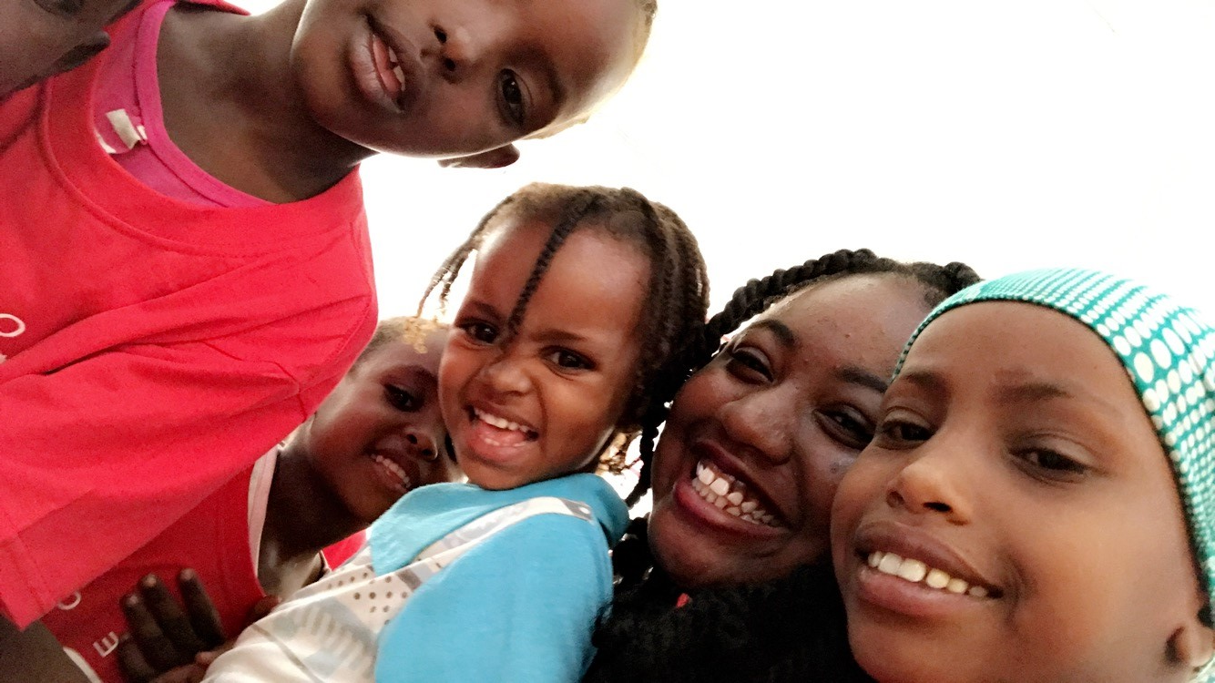

Slide 35
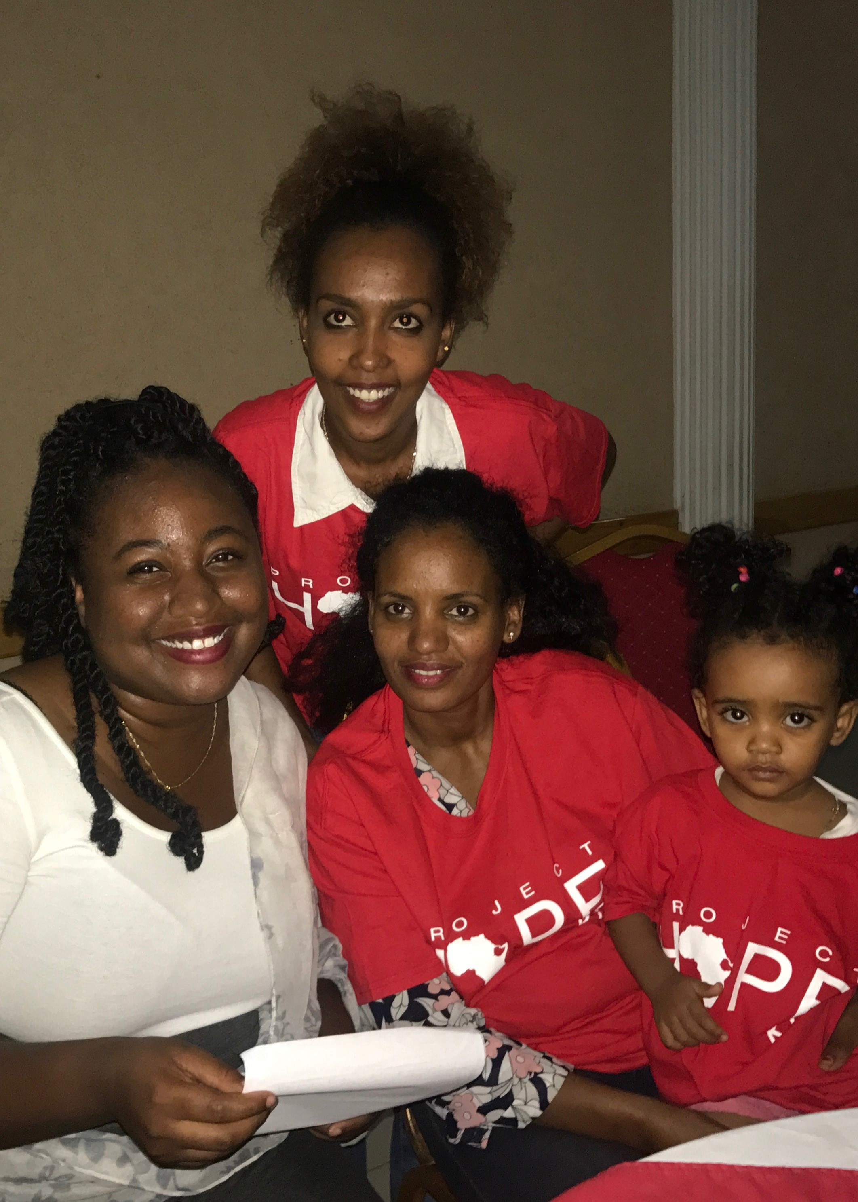

Slide 36
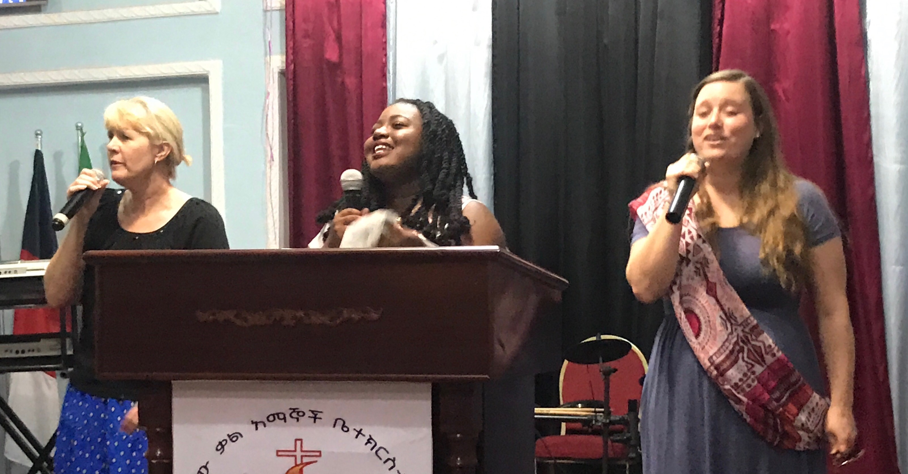
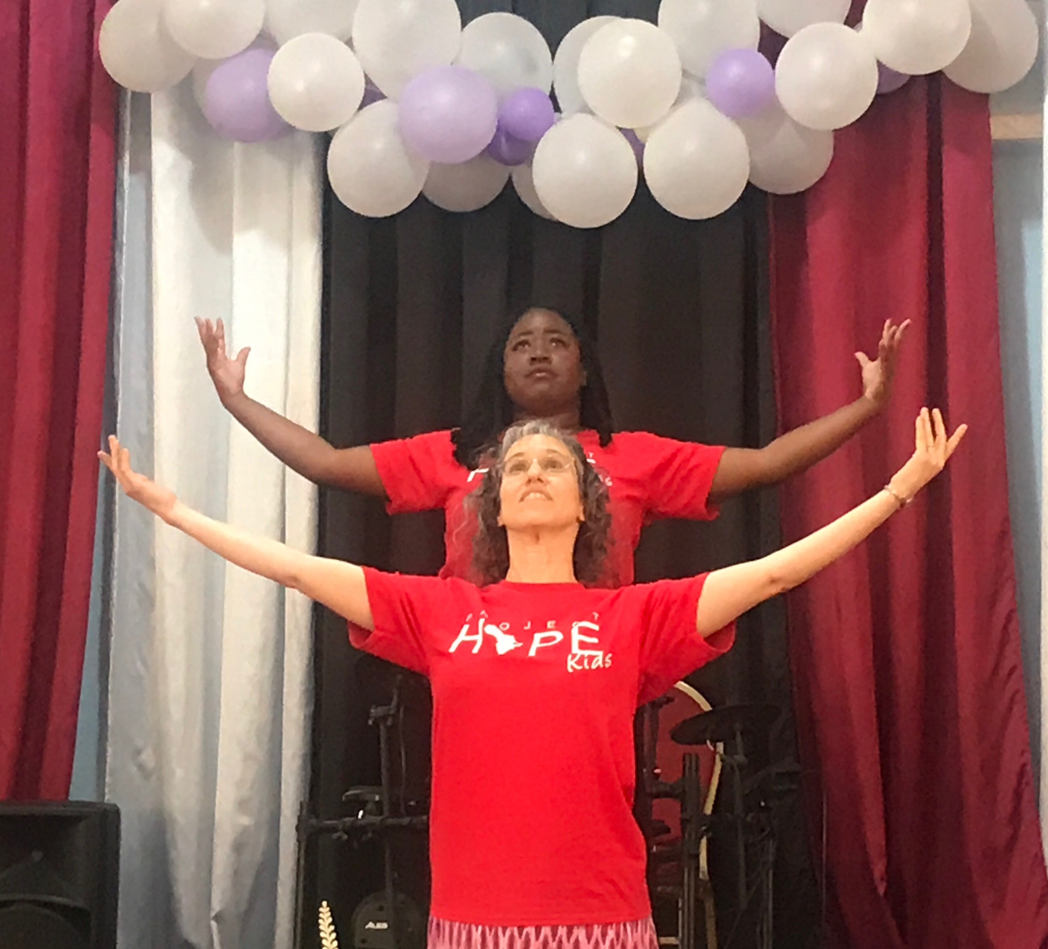

Slide 37
2nd Service Heather

Slide 38
Heather / Teacher

Slide 40
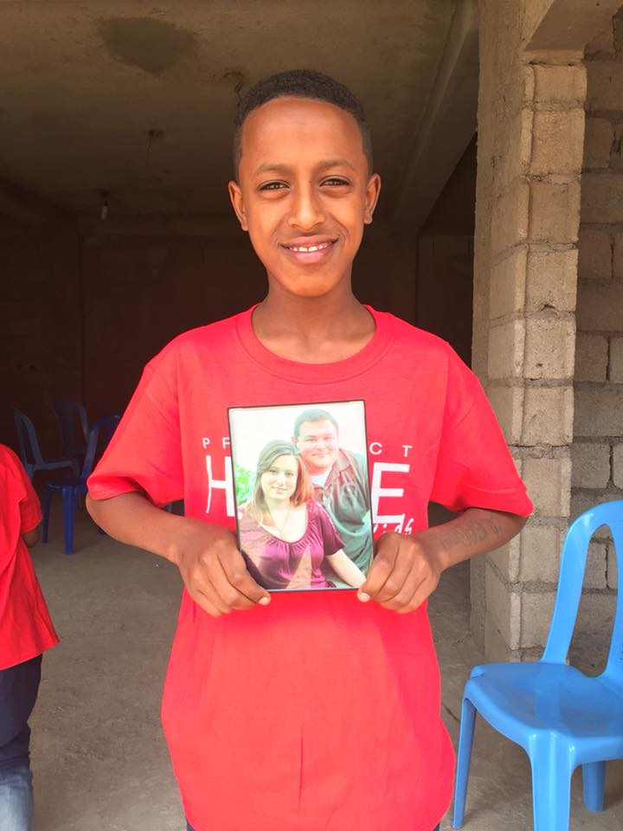
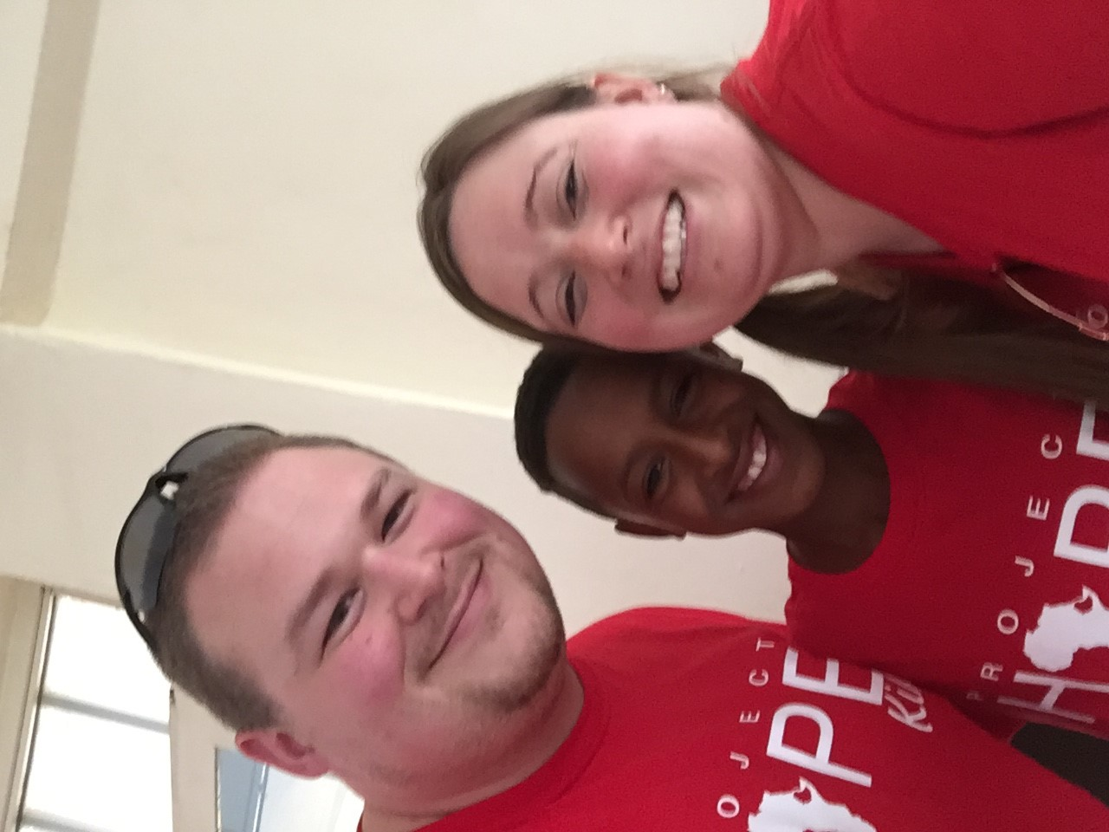

Slide 41
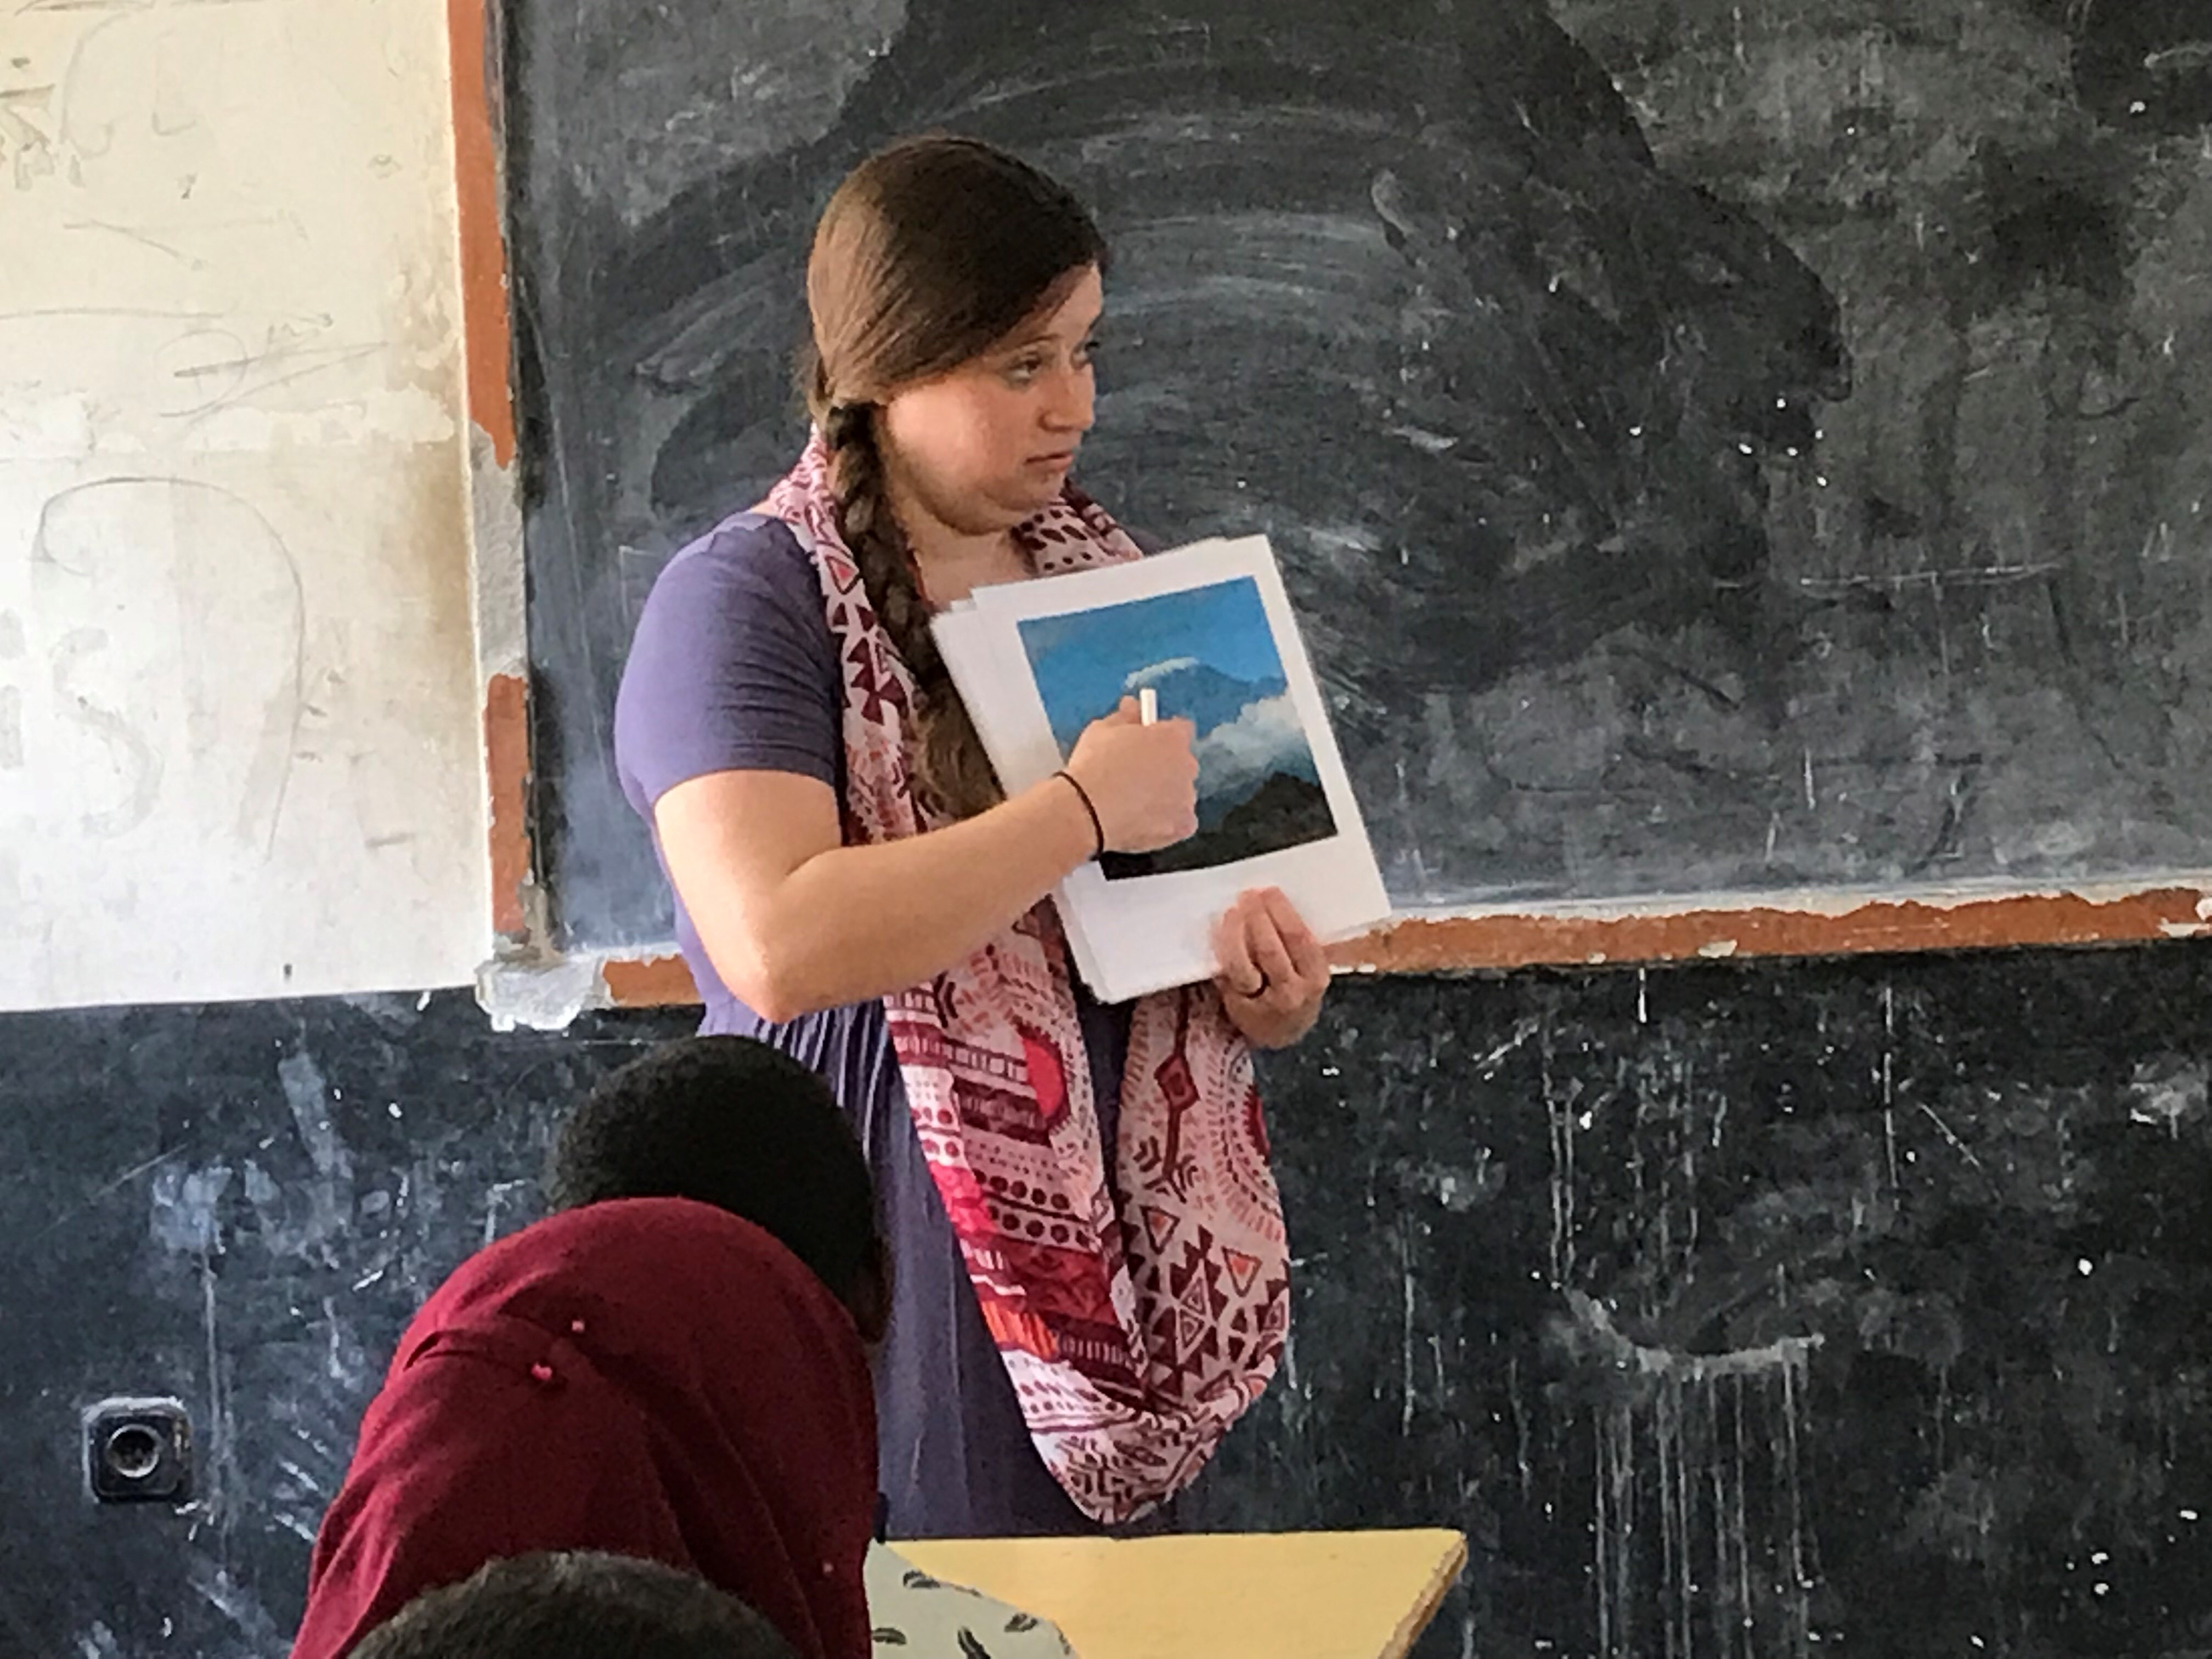

Slide 42
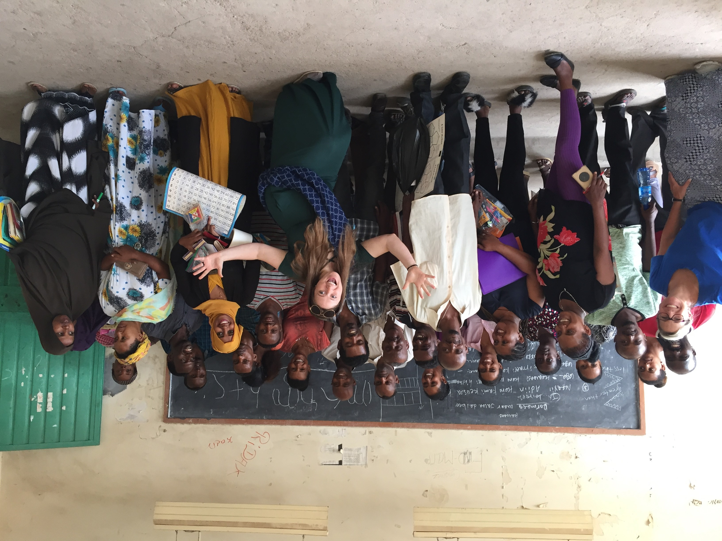

Slide 43
Laurel / Teacher

Slide 44
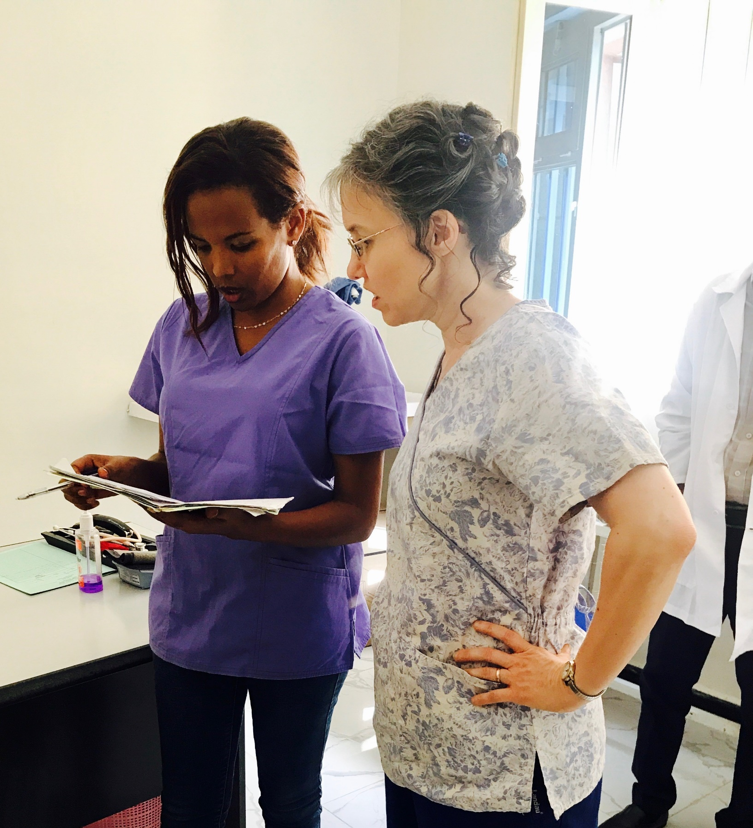
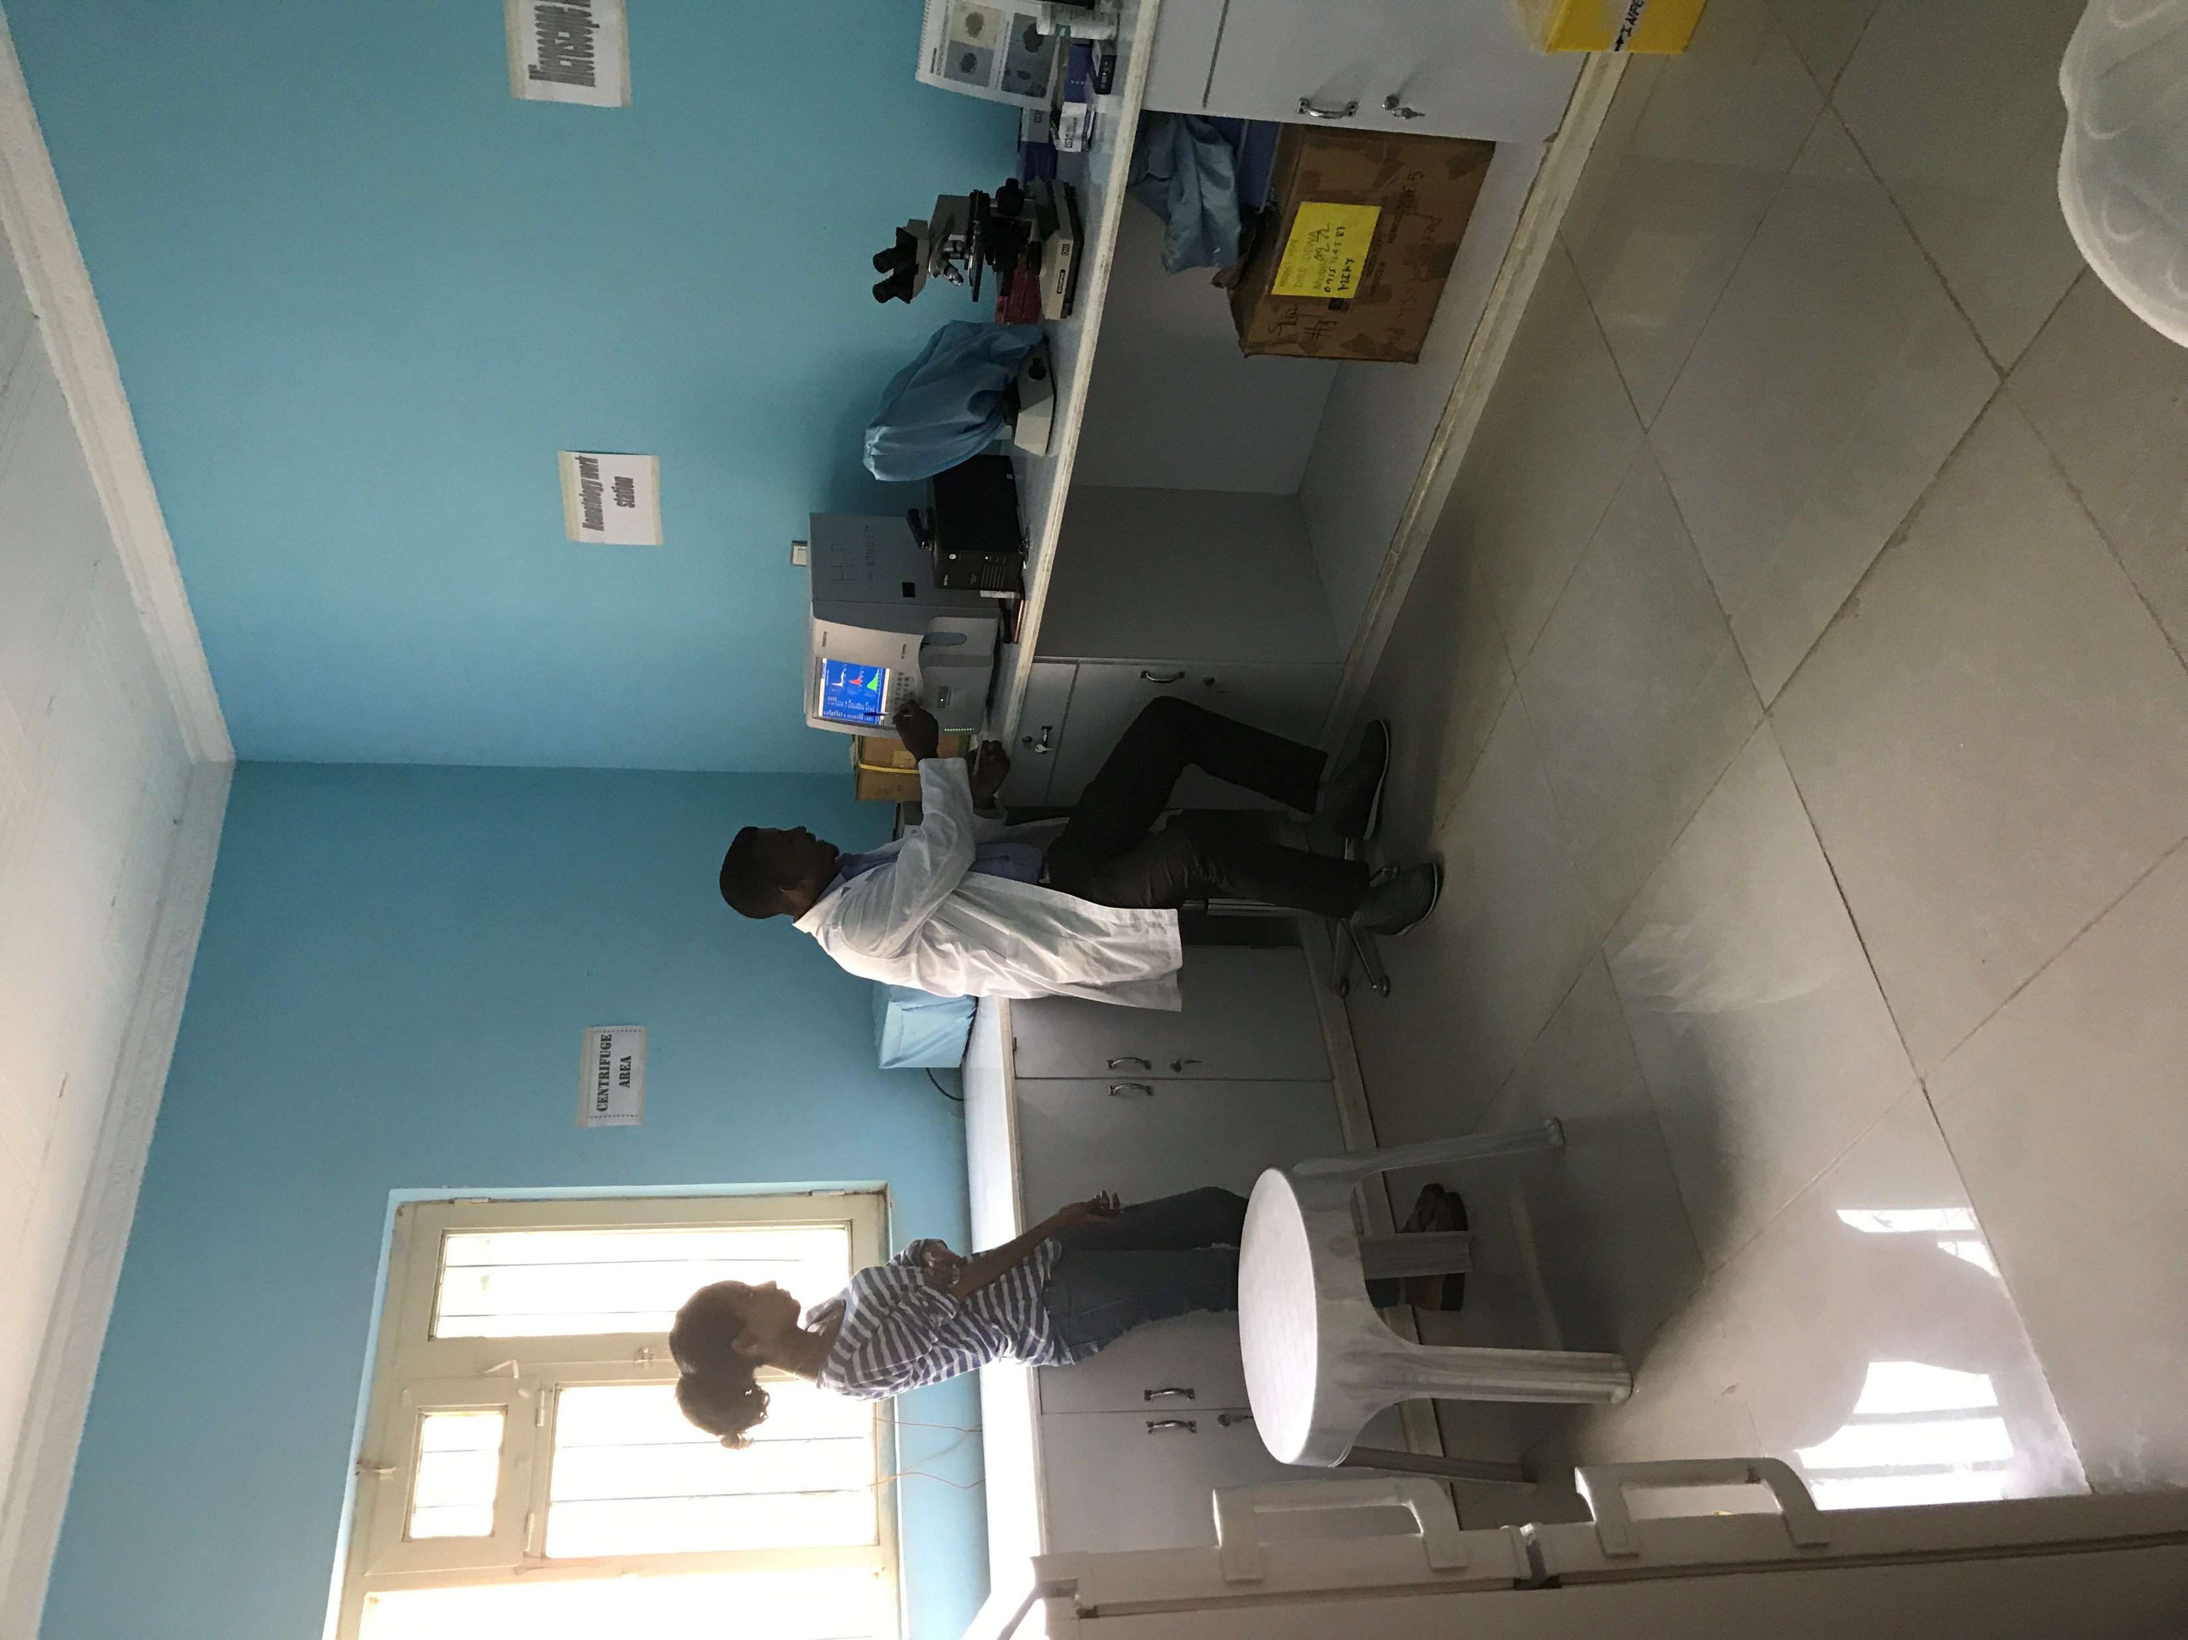

Slide 46
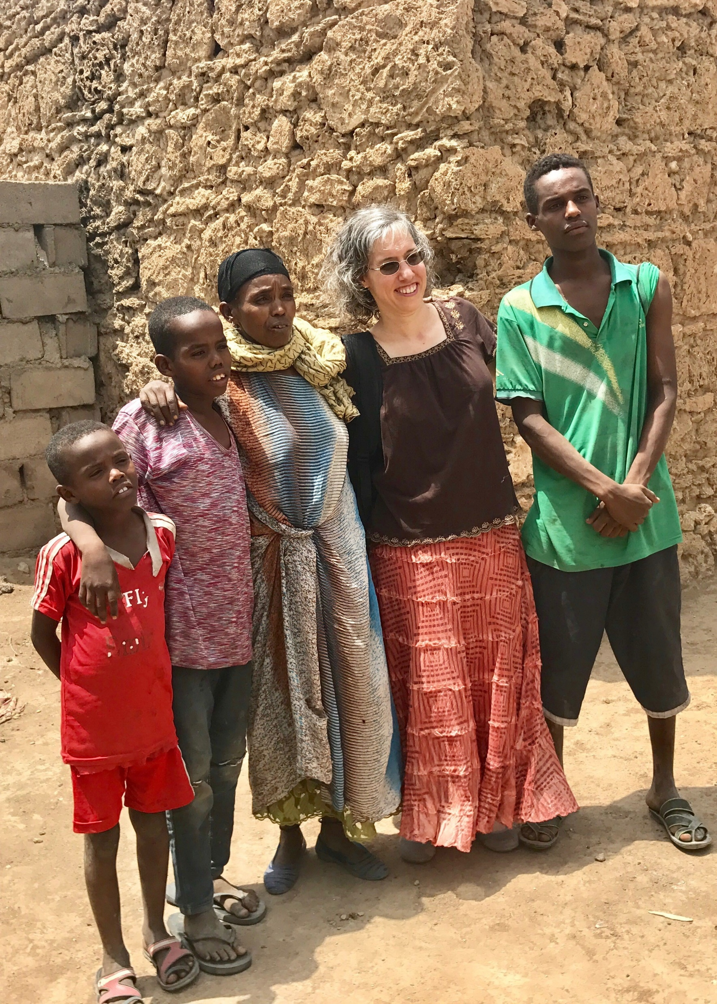

Slide 47
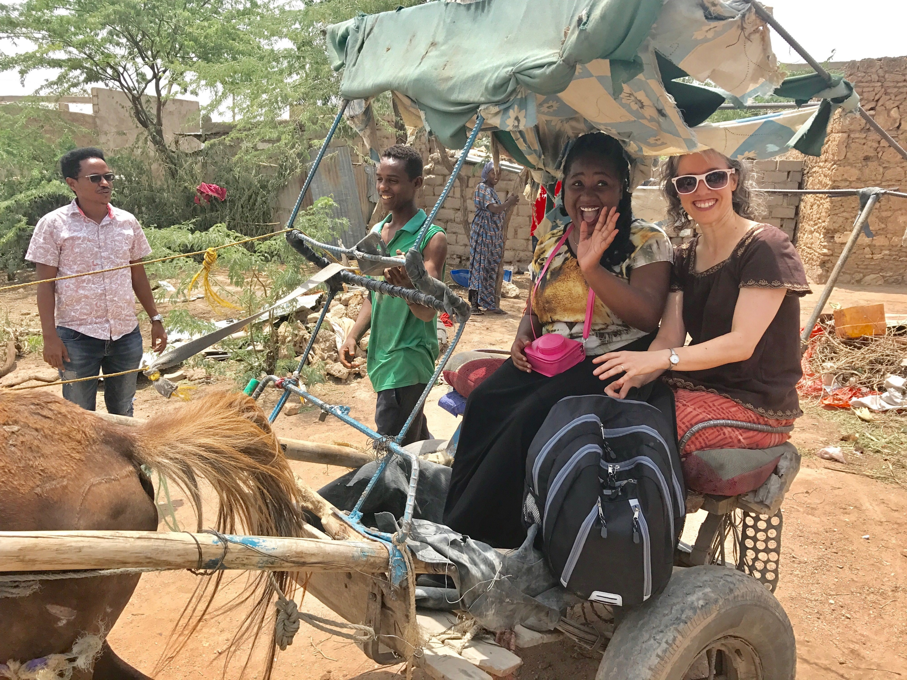

Slide 48
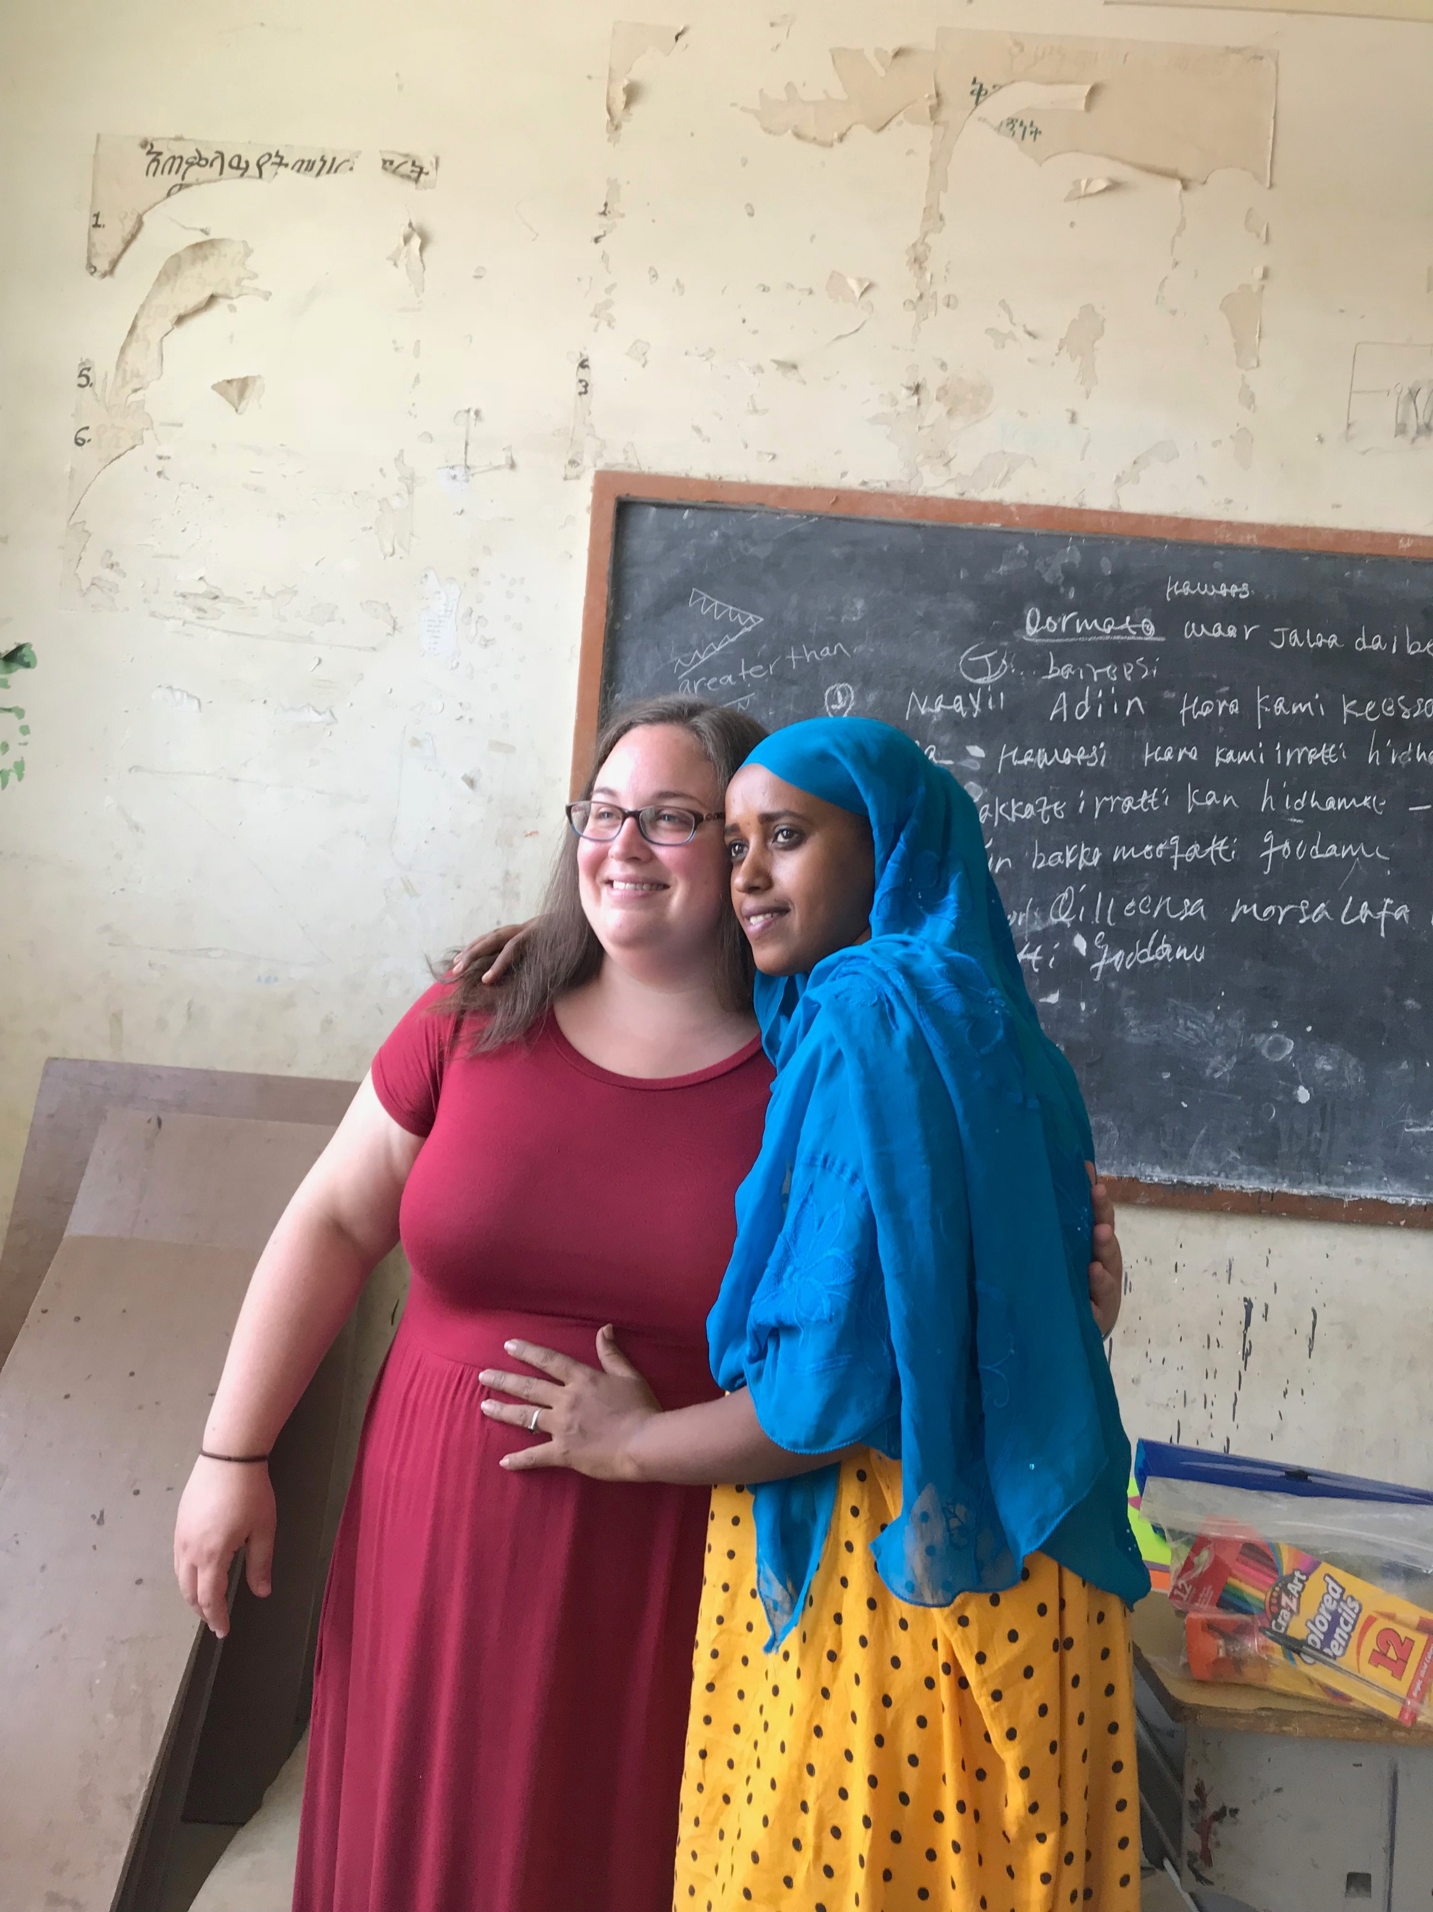
Hannah / Teacher

Slide 52
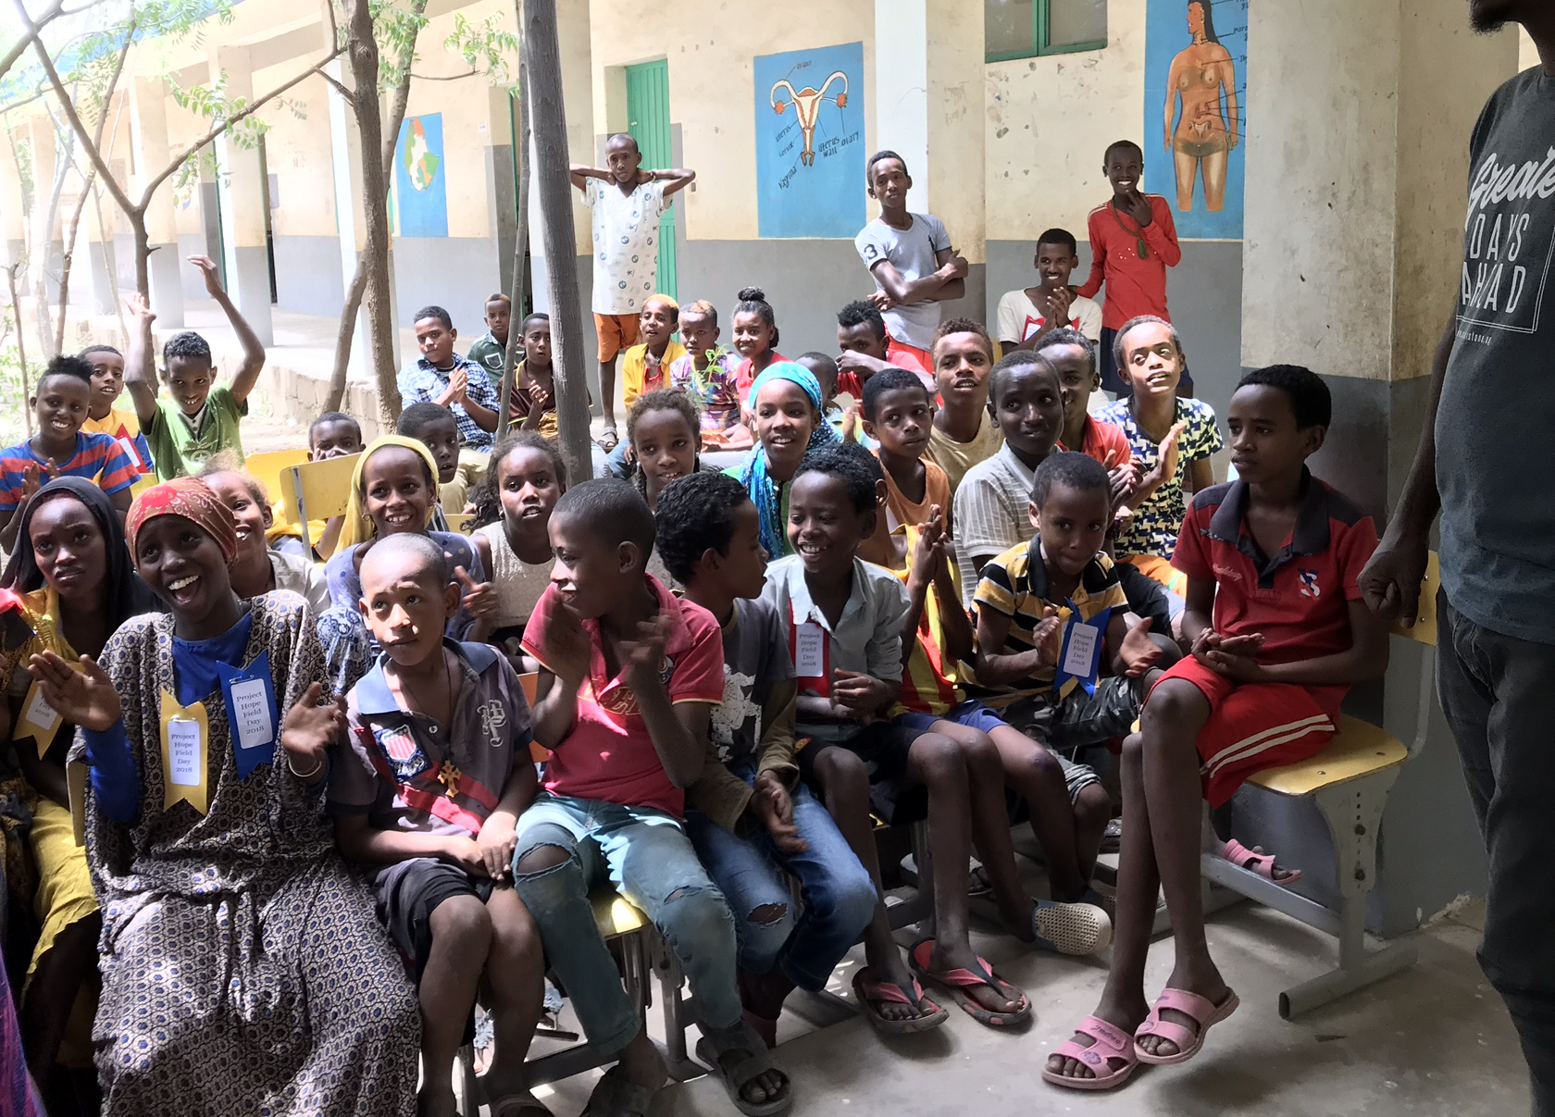

Slide 53
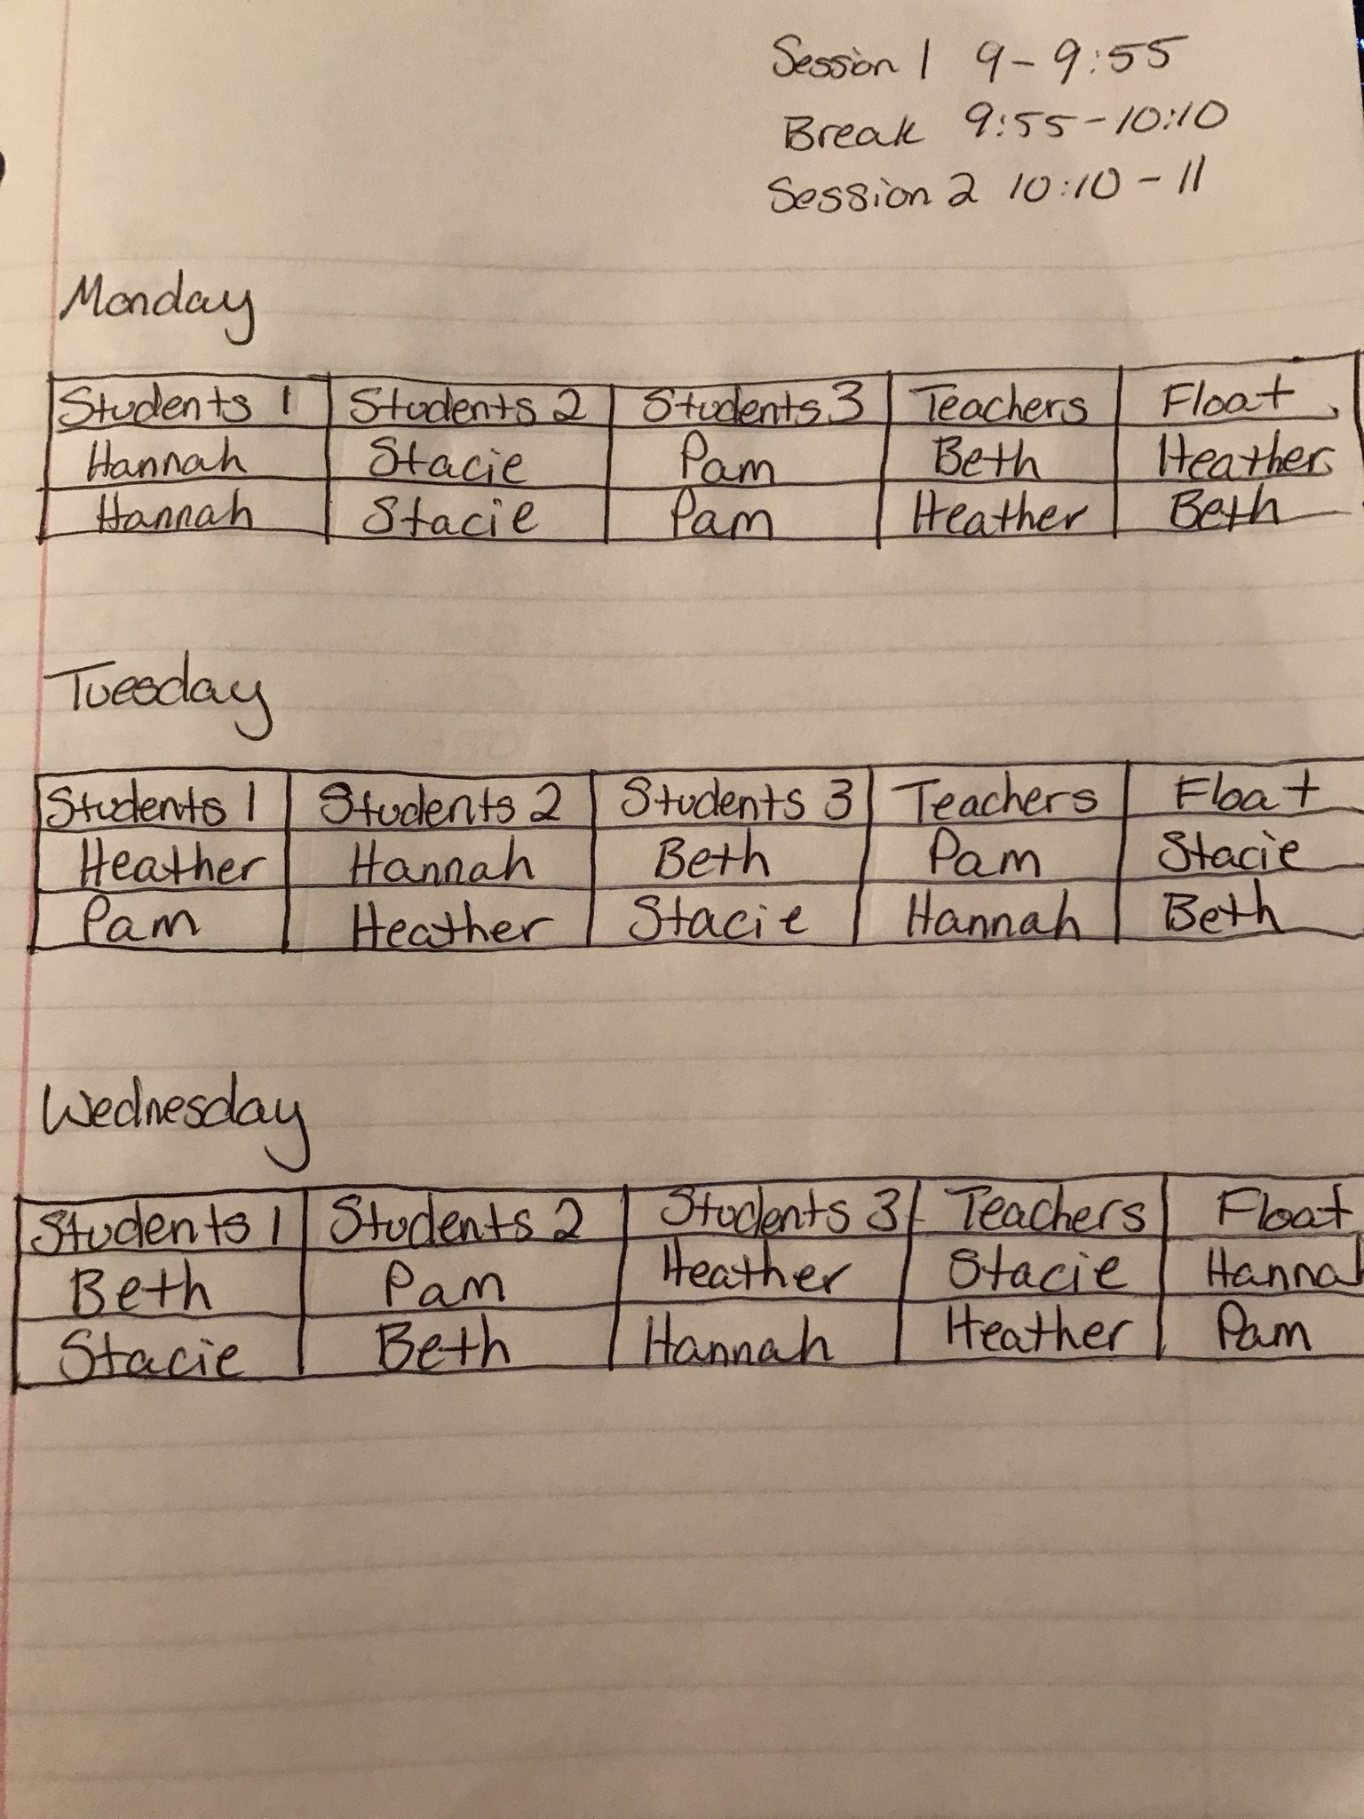

Slide 55
Both services

Slide 56
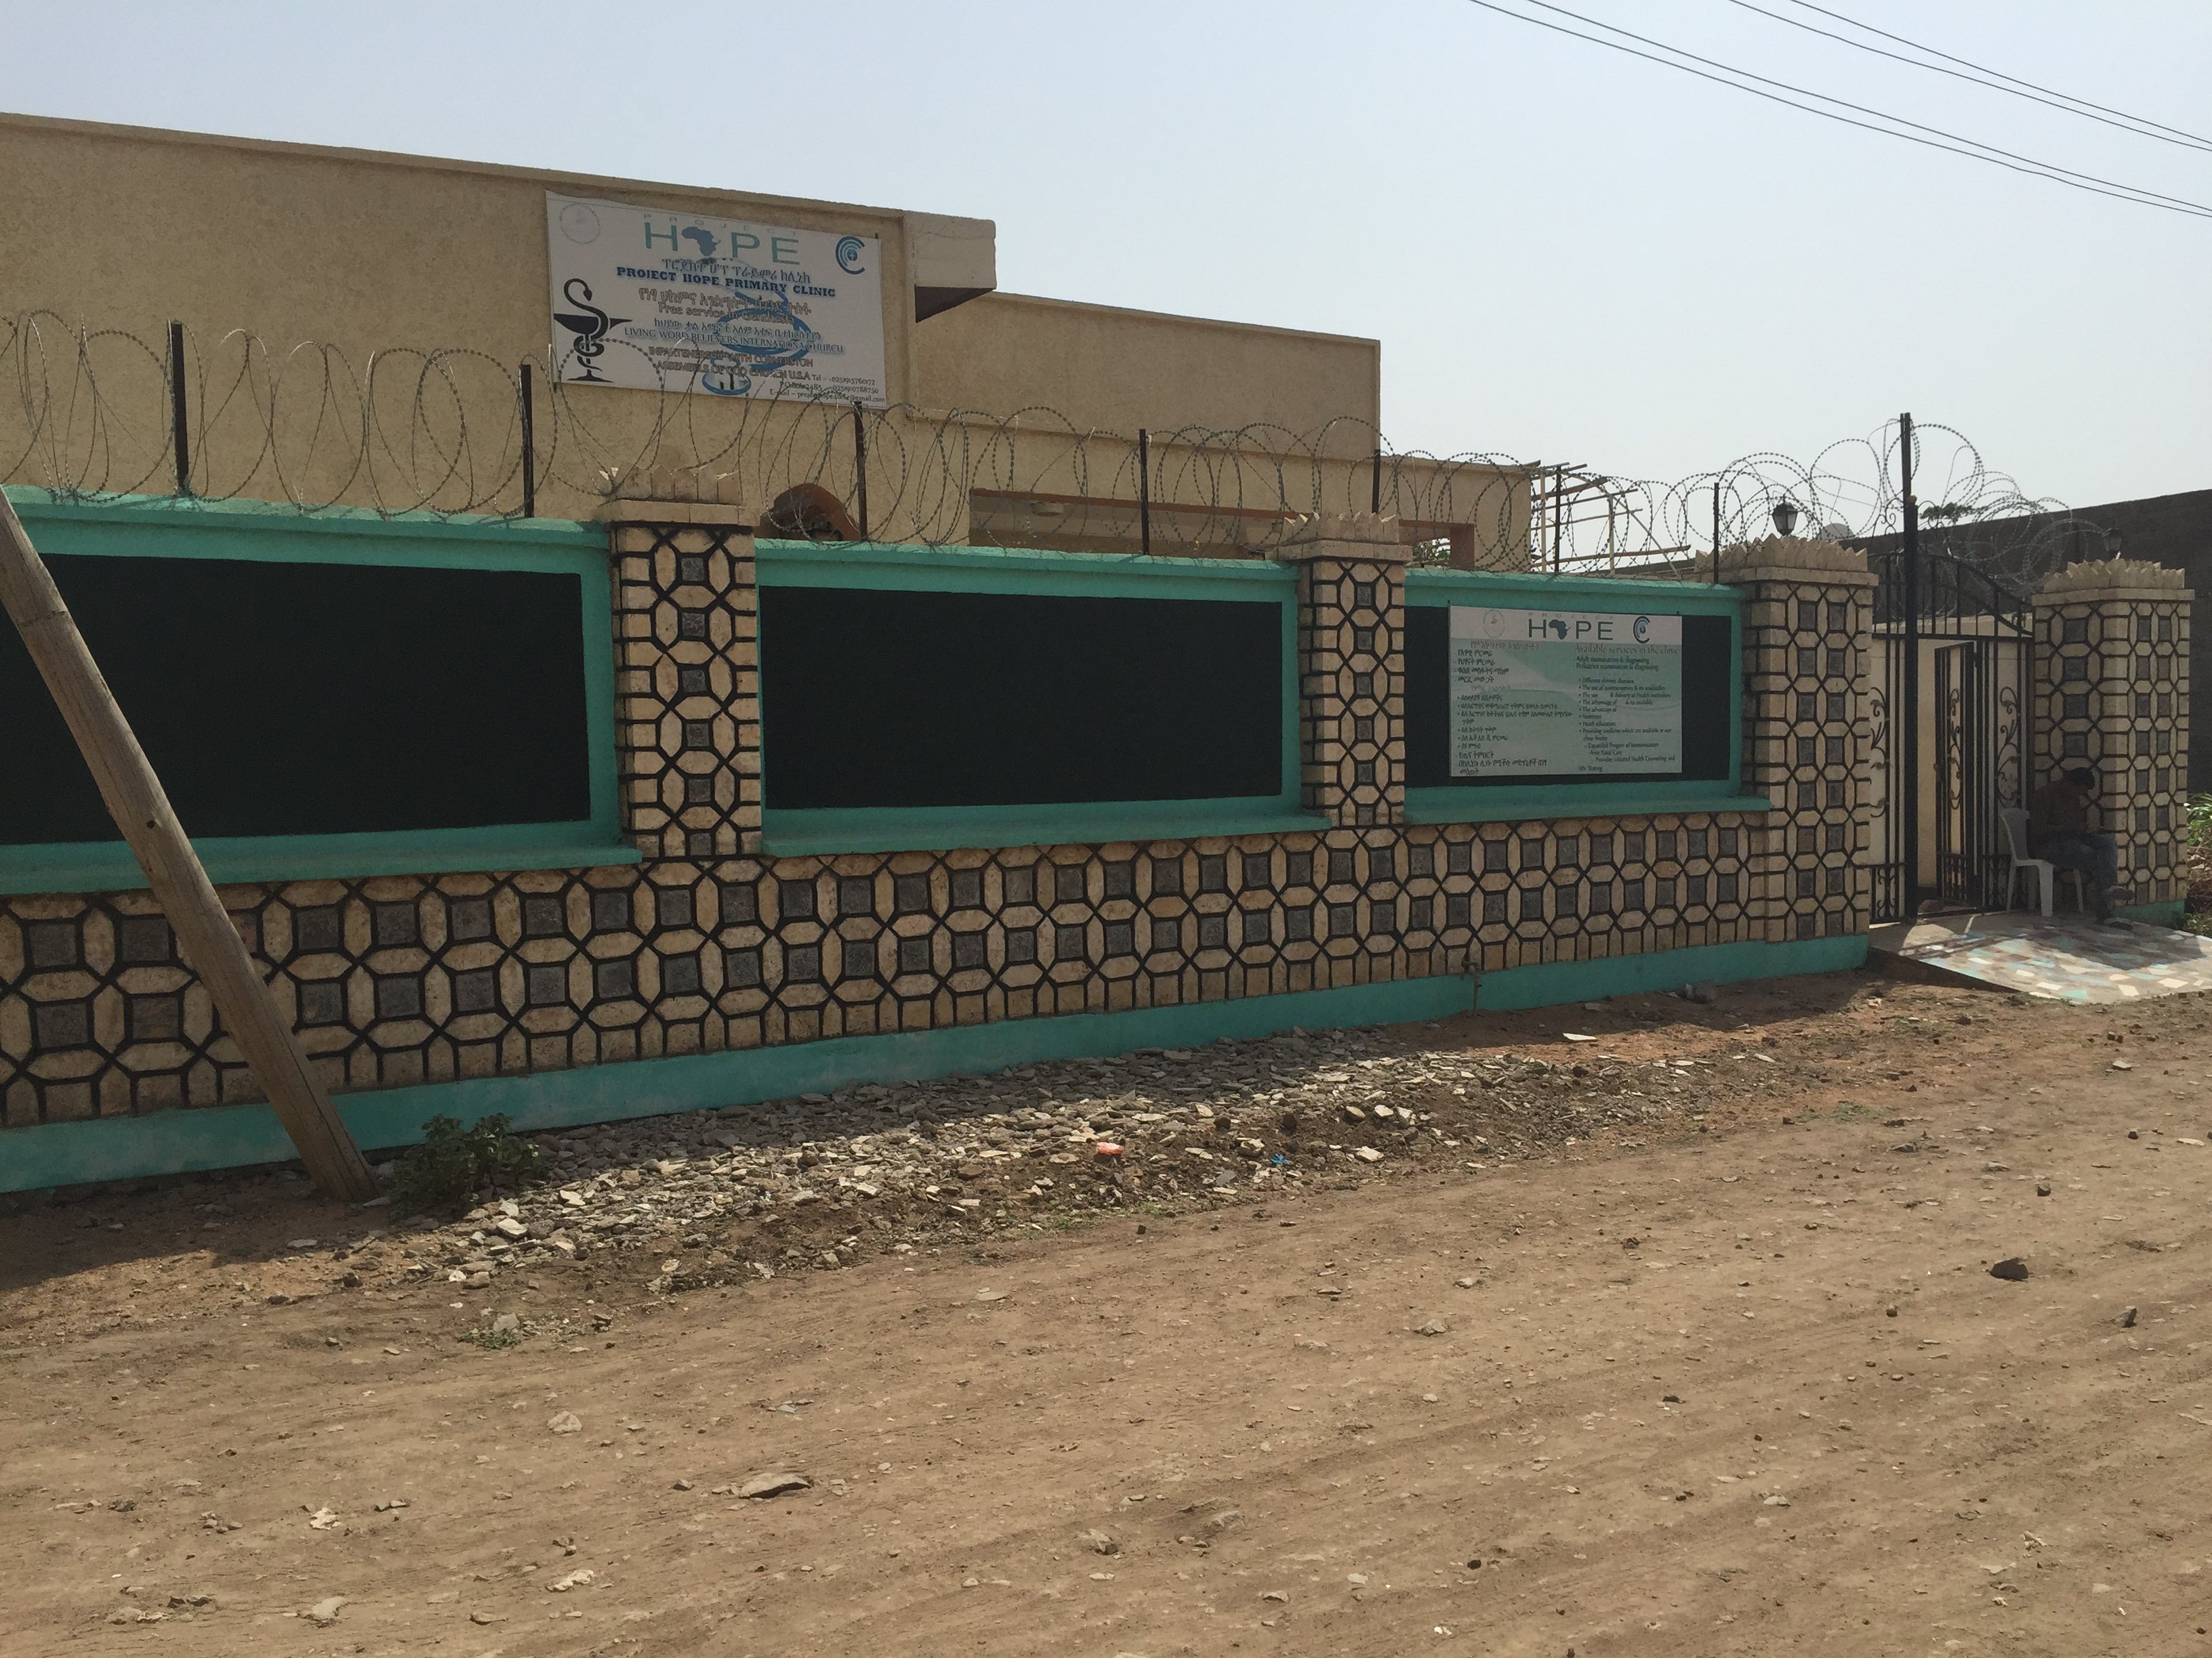

Slide 57
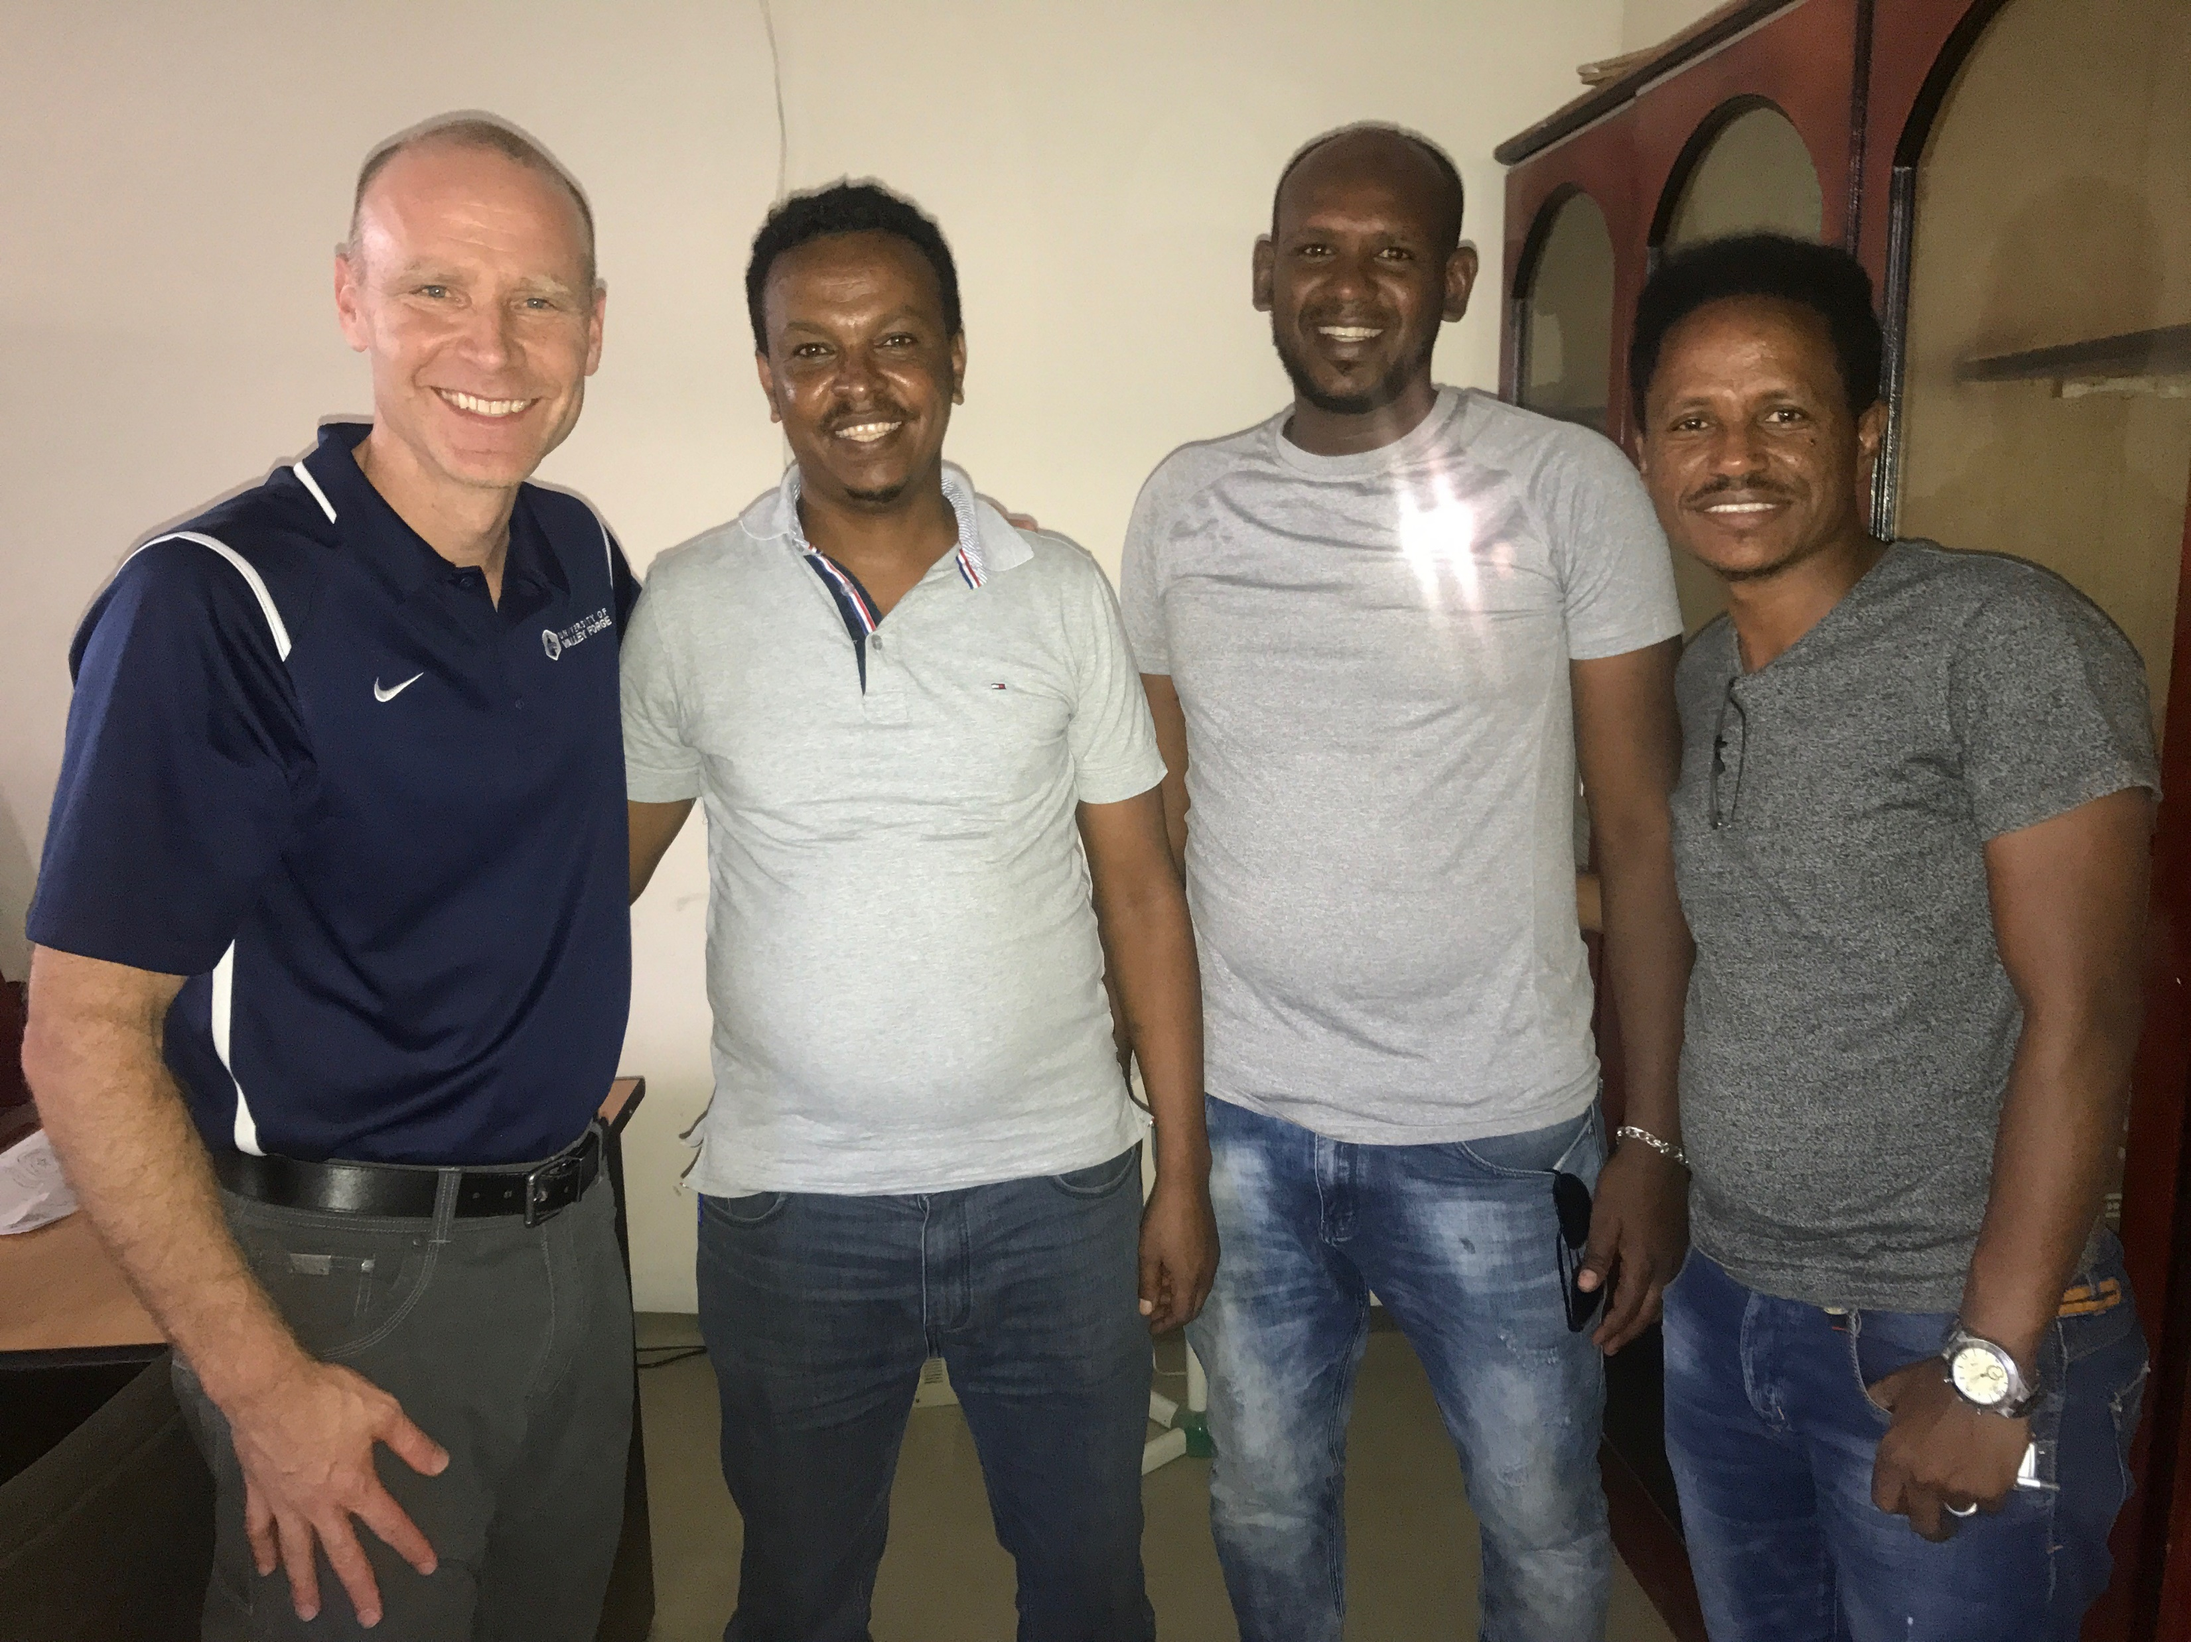

Slide 58
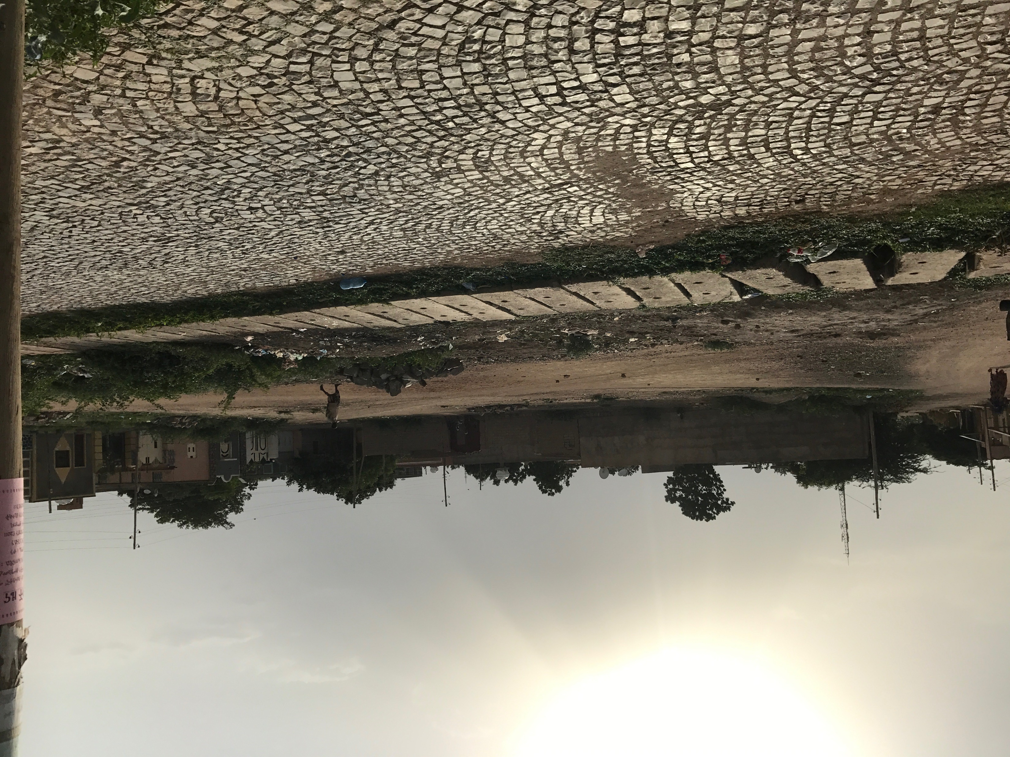

Slide 59
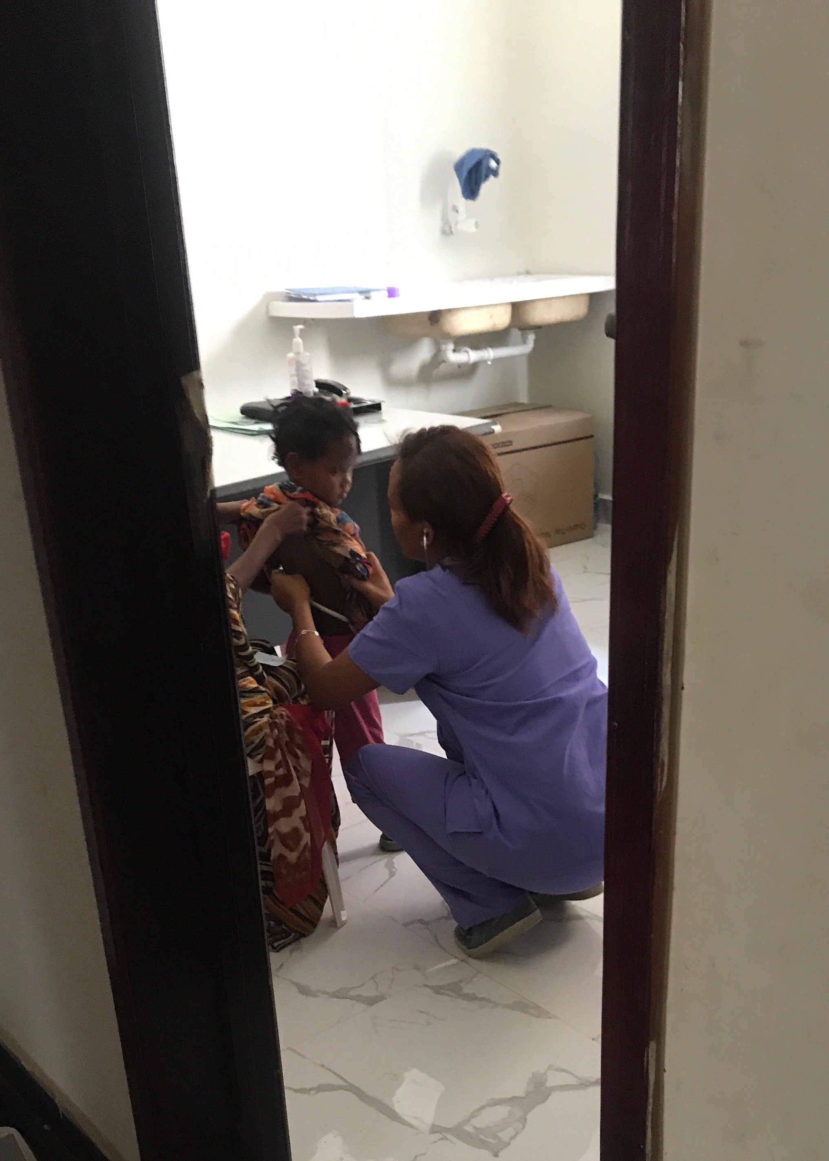
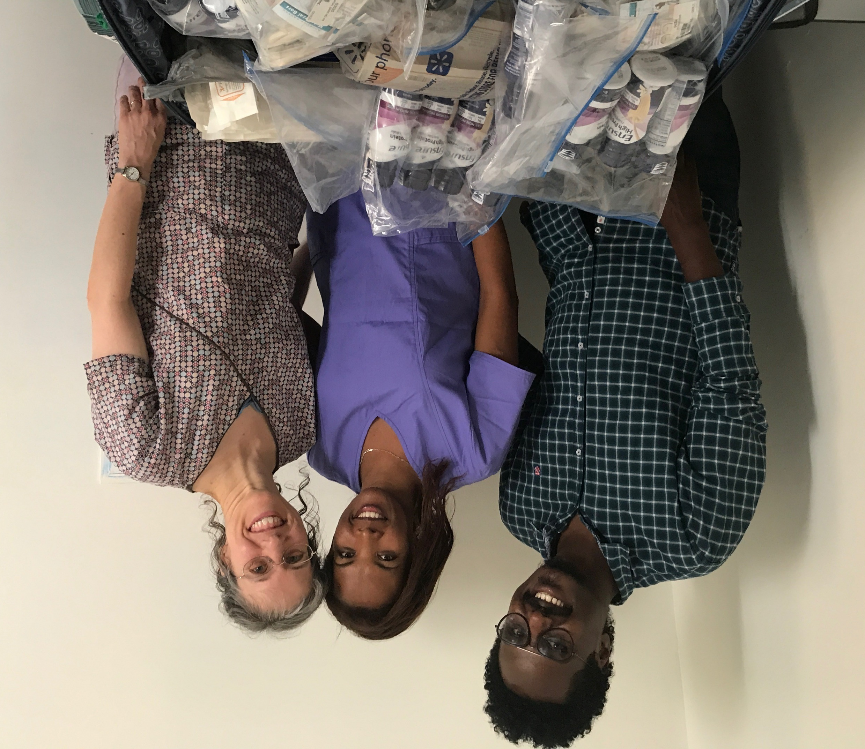

Slide 60
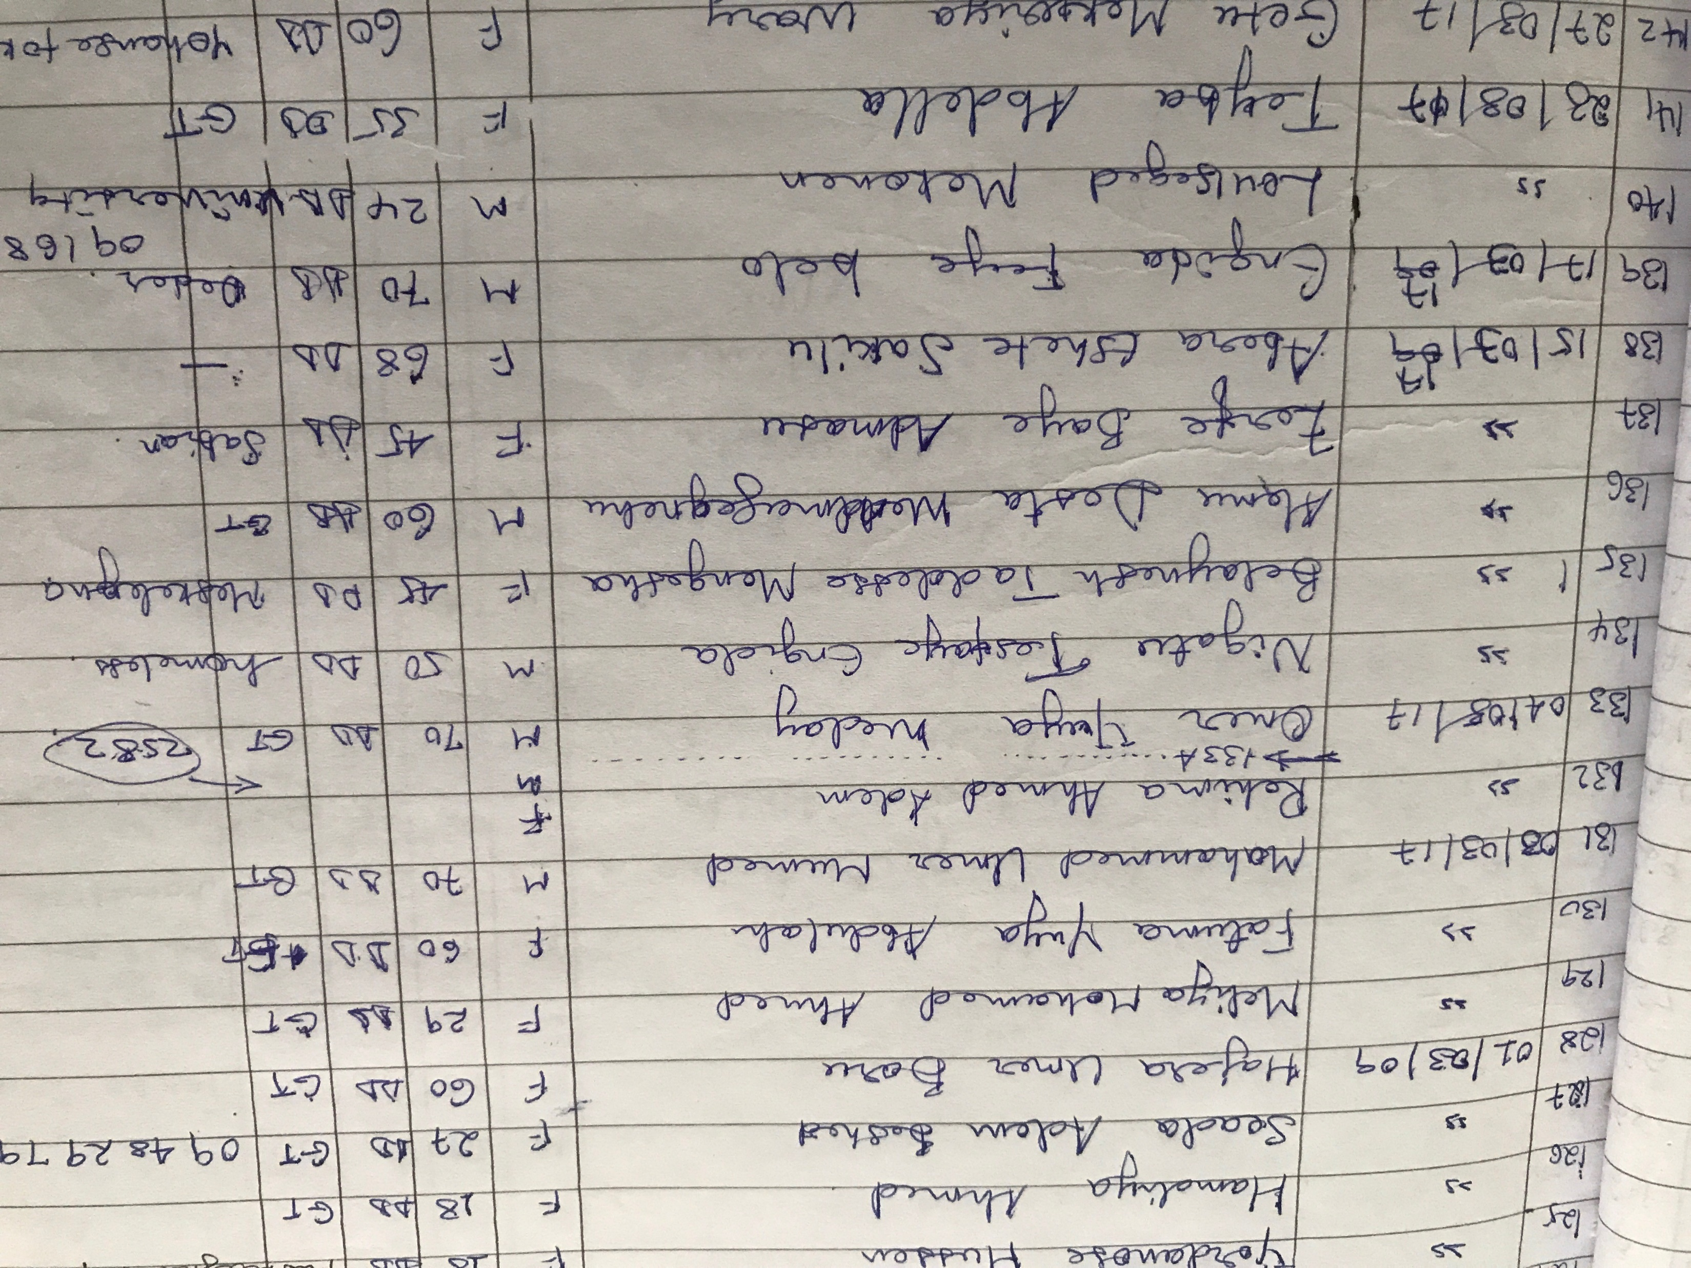

Slide 61
