Slide 1
Notes:
As the kids have told the Christmas story,

Slide 2
“While they were in Bethlehem, the time came for the baby to be born. And Mary gave birth to her firstborn son and wrapped him in swaddling cloths and laid him in a manger, because there was no place for them in the inn.”
“And there were shepherds living out in the fields nearby, keeping watch over their flocks at night. An angel of the Lord appeared to them, and the glory of the Lord shone around them, and they were terrified.

Slide 3
But the angel said to them, “Do not be afraid. I bring you good news of great joy that will be for all the people. Today in the town of David a Savior has been born to you; he is Christ the Lord. This will be a sign to you: You will find a baby wrapped in cloths and lying in a manger.”
Suddenly a great company of the heavenly host appeared with the angel, praising God and saying,

Slide 4
“Glory to God in the highest, and on earth peace to men on whom his favor rests.”
When the angels had left them and gone into heaven, the shepherds said to one another, “Let’s go to Bethlehem and see this thing that has happened, which the Lord has told us about.”
So they hurried off and found Mary and Joseph, and the newborn baby, who was lying in the manger.”

Slide 5
Don’t miss new beginnings in old places!
Notes:
Not just the play
But it’s the very Christmas story
Christmas is about
The greatest gift that ever came to the world
That almost everybody missed
Everyone who celebrated the birth of Jesus
Had seen an angel or a star.
No one else was there
Everyone else missed the new beginning
Why?

Slide 6
In a world of busyness, burdens and brokenness so many other things seem more important!
Notes:
The shepherds had to go be told
A new beginning is here
God’s peace can be found on earth
Go to place, Bethlehem, you’ve been so many times before
But go looking for a new beginning

Slide 7
In a world of busyness, burdens and brokenness so many other things seem more important!
We look at the:
- Urgent instead of the important

Slide 8
In a world of busyness, burdens and brokenness so many other things seem more important!
We look at:
- The urgent instead of the important
- Past pain instead of future priorities

Slide 9
In a world of busyness, burdens and brokenness so many other things seem more important!
We look at:
- The urgent instead of the important
- Past pain instead of future priorities
- Our plans instead of God’s simple solutions
Notes:
Someone here today or watching
The solution is simple if you’d just follow me

Slide 10
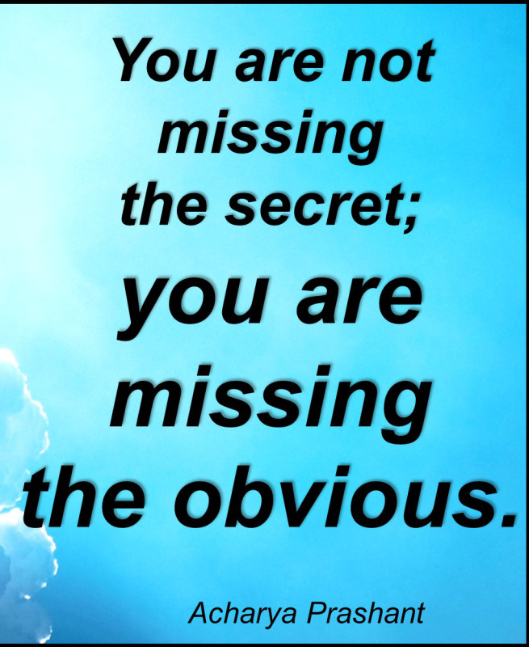
So how do you look for new beginnings
in old places?

Slide 11
You find new beginnings when you start focusing on familiar blessings
(start with being thankful)
Notes:
New beginnings start familiar blessings
Be thankful for what you have and you will find what you’ve never had
Ever hear about a new car, smartphone or show
Then you see it all the time
When you started looking for good – you found it
When yous start looking for how God has been good
You will find the new ways he is being good
You find what you look for
Start with familiar blessings you’ve been taken for granted
Blessings like these

Slide 12
MY Christmas Facebook video here

Slide 13
You find new beginnings when you start focusing on familiar blessings
(start with being thankful)
Notes:
This Christmas let’s be aware of our blessings
And what is going on around us
This Christmas – company is tell you what you don’t have
This Christmas – there is a news agency that isn’t trying to get you to subcribe through by telling you what should shock, alarm and frighten you
This Christmas – most people don’t know how to feel good about themselves except by cutting you down
This Christmas there are plenty of troubles, and trials and challenges in life
But there is also more
If you’’’ start being grateful for what you have
You’ll start to find what new beginnings God wants to give you next
Realizing what we have
And what we can bless others with

Slide 14
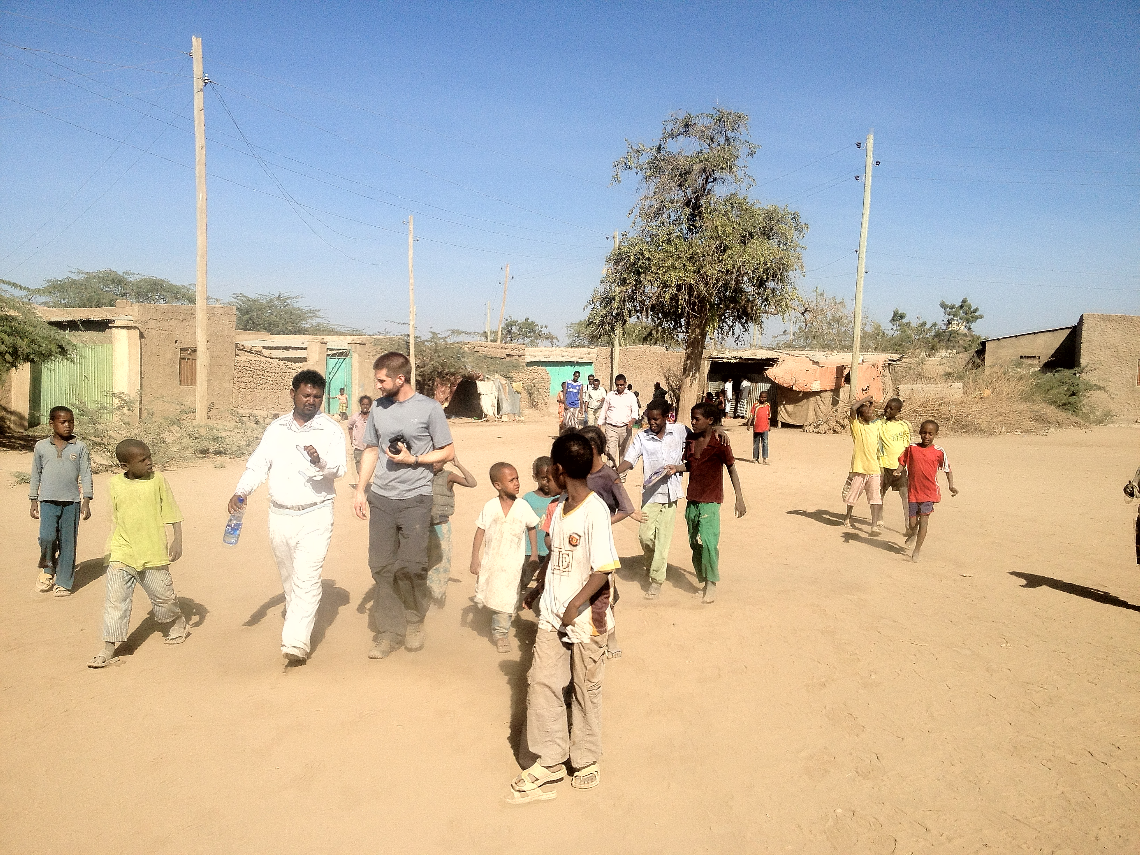
Project Hope in Gendetesfa, Ethiopia
Notes:
Our friends in Gendetesfa Ethiopia
Where we have our free service medical clinic
Most don’t have clean water or consistent electricity

Slide 15
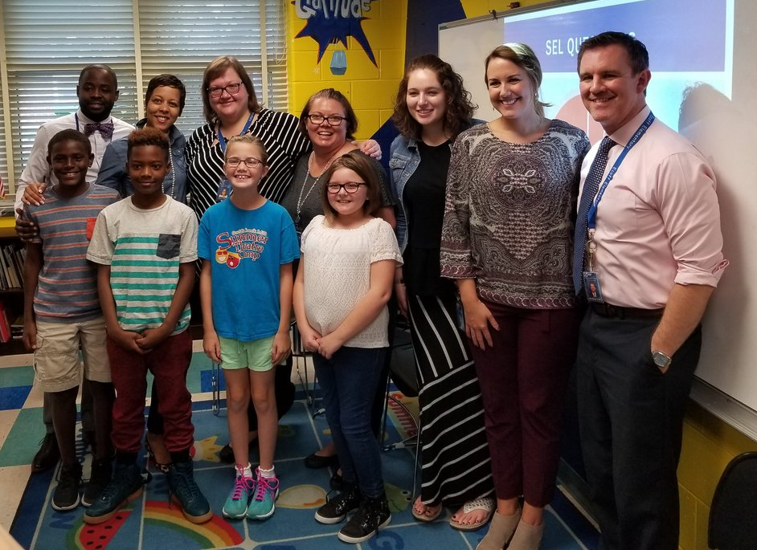
Notes:
Our students at our public schools
Don’t necessarily have a family around them or breakfast in the morning

Slide 16
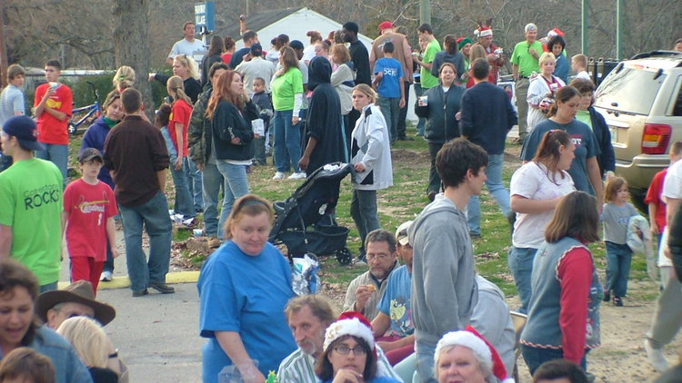
Notes:
Our friends on the Jeff Davis Corridor that CRC works with
They don’t have transportation to get to a job
Or parents to help them do homework

Slide 17
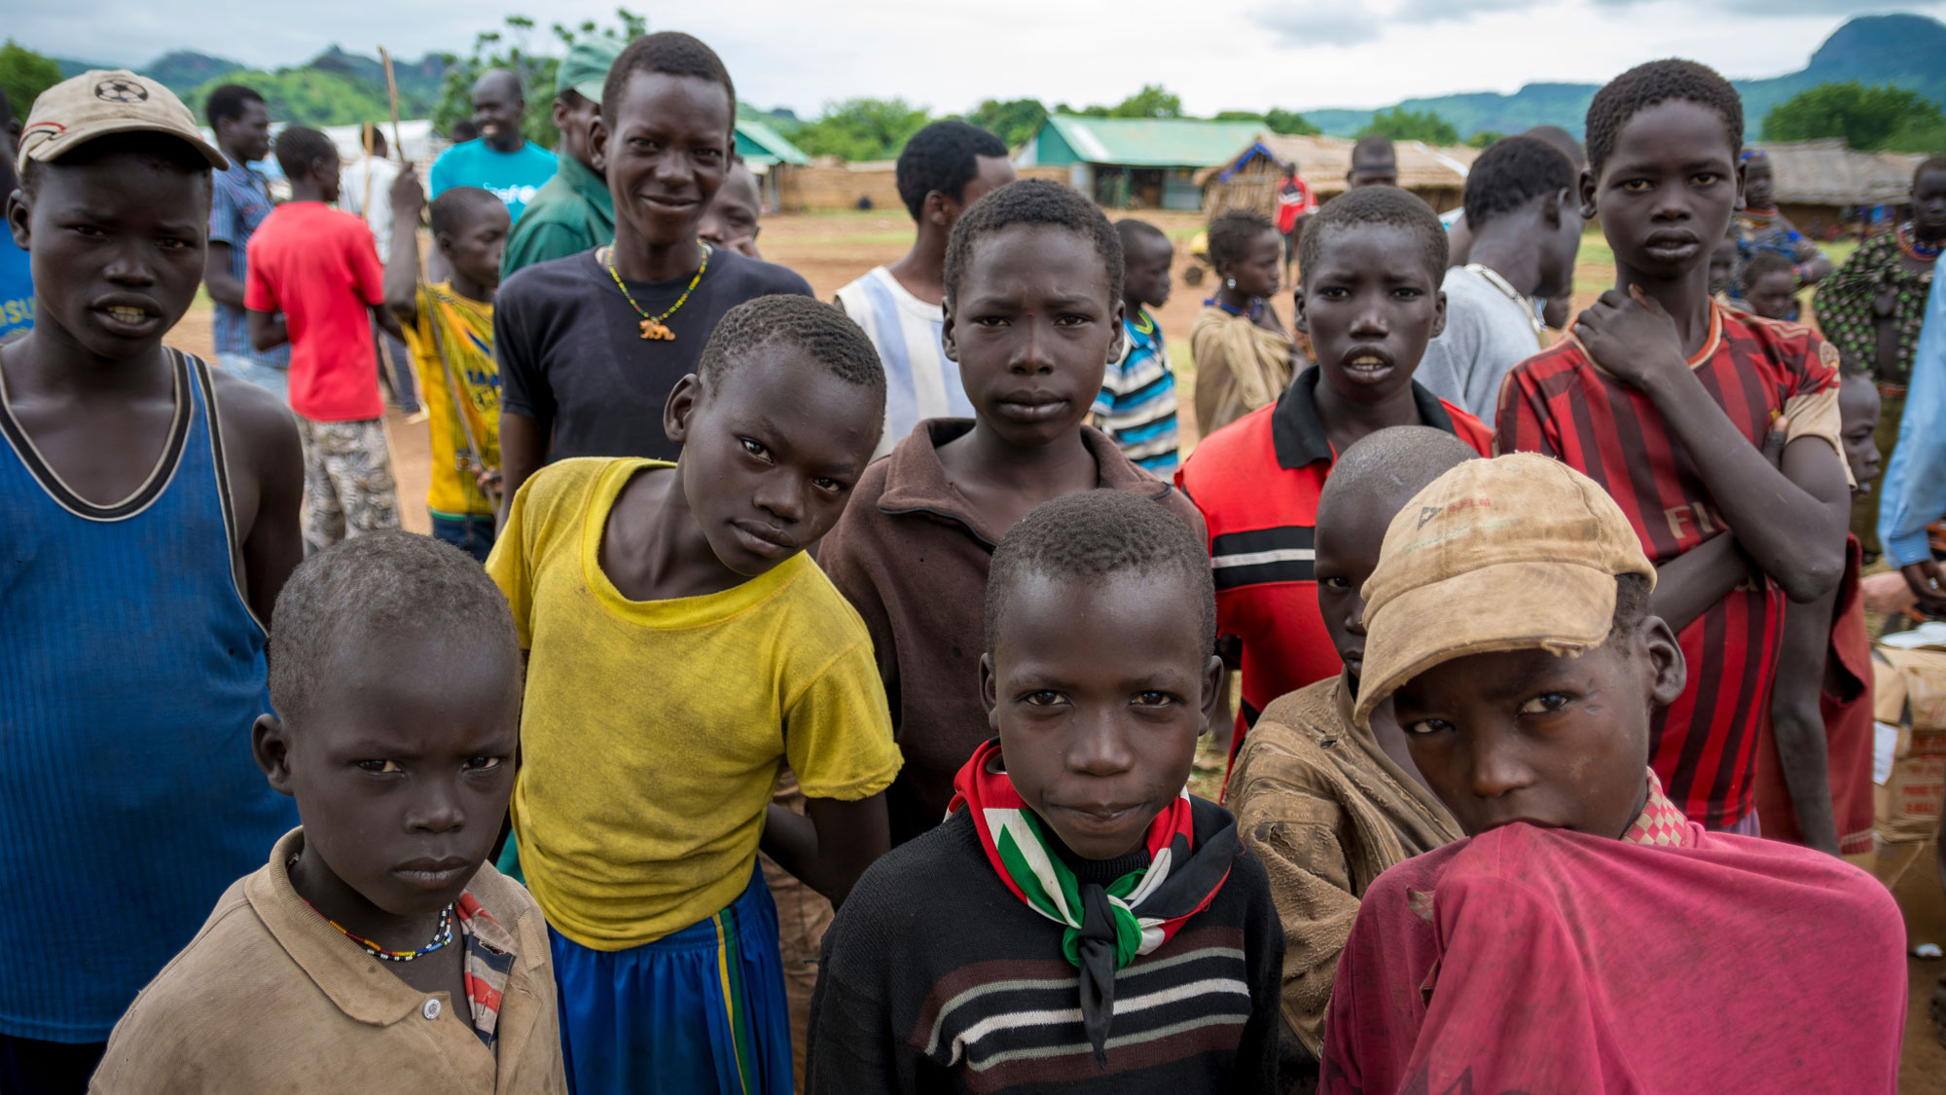
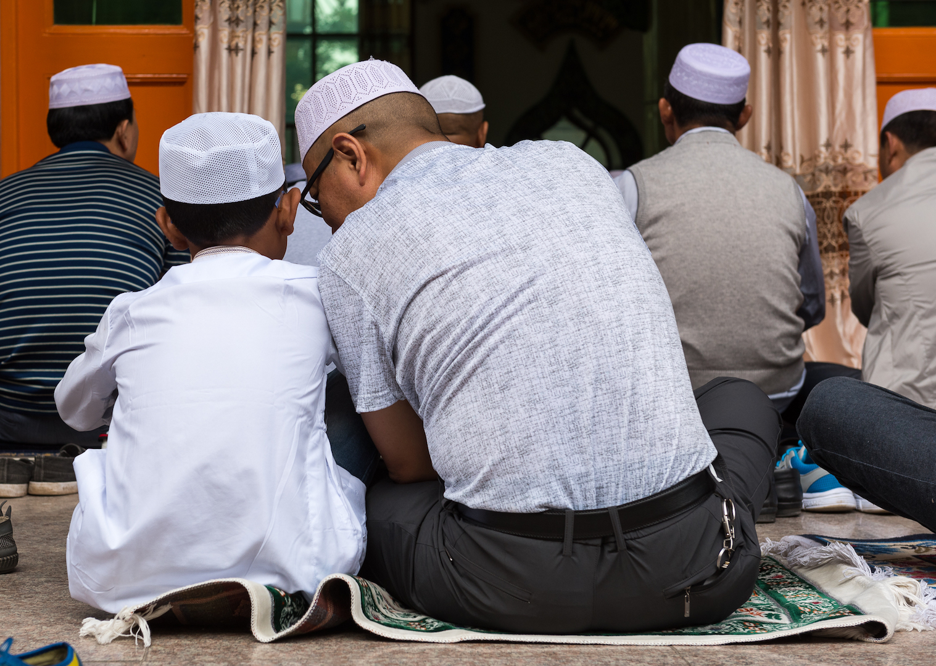
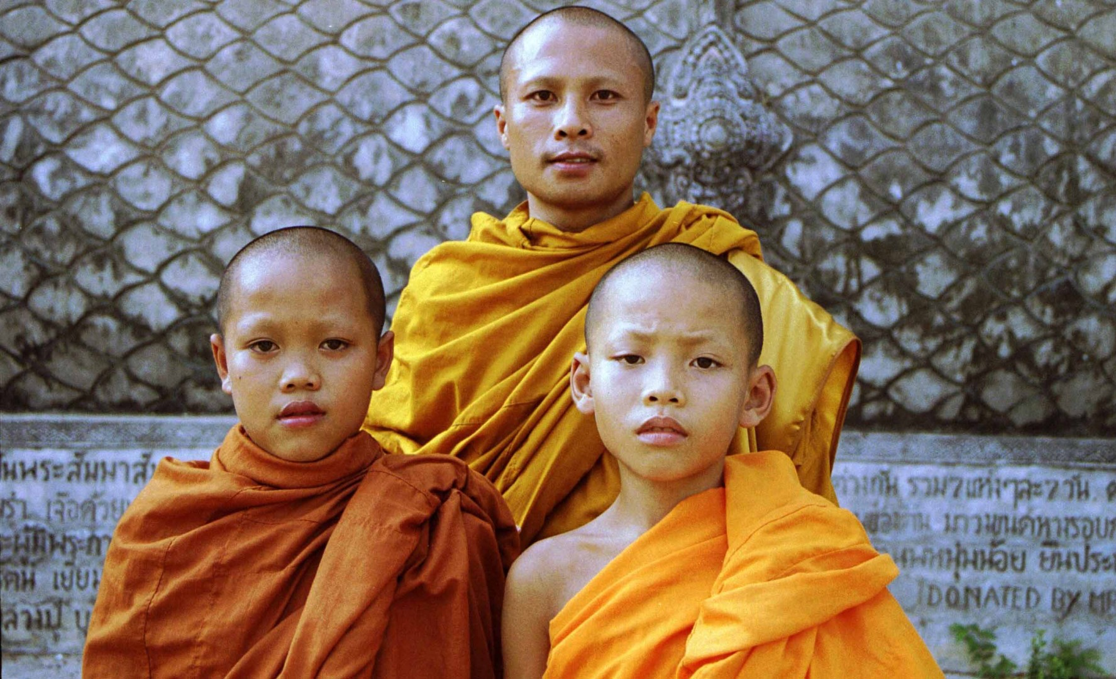
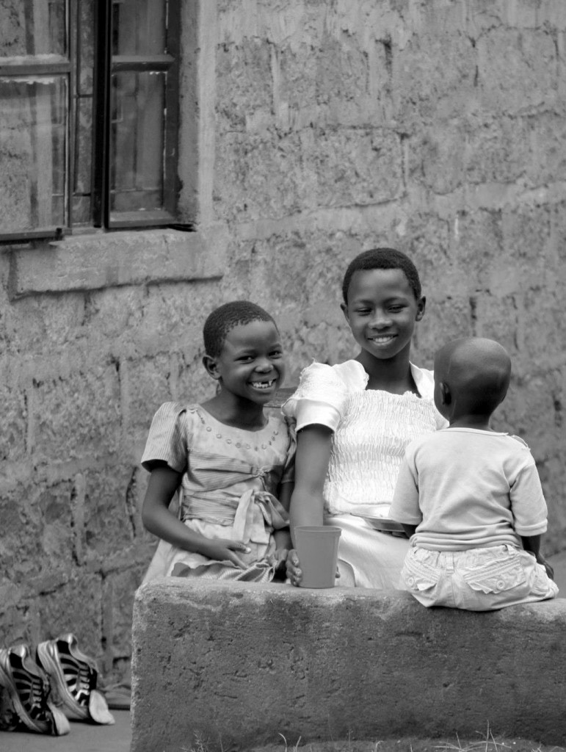
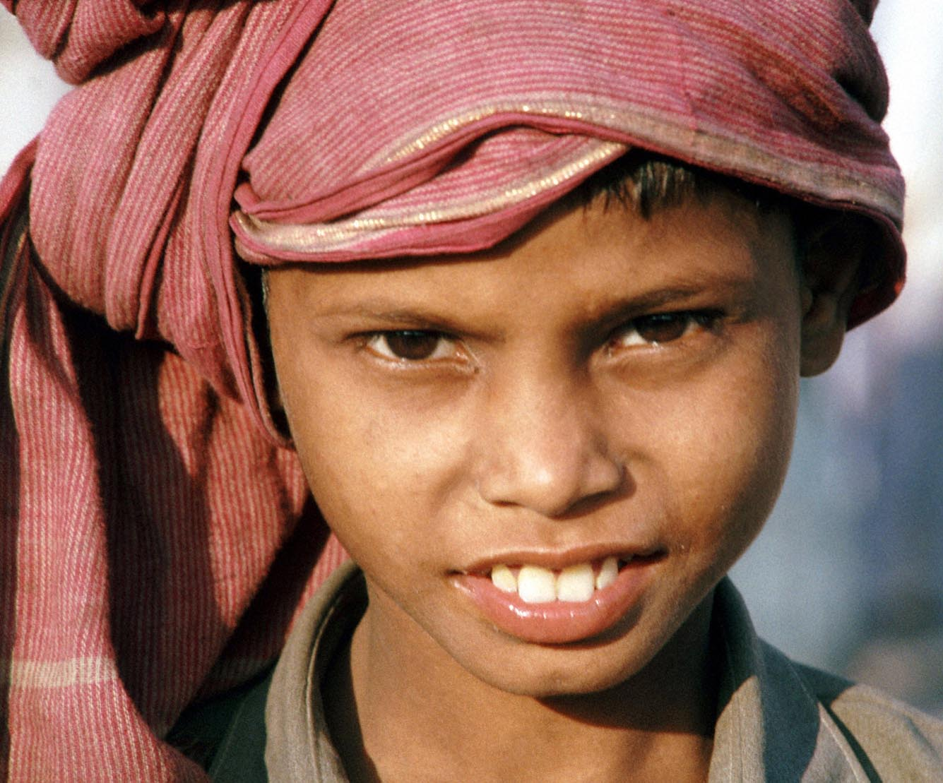
Cornerstone Missionaries
Around The World
Notes:
Our missionaries in Thailand, Senegal, Honduras, India, Peru
Don’t know God loves them and supplies for them

Slide 18
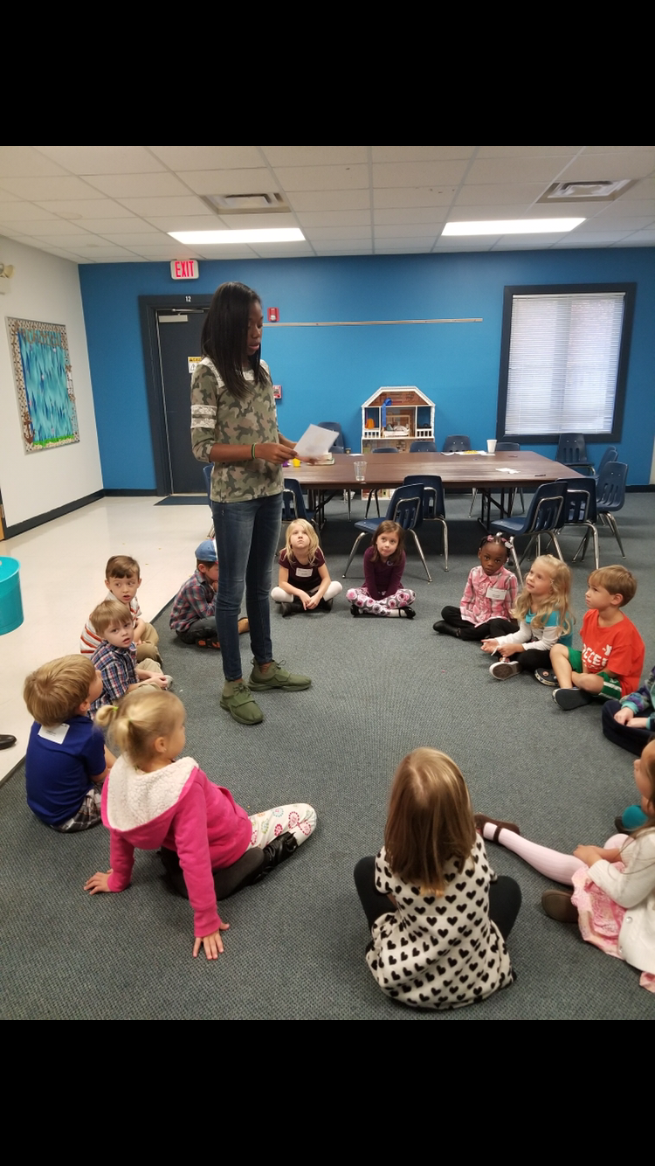
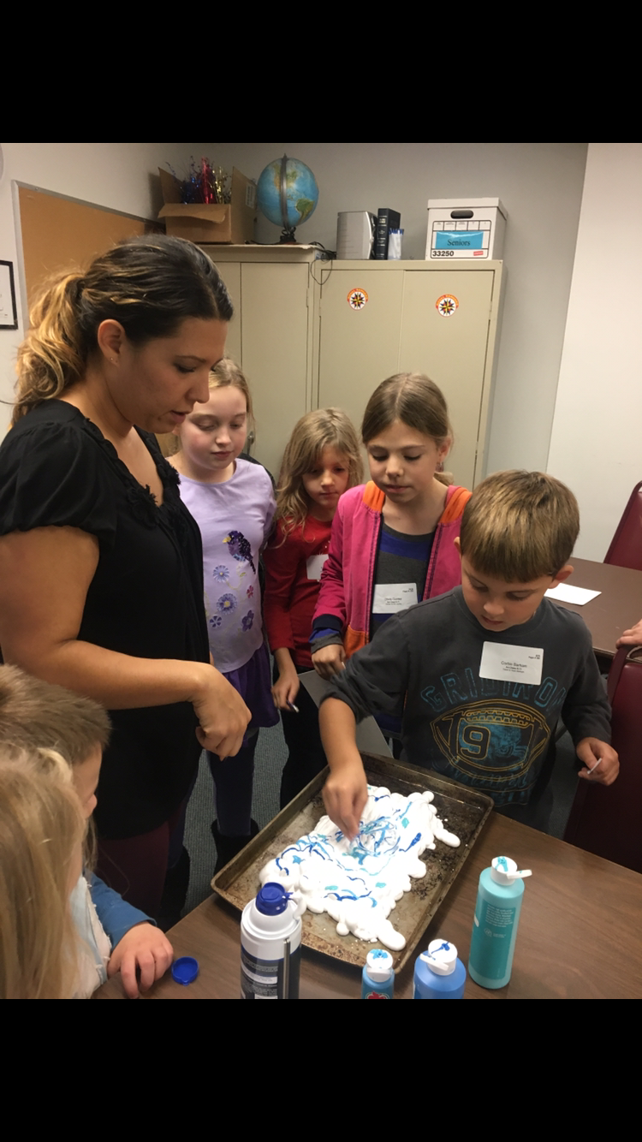
Cornerstone
Family Legacy
Notes:
And the next generation around our community, they don’t even know who Jesus is
My daughter 10th grade at Thomas Dale
Friend – thought Jesus’ parents in the Christmas Story were adam and eve

Slide 19
Let’s remember our blessings
And know God isn’t finished yet.
Notes:
The shepherds had to go be told
A new beginning is here
God’s peace can be found on earth
Go to place, Bethlehem, you’ve been so many times before
But go looking for a new beginning

Slide 20
Let’s remember our blessings
And know God isn’t finished yet.
Let a messenger tell us today to go
looking in old places for new beginnings
Notes:
The shepherds had to go be told
A new beginning is here
God’s peace can be found on earth
Go to place, Bethlehem, you’ve been so many times before
But go looking for a new beginning

Slide 21
Let’s remember our blessings
And know God isn’t finished yet.
Let a messenger tell us today to go
looking in old places for new beginnings
And then let’s become
the messenger for others
Notes:
The shepherds had to go be told
A new beginning is here
God’s peace can be found on earth
Go to place, Bethlehem, you’ve been so many times before
But go looking for a new beginning

Slide 22
“I HAVE DECIDED” Card
Start your new beginning today (card in seat)
Notes:
We are the home owner
Jesus come on in. Jesus, the word made flesh – come on in
But the place of honor in my life – that’s crowded.
So I totally am glad you’re here.
Find someplace to be – your word – whatever space/time is left over – I’ll get to it.
Here is the word of God for you and I today:

Slide 23
“I HAVE DECIDED” Card
Start your new beginning today (card in seat)
Cornerstone Advent Devotional
On website, FB, paper copies (connection center)
Notes:
We are the home owner
Jesus come on in. Jesus, the word made flesh – come on in
But the place of honor in my life – that’s crowded.
So I totally am glad you’re here.
Find someplace to be – your word – whatever space/time is left over – I’ll get to it.
Here is the word of God for you and I today:

Slide 24
“I HAVE DECIDED” Card
Start your new beginning today (card in seat)
Cornerstone Advent Devotional
On website, FB, paper copies (connection center)
The Bible Project (Jan 1)
A year of understanding the Bible (brochure in foyer)
Notes:
We are the home owner
Jesus come on in. Jesus, the word made flesh – come on in
But the place of honor in my life – that’s crowded.
So I totally am glad you’re here.
Find someplace to be – your word – whatever space/time is left over – I’ll get to it.
Here is the word of God for you and I today:

Slide 25
Choosing to simplify our lives
so others can simply live
(in God’s new beginnings)
Notes:
Jesus I have room for you

