Slide 1
Notes:
(this story is told three places: Mk 14:3-9, John 12:1-8, Mt. ???)
John’s account tells us the woman is Mary, the sister to Martha & Lazarus
Read Mark 14:3-9
The one that sat at Jesus feet
The one who saw her raise Lazarus
The one who now gives all she owns to him

Slide 2
JESUS HAS AN ETERNALLY IMPORTANT PURPOSE FOR YOUR LIFE
“I tell you the truth, wherever the gospel is preached throughout the world, what she has done [given] will also be told, in memory of her.” (Mark 14:8-9)

Slide 3
Legacy
the eternal difference
you are to make
What people remember
about you when you are gone

Slide 4
Legacy
We leave a legacy
by what we give
not what we get
Notes:
And we live our legacy by how we finish, not how we start
(parenting, ministry, friendship, marriage

Slide 5
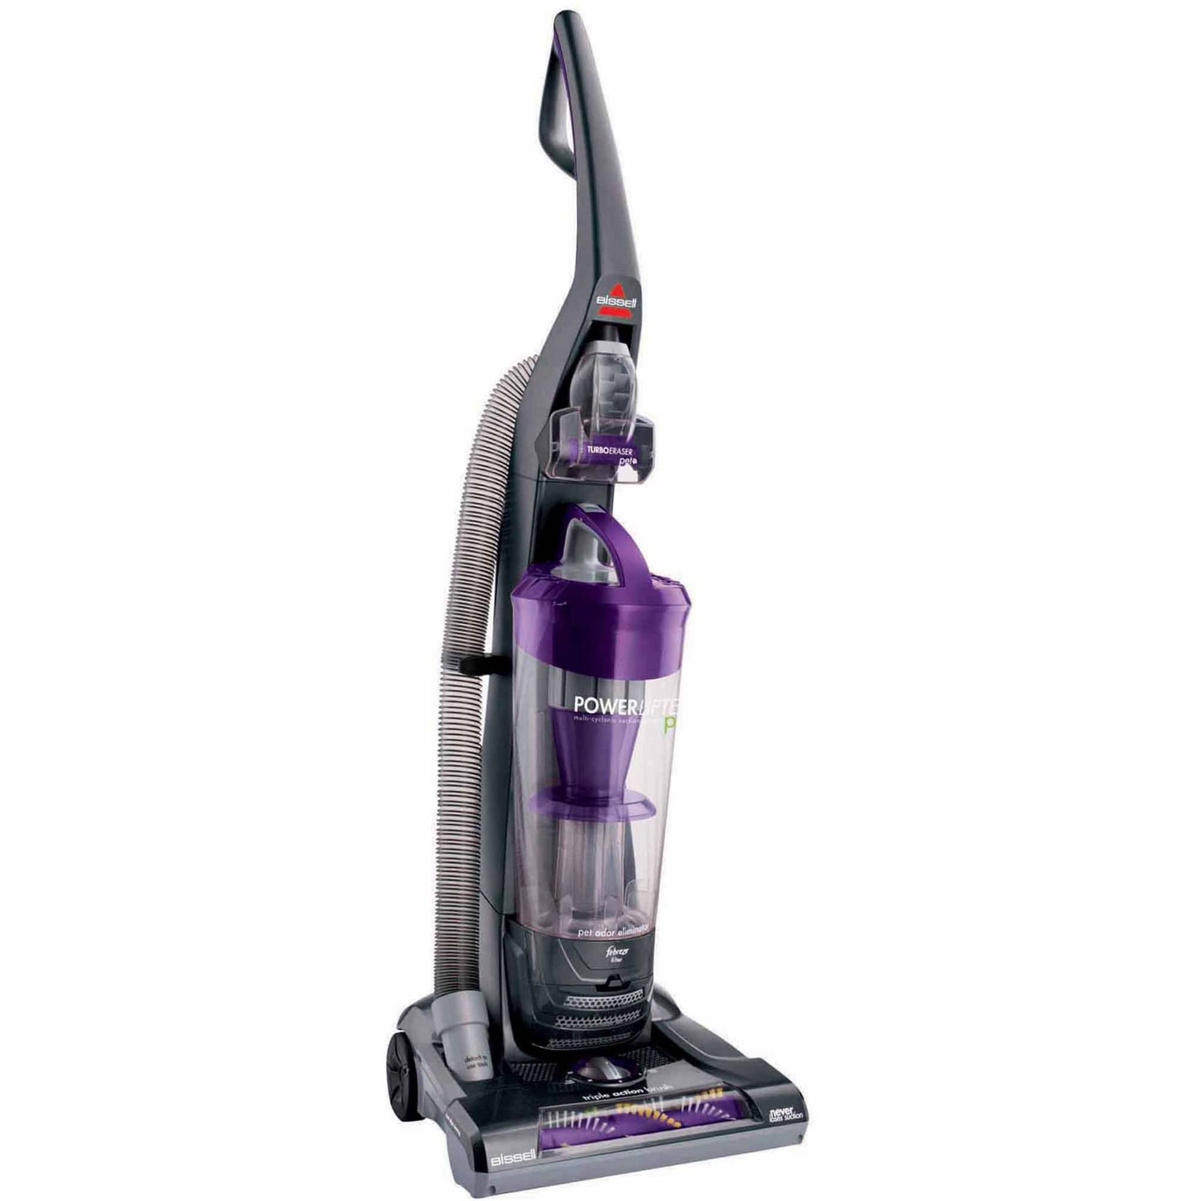

Slide 6
“Good will come to him who is generous and lends freely, who conducts his affairs with justice. Surely he will never be shaken; a righteous man will be remembered forever. . . He shares freely and gives generously to those in need. His good deeds will be remembered forever. He will have influence and honor.”
(Ps 112:5-6, 9, nlt)

Slide 7
“God’s purpose in all this was to use the church to display his wisdom in its rich variety to all the world and its unseen rulers and authorities.
This was his eternal plan . . .”
Eph 3:10 (nlt)
Notes:
“You [plural] are the light of the world. A city on a hill cannot be hidden . . . let your light shine before men, that they may see your good deeds and praise your Father in heaven.”
(Mt. 5:14-16)

Slide 8
Our season of
ThanksGIVING
Missions Fair (today)

Slide 9
Our season of
ThanksGIVING
Missions Fair (today)
Advent Offering (Sunday, Dec. 10)
Notes:
This last year we gave over a quarter of a million dollars to all these things

Slide 10
Advent Offering / Dec 10
Leaving a legacy of Jesus to . . .
Our Community
Next Generation Missionaries
Current Missionaries
The Unreached
Our Future Family
Notes:
Five areas
Outreach to our community – ecoff, bensely, crc
Next generation discipleship – next gen missionaries
Missionaries – Christmas
Unreached - Project Hope
Family Legacy – church fam for future generations

Slide 11
Our season of
ThanksGIVING
Missions Fair (today)
Advent Offering (Sunday, Dec. 10)
New ways to live a generous life
Notes:
Something extra to show you god loves you! (with a big tip)
(more people commit suicide in thanksgiving – Christmas) (feel their problems more)

Slide 12
Why we give
When we lose our why we lose our way in life

Slide 13
“That is why we never give up. . . For our present troubles are small and won’t last very long. . . So we don’t look at the troubles we can see now; rather, we fix our gaze on things that cannot be seen. For the things we see now will soon be gone, but the things we cannot see will last forever. 2 Cor. 4:17
Notes:
Its not how how you start – its how you finish
Its not how you feel – its what you see forever
God doesn’t want you to give up on His legacy through you
There are greater days ahead
Mary’s story show us this!

Slide 14
Why we get to give & leave a legacy
[1] because Jesus has given to us first
“Jesus arrived at Bethany, where Lazarus lived, whom Jesus had raised from the dead.” (John 12:1)
Notes:
Mary remembered all Jesus had done – given her and her family
“This is how we know what love is: Jesus Christ laid down his life for us. And we ought to lay down our lives for our brothers.” 1 John 3:16
Jesus had brought her brother back from the dead.
He had given her knew life
And she was so grateful – she didn’t just give her leftovers
She gave as a legacy
Do you remember who you were before Jesus became real to you?
Do you remember how you felt about your future?
Do you remember His great forgiveness?

Slide 15
Psalms of Remembrance / Historical Psalms
“Give thanks to the Lord, for he is good;
his love endures forever. . . When our fathers were in Egypt, they gave no thought to your miracles; they did not remember your many kindnesses, and [because of this] they rebelled by the Red Sea.”
Ps 106:1, 7
Notes:
Time to remember / holidays last season
Read this psalm

Slide 16
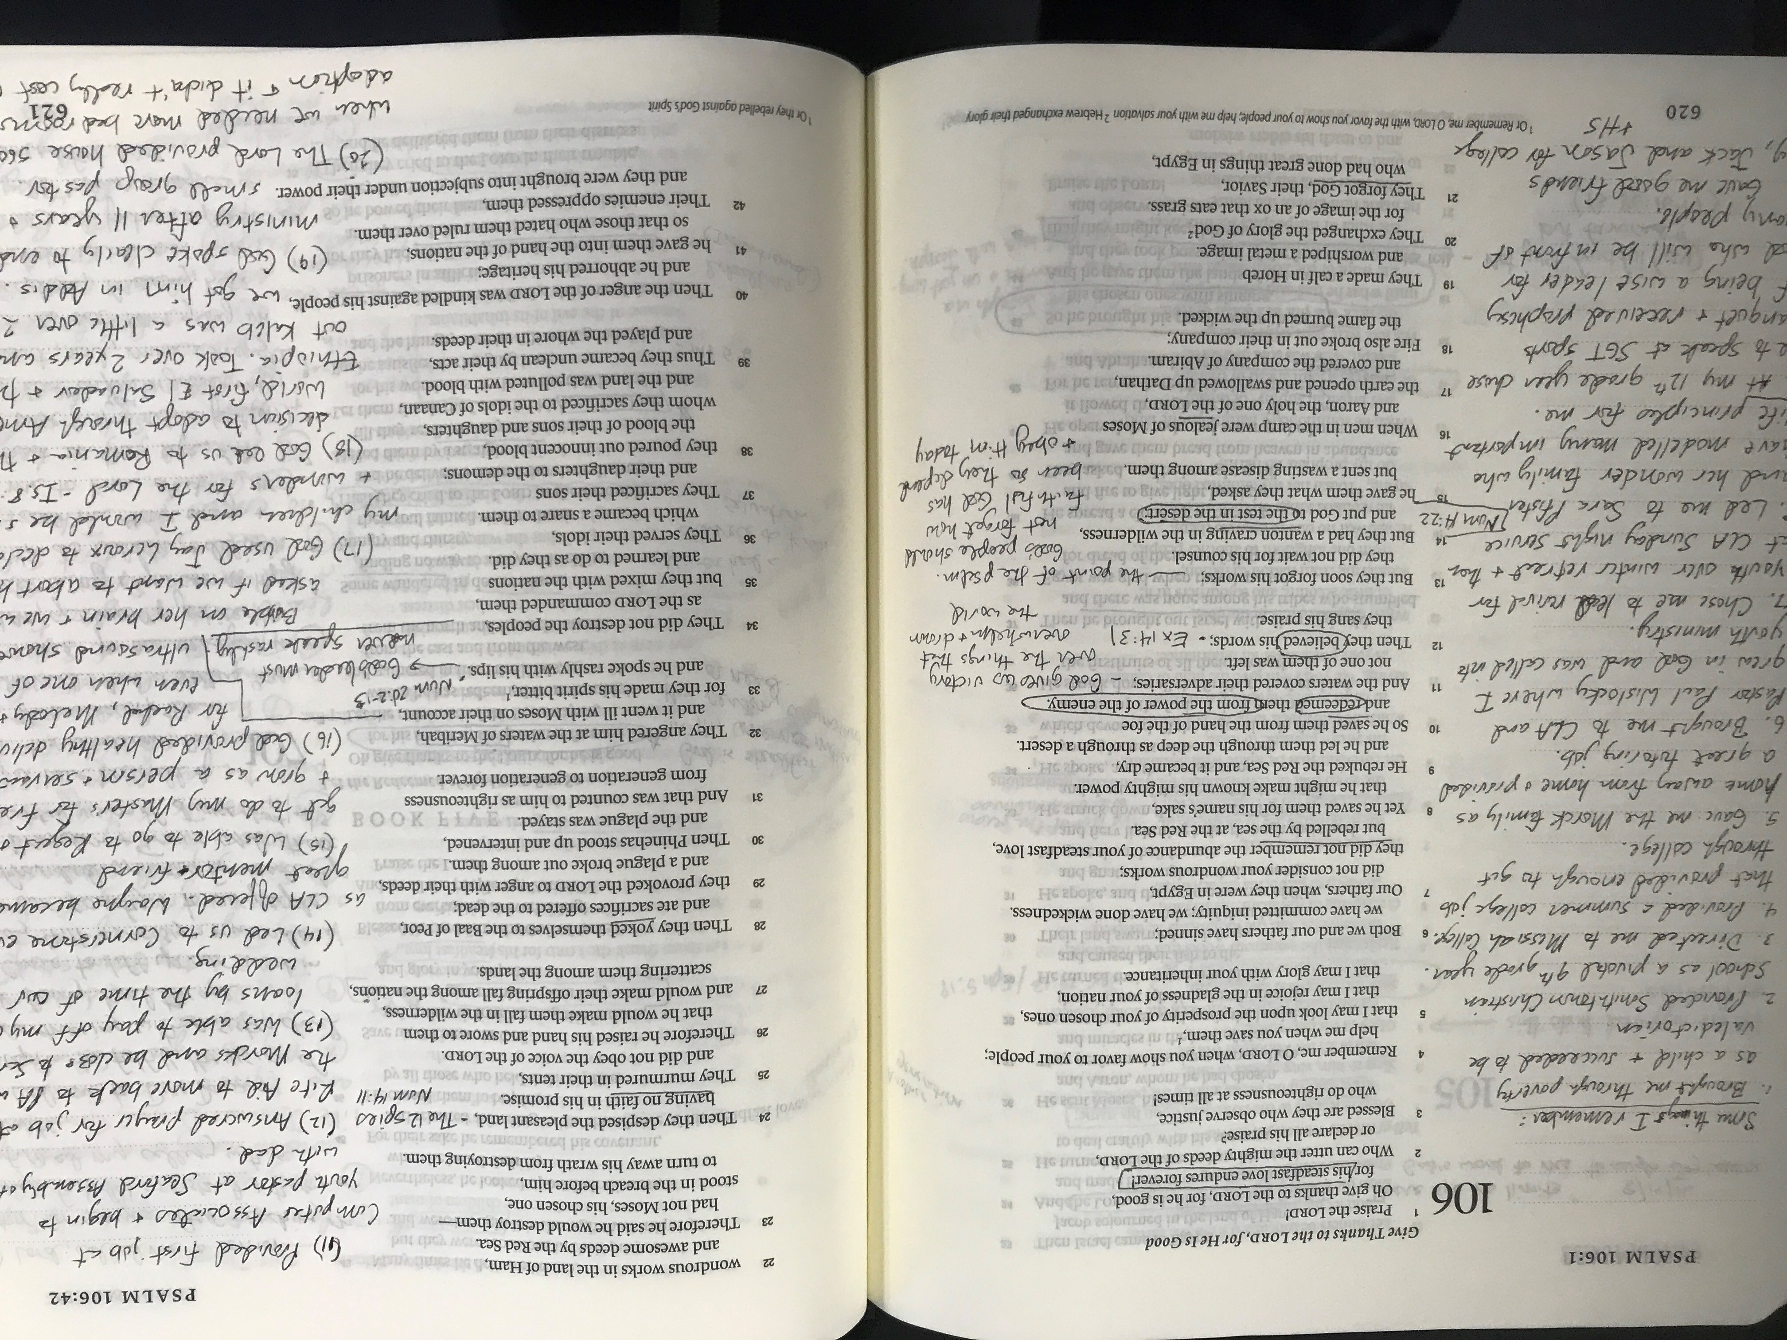

Slide 17
When we remember the miracles
God has given us
We refocus on faith in the present
and live to give His miracles to others
Notes:
Provision / People / Perspective / Peace / Past
When we are filled with what we have been given,
We pour out what we have been given

Slide 18
“Heal the sick, raise the dead, cleanse those who have leprosy, drive out demons. Freely you have received, freely give.” (Mt 10:8)
“Generous love is the proof that a person has received forgiveness and eternal life in Jesus. The more people are forgiven, the more they will love unconditionally and give to others.”

Slide 19
Why we get to give & leave a legacy
[2] because Jesus has given us the key to life
“She did [gave] what she could.” (Mark 14:8)
“remembering the words the Lord Jesus himself said: ‘It is more blessed to give than to receive.’ ”
(Acts 20:35)
Notes:
Mary had been given something and it caused great joy
The joy grew by giving back
It kept flowing like water out of a fire hydrant
And that’s the key to joy
It needs to keep flowing and pouring out of you to others

Slide 20
“Give, and it will be given to you. A good measure, pressed down, shaken together and running over, will be poured into your lap. For with the measure you use, it will be measured to you.” (Mt. 6:38)
“I have come as a light to shine in this dark world, so that all who put their trust in me will no longer remain in the dark.” (Jn 12:46)
Notes:
Winston Churchill
“We make a living by what we get.
But we make a life [& legacy] by what we give.”
This is the key to unending joy
To stop giving like Jesus is to stop having vicotyr like Jesus
Your legacy is in what you give

Slide 21
TYPE OF GIVING
TRUST GOD WITH
JESUS
[First] - my heart Lk 10:27
“Love the Lord your God with all your heart and with all your soul and with all your strength and with all your mind”
Notes:
All your giving & effort is temporary until you take the first and most important step of trust
Celebrated incredible baptisms two weeks ago

Slide 22
TYPE OF GIVING
TRUST GOD WITH
JESUS
[Emotional] - helping others Lk 19:1-9
[First] - my heart Lk 10:27
“Look, Lord! Here and now I give half of my possessions to the poor.”
Notes:
We gave over $5,00o to hurricane relief
And now put it on our hearts to give to Puerto rico
Emotional giving - one time – is a blessing
A nice step in trusting God in a moment
We want to go higher and develop lifestyle of trust
Emotional is giving with god when I want and how I want

Slide 23
TYPE OF GIVING
TRUST GOD WITH
JESUS
[Tithing] - my first Lk 11:42
[Emotional] - helping others Lk 19:1-9
[First] - my heart Lk 10:27
“For you tithe every herb, and neglect justice and the love of God. These you ought to have done, without neglecting the others.”
Notes:
Jesus is always teaching on giving first to God in all areas
(which includes money – can be our greatest idol)
We want to develop a pattern of trust
Going higher with God – trusting him with everything
How do we do that
We start with the first
The first always belongs to God
When I give him my first he takes care of the rest
I live in the reality that I trust in his riches and not mine
I declare my treasure is god not money
See sermon
For some, that’s the next step of trust
Measuring out more so God flow even more
Through your tithes – we given over $200k to missions last year

Slide 24
TYPE OF GIVING
TRUST GOD WITH
JESUS
[Sacrificial] - doing without Lk 16:1-13
[Tithing] - my first Lk 11:24
[Emotional] - help for others Lk 19:1-9
[First] - my heart Lk 10:27
“use worldly wealth to gain treasure that will last, so that when it is gone, you will be welcomed into eternal dwellings.”
Notes:
Sacrificially or strategically
Give my temporary comfort and success for eternal
I want to sacrifice to live simply so others can simply live
Over $60k to motivation church
60 members sponsor kids in Ethiopia
Many called to go – sacrifice
Extra funds (offerings) but time and skill and comfort

Slide 25
TYPE OF GIVING
TRUST GOD WITH
JESUS
[Life] - source of my life Lk 21:1-4
[Sacrificial] - doing without Lk 16:1-3
[Tithing] - my first to God Lk 11:24
[Emotional] - helping others Lk 19:1-9
[First] - my heart to God Lk 10:27
“All these people gave their gifts out of their wealth;
but she out of her poverty put in all she had to live on.”
Notes:
Widow
This is where the legacy finalizes itself
This is where Jesus taking all of us
To give our life away to the world the way He did
This is how we finish – we give it all away
Martyrs do
This is what legacy people
This is mary did –she gave away her future – all of it
Mark –years salary – security
Most likely gave her life soon after
What I want to do –
Because I’m not keeping
So I want to make sure treasures for eternity
Dying – maybe go to Ethiopia – mosk talk about Jesus
I’ll always have my family

Slide 26
Why we get to give & leave a legacy
[3] because Jesus will give us even more
“I tell you the truth, wherever the gospel is preached throughout the world, what she has done will also be told, in memory of her.” (Mk. 14:8-9)
Notes:
Mary had been given something and it caused great joy
So she gave everything
And then Jesus gave her more back – a legacy
Eternal difference –salvation of souls
Not just that day

Slide 27
“His master replied, ‘Well done, good and faithful servant! You have been faithful with a few things; I will put you in charge of [give you] many things. Come and share your master’s happiness!’ (Mt 25:23)
Notes:
She has done what she could?
She has a legacy
She started believing – first give
She gave her time emotionally – I just want to hear
She followed the pattern of worship in the temple
She gave sacrificially – one day gave her life
What can you give next?
Trust him more and increase your treasure in Him
Help others the miracle
Fair – time to go – beyond tithe of money
Sacrificially – time, talent, profession

Slide 28
What can you do next for Jesus?
“She did [gave] what she could.” (Mark 14:8)
Notes:
Mary had been given something and it caused great joy
The joy grew by giving back
It kept flowing like water out of a fire hydrant
And that’s the key to joy
It needs to keep flowing and pouring out of you to others

