Slide 2
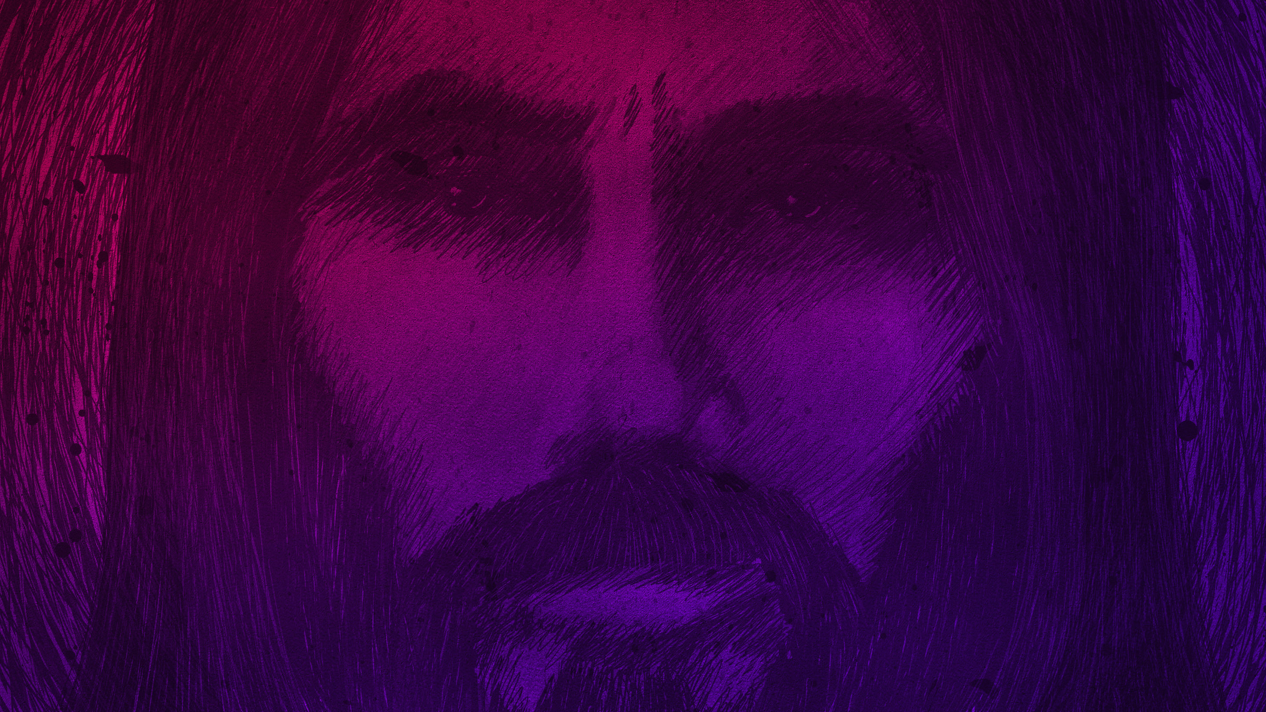
HERE IS THE AMAZING LOVE OF JESUS: He takes on our story of defeat so He can give us His story of victory
Notes:
This is what love does
I think the place we can most relate to it is here

Slide 3
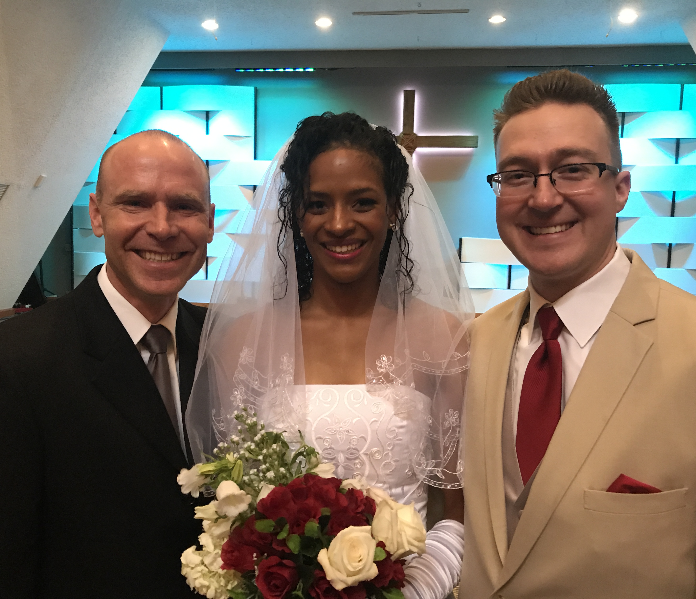
Notes:
In a wedding
I had the honor of officiating Joe-swan- E & Kevin’s wedding yesterday
When they do their vows they say something like this
[Next slide]

Slide 4
“All I am
I give
to you.
All I have
I share
with you.”
Notes:
That’s the heart of Biblical covenant love when you want to give someone your life for as long as you live
And those words sound so beautiful
But they are not painless words
You see get ready for this next picture of a wedding couple

Slide 5
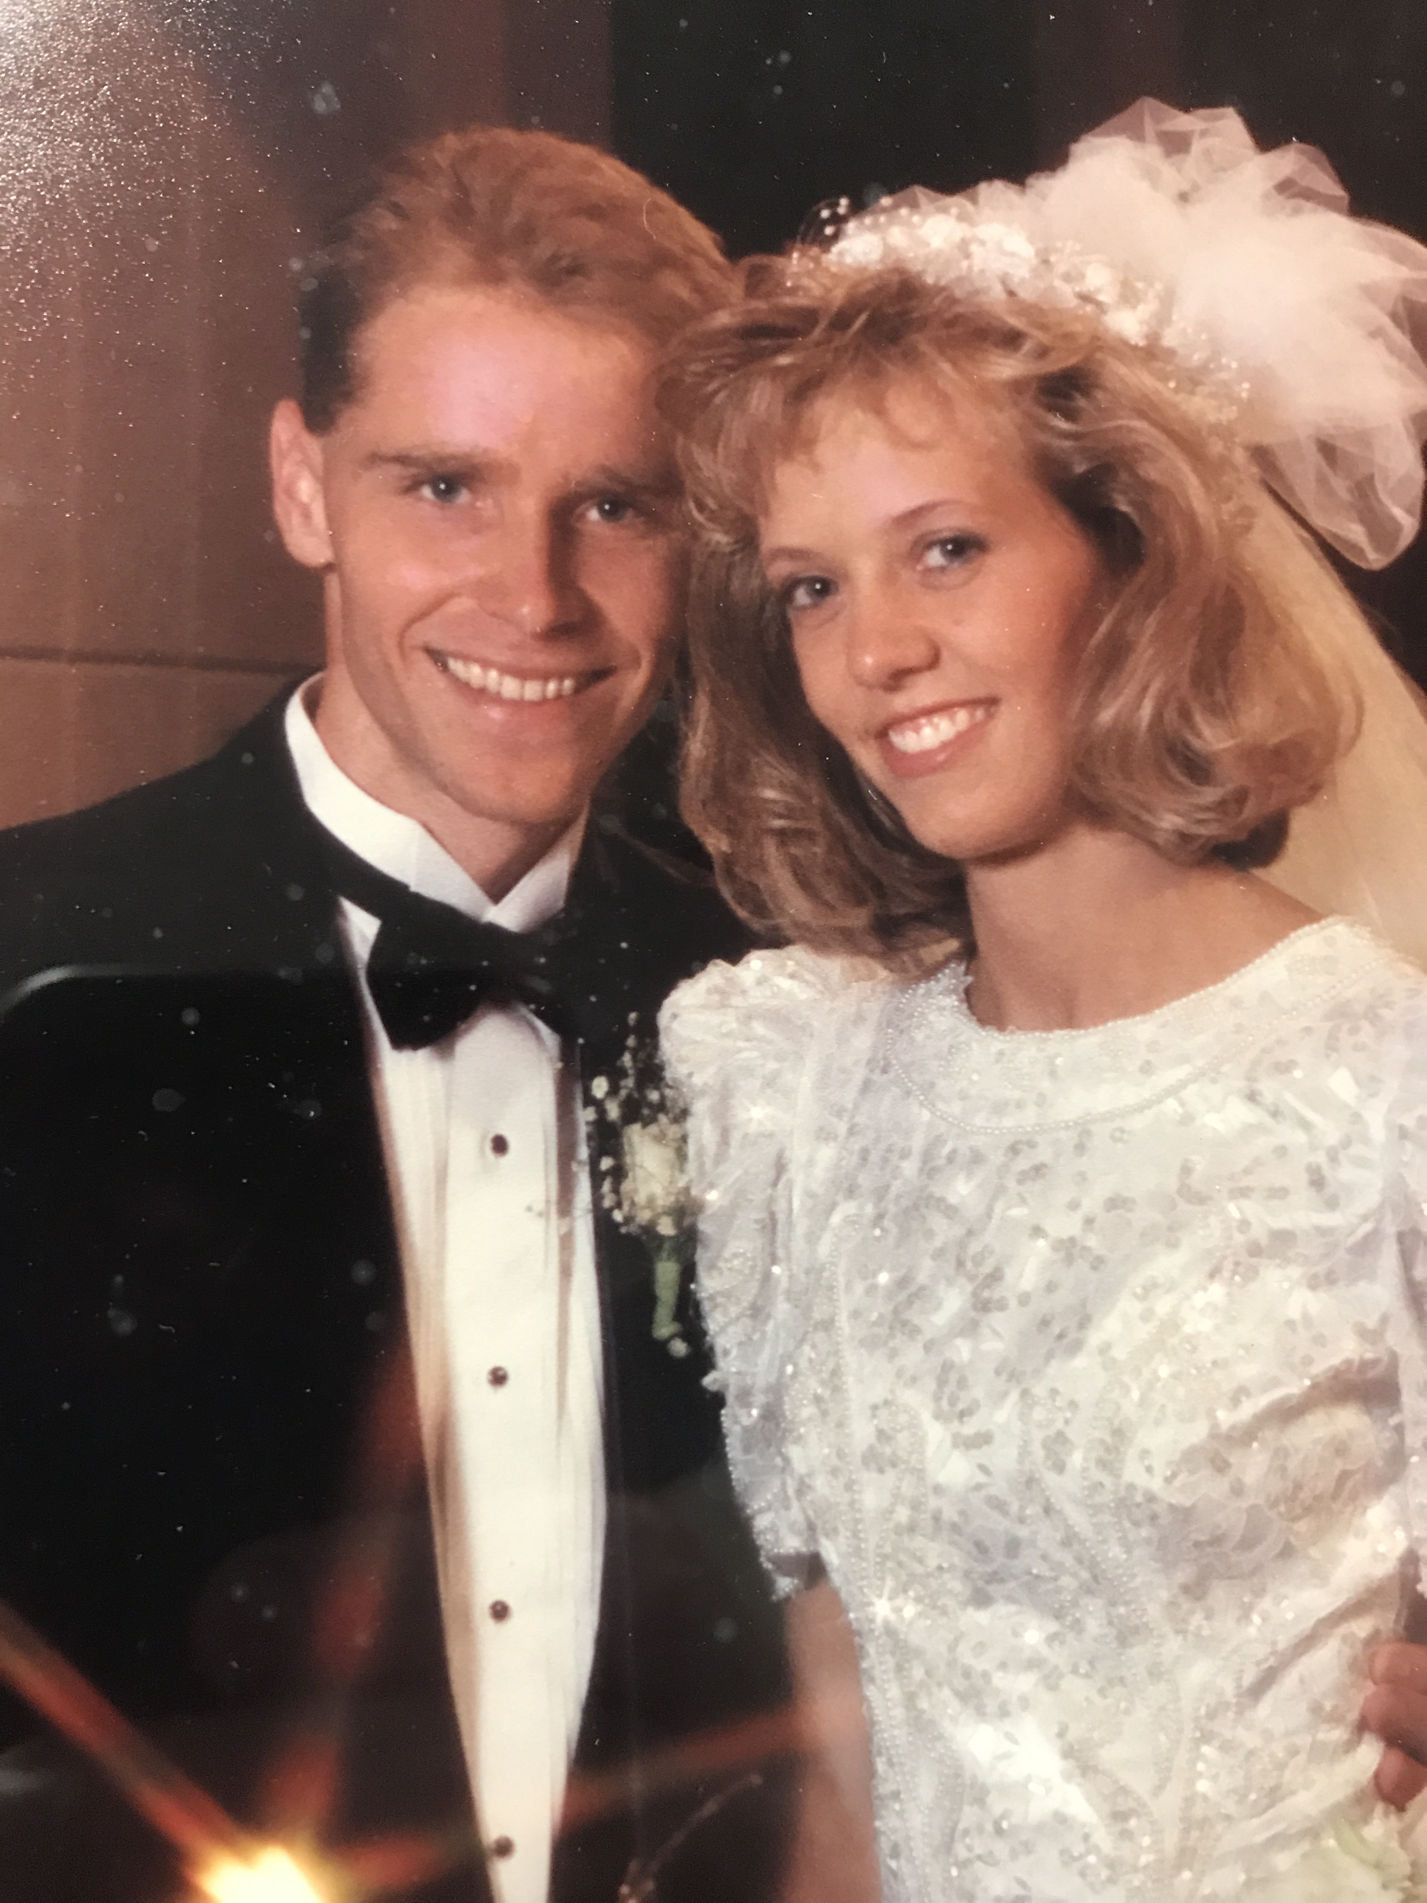
“All I am
I give
to you.
All I have
I share
with you.”
Notes:
23 years ago – Sept 3, 1994
When I asked Sara to marry me here is what those words meant
I grew up in poverty
So after college I had student debt
Sara grew up in family that gave her a chance to save
She had saved up and purchased a new car
And when said these words here is what happened

Slide 6
She got
my debt
and I got
her riches
Notes:
23 years ago – Sept 3, 1994
When I asked Sara to marry me here is what those words meant
I grew up in poverty
So after college I had student debt
Sara grew up in family that gave her a chance to save
She had saved up and purchased a new car
And when said these words here is what happened

Slide 7
HE CAME TO TAKE OUR DEBT AND GIVE US HIS RICHES BECAUSE HE LOVED US SO MUCH
Notes:
He came down and with his miracles, teaching and sacrifice on the cross,
Jesus said “All I am I give to you. And all I have I share with you.”
And its not a fair deal –
but it’S WHAT LOVE DOES
When you love someone
You sacrifice to be with them
It’s not about a profit but about a passion
And that’s what Jesus came to do
To take all our debts (we’ve been looking at them)
And give us his riches
No better place to see this than at His water baptism in Luke 3:21-22
It’s where He proposes to all of us
There he says what his life is all about
Taking our debts and giving us his riches
And as we look at this – this not a nice religious idea
It forces us to change the way we love, live and look in this world
And we will see how –look at these two verses with me
Read them

Slide 8
[Week/Debt #1] We are trapped in a broken world The world’s way always end in painful brokenness
Notes:
And we are trapped in it
Trapped in bad relationships
Really bad ways of having relationship
Stuck in bad decisions, mistakes of our past and habits
The world got us there and keeps us there
No one is the exception
By the end of life its all broken
No matter the money, the professional status, the physical beauty
No matter how good you look on facebook, at the party, at the game, or at the plastic surgeons
Jesus comes to this earth and lives to show us a better way
A way not to fit and not to live broken

Slide 9
[Week/Debt #2] We are lost in our sinful nature We can’t say no to ourselves and we fight against eternal life
Notes:
We don’t want the brokenness of this world
But we don’t fit in God’s world either
But our selfishness fights against everything in God’s world
We can’t say no to ourselves (slave to sin)
Jesus says we have a deep problem
We can’t get away from our selfishness
So Jesus invites us to die with him at the cross
To die to a sinful nature that will one day make our life look like this

Slide 10
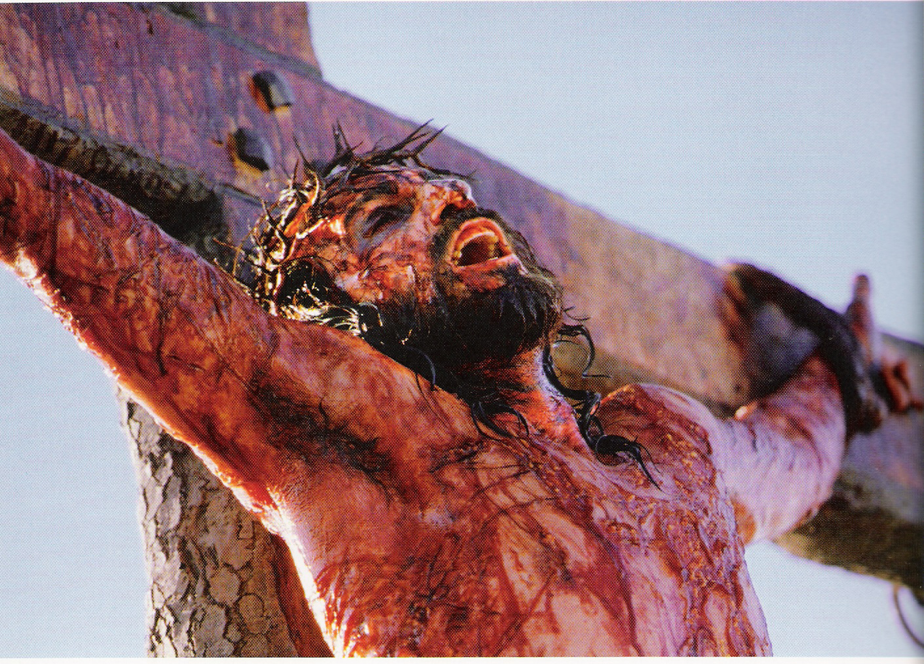
Notes:
In the end this is what our selfishness does
To our marriages, our families, our communities, our nations
Jesus says we need to be saved from this
He is willing for his life to look like ours
And he will give us his life
To resurrect our marriages, families, communities and nation

Slide 11
[Week/Debt #3] We are alone in our hearts A broken world and selfish nature repels true togetherness
Notes:
This is our greatest debt
We don’t know how to truly love and be loved
All our relationships break
Our world thinks faithful love for a lifetime is a dream
And everyone we know religious or not seems to prove it
Now this where Jesus offers us something so different
We almost can’t recognize it or believe it
And it has everything to do with this

Slide 12
“heaven was opened and the Holy Spirit descended on him in bodily form like a dove. And a voice came from heaven: “You are my Son, whom I love; with you I am well pleased.” (Lk 3:21-22)
Notes:
This is where Heaven opens up and shows us what life is supposed to be like
Jesus always sees this – but when Jesus is baptized God The Father opens up and heaven and let’s the entire world see it
And here it is . . .

Slide 13
JESUS IS NEVER JUST JESUS!
Notes:
he is never alone – he is never by himself

Slide 14
JESUS IS NEVER JUST JESUS! (He is never alone)
Notes:
he is never alone – he is never by himself
“I and the Father are one.” John 10:30 love the Father and that I do exactly what my Father has commanded me.
At the baptism we see it
The Father speaks how pleased he is
The Spirit is upon Jesus always
This is how Jesus is always different than us
He is rich in love and we are in debt

Slide 15
JESUS IS NEVER JUST JESUS! (He is never alone) The Father always loves the Son in the joy of the Holy Spirit
Notes:
So here is what is opened to us for a glimpse
This is always how it is for Jesus
And get why showing us this at the water baptism is so powerful

Slide 16
The Baptism of John
- At the Jordan River
- “I need to start again”
Notes:
John the Baptist is calling people to be baptized
Why the Jordan
It’s the border of God’s land, His home – Israel
And these people are livig in God’s land but here is what is going on

Slide 17
The Baptism of John
- At the Jordan River
- “I need to start again”
The feel far from God

Slide 18
The Baptism of John
- At the Jordan River
“I need to start again”
far from God
Filthy on the inside

Slide 19
The Baptism of John
- At the Jordan River
“I need to start again”
far from God
Filthy on the inside
Fruitless in life
Notes:
They all feel trapped, lost and alone!!!!
So John says – lets go to the Jordan
Where our people first entered the promise land
And let’s all start again
(go out and come back in)
Wasn’t so much up and down as out and in
And Jesus shows up here
He is none of these things
Not lost (feeling far from God)
Not trapped (feeling filthy on the inside)
Not alone (fruitless and purposeless and disconnected)
He goes down into the water
To share our story and then to give us his
When he shares our story . . .

Slide 20
Heaven opens us and shows us another way we can live.
Notes:
You can go into the water
Far from God, filthy on the inside, fruitless in life
Come out with a new family
You can live like Jesus
Jesus is making a wedding proposal

Slide 21
I’ll identify with your failures so you can have My family.
“All I am I give to you.
All I have I share with you.”
Notes:
This is the idea of the trinity.
Family is not a full way to explain it
But it a good way to think of it
Jesus wants you to never be alone again like He is never alone!

Slide 22
“In my Father’s house are many rooms; if it were not so, I would have told you. I am going there to prepare a place for you.” (John 14:2)

Slide 23
“Jesus replied, “If anyone loves me, he will obey my teaching. My Father will love him, and we will come to him and make our home with him.” (John 14:23)

Slide 24
“And I will ask the Father, and he will give you another Counselor to be with you forever— the Spirit of truth [the Holy Spirit] . . .he will be in you. I will not leave you as orphans; I will come to you.” (John 14:16-18)
Notes:
This is what Jesus lives out all of his earthly life
He is showing us a new life
Father is always showing him what to say and do
Spirit is always providing the power and the victory
And Jesus wants us to have it
So he goes to this . . .

Slide 25
“All I am
I give
to you.
All I have
I share
with you.”
Notes:
On the cross
He doesn’t have to go
He even asks His Father not to
But He does
There
1) He is trapped by the world like we are – condemned and broken
2) He is lost
3) And there he feels alone
As he cries out Father, why have you forsaken me
He takes our entire brokenness, sin and isolation on himself
And what is the last words he says
As he lives out this nightmare

Slide 26
Jesus said, “It is finished.” With that, he bowed his head and gave up his spirit. (Jn 19:30)
Notes:
Victory!
Mission Accomplished!
Paid in full!
Total Triumph!
Done!
He declares victory for who – us!
Listen to what he says to the disciples after the resurrection

Slide 27
“Jesus said, “Do not hold on to me, for I have not yet returned to the Father. Go instead to my brothers and tell them, ‘I am returning to my Father and your Father, to my God and your God.’”
(John 20:17)
Notes:
You’re in the family now!
He took your failures so you could take his family

Slide 28
“surely I am with you always” (Mt 28:20)
“I have told you these things, so that in me you may have peace. In this world you will have trouble. But take heart! I have overcome the world.” (John 16:33)
Notes:
You’re in the family now!
He took your failures so you could take his family

Slide 29
This should change everything about how you love, live and look at this life!
How would you do it differently if you were never trapped, lost or alone again?
If every debt was paid?

Slide 30
This should change everything about how you love, live and look at this life!
How would you love differently if you were never trapped, lost or alone again?
If every debt was paid?
Notes:
You’d stop surviving and start loving
When you are in survival mode – you never love anyone well
When you’re trapped, lost and desperately alone
You miss out on all the people to love around you
Sometimes in big moments of regret and tragedy
Often in times that it just slips by
Wrote my daughter, Melody a letter yesterday
Senior in high school
I’m so busy –I don’t want to miss this
I want to love better
If you were living like Jesus in perfect love of the father
Like at water baptism
You sure would let other people love you better

Slide 31
This should change everything about how you love, live and look at this life!
How would you live differently if you were never trapped, lost or alone again?
If every debt was paid?
Notes:
You’d live way more generously
You would give without worry
You’d give out of joy
You’d give for someone else to know the family love you have
You’d be like a kid with endless allowance
And you’d help everyone you could
Tithing would be a non-issue
Tithing would be like getting money from your mom to buy her a mother’s day present
You’d love to do it!
You wouldn’t stop there
Because you couldn’t wait to let someone else feel loved and provided for like you do

Slide 32
This should change everything about how you love, live and look at this life!
How would you look at this life differently if you were never trapped, lost or alone again? If every debt was paid?
Notes:
You wouldn’t be afraid of the storms of life any more
Jesus said – in this world you will have trouble
Take heart I have overcome the world
You have a family with you
The rain starts to come and days get dark
The Father covers you with His love
The Spirit walks right beside you
The Son lights the way
Someone here needs to see that today
You don’t have to go through storms alone any more
You don’t have to be afraid of them any more

Slide 33
“All I am I give to you. All I have (my family) I share with you.”
Notes:
Just say yes this morning
He is proposing –all over again
Anybody want to come under the umbrella of his family today?

