Slide 3
“The show is so popular because it talks about stuff we all go through.
Instead of being an escape from the world – it brings deeper meaning to the world you are in.”
Notes:
Well – its view of life is sometimes great and sometimes unrealistic
But what he says about what we are looking for is true

Slide 4
You and I are looking for a bigger story that helps us make sense of our story
Notes:
We are looking for a story that helps us understand what is normal, healthy and right about ours
Sometimes you go around in this life and feel like Am I the only one who struggles with this?
Like at grocery store and you go to self check out and you have to pull apart the plastic grocery bags but instead all you do is pull them off the rack
Am I the only one who struggles with hat
Am I the only one who thinks this is wrong?
Like when
Am I the only one that thinks that is beautiful?
Like when
All of us are looking for a story outside of ourselves to understand the story in ourselves

Slide 5
We look for meaning outside ourselves because we were made by something outside ourselves
Notes:
So people look for God – do you believe in God?
Better question is which one
At last check historians have cataloged that over 3700 religions over time and people have believed in specifically 2870 deities in the course of history.
People look for meaning outside themselves.
They want to find the story that makes sense of their story
But all of those deities have proven to be nothing
Not consistent, comprehensive, origin or our destiny
And then comes JESUS

Slide 6
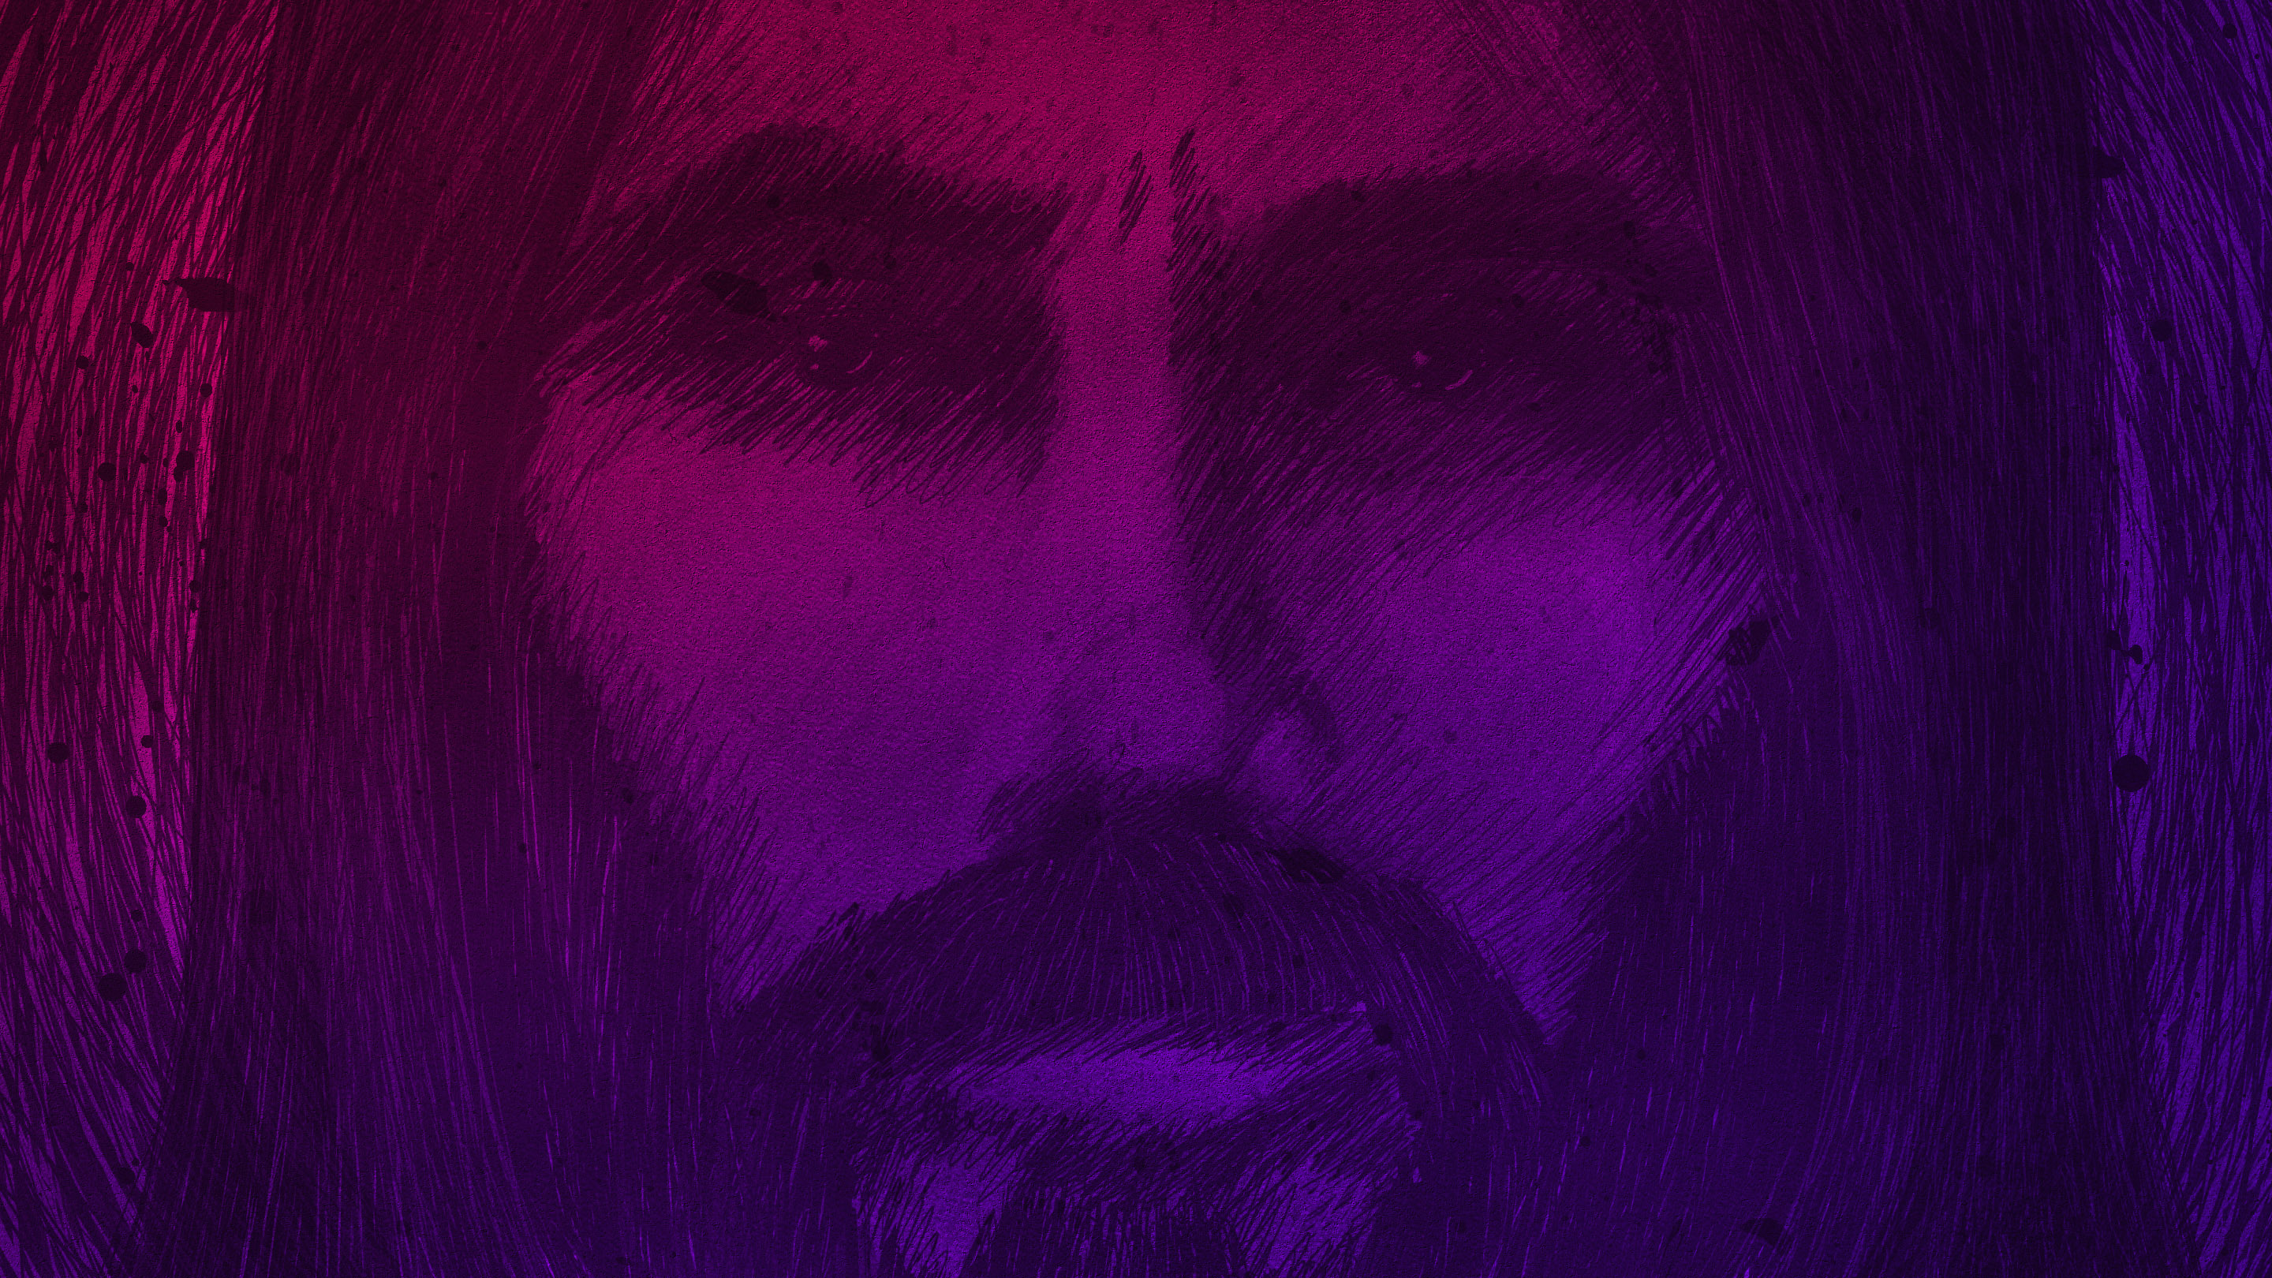
Jesus = love Jesus nice
Notes:
Here comes Jesus who changes the world and but us rejected by the world
He heals and saves many – but just as many hate him
He shares simple wisdom but most don’t understand him
If you think Jesus comes to give you a nice life that makes sense in this world. You don’t know Jesus
Jesus doesn’t fit most of our expectations of what God should be
On earth - Jesus doesn’t fit any story he is in
And so since he doesn’t fit – we think he can’t be God
Jesus doesn’t fit – but he also doesn’t go away
He is the only one that defeats hate with love
to the point that he rises from the dead to do it

Slide 7
Jesus = love Jesus nice Jesus changes the world He loves the world but He never fits in the world

Slide 8
Jesus never completely fits in the world because He is greater than the world & anything in it!
Notes:
And so you have a choice – either don’t believing in him
Or stop believing that what you see in this world is the greatest reality

Slide 9
The Beginning of His Life (Luke 2)
The Beginning of His Life
“Today in the town of David [Bethlehem] a Savior has been born to you; he is Christ the Lord.” (2:11)
Notes:
Look at the story of Jesus mostly thorugh Luek 2-6 today (read it this week) & right now media to understand – and see if I’m right
Here is how his story in this world starts
LUKE 2:11
Christ the Lord – “the anointed king of the universe” who is your master
Messiah comes from the Hebrew word mashiach and means “anointed or chosen one (king).”
The Greek equivalent is the word Christos or, in English, Christ.
They both basically mean – “The anointed king of heaven (universe)”

Slide 10
The Beginning of His Life (Luke 2)
The King of The Universe?
Born in someone else’s shed

Slide 11
The Beginning of His Life (Luke 2)
The King of The Universe?
Born in someone else’s shed
Starts as a refugee

Slide 12
The Beginning of His Life (Luke 2)
The King of The Universe?
Born in someone else’s shed
Starts as a refugee
Grows up in nowhere under oppression
Notes:
__ 15 miles away from Capernum – major international route –
__ 3.5 miles away formSepphoris- major roman construction project

Slide 13
The Beginning of His Life (Luke 2)
The King of The Universe?
Born in someone else’s shed
Starts as a refugee
Grows up in nowhere under oppression
Spends his 20’s working construction

Slide 14
Jesus Doesn’t “Fit” (Luke 2)
The King of The Universe?
Born in someone else’s shed (no support)
Starts as a refugee (no justice)
Lives oppression (no power)
his 20’s working construction (no privilege)
Notes:
And the Bible has said over 700 years ago what God’s messiah would be like

Slide 15
Isaiah 53:1-4 (GNB)
“Who would have believed what we now report? Who could have seen the LORD’s hand in this? It was the will of the LORD that his servant should grow like a plant taking root in dry ground. . . There was nothing to make him take notice of him . . .we ignored him as if he were nobody.”

Slide 16
Isaiah 53:13 (GNB)
“He willingly gave his life and shared the fate of evil men [he identified with them]. He took the place of many sinners and interceded for them that they might be forgiven.”
Notes:
Everything he does is to identify with them
He even lives in a place that is considered dark and blind to God

Slide 17
Matthew 4:12-16
“Jesus went and lived in Capernaum . . . To fulfill what was prophesied . . . ‘the people living in darkness have seen a great light; on those living in the land of the shadow of death a light has dawned.’”
Notes:
So the Bible paints this picture about the coming king
Coming to save us from a broken world that we are imprisoned by and blinded by
So we don’t even know its broken or that we are living in broken ways
To us it just feels natural
And if any one tries to tell us different we just say – well you don’t know what I’ve gone through
But Jesus does!!!
Jesus lives like us so that then we will eventually believe we can live like him
And not escape this world but go deeper to a way better life in it and beyond
Doesn’t just live his life like it / he starts his ministry this way

Slide 18
The Beginning Of His Ministry (Lk 3-6)
The Beginning of His Ministry
Confusing first public appearance (Lk 3:21f)
Notes:
“It’s a marketing disaster for Team Jesus. It looks for all the world like he too is a spiritual failure. But he doesn’t seem to mind. He’s happy to be counted among the messy people.” P17
Jesus is greater than what people think

Slide 19
The Beginning Of His Ministry (Lk 3-6)
The Beginning of His Ministry
Confusing first public appearance (Lk 3:21f)
Disastrous first speech (Lk 4:18f)
Notes:
Jesus’ inaugural address ends with him escaping an early martyrdom. It’s a sign of things to come. Jesus brings to the world an unbounded offer of life and liberation. To the poor, the prisoners, the blind and the oppressed he is received gladly. To the rich, the strong, the religious, the comfortable he provokes anger and violence.” (p18)
Jesus is greater than what the oppressed crowd wants

Slide 20
The Beginning Of His Ministry (Lk 3-6)
The Beginning of His Ministry
Confusing first public appearance (Lk 3:21f)
Disastrous first speech (Lk 4:18f)
Worst draft picks ever (Lk 5)
Notes:
Like 5:1-11 where – the fishing docks (first three disciples)
This guy peter as his spokesperson – first words are “Depart from me, for I am a sinful man”
(great first interview)
Jesus is greater than your weaknesses
Who’s next - a leper (Luke 5:12-16)
His second round pick – someone who the world runs away from
An outcast through no fault of his own
World runs away – jesus runs to him!
Jesus is greater than sickness
“something is building. Here is the long promised kingdom of god: a carpenter turned rabbi, three unemployed fishermen and a leper. Who’s next” pg 18
Jesus answers – I’ll show you that God forgives you – rise up and walk
. . . and don’t forget your mat!
Don’t forget your mat -Jesus is greater than your greatest tragedy
And the world is now officially upside down

Slide 21
The Beginning Of His Ministry (Lk 3-6)
The Beginning of His Ministry
Confusing first public appearance (Lk 3:21f)
Disastrous first speech (Lk 4:18f)
Worst draft picks ever (Lk 5)
Recruits the most hated guy in town (5:27f)
Notes:
Jesus enlists the most hated man in the province! As an ancient tax collector Levi was about as depraved as its possible to be: socially, he was a collaborator with the Romans; morally he was a white collar criminal stealing from his own people; spiritually he had betrayed the God of Israel. The masses despise him as a traitor. The religious denounce him as ‘unclean’. Jesus recruits him with a second thought. ‘Follow me,’ Jesus says, and now everyone is scandalized!
What kind of recruitment policy is this? Jesus’ kingdom is unlike any seen before. There is nothing careful, calculating about this movement. Frankly it looks like an almight free-for-all”
Jesus is greater than money and the wealthy
V30 -32
Heaven is a home for anyone who knows they need it
Eveyrone is seeing him do miracles and see healing and setting free
But Jesus doesn’t fit
Everyone wants him to fit as their king, as their rabbi, as their military leader and Jesus won’t do it
He finally explains why?
He says the reason I don’t fit is because fitting into this world is death
And if you want true life you need to stop wanting to fit in too
The gospel of the misfits

Slide 22
His “Don’t Fit Gospel”
“Blessed are you who are poor, for yours is the kingdom of God. Blessed are you who hunger now, for you will be satisfied. Blessed are you who weep now, for you will laugh. Blessed are you when men hate you, when they exclude you and insult you . . . because of the Son of Man. ” (Luke 6:20-23)

Slide 23
His “Don’t Fit Gospel”
“Jesus went into Galilee, proclaiming the good news of God. “The time has come,” he said. “The kingdom of God is near. Repent and believe the good news!” (Mark 1:14-15)
Notes:
He has been saying to not fit all along
Repent from this world’s common sense & get heaven sense

Slide 24
His “Don’t Fit Gospel”
“Do not conform any longer to the pattern of this world, but be transformed by the renewing of your mind.” (Romans 12:2)
Notes:
Not calling us to be rebels –be against
He calling us to be revolutionaries – to be for something greater

Slide 25
His Call Of Faith Jesus says I don’t fit in the world And you shouldn’t either!

Slide 26
To fit in a broken world is to live a broken life

Slide 27
HIS CALL FOR FAITH TO US TODAY
“He said to them, Make every effort to enter through the narrow door, because many, I tell you, will try to enter and will not be able to.” (Luke 13:23-24)

Slide 28
HIS CALL FOR FAITH TO US TODAY
Come to me, all of you who are tired from carrying heavy loads and priorities from a world that doesn’t work. You weren’t designed to live by it. Take my upside down way as your own and learn from me, because I am gentle and humble in spirit; and you will find the peace, rest and joy you are looking for. (Matthew 13:23-24, paraphrased)

Slide 29
So don’t fit!!!

Slide 30
So don’t fit! (Luke 6)
Don’t fit – “love your enemies”

Slide 31
So don’t fit! (Luke 6)
Don’t fit – “love your enemies”
Don’t fit – “do good to those who hate you”

Slide 32
So don’t fit! (Luke 6)
Don’t fit – “love your enemies”
Don’t fit – “do good to those who hate you”
Don’t fit – “bless those who curse you”

Slide 33
So don’t fit! (Luke 6)
Don’t fit – “love your enemies”
Don’t fit – “do good to those who hate you”
Don’t fit – “bless those who curse you”
Don’t fit – “give and it will be given to you”
Don’t fit – “do not condemn & you won’t
be condemned”
Notes:
Lose your life to find it
Die to gain
Serve to lead
Show mercy to get justice

Slide 34
AND FIT INTO SOMETHING SO MUCH GREATER!
“The more I considered Christianity, the more I found that while it had established a rule and order, the chief aim of that order was to give room for good things to run wild.”
(G.K. Chesterton)

